Slide 1
EDA: Resume Extractor
Zongdao Wen
Email: zongdaow@usc.edu

Slide 2
Description
The model is trained with 200 resumes with entity annotations. The resume extractor could extract information that belongs to one of the following 10 entity categories.:
Years of Experience
Graduation Year
Companies worked at
College Name
Name
Designation
Location
Degree
Email Address
Skills

Slide 3
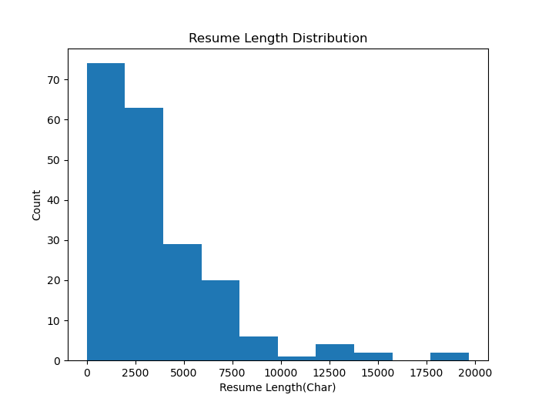
Resume Length (Avg. 3582 Char)

Slide 4
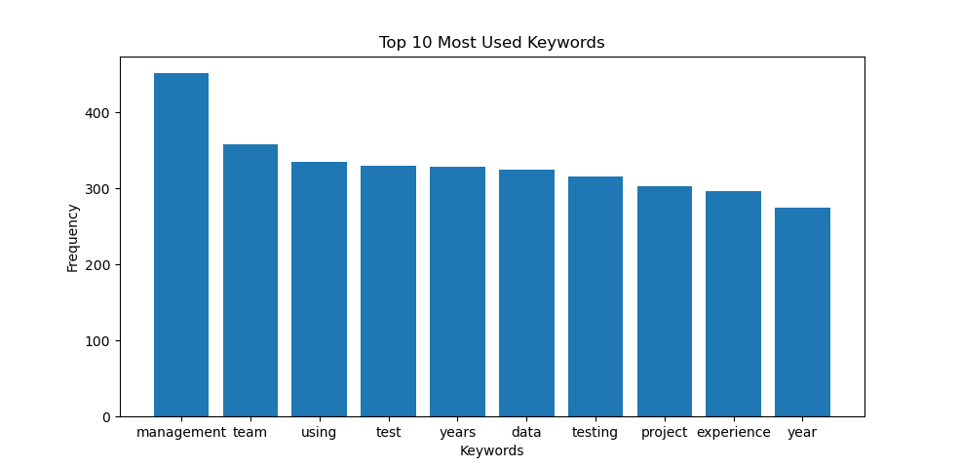
Top 10 Frequent Words

Slide 5
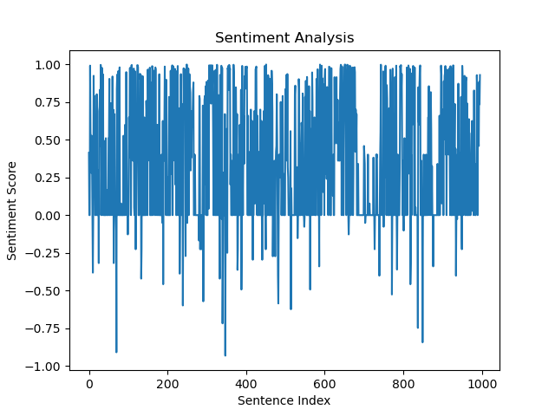
Sentiment Analysis (1 positive, -1 negative)

Slide 6
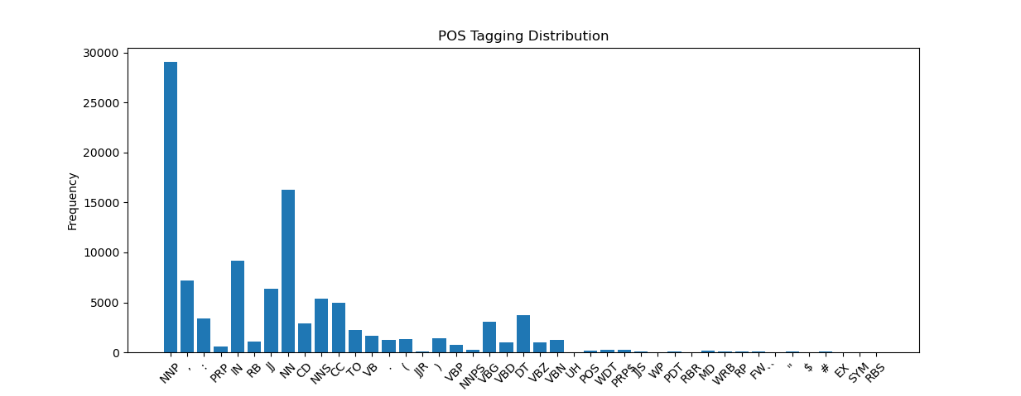
POS Tag Distribution
The data is predominantly with nouns.

Slide 7
Resume Extractor
The spaCy NER (Named Entity Recognition) model is a powerful tool for extracting entities such as names, organizations, locations, and other predefined categories from text data like resumes. By training the NER model on a labeled dataset of resumes, it can learn to recognize and classify specific entities within new resume texts.
Training the spaCy NER model involves providing annotated examples of resumes where entities of interest are labeled. These labeled examples serve as the training data for the model. The model then learns to identify patterns and features associated with different entity types, enabling it to make predictions on unseen resume texts.
By leveraging the spaCy NER model for resume parsing, businesses can automate and streamline their recruitment processes, improving efficiency, accuracy, and scalability. It enables effective management of large volumes of resume data and enhances decision-making in the hiring process.

