Slide 1
AEC Algorithm on FPGA
Jan 9, 2011

Slide 2
Agenda
Interfacing FPGA with other Chips
Custom Component Example – A Timer
Audio Codec Overview
FFT
256 Real Point Input FFT Overview
MAC
Performance and Resource Utilization
Problems with Current Design

Slide 3
Interfacing FPGA with other Chips
In the AEC demo, the FPGA interfaces with audio codec, external FPGA, flash memory, and SSRAM.
NIOS 2 access a custom component, which in turn access the peripheral.
The general custom component procedure:
#1. Read device data sheet to understand the necessary waveforms.
#2. Generate the waveforms by writing custom Verilog code.
#3. Write code to allow NIOS 2 to interact with hardware.

Slide 4
Simplest Custom Component – A Timer
module timer(input clk, read, write, output [31:0] readdata, input [31:0] writedata); reg [31:0] counter; assign readdata = counter; //setting "counter" always @ (posedge clk) if(write) counter <= writedata ; else counter <= counter + 32'd1; endmodule

Slide 5
NIOS 2 Side Code to use the Timer
int run_time;
IOWR(TIMER_0_BASE, 0, 0);
aec(dn, xn, out);
run_time = IORD(TIMER_0_BASE, 0);
TIMER_0_BASE comes from “system.h”: #define TIMER_0_BASE 0x1001048

Slide 6
Custom Component with Address
always @ (posedge clk) if(reset) … else if(read) case(address) … readdata <= …; else if(write) case(address) … writedata <= …;

Slide 7
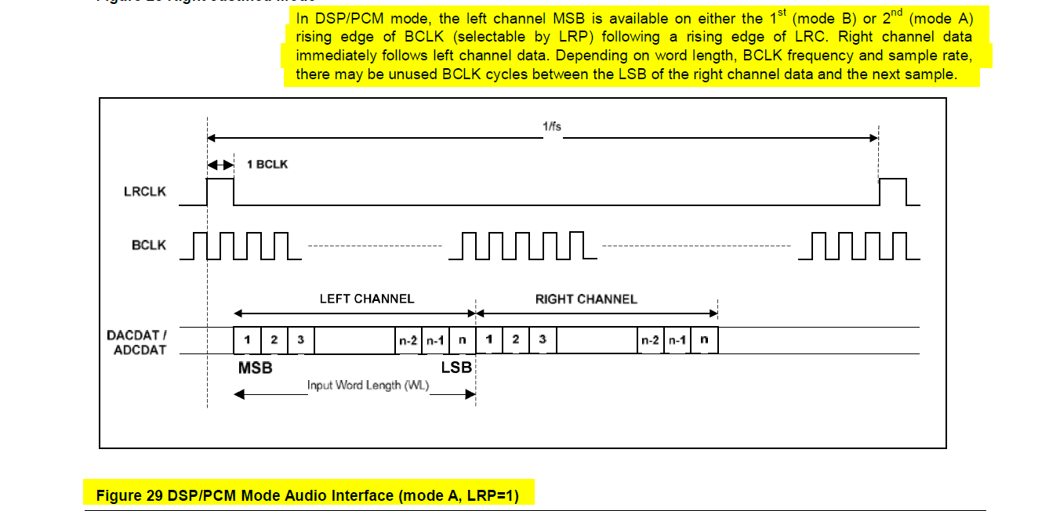
Audio Codec Interface Example
#1. Read device data sheet to understand the necessary waveforms. Annotate the datasheet to make future reviews easy.

Slide 8
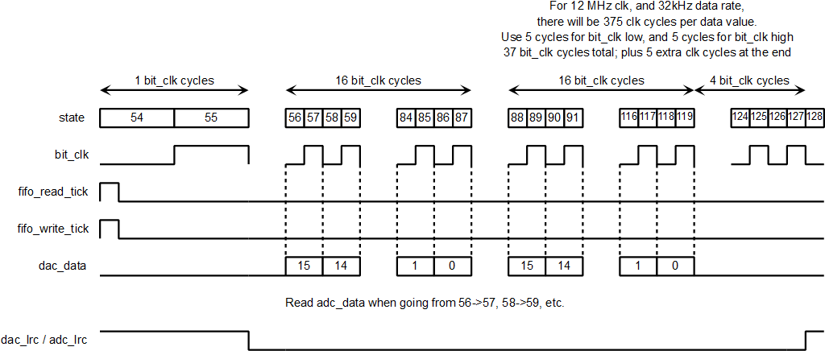
Audio Codec Interface Example
#2. Generate the waveforms by writing custom Verilog code. The key is to document the plan to achieve a certain waveform.

Slide 9
Audio Codec Interface Example
#3. Write code to allow NIOS 2 to interact with hardware.
The audio codec Verilog code stores data into a FIFO.
NIOS 2 CPU C-code to read the FIFO:
#define AUDIO AUDIO_AVALON_0_BASE int mic_data;
mic_data = IORD(AUDIO,0);
Verilog code that “answers” the NIOS 2 request:
readdata <= {{16{in_fifo_q[15]}}, in_fifo_q[15:0]};

Slide 10
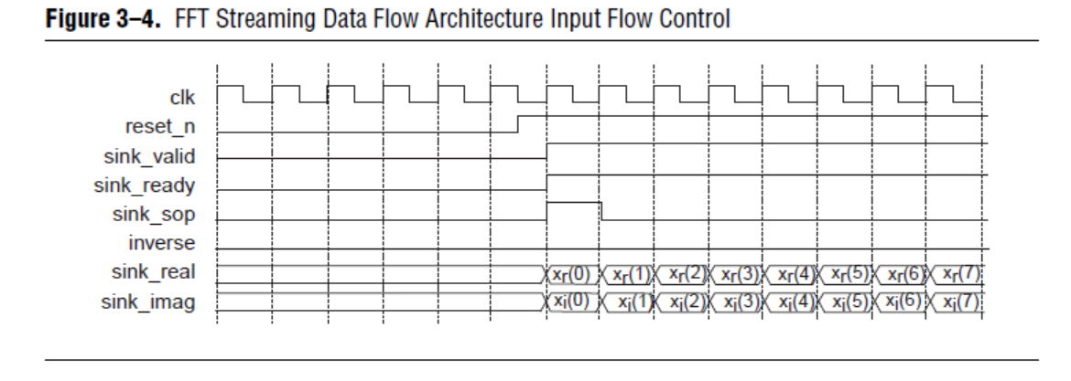
FFT
FFT is handled by the FFT component from Altera’s library.
Radix-4 FFT engine, so 256 cycles to do 256 point FFT.
Moving data into the FFT block, and reading out from it, takes much more time.
#1. Read device data sheet to understand the necessary waveforms.

Slide 11
FFT
#2. Generate the waveforms by writing custom Verilog code.
The AEC algorithm often do not write both real and imaginary values into FFT simultaneously.
Four write modes are defined to reduce data transfer.
Example: Write mode 00 loads 256 real values, and imaginary value = 0, then start FFT.

Slide 12
Write Mode 00 implmentation (1/2)
case(write_mode) 2'b00: begin //loading a real value only sink_real <= writedata; sink_imag <= 0; sink_valid <= 1; if(write_start) begin sink_sop <= 1; write_start <= 0; //sink_sop = 1 for 1 cycle only end else sink_sop <= 0; if(word_counter[N]) begin sink_eop <= 1; word_counter <= 0; end else begin sink_eop <= 0; word_counter <= word_counter + ONE; end end

Slide 13
Write Mode 00 implmentation (2/2)
case(write_mode) 2'b00: begin //loading a real value only sink_real <= writedata; sink_imag <= 0; sink_valid <= 1; if(write_start) begin sink_sop <= 1; write_start <= 0; //sink_sop = 1 for 1 cycle only end else sink_sop <= 0; if(word_counter[N]) begin sink_eop <= 1; word_counter <= 0; end else begin sink_eop <= 0; word_counter <= word_counter + ONE; end end
EOP means end of packet.
FFT engine will run.

Slide 14
FFT
#3. Write code to allow NIOS 2 to interact with hardware.
Different NIOS 2 functions do different FFT variants – to save time by avoiding unnecessary data transfer.
Example: “void fpga_fft256_real_input(COMPLEX* input_values)” uses write mode 00 to pass 256 real values into FFT engine. No imaginary values are passed.

Slide 15
FFT (NIOS 2 Example Code)
#define FPGA_FFT FFT_256_0_BASE void fpga_fft256_real_input(COMPLEX* input_values) { int i, temp; //set up: inverse = 0, read_mode = 01, start = 1, write_mode = 00 //00_1100 = 0xC IOWR(FPGA_FFT, 3, 0xC); //putting in data - put in real numbers only for(i = 0; i < N2; i++) { IOWR(FPGA_FFT, 0, input_values[i].re); } fpga_fft256_wait_for_output(); //getting data out for(i = 0; i < N2; i++) { //need to bit reverse "i" into the correct address temp = ALT_CI_FFT256_BITREV_INST(i,0); input_values[temp].re = IORD(FPGA_FFT, 0); input_values[temp].im = IORD(FPGA_FFT, 1); } }

Slide 16
MAC (Multiply Accumulate)
Math more than 32 bit wide
Custom Instruction Characteristics
“Address” field is up to 8 bits
Input data (writedata equivalent) is 2x 32 bits
Output data (readdata equivalent) is 1x 32 bit
Direct access to CPU – not a “switch fabric”

Slide 17
Simplest Custom Instruction Example – Bit Reverse
Verilog
NIOS 2 (used in FFT functions)
module ci_fft256_bitrev(input [31:0] dataa, output [31:0] result); assign result[31:8] = 0; assign result[0] = dataa[7]; assign result[1] = dataa[6]; assign result[2] = dataa[5]; assign result[3] = dataa[4]; assign result[4] = dataa[3]; assign result[5] = dataa[2]; assign result[6] = dataa[1]; assign result[7] = dataa[0]; endmodule
for(i = 0; i < N2; i++) { //need to bit reverse "i" into the correct address temp = ALT_CI_FFT256_BITREV_INST(i,0); input_values[temp].re = IORD(FPGA_FFT, 0); input_values[temp].im = IORD(FPGA_FFT, 1); }

Slide 18
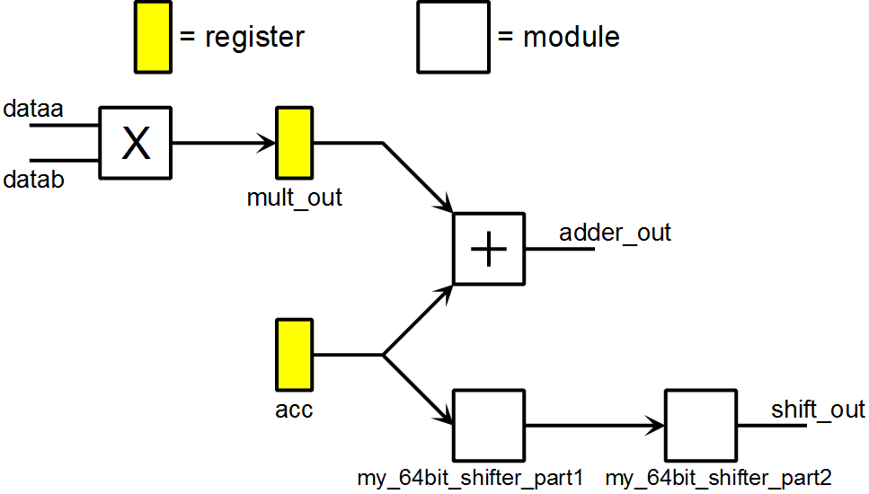
MAC Unit
N | Operation
00 | 0 → accumulator
01 | adder_out → accumulator
10 | shift_out → accumulator Shift accumulator up (to the left) based on dataa[5:0]
11 | shift_out → accumulator Shift accumulator down (to the right) based on dataa[5:0]

Slide 19
MAC Unit Usage in NIOS 2
int temp; ALT_CI_MAC64_INST(2, 0x100, 0); //truncating mode on temp = ALT_CI_MAC64_INST(0, 1000, 4000*4096); temp = ALT_CI_MAC64_INST(1, 2000, 3000*4096); temp = ALT_CI_MAC64_INST(1, 6000, 3000*4096); // temp = 4 million temp = ALT_CI_MAC64_INST(1, 0, 0); // temp = 10 million temp = ALT_CI_MAC64_INST(2, 256+4, 0); //temp = 28 million temp = ALT_CI_MAC64_INST(3, 256+6, 0); //temp = 448 million temp = ALT_CI_MAC64_INST(1, 0, 0); //temp = 7 million temp = ALT_CI_MAC64_INST(1, 0, 0); //temp = 7 million temp = ALT_CI_MAC64_INST(1, 0, 0); //temp = 7 million
“truncating mode on” means to automatically throw away the lower 12 bits (which is 4096).

Slide 20
Performance and Resource Utilization
CPU clock is 100 MHz, so a total of 800,000 cycles is available per block.
Maximum run time = 603,680 cycles
 | LC (Comb) | LC (Reg) | Mem (bits) | DSP 9x9 | DSP 18x18
Total | 11,971 | 10,397 | 476,105 | 16 | 70
#1. FFT | 6,520 | 7,283 | 19,145 | 16 | 64
#2. NIOS 2 | 2,460 | 1,862 | 219,392 | 0 | 2
#3. MAC | 1,167 | 129 | 0 | 0 | 4

Slide 21
Problems with Current Design
Radix 4 FFT
Too fast – 256 cycles to do 256 point FFT
Idle most of the time
NIOS 2
Not contributing to AEC algorithm – It off-loads almost everything.
AEC algorithm has very few and very simple “if” loops
Possible Solution: a mini-CPU (no stack, no interrupt), but with FFT butterfly as datapath.

