Slide 1
FPGA Implementation of a Real Time Acoustic Echo Cancelling System
Louis Yang
San Jose State University, May 5, 2011

Slide 2
Acknowledgement
Advisor: Chang Choo
CoAdvisor: Robert Morelos-Zaragoza
Other Contributors
Altera
Terasic
Mr. In Ki Hwang (ETRI)

Slide 3
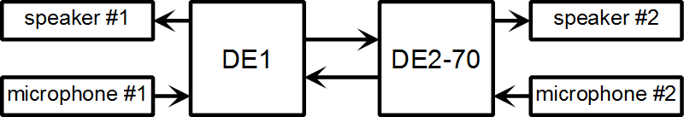
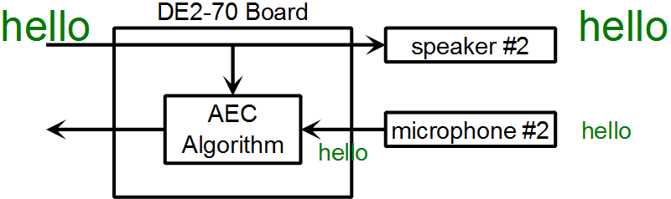
Acoustic Echo Cancelling

Slide 4
Peripherals
WM8731 Audio Codec
speaker
microphone
GPIO Ribbon
SSRAM
RS-232 Uart
Small dataset testing
Flash Memory
Large dataset testing

Slide 5
Processors Advantages over FPGA
Works out of the box
Much higher performance than softcore CPU
Software Libraries and OS
Mixed signal peripherals
OnChip Flash

Slide 6
FPGA Advantages
Low Volume Number Crunching:
Customizable datapath
Variable precision, very wide bus width (48 bit math)
Reduced clock rate
Advanced IO technology (PCIe, GbE, DDR3)
Low Volume Peripheral Access
Verilog versus Registers
B0[k] = mu_k * Complex.Conjugate(A0[k]) * A1[k] * (double) (1 << Pi_int[k])

Slide 7
Cyclone 2
 | Altera Cyclone 2 | Altera Cyclone 3 | Altera Cyclone 4 | Xilinx Spartan 6
Manufacturing Process | 90 nm | 65 nm | 60 nm | 45 nm
NIOS 2 top speed | 140 MHz | 175 MHz | 165 MHz | N/A
High Speed Transceiver for PCI Express |  |  | Yes | Yes
Memory Controller |  |  |  | Yes (DDR2, 3)
Efficient shift register implementation | No | No | No | Yes
Cyclone 5 Features: ALM, DSP Blocks, Larger Multipliers

Slide 8
Speed versus Area
100 MHz clock
= 3125 clock / data
Area
Speed
32 kHz
Application Specific Instruction-set Processor
Example: Tensilica

Slide 9
NIOS 2 Processor
 | Nios II / e (Economy) | Nios II / s (Standard) | Nios II / f (Full)
f_{MAX} | 195 | 110 | 140
MIPS / MHz | 0.107 | 0.518 | 1.105
Resource Usage (LEs) | 540 | 1030 | 1600
www.altera.com/literature/ds/ds_nios2_perf.pdf
Comparison
Microchip PIC 32 – 125 MIPS @ 1.56 MIPS/MHz
Atmel AT91SAM9261 – 210 MIPS @ 1.105 MIPS/MHz

Slide 10
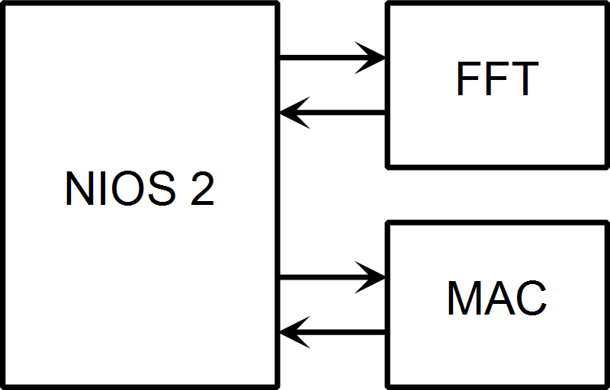
Quick and Dirty Approach
Uses 80% of processor time to meet 16 kHz real time requirement.

Slide 11
First Approach Resource Usage
 | Logic Cells | Dedicated Logic Registers | Multipliers 18x18
Total | 14,822 | 10,021 | 70
FFT (Full) | 8,600 | 6,991 | 64
FFT (Altera Core) | 8,288 | 6,810 | 64
NIOS 2 (CPU) | 2,950 | 1,771 | 2
On Chip Memory (Code and some data) | 3 | 1
MAC | 1,117 | 129

Slide 12
New Approach
FFT scale down to Radix 2
(Butterfly) Array Processor – Use FFT multiplier and memory to do other array operations
 | Butterfly per Pass | Complex Multiplier | Speed (if data is power of 4)
Radix 2 FFT | 1 | 1 | 1x
Radix 4 FFT | 4 | 3 | 4x

Slide 13
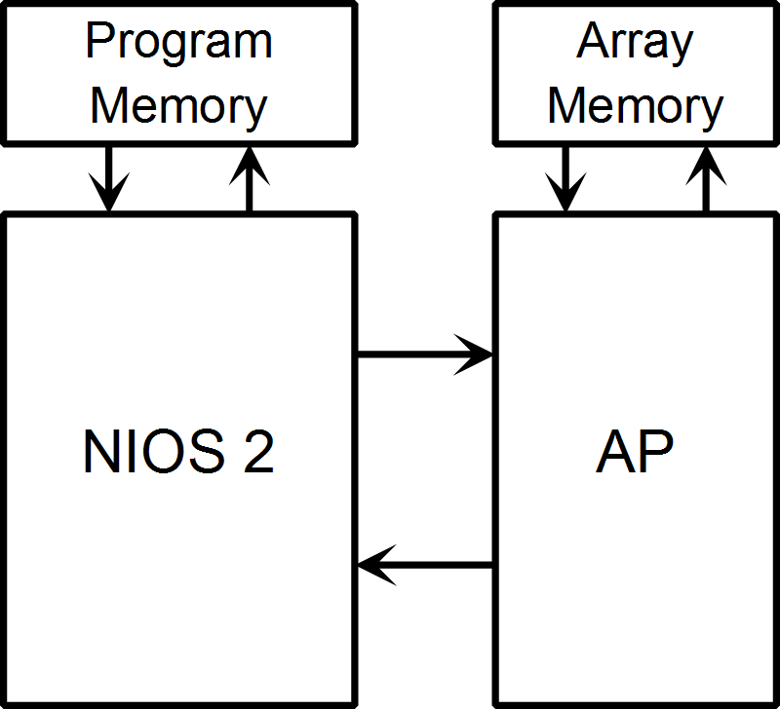
Array Processor Block Diagram
Part Number | Free IO Pins | Price
EP3C16E144C8N | 84 | $26.70
EP3C16U256C8N | 168 | $31.70
EP3C16F484C8N | 346 | $33.20

Slide 14
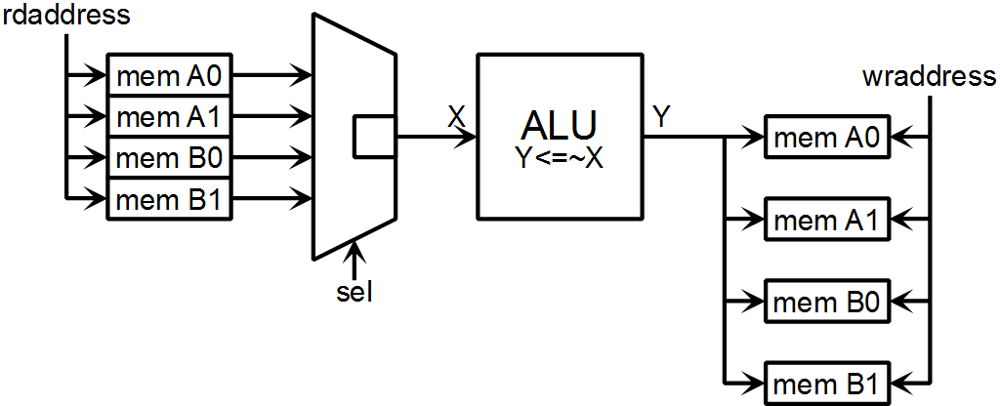
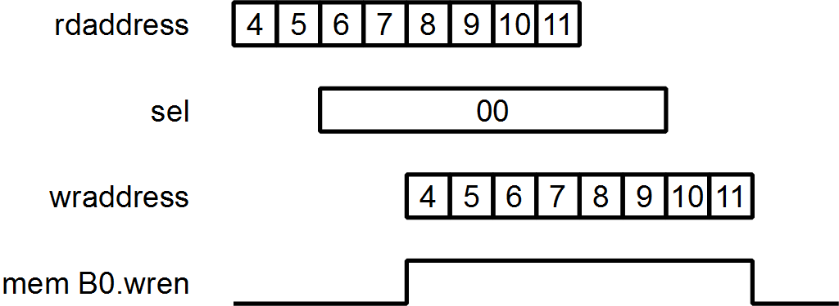
Array Processor Structure
t=4
t=3
t=0
t=2
Copy A0 → B0

Slide 15
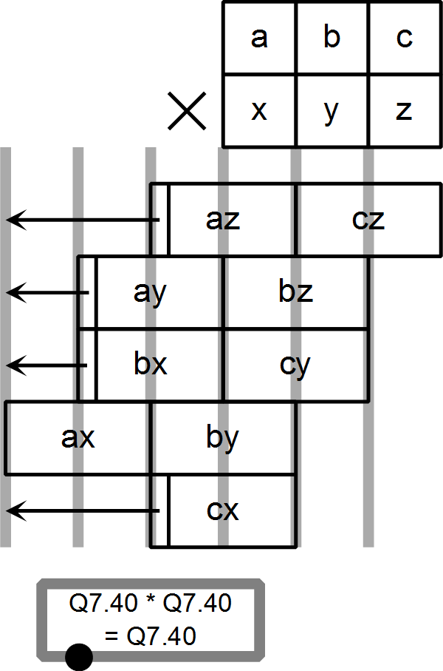
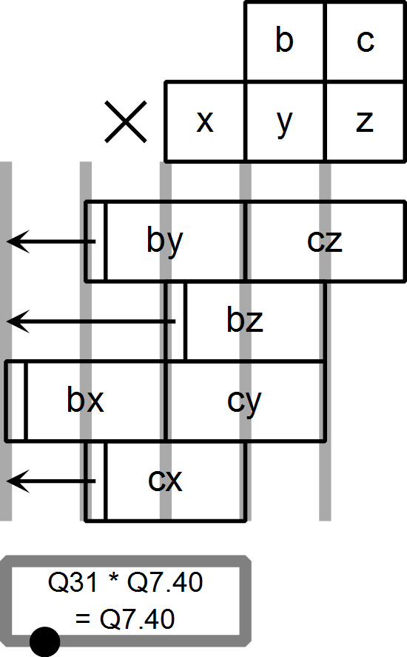
Pipelined Multipliers
48x48
32x48

Slide 16
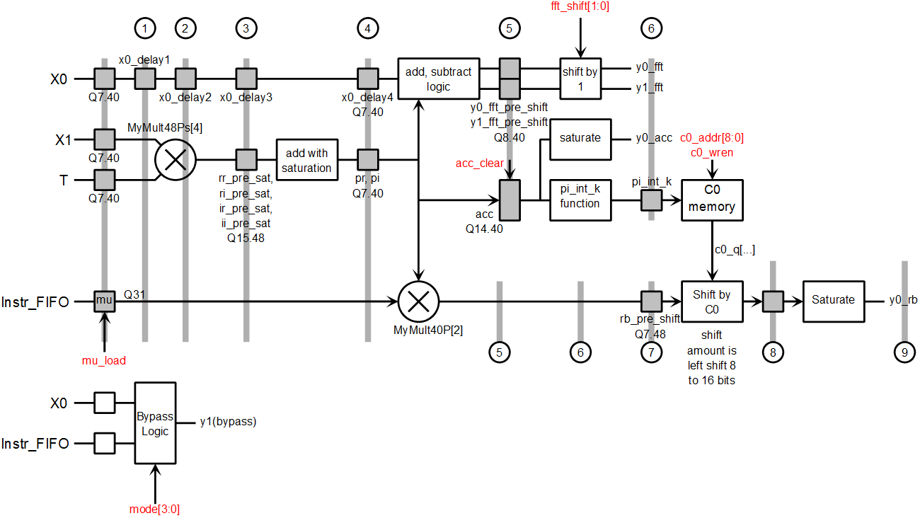
ALU
FFT
Complex MAC
Logarithm
Rb
Rb = mu_k * X1 * T * (1 << Pi_int[k])
Resource Reuse
1 ~ 9 cycle pipeline

Slide 17
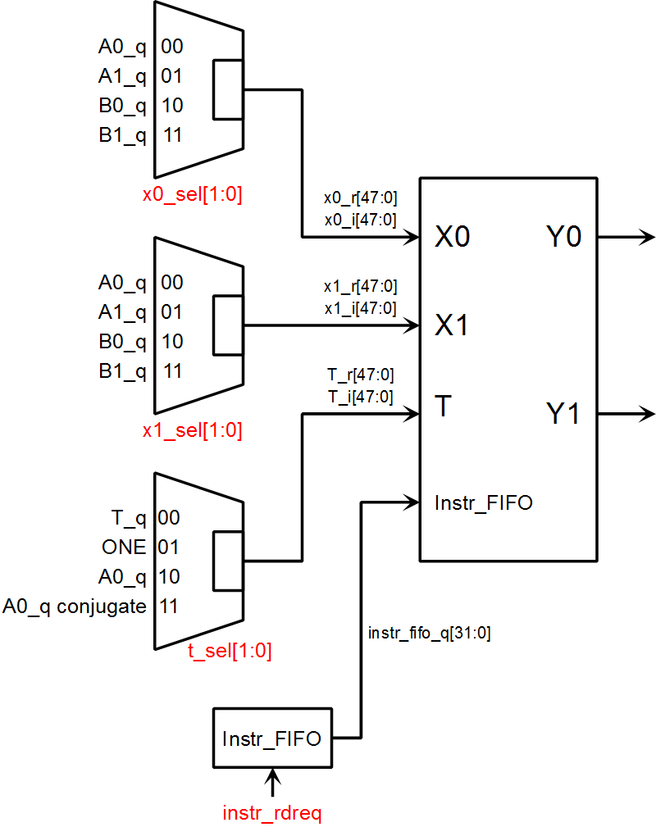
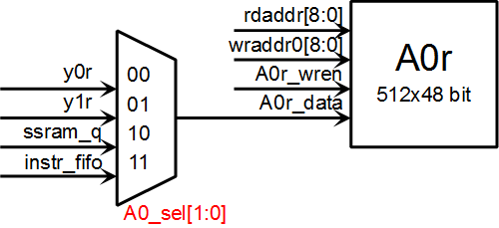
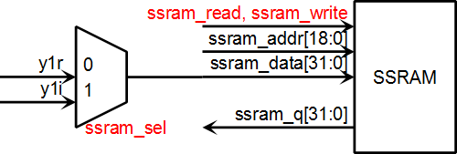
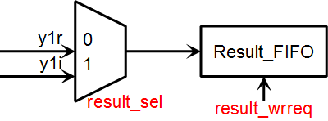
Datapath

Slide 18
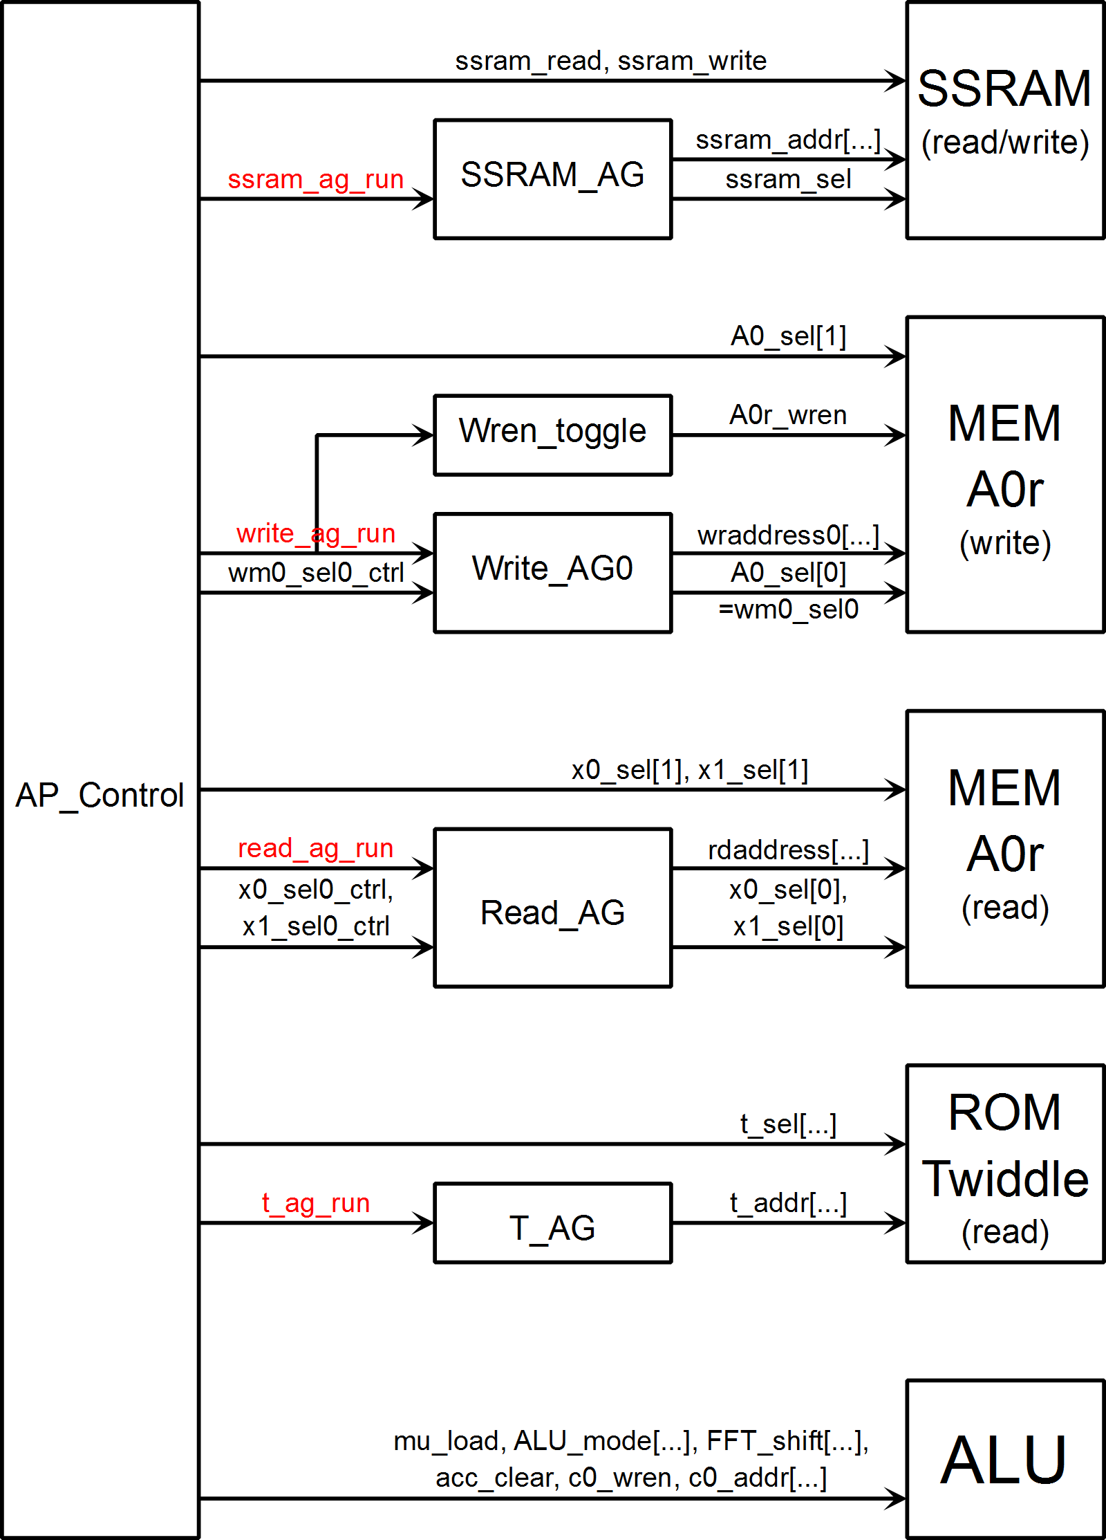
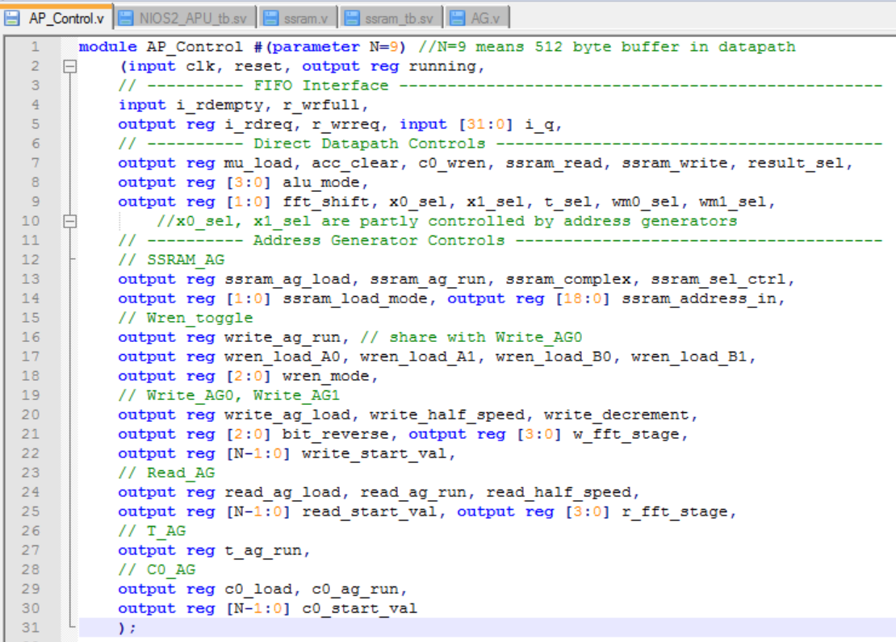
Layered Control

Slide 19
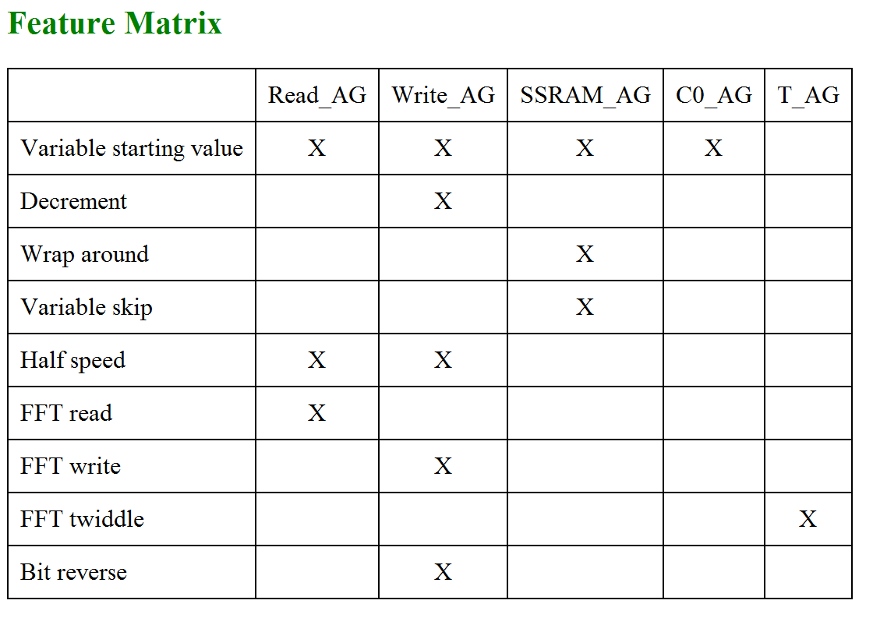
Address Generators

Slide 20
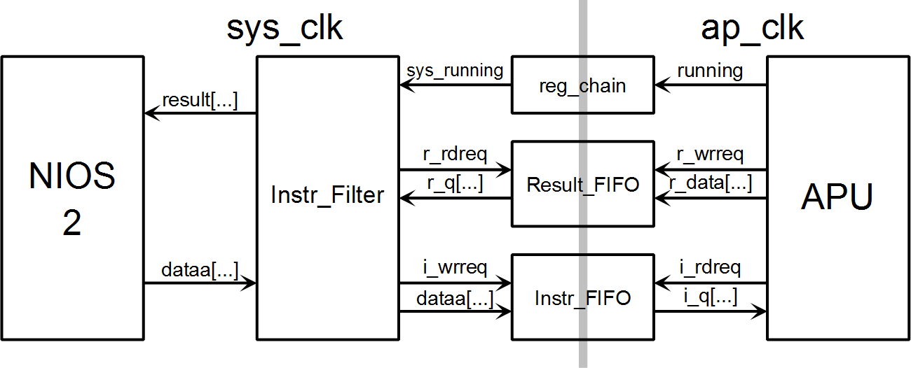
NIOS 2 – Array Processor Link

Slide 21
Instruction Encoding
Instructions are 32 bits per word, and multiple words.
First word has fixed format:
Mode drives ALU mode
Source ALU input MUX
DEST is decoded and configures write enable states
Arg is length of the array operation
[31:28] | [27:24] | [23:20] | [19:16] | [15:0]
Mode | Code | Source | Dest | Arg

Slide 22
Longest Instruction
Circular Buffer Addressing: 100, 105, 110, 115, 120, 125, 130, 70, 75, 80 …
This requires four additional words:
Word[1] = base_addr = 100
Word[2] = skip = 5
Word[3] = highest_addr = 131
Word[4] = block_size = 60
135>1131
100
+5
-60

Slide 23
NIOS 2 + Array Processor = ASIP
NIOS 2 | Array Processor
RISC | CISC
Fixed Instruction Length | Variable Instruction Length
Fixed Pipeline | Widely Variable Pipleline
Loop | Does not loop
ASIP
Decision Maker
Number Cruncher

Slide 24
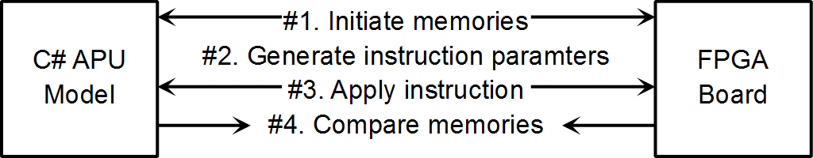
C# Verification
Other Verification:
Random Number File (48 bit Multiplier)
Assertions (ALU)
Directed Testbench + Visual (address generators, instructions)

Slide 25
FPGA ASIP Conclusions
Good
Simpler Peripherals
Computation
“Potential”
Bad
Inferior Scalar Processing
Lack of Features
Enormous Time Investment

Slide 28
Implementation Process
C# Port
Binary presentation (hide the algorithm)
WAV file direct use
Echo attenuation plot
Bit width survey
C# FPGA Port
Instruction Identification
Avoid debugging on NIOS 2
Coding and Testing
Verilog coding
System Verilog simulation
C# System Testing

Slide 29
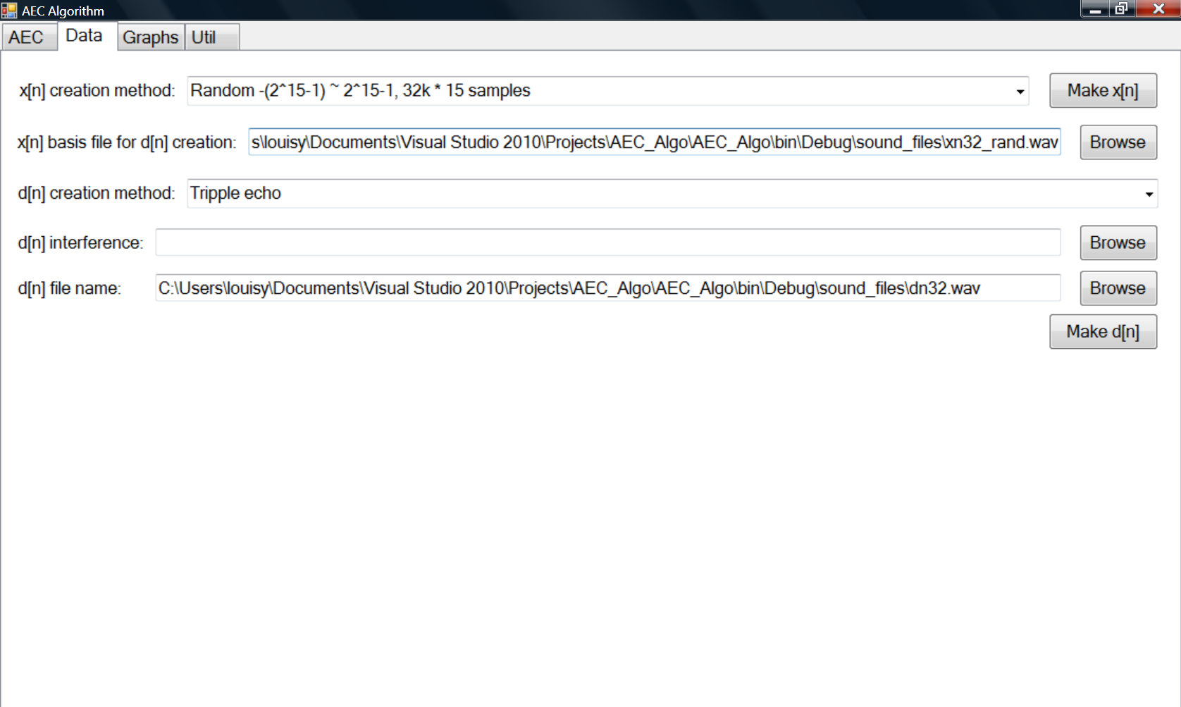
C# Port Screen Shots (1/2)

Slide 30
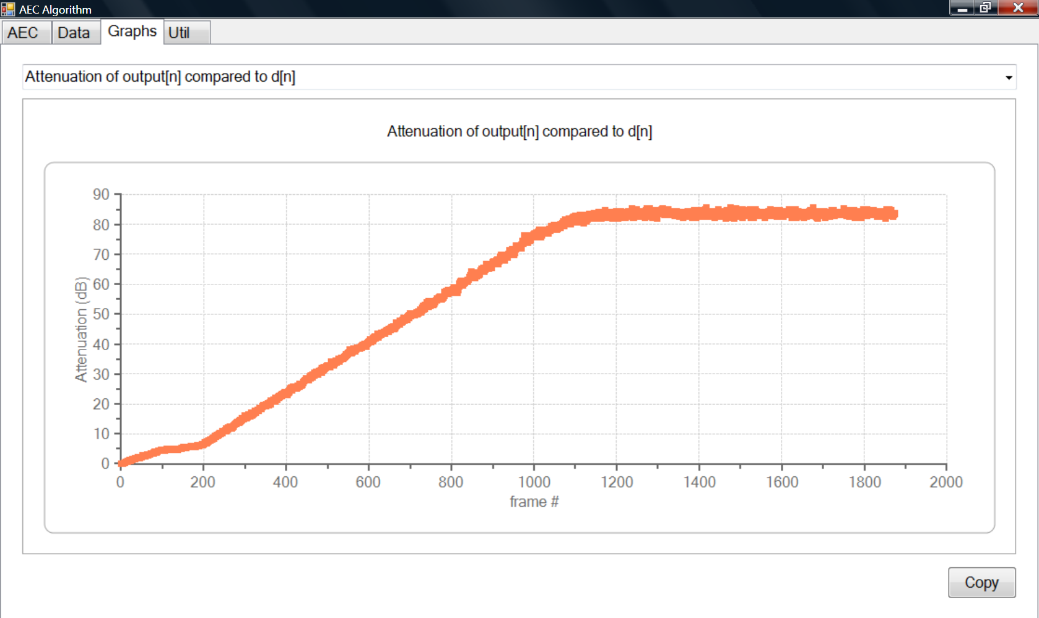
C# Port Screen Shots (2/2)

Slide 31
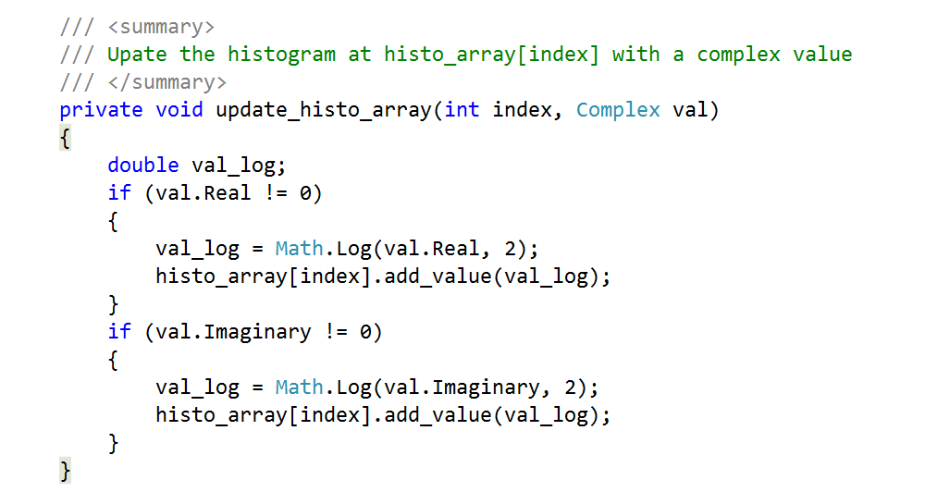
C# Port – Bit Width Survey – key code

Slide 32
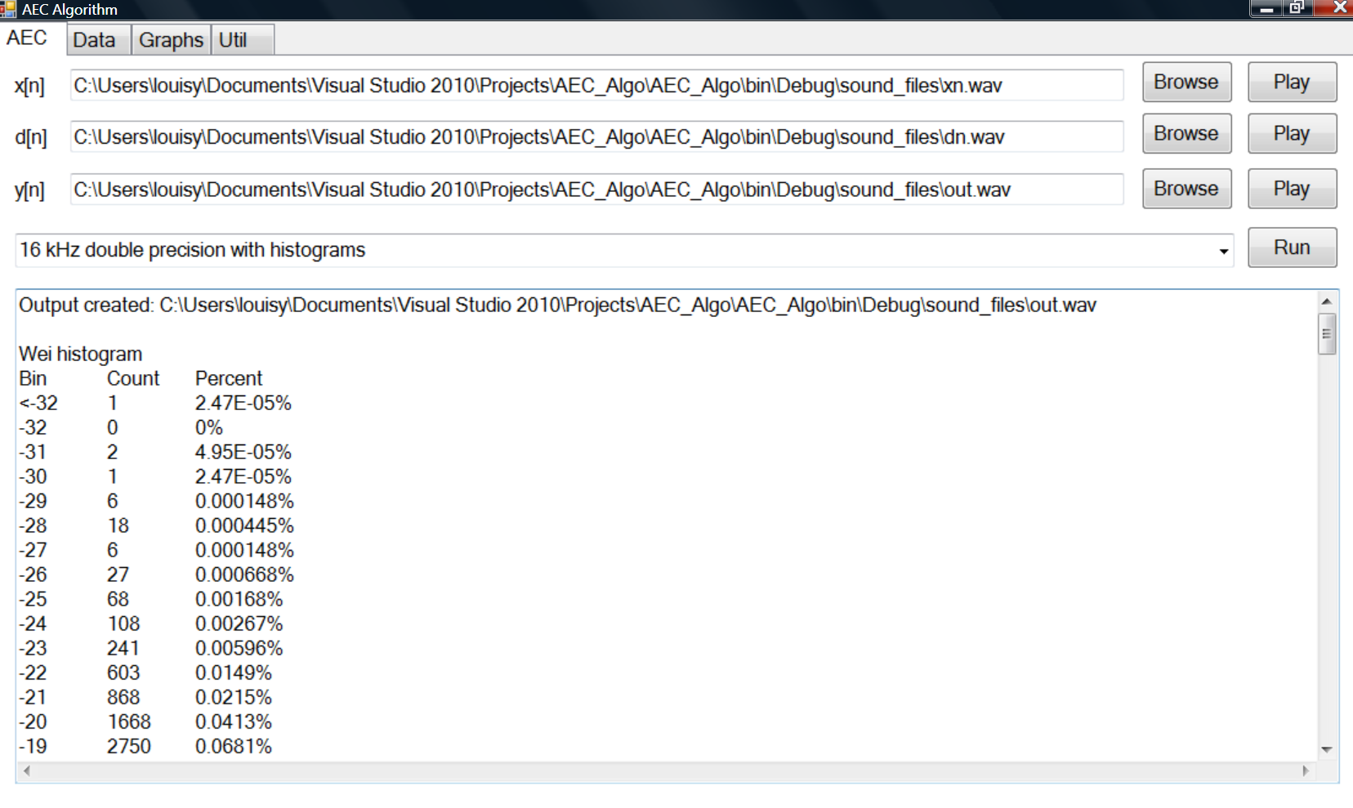
Bit Survey Actual Output

Slide 33
Bit Plot
Q18 may be sufficient ?

Slide 34
Precision Plan
float
Q31
Q31
Q31
float
Q7.40

Slide 35
C# FPGA Version Porting (1/2)
Grouping array operations together
Circular Array Implementation
NIOS 2 Operation
Array Operation
NIOS 2 Operation
Array Operation
NIOS 2 Operation
NIOS 2 Operation NIOS 2 Operation NIOS 2 Operation
Array Operation Array Operation
for (m = M + nd + 3; m > 0; m--)
{
for (k = 0; k < N + 1; k++)
{
Xb[k, m] = Xb[k, m - 1];
}
}
Xb_offset--;
if (Xb_offset < 0) Xb_offset = Xb_offset + Xb_num_rows;

Slide 36
C# FPGA Version Porting (2/2)
Array elements storage changed to “int”, but intermediate computation still in “double”.
2D arrays to 1D array
Separation of Code as ArrayProc
for (k = 0; k < N + 1; k++)
{
Xb[Xb_offset, k] = Xc[k];
}
ap.write_to_ssram(ArrayProc.SOURCE.B0, Xb_base + 2 * Xb_offset * XB_NUM_COLS, N);
// Store Xc[0~255]
ap.write_to_ssram(ArrayProc.SOURCE.B1, Xb_base + 2 * Xb_offset * XB_NUM_COLS + N * 2, 1);
// Store Xc[256]

Slide 37
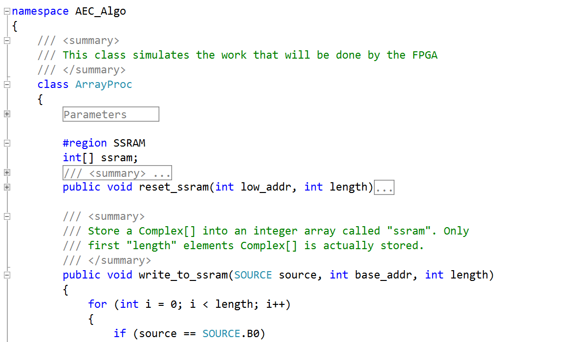
C# FPGA Port Result: ArrayProc
Two key questions to answer:
What “ArrayProc” needs to do?
How to invoke it?

Slide 38
Array Processor Development Process
Approach
Bottom Up
CISC
Multiplier
ALU
Datapath
Instruction Encoding
FFT Addressing Modes
Control

Slide 39
ALU Specification
Computation Output Y0
mode[3:0] | Effect on output Y0
0 | Zero: Y0 = 0 and Y1 = 0
1 | FFT: Y0 = X0 + X1*T ; Y1 = X0 - X1*T The "FFT_shift" determines what bit shift will take place
2 | Y0 = accumulator (acc)
3 | Y0 = rb = mu * T * X1 * (1 << C0) The value of C0[] shift value is 8 to 16, all left shifts
Bypass Output Y1
mode[3:0] | Effect on output Y0
0 | Zero: Y0 = 0 and Y1 = 0
1 | FFT: Y0 = X0 + X1*T ; Y1 = X0 - X1*T The "FFT_shift" determines what bit shift will take place
2 | Simple copy: Y1 = X0
3 | Copy real component only: Y1 = {X0.real, 0}

Slide 40
Multi-word Instruction
Instruction up to 5 words.
Longest instruction:
/// <summary>
/// Retrieve a Complex[] from an integer array called "ssram". This
/// version has a wrap around capability for circular buffer addressing.
/// When the address computed goes over highest_addr, the address
/// used for ssram access will be the computed address minus "block_size".
/// </summary>
public void read_ssram(DEST dest, int base_addr, int length, int skip,
int highest_addr, int block_size)
{
for (int i = 0; i < length; i++)
{
int address = base_addr + skip * 2 * i;
if (address > highest_addr) address -= block_size;
int real = ssram[address];
int imag = ssram[address + 1];
if (dest == DEST.A0)
A0[i] = new Complex(real * fraction, imag * fraction);
else if (dest == DEST.A1)
A1[i] = new Complex(real * fraction, imag * fraction);
}
}
Word[1] = base_addr Word[2] = skip Word[3] = highest_addr Word[4] = block_size

Slide 41
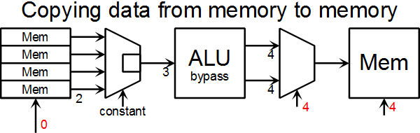
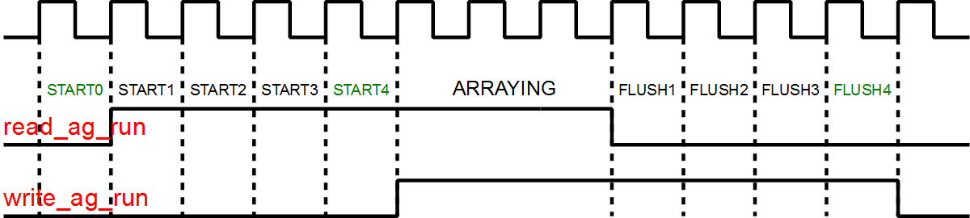
Control Timing Revisited

Slide 42
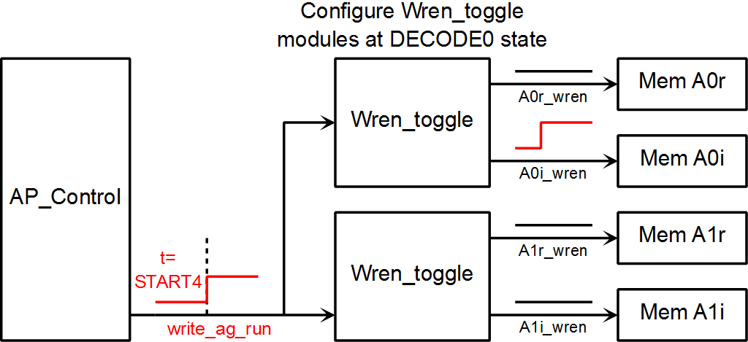
Write Enable Control

Slide 43
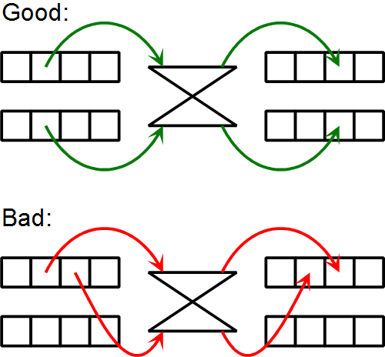
FFT Addressing Concept

Slide 44
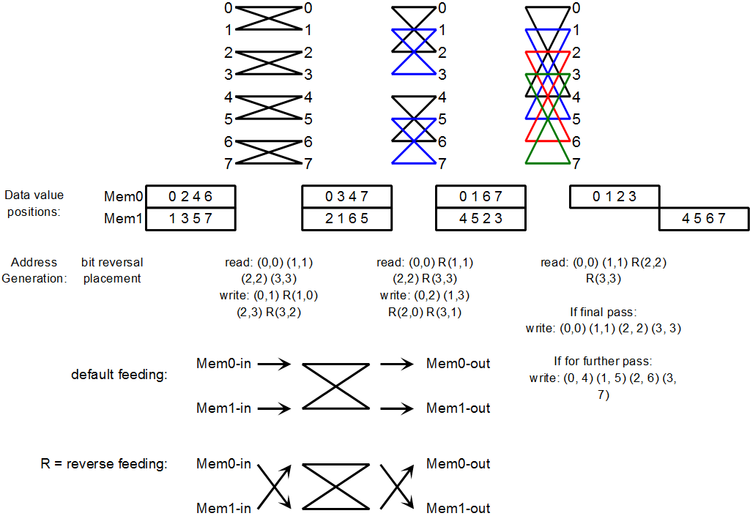
FFT Addressing

Slide 45
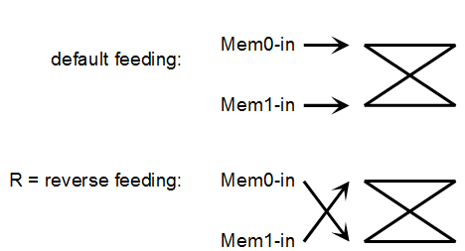
FFT Addressing Requirement
8 Point FFT is a bit reverse stage, followed by 3 separate array operations.
During a single array operation, memory feeding the ALU may change:
Bit inversed address.
Linear |  |  | Bit Inversed
0 | 000 | 010 | 2
1 | 001 | 011 | 3
2 | 010 | 000 | 0
3 | 011 | 001 | 1

Slide 46
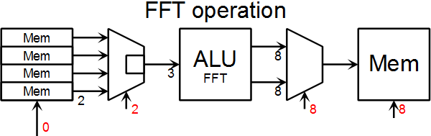
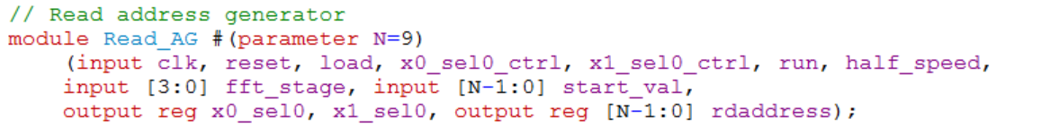
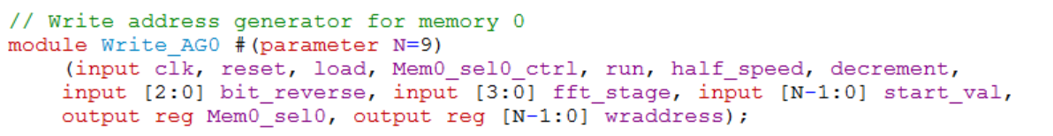
FFT Complications

Slide 47
Verification
File Based (48 bit Multiplier)
C# to generate random input values and store them in a file.
C# also compute output using System.Numerics.BigInteger and stores that in a file.
Assertions (ALU)
Directed test bench containing a few test cases
Visual (address generators, instructions)
PC Based
PC sends data to FPGA board and reads back the result
PC computes its own result (with double precision) and compare with FPGA

Slide 48
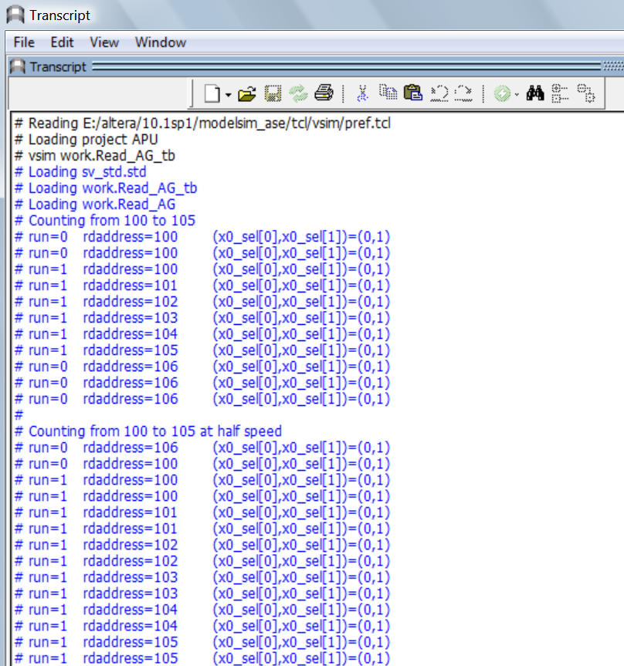
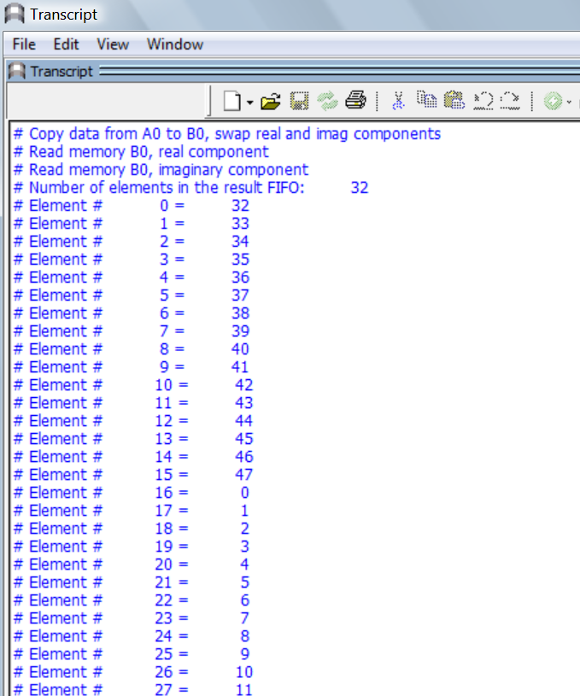
Visual Verification Screen Shots

Slide 49
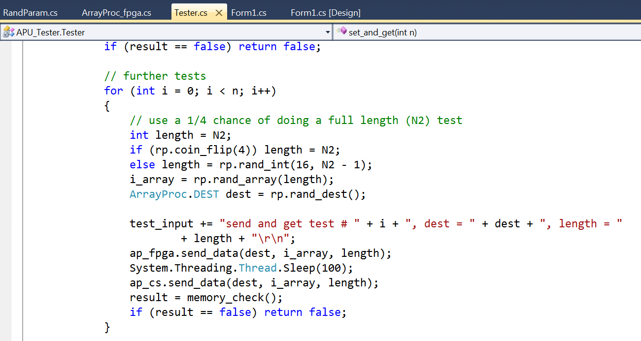
PC Based Testing (1/2)

Slide 50
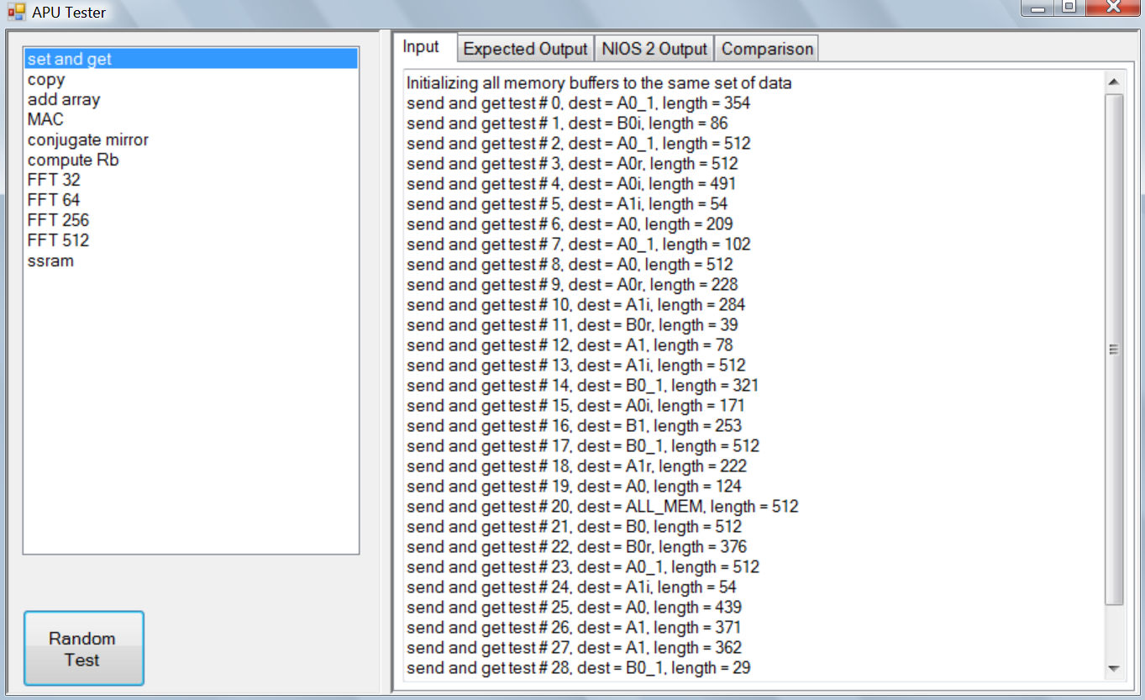
PC Based Testing (2/2)

