Slide 1
FPGA Implementation of a Real Time Acoustic Echo Cancelling System
Louis Yang
San Jose State University, April 24, 2011

Slide 2
Acknowledgement
Advisor: Chang Choo
CoAdvisor: Robert Morelos-Zaragoza
Other Contributors
Altera
Terasic
Mr. In Ki Hwang (ETRI)

Slide 3
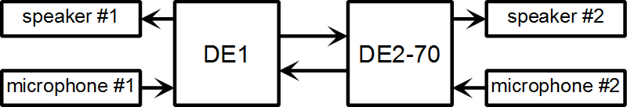
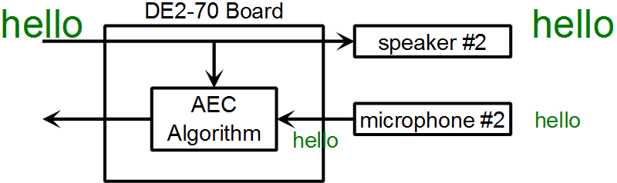
Acoustic Echo Cancelling

Slide 4
ESC Photo

Slide 5
Peripherals
WM8731 Audio Codec
speaker
microphone
GPIO Ribbon
SSRAM
RS-232 Uart
Small dataset testing
Flash Memory
Large dataset testing

Slide 6
FPGA versus Processors
ASIC
High volume, hardware not programmable
Microcontroller / Processors
Extreme variety, cost optimal for specific tasks
Mixed signal chips rich in features
Heart of most embedded Systems (General Market)
Largest number of jobs!
FPGA
ASIC prototyping – hardware re-programmable
High Performance Computing (Niche Market)
Customizable datapath
Variable precision, very wide bus width
Advanced IO technology (PCIe, GbE, DDR3)

Slide 7
Cyclone 2
 | Altera Cyclone 2 | Altera Cyclone 3 | Altera Cyclone 4 | Xilinx Spartan 6
Manufacturing Process | 90 nm | 65 nm | 60 nm | 45 nm
NIOS 2 top speed | 140 MHz | 175 MHz | 165 MHz | N/A
High Speed Transceiver for PCI Express |  |  | Yes | Yes
Memory Controller |  |  |  | Yes (DDR2, 3)
Efficient shift register implementation | No | No | No | Yes
Cyclone 5 Features: ALM, DSP Blocks, Larger Multipliers

Slide 8
NIOS 2 Processor
 | Nios II / e (Economy) | Nios II / s (Standard) | Nios II / f (Full)
f_{MAX} | 195 | 110 | 140
MIPS / MHz | 0.107 | 0.518 | 1.105
Resource Usage (LEs) | 540 | 1030 | 1600
www.altera.com/literature/ds/ds_nios2_perf.pdf
Comparison
Microchip PIC 32 – 125 MIPS @ 1.56 MIPS/MHz
Atmel AT91SAM9261 – 210 MIPS @ 1.105 MIPS/MHz

Slide 9
Speed versus Area
Area
Speed
32 kHz
NIOS 2

Slide 10
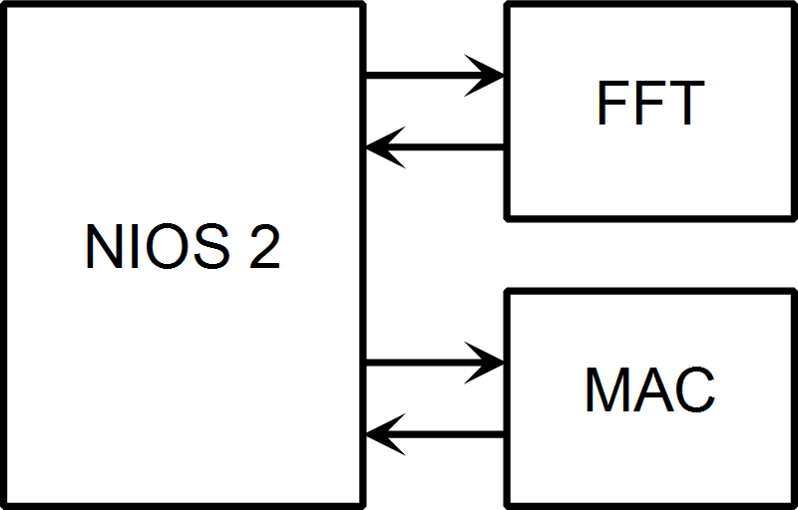
Quick and Dirty Approach
Uses 80% of processor time to meet 16 kHz real time requirement.

Slide 11
First Approach Resource Usage
 | Logic Cells | Dedicated Logic Registers | M4Ks (memory blocks) | Multipliers 9x9 | Multipliers 18x18
Total | 14,822 | 10,021 | 146 | 16 | 70
FFT (Full) | 8,600 | 6,991 | 30 | 16 | 64
FFT (Altera Core) | 8,288 | 6,810 | 30 | 16 | 64
NIOS 2 (CPU) | 2,950 | 1,771 | 58 |  | 2
On Chip Memory (Code and some data) | 3 | 1 | 48
MAC | 1,117 | 129 |  | 4

Slide 12
New Approach
FFT scale down to Radix 2
Radix 4 FFT overkill
32 kHz case uses 512 point FFT (which happens to be NOT a power of 4)
(Butterfly) Array Processor – Use FFT multiplier and memory to do other array operations
 | Butterfly per Pass | Complex Multiplier | Speed (if data is power of 4)
Radix 2 FFT | 1 | 1 | 1x
Radix 4 FFT | 4 | 3 | 4x

Slide 13
Array Processor and FPGA Economics
Hardware acceleration in CPUs – only high volume may apply:
Intel Sandy Bridge “Quick Sync” H.264 encoder
Atmel AT91SAM9M10-CU video decoder
FPGA allows customized datapath for hardware acceleration in low volume applications
FPGA bandwidth expansion is cheap (relatively)
Part Number | Free IO Pins | Price
EP3C16E144C8N | 84 | $26.70
EP3C16U256C8N | 168 | $31.70
EP3C16F484C8N | 346 | $33.20

Slide 14
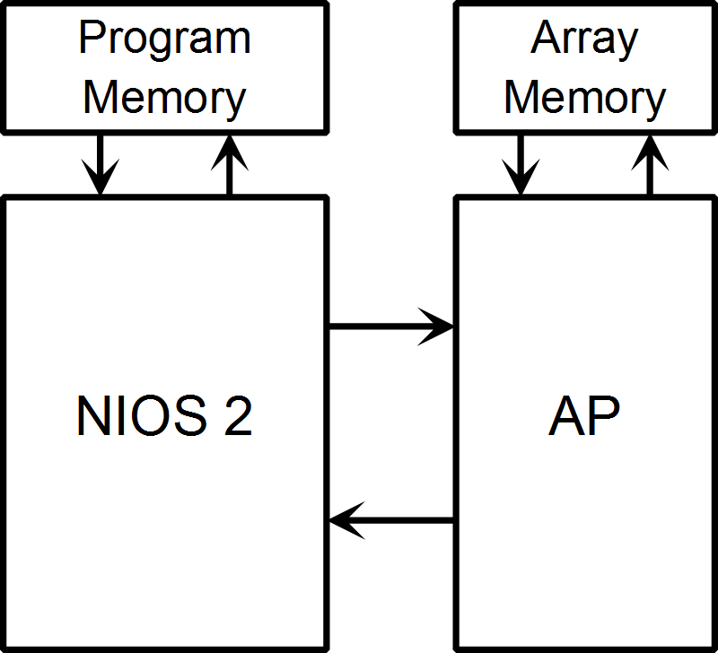
Array Processor Block Diagram

Slide 15
Implementation Process
C# Port
Binary presentation (hide the algorithm)
WAV file direct use
Echo attenuation plot
Bit width survey
C# FPGA Port
Instruction Identification
Avoid debugging on NIOS 2
Coding and Testing
Verilog coding
System Verilog simulation
C# System Testing

Slide 16
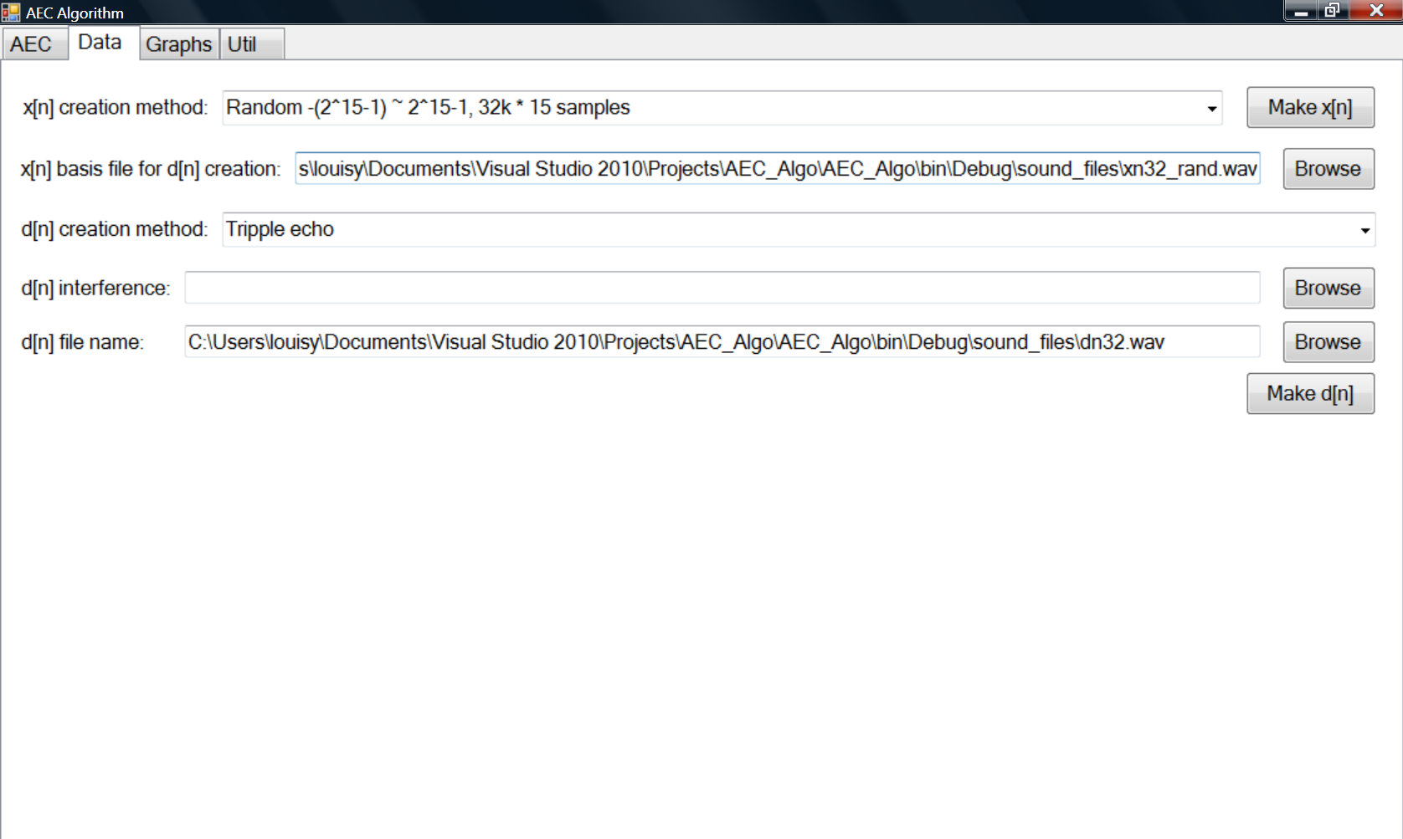
C# Port Screen Shots (1/2)

Slide 17
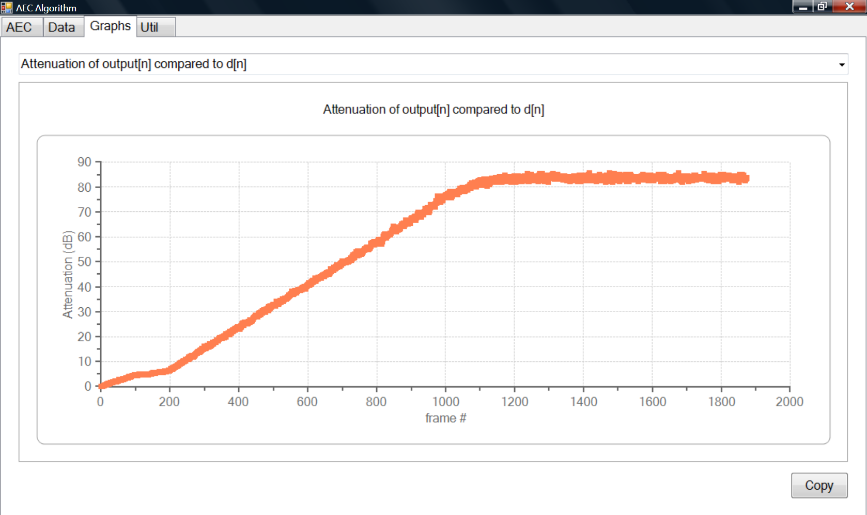
C# Port Screen Shots (2/2)

Slide 18
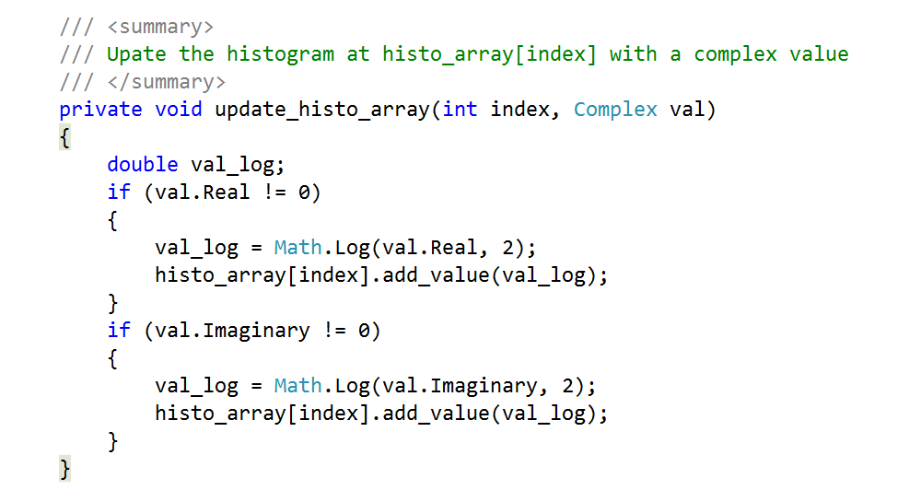
C# Port – Bit Width Survey – key code

Slide 19
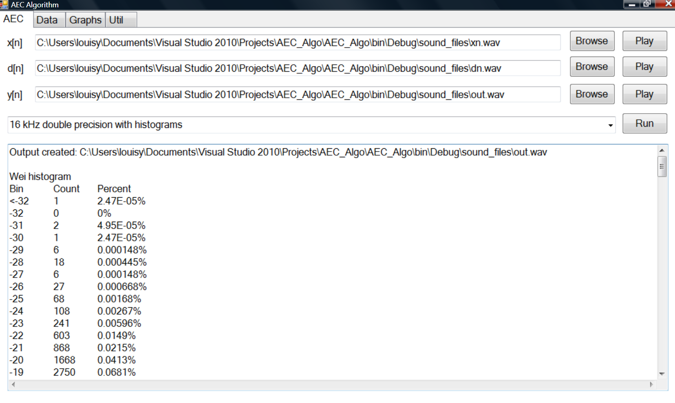
Bit Survey Actual Output

Slide 20
Bit Plot
Q18 may be sufficient ?

Slide 21
Precision Plan
float
Q31
Q31
Q31
float
Q7.40

Slide 22
C# FPGA Version Porting (1/2)
Grouping array operations together
Circular Array Implementation
NIOS 2 Operation
Array Operation
NIOS 2 Operation
Array Operation
NIOS 2 Operation
NIOS 2 Operation NIOS 2 Operation NIOS 2 Operation
Array Operation Array Operation
for (m = M + nd + 3; m > 0; m--)
{
for (k = 0; k < N + 1; k++)
{
Xb[k, m] = Xb[k, m - 1];
}
}
Xb_offset--;
if (Xb_offset < 0) Xb_offset = Xb_offset + Xb_num_rows;

Slide 23
C# FPGA Version Porting (2/2)
Array elements storage changed to “int”, but intermediate computation still in “double”.
2D arrays to 1D array
Separation of Code as ArrayProc
for (k = 0; k < N + 1; k++)
{
Xb[Xb_offset, k] = Xc[k];
}
ap.write_to_ssram(ArrayProc.SOURCE.B0, Xb_base + 2 * Xb_offset * XB_NUM_COLS, N);
// Store Xc[0~255]
ap.write_to_ssram(ArrayProc.SOURCE.B1, Xb_base + 2 * Xb_offset * XB_NUM_COLS + N * 2, 1);
// Store Xc[256]

Slide 24
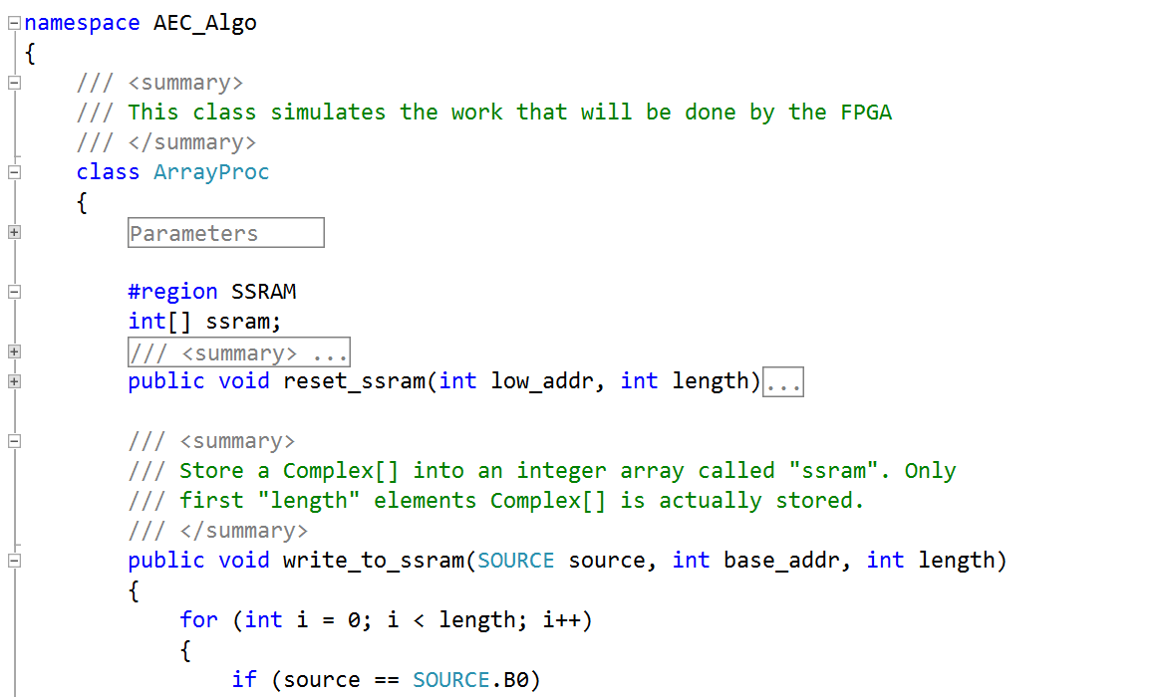
C# FPGA Port Result: ArrayProc
Two key questions to answer:
What “ArrayProc” needs to do?
How to invoke it?

Slide 25
Array Processor Development Process
Approach
Bottom Up
CISC
Multiplier
ALU
Datapath
Instruction Encoding
FFT Addressing Modes
Control

Slide 26
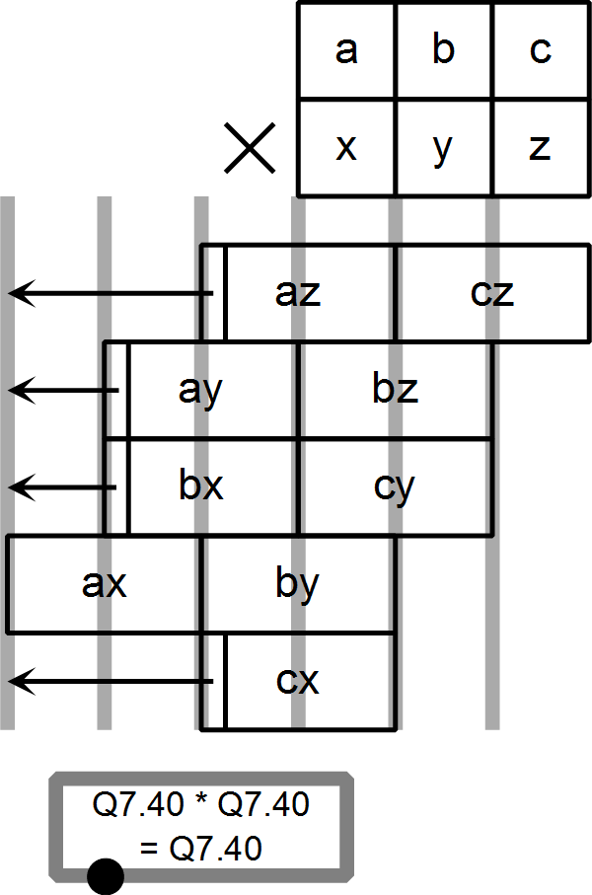
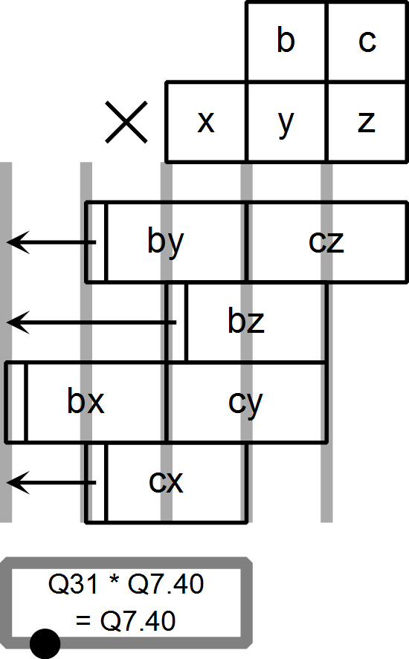
Pipelined Multiplier
48x48
32x48

Slide 27
ALU Specification
Computation Output Y0
mode[3:0] | Effect on output Y0
0 | Zero: Y0 = 0 and Y1 = 0
1 | FFT: Y0 = X0 + X1*T ; Y1 = X0 - X1*T The "FFT_shift" determines what bit shift will take place
2 | Y0 = accumulator (acc)
3 | Y0 = rb = mu * T * X1 * (1 << C0) The value of C0[] shift value is 8 to 16, all left shifts
Bypass Output Y1
mode[3:0] | Effect on output Y0
0 | Zero: Y0 = 0 and Y1 = 0
1 | FFT: Y0 = X0 + X1*T ; Y1 = X0 - X1*T The "FFT_shift" determines what bit shift will take place
2 | Simple copy: Y1 = X0
3 | Copy real component only: Y1 = {X0.real, 0}

Slide 28
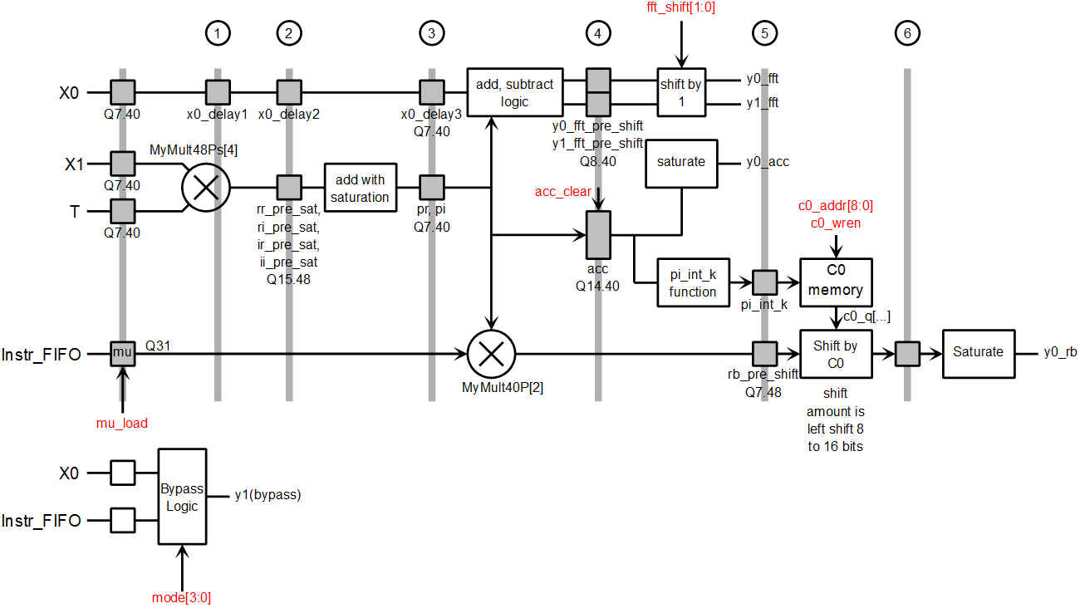
ALU
FFT
Variable Pipelining
(1 ~7 cycles)
Resource Reuse

Slide 29
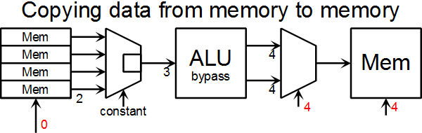
Datapath Concept
To copy from memory A[0,1,2,3] to memory B[5,6,7,8]:
Have the correct selector and write enable signals
t = 0 : Launch the read address sequence {0,1,2,3}
t = 4 : Launch the write address sequence {5,6,7,8}
t = 4 : turn on the write enable signal for memory B

Slide 30
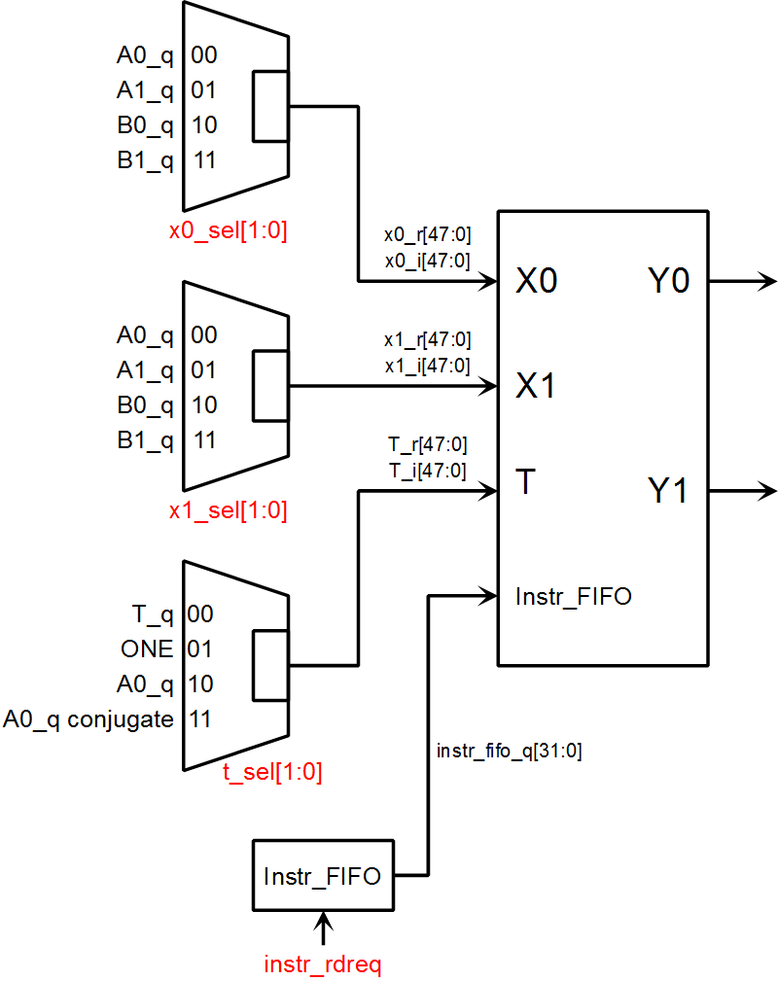
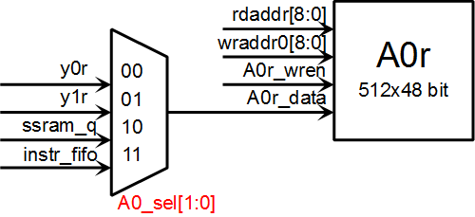
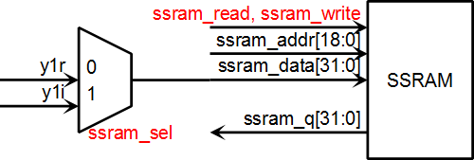
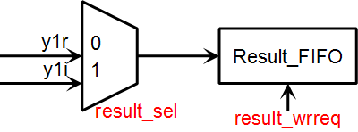
Datapath

Slide 31
Instruction Encoding
Instructions are 32 bits per word, and multiple words.
First word has fixed format:
Mode drives ALU mode
Source ALU input MUX
DEST is decoded and configures write enable states
Arg is length of the array operation
[31:28] | [27:24] | [23:20] | [19:16] | [15:0]
Mode | Code | Source | Dest | Arg

Slide 32
Multi-word Instruction
Instruction up to 5 words.
Longest instruction:
/// <summary>
/// Retrieve a Complex[] from an integer array called "ssram". This
/// version has a wrap around capability for circular buffer addressing.
/// When the address computed goes over highest_addr, the address
/// used for ssram access will be the computed address minus "block_size".
/// </summary>
public void read_ssram(DEST dest, int base_addr, int length, int skip,
int highest_addr, int block_size)
{
for (int i = 0; i < length; i++)
{
int address = base_addr + skip * 2 * i;
if (address > highest_addr) address -= block_size;
int real = ssram[address];
int imag = ssram[address + 1];
if (dest == DEST.A0)
A0[i] = new Complex(real * fraction, imag * fraction);
else if (dest == DEST.A1)
A1[i] = new Complex(real * fraction, imag * fraction);
}
}
Word[1] = base_addr Word[2] = skip Word[3] = highest_addr Word[4] = block_size

Slide 33
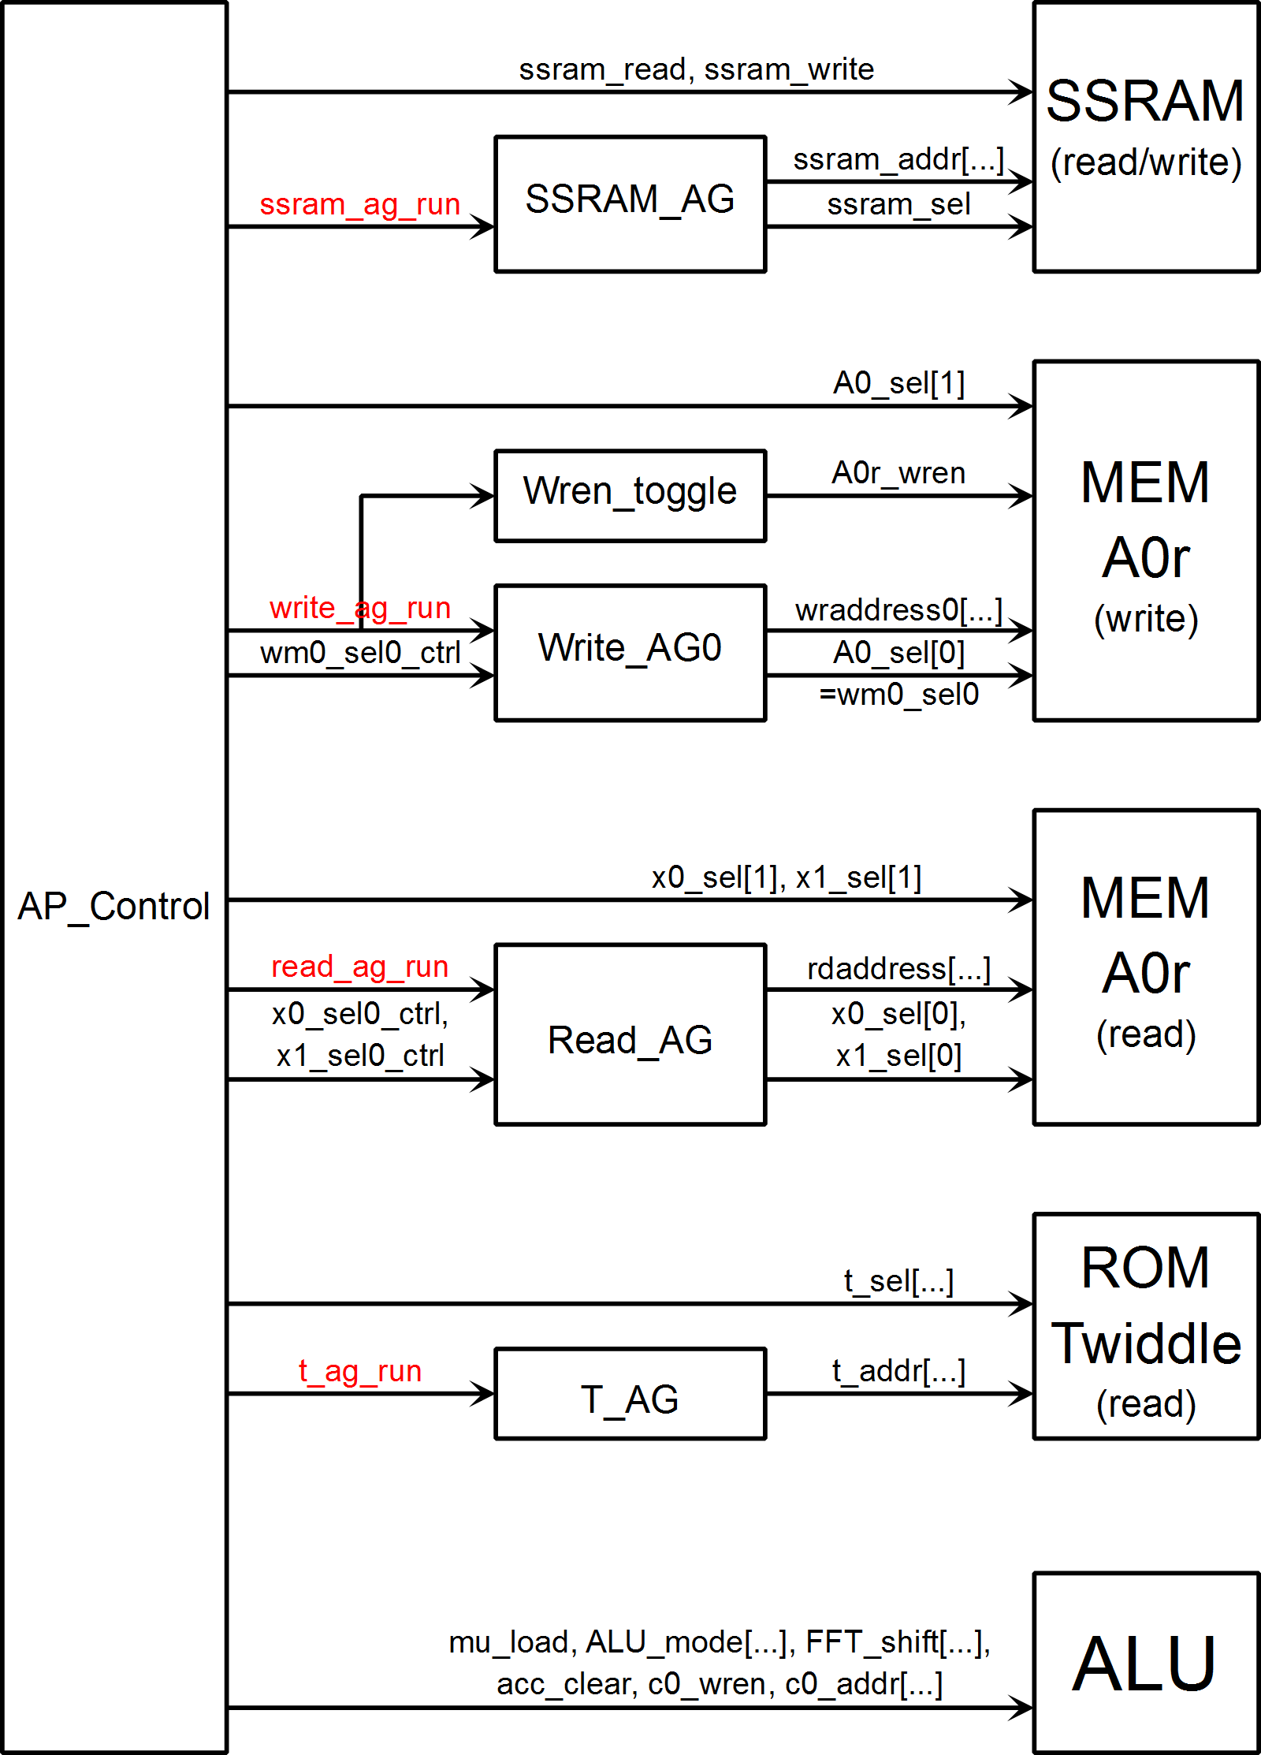
Layered Control

Slide 34
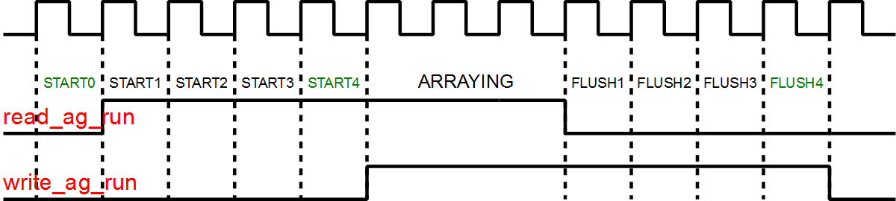
Control Timing Revisited

Slide 35
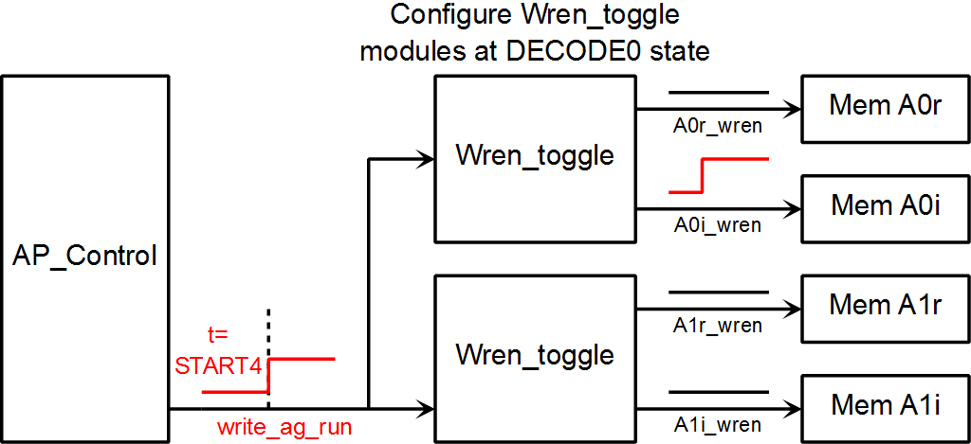
Write Enable Control

Slide 36
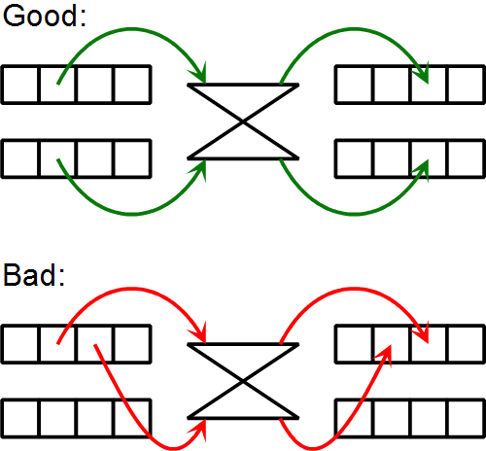
FFT Addressing Concept

Slide 37
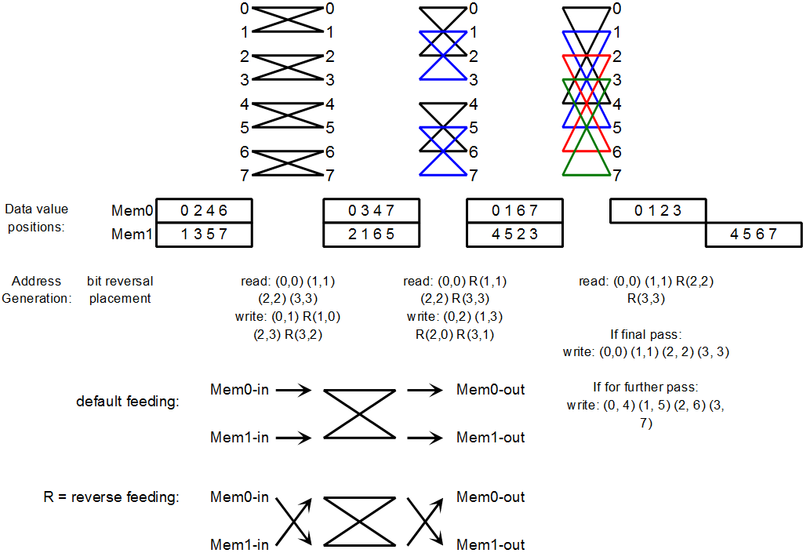
FFT Addressing

Slide 38
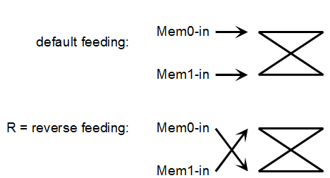
FFT Addressing Requirement
8 Point FFT is a bit reverse stage, followed by 3 separate array operations.
During a single array operation, memory feeding the ALU may change:
Bit inversed address.
Linear |  |  | Bit Inversed
0 | 000 | 010 | 2
1 | 001 | 011 | 3
2 | 010 | 000 | 0
3 | 011 | 001 | 1

Slide 39
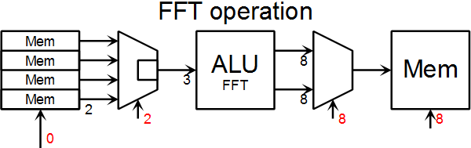
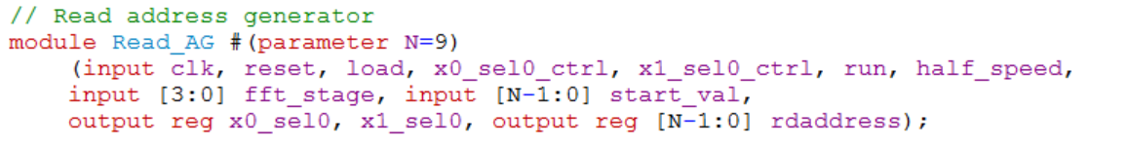
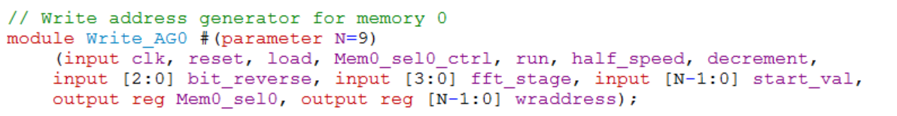
FFT Complications

Slide 40
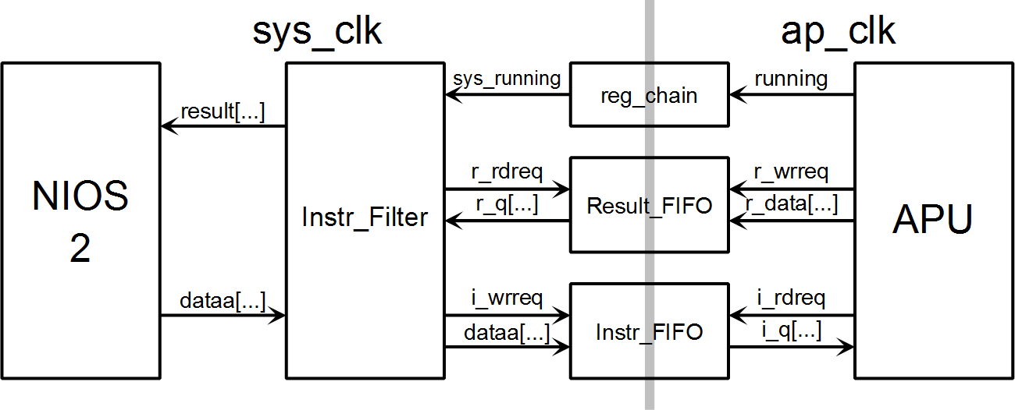
NIOS 2 – Array Processor Link

Slide 41
Verification
File Based (48 bit Multiplier)
C# to generate random input values and store them in a file.
C# also compute output using System.Numerics.BigInteger and stores that in a file.
Assertions (ALU)
Directed test bench containing a few test cases
Visual (address generators, instructions)
PC Based
PC sends data to FPGA board and reads back the result
PC computes its own result (with double precision) and compare with FPGA

Slide 42
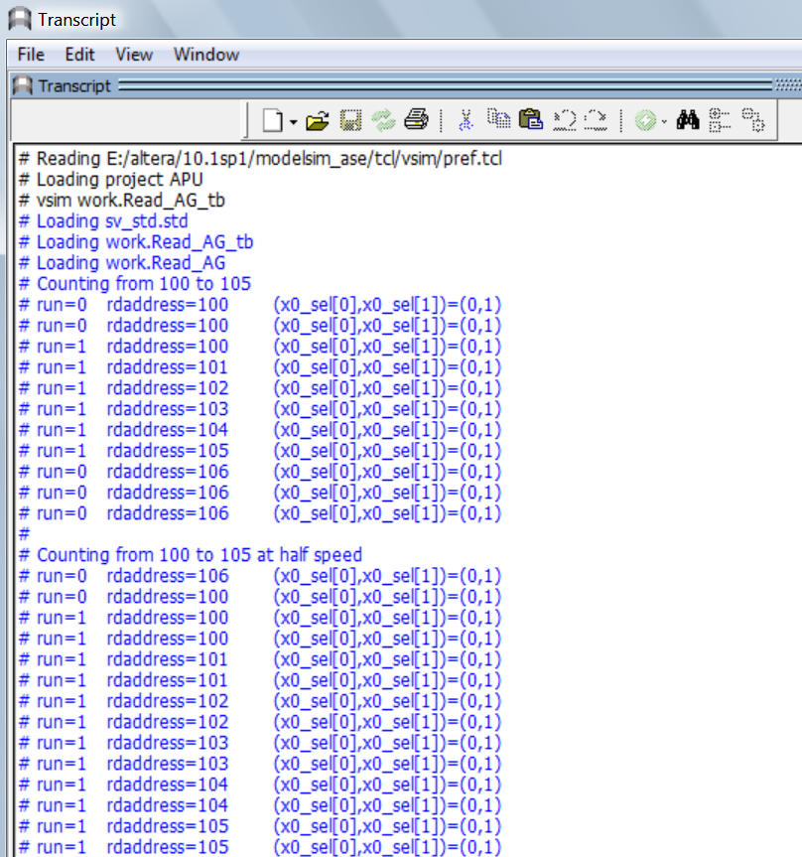
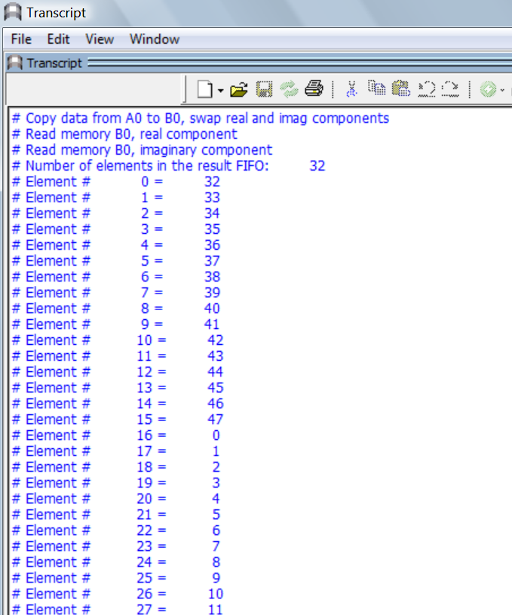
Visual Verification Screen Shots

Slide 43
Conclusions

