Slide 1
CH 2 Review of Circuit Theory
Saturated Transistor
Transistor Amplifier

Slide 2
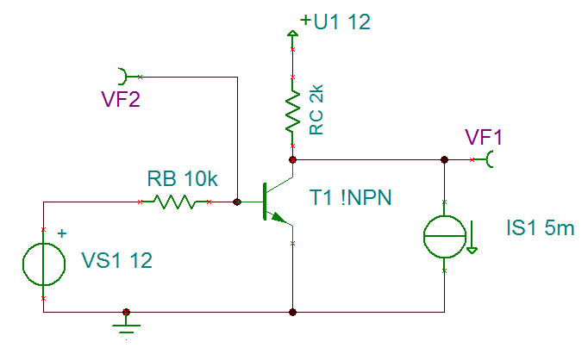
Saturated Transistor (Off)
RC = small
=> output > X for a sink current Y
INPUT
= LOW
Transistor = off

Slide 3
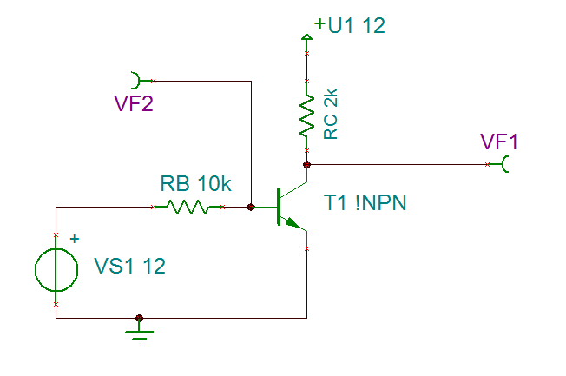
Saturated Transistor (On)
RB => base current => collector current
INPUT
= HIGH
Transistor = On
=> Sink a certain current into it

Slide 4
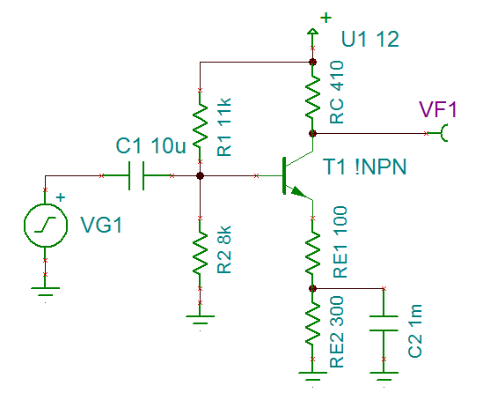
Transistor Amplifier (DC Bias)
First choose a DC bias collector current
RC => DC bias the output so it can swing up and down
R1 and R2 => DC bias the base voltage to be 0.6V above emitter voltage
RE1 and RE2 => DC bias the emitter voltage to 4V

Slide 5
Transistor Amplifier (RE1, RE2)
Gain = RC / RE1
RE1 + RE2 = a value to satisfy DC Bias

