Slide 1
Op Amps for Everyone
CH 3 – Development of the Ideal Op Amp Equations

Slide 2
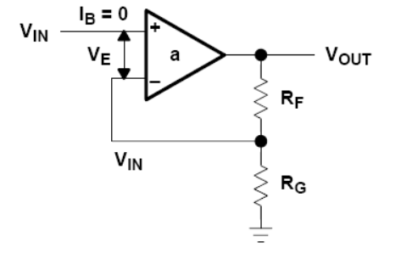
The Non-Inverting Op Amp
Input is applied to the non-inverting end
RF and RG network is common to both non-inverting and inverting configurations
GND is applied to the inverting end
For unity gain buffer, RG is open, RF is not to be shorted though. A 20k there help prevent electro-static discharge.

Slide 3
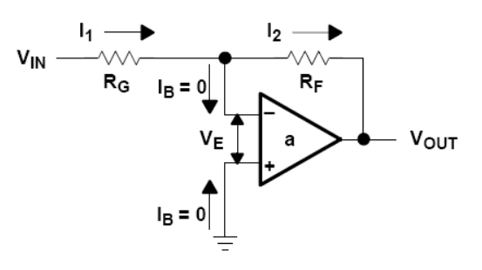
The Inverting Op Amp
Input applied to the inverting end
GND applied to the non-inverting end

Slide 4
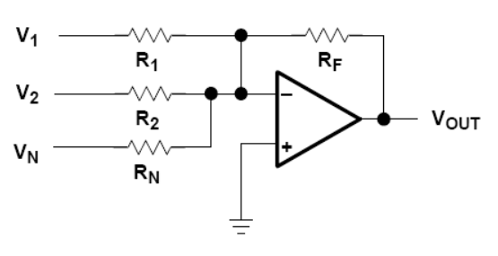
The Adder
This circuit works by having
I_{F} = I_{R1} + I_{R2} + … + I_{RN}
The resistors are for giving each term a weight.

Slide 5
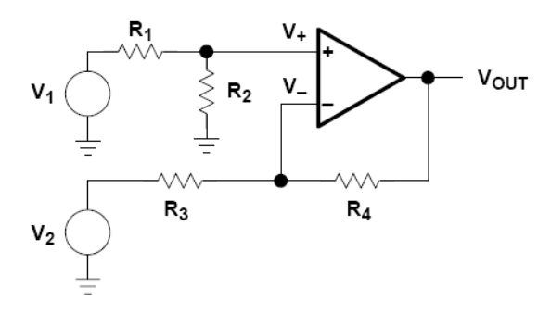
The Differential Amplifier (Equation)
When V₂ = 0 :
When V₁ = 0:
Note that the total V_{out} = V_{out1} + V_{out2} , which has the term V₁-V₂ in it.

Slide 6
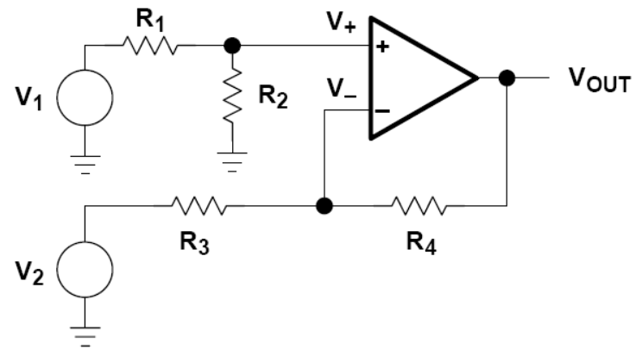
The Differential Amplifier (Typical Formula)
Note the two input impedances are not matched.
IF: R₁ = R₃ and R₂ = R₄
Then:

Slide 7
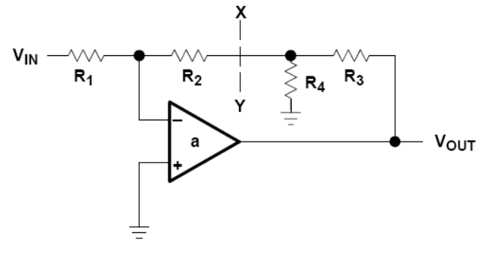
T-Network in Feedback Loop (Circuit Basics)
The gold node will be negative. So a green current will flow out of the ground and drive the output even more negative than before.
Conclusion: T-Network reduce the feedback resistance needed to achieve a given gain by the presence of a helper current

Slide 8
T-Network in Feedback Loop (Design Equation)
R₄ boost the gain of the amplifier circuit:

Slide 9
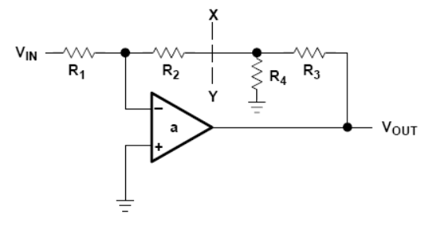
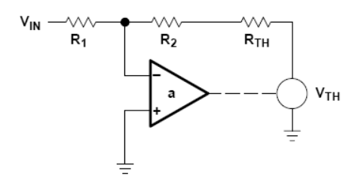
T-Network in Feedback Loop (Circuit Analysis)
Original circuit:
Thevenin form:
R_{TH} = R₃ || R₄

Slide 10
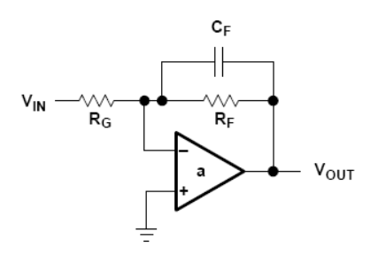
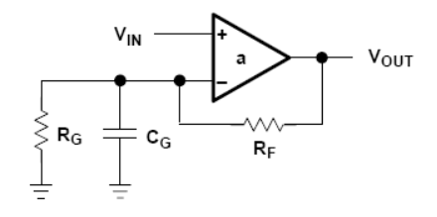
Capacitors in the Feedback Network
Low pass filter:
Reduce Z_{F} at high frequencies
High pass filter:
Reduce Z_{G} at high frequencies

