Slide 1
Op Amps for Everyone
CH 4 Single Supply Op Amp Design Techniques

Slide 2
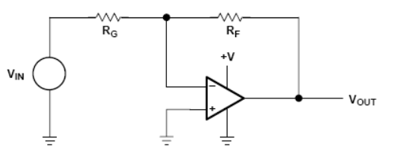
Problems of Using Inverting Configuration with Positive Supply
Positive input will not work since output cannot go negative
Works only marginally with small negative input because op amps are highly susceptible to reverse voltage breakdown

Slide 3
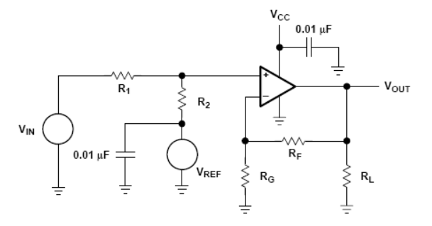
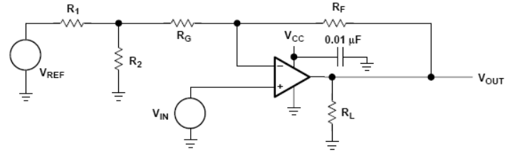
Circuits to Implement V_{OUT} = +m V_{IN} ± b
+b
Apply V_{IN} to the + terminal
Like-wise, b goes to + or – terminal as needed
-b

Slide 4
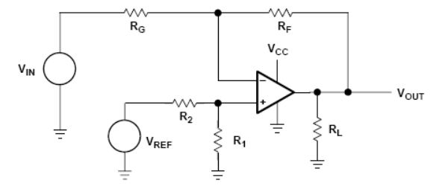
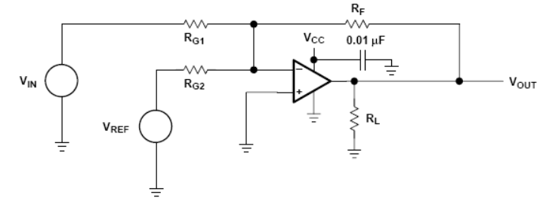
Circuits to Implement V_{OUT} = -m V_{IN} ± b
Apply V_{IN} to the - terminal
+b
Due to V_{IN} going negative, these circuits require special protection
-b

Slide 5
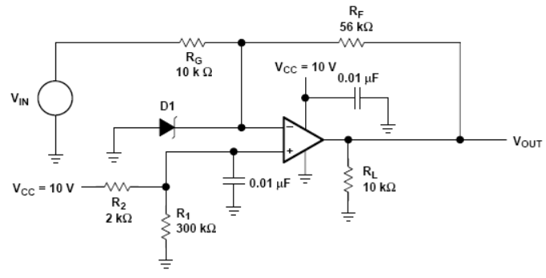
Circuit Protection for Op Amp Input in Inverter Circuits
If op amp has no power, and input is negative, the entire negative input will appear at the red node.
Use a schottky diode to keep the red node to above -200mV.

Slide 6
Circuit to implement: V_{OUT} = +m +V_{IN} + b
Equations are derived by using superposition
V_{REF} must be low in noise --- any noise in V_{REF} might be amplified
Resistors can be decreased to reduced input current error (more current = less of that current going into op amp’s +/- terminals)
Smaller resistors leads to better frequency response

Slide 7
Circuit to implement: V_{OUT} = +m +V_{IN} - b
In writing the contribution from V_{REF}, the high lighted part is treated as a Thevenin source.
Assume R_{G} > R₁ || R₂ to simplify finding the needed resistor ratios.

Slide 8
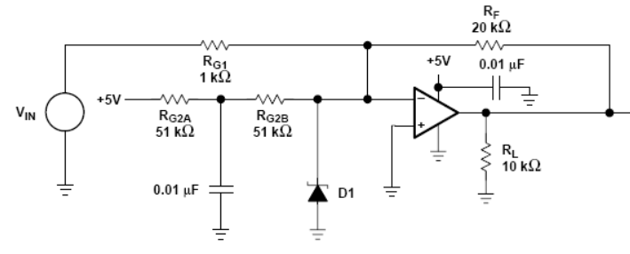
Using V_{CC} as V_{REF}
Using V_{CC} as V_{REF} can save money, but be sure to filter the V_{CC}
This capacitor is for filtering.

