Slide 1
Op Amps for Everyone
CH 6 – Development of Non Ideal Op Amp Equations

Slide 2
Types of Errors with the Ideal Op Amp Assumption
DC Errors – These do not change with frequency. Example: Input bias current is 10 pA at 1 kHz and still 10 pA at 10 kHz
AC Errors – These do change with frequency. The main error being the differential gain reducing at higher frequencies.

Slide 3
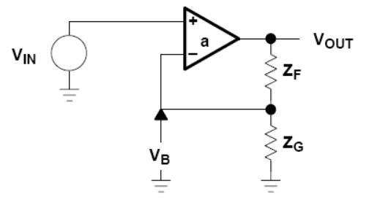
Non-inverting Op Amp

Slide 4
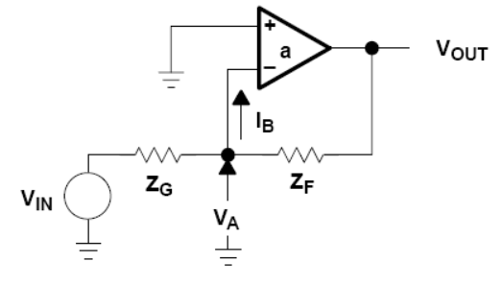
Inverting Op Amp

Slide 5
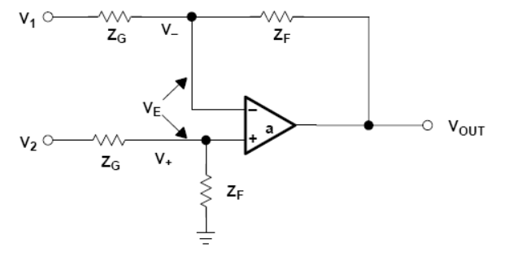
Differential Op Amps (Circuit Analysis)

Slide 6
Differential Op Amps (Close Loop Equation)

Slide 7
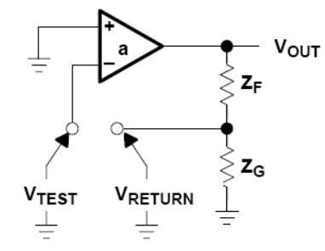
Loop Gain
For all three circuit configuration, setting the inputs to zero results in the same circuit:
So loop gain is always:
While forward gain is different for each configuration.

