Slide 1
Op Amps for Everyone
Voltage-Feedback Op Amp Compensation

Slide 2
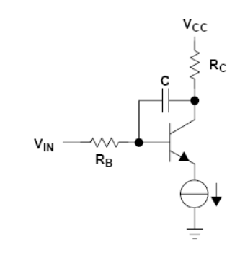
Internal Compensation
Op amps that are internally compensated have their gain roll off faster
+ Such op amps are more stable when used in circuits
- Such op amps have less bandwidth
C will reduce gain at high frequency. The Miller effect multiplies the capacitor by the amount of gain.

Slide 3
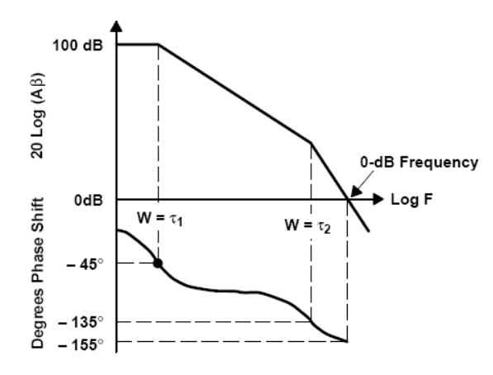
Op Amp Poles
Op amps are modeled as two pole devices
Each pole introduce 45 degree phase shift a decade before the pole and a decade after a pole
So in a loop gain equation, the op amp itself can have a phase margin of almost zero if we have poles that are low enough in frequency

Slide 4
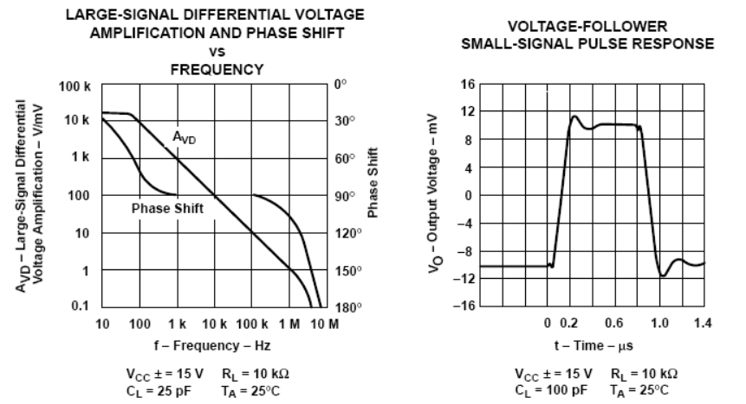
Op Amp Stability in Datasheets
- Left plot shows phase margin > 60 degrees, so output should be pretty stable.
- Right plot shows instability. This is due to the increased load capacitance.

Slide 5
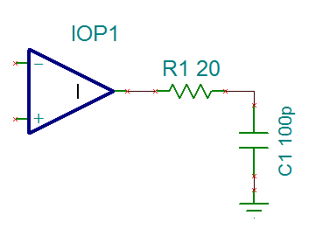
The Source of Instability
Op amp output impedance and output capacitance forms an RC filter.
Larger C moves the pole to lower frequency
RC Filter Transfer Function =
If the pole gets small enough, it will introduce enough negative phase shift before loop gain < 1, to make the loop gain unstable.

Slide 6
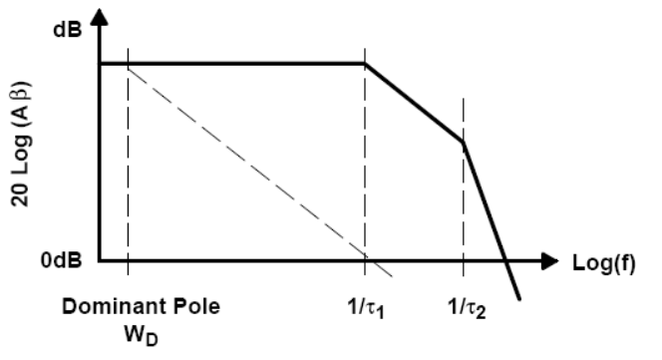
Dominant-Pole Compensation
If we make the output impedance and capacitor big enough, we can create a pole so low that the op amp becomes stable.
W_{D} is the dominant pole created by large output R and C. Phase margin is 45 degrees, but bandwidth is greatly reduced.
This stabilization method is used by the internally compensated op amps.

Slide 7
Key Points of Good Op Amp Datasheets
Gain / phase Bode plots are done with substantial loading capacitors (600 pF)
Phase margin is shown for different supply voltages
Small-signal pulse response done with mV-signals

Slide 8
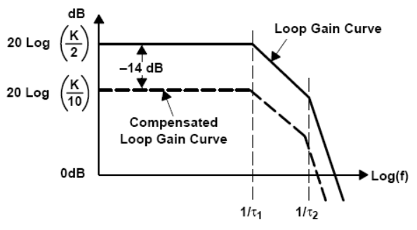
Gain Compensation
Decrease Feedback
Increase Close Loop Gain
Decrease Loop Gain
This works for voltage-feedback op amps
When the feedback divider Z_{G} / (Z_{G} + Z_{F}) smaller, the close loop gain increase for all three major op amp configurations (see CH 6 for details)

Slide 9
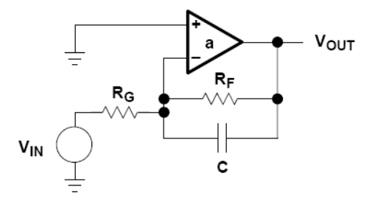
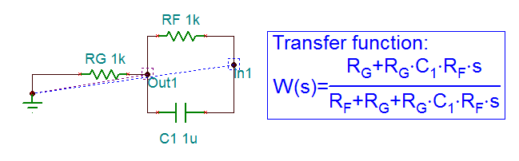
Lead Compensation (Circuit Analysis)
Loop Gain =
Tina Analysis:
Conclusions:
A zero is introduced at 1/(CR_{F})
A pole is introduced at (R_{F}+R_{G})/(R_{G}CR_{F})
Zero < Pole

Slide 10
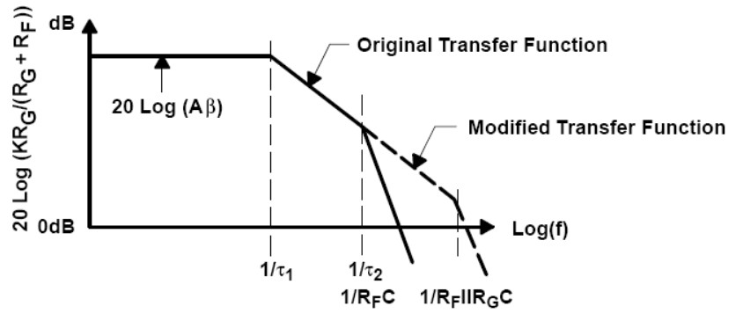
Lead Compensation (Bode Plot)
Loop Gain Plot:
The zero introduced will happen at a lower frequency than the pole
The zero is chosen to act at the unity crossing frequency to boost phase. Putting the zero too low in frequency is bad for stability because the extra phase boost from the zero will eventually be erased by the pole. The phase in the long term does not change, but the unity crossing frequency has been increased.
-Feedback capacitor will reduce close loop gain at high frequencies and that reduce the amplifier bandwidth.

Slide 11
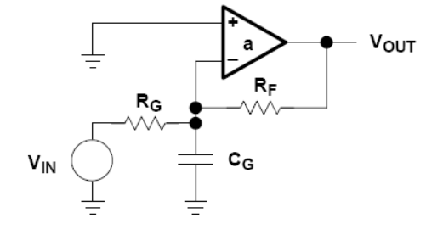
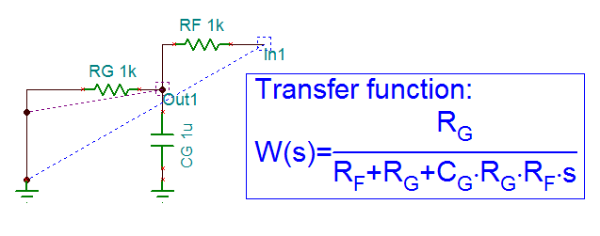
The C_{G} Problem
C_{G} is the parasitic capacitance between the inverting input and ground
Tina analysis shows that a pole is created.
If C_{G} is big enough, the pole can be low enough in frequency to cause instability.

Slide 12
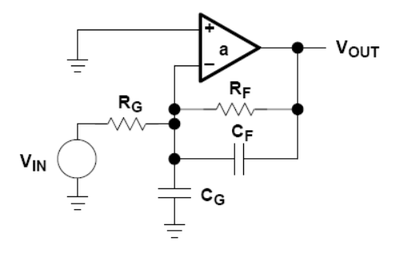
The C_{F} C_{G} Cancellation
If R_{G}C_{G} = RFCF,
Loop gain and close loop gain will ignore the effect of C_{G} and C_{F}.
To achieve such cancellation, C_{F} would have to be a PCB trace that is manually trimmed.

Slide 13
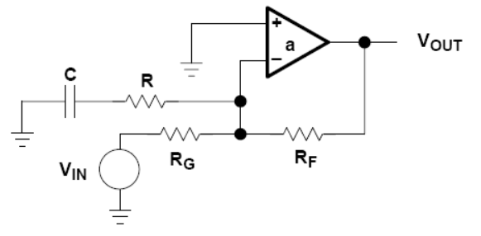
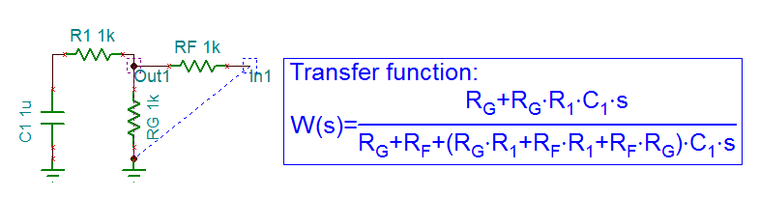
Lead-Lag Compensation (Circuit Analysis)
Feedback generates a zero and a pole:
It can be shown that:
pole < zero

Slide 14
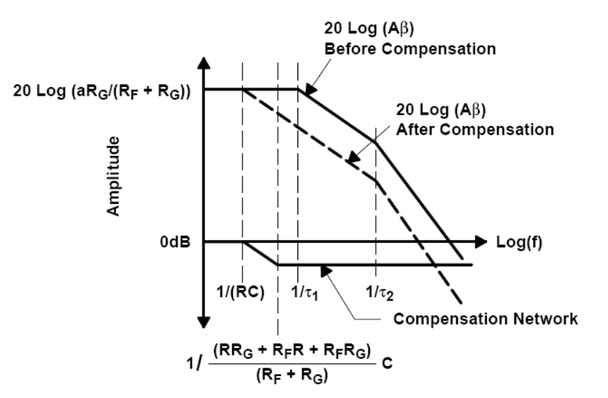
Lead-Lag Compensation (Bode Plot)
The pole and zero leads to no net phase change, but loop gain approaches unity faster.

Slide 15
Lead-Lag Compensation (Closed Loop Gain)
Ideal Equation:
The RC network is placed across a virtual ground, so that ideally there is no effect on close loop gain.

Slide 16
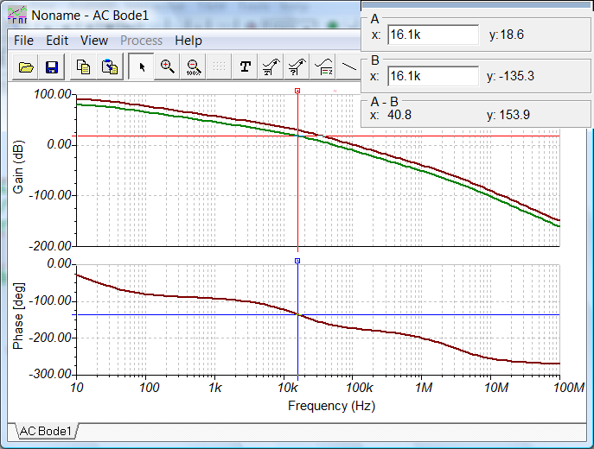
Lead-Lag Compensation (Additional Notes)
The extra RC components decrease the open loop gain as frequency increases. So the close loop gain (1/B) will increase with frequency due to RC.
One way to compute a value for RC is to target a certain amount of open loop gain reduction at a certain frequency.
Un-compensated open loop gain
In the above Bode plot, if we can reduce the loop gain by 16 dB, and not change the phase, the phase margin will be 45 degrees. We then select R and C to achieve this.

