Slide 1
Op Amps for Everyone
CH 8 --- Current-Feedback Op Amp Analysis

Slide 2
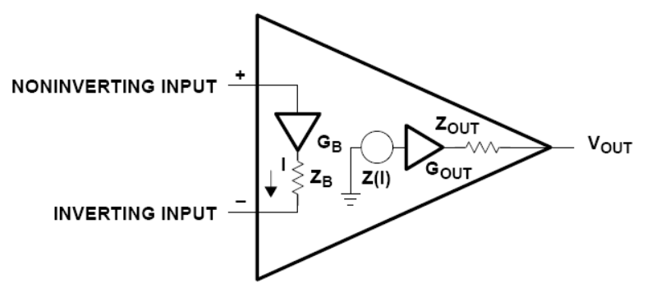
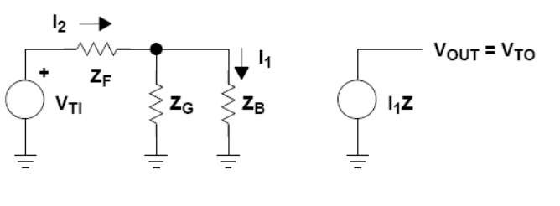
CFA Model
G_{B} and G_{OUT} around 1
Z_{B} usually < 50 ohm
Z = Transimpedance
Measured in (V/A) = Ω

Slide 3
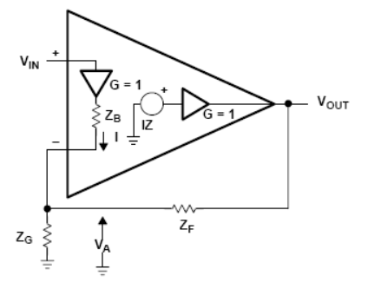
Non-inverting CFA Circuit Analysis

Slide 4
Non-inverting CFA Ideal Equation
Requirements:
Z_{B} the input buffer output impedance is zero
Z the transimpedance is very high
CFA departs from the ideal more than the VFA does

Slide 5
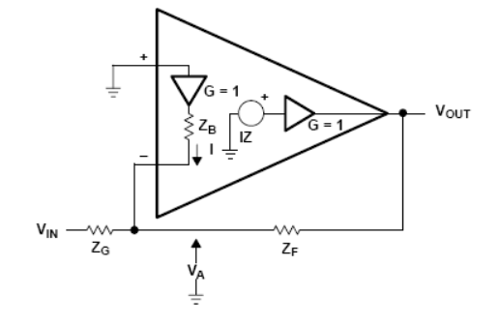
The Inverting CFA Ideal Equation
Note the input resistance seen will be (Z_{G} + Z_{B} || Z_{F})
CFA is not good for the differential amplifier configuration due to the input impedance mismatch

Slide 6
Loop Gain Equation

Slide 7
CFA Stability
Z has two poles just like voltage op amps
Z_{F}, Z_{B}, and Z_{G} reduce Z so that the loop gain cross unity at phase < 180 degrees
Z_{B} is internal and Z_{G} has little effect
Z_{F} is the key component to be adjusted
Datasheet will advise an optimal value for Z_{F} . A higher Z_{F} will increase stability but decrease bandwidth.

Slide 8
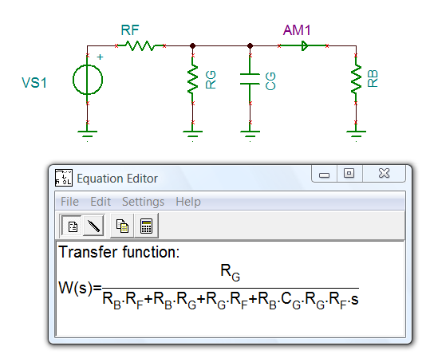
Stability and Input Capacitance
Tina analysis of adding input capacitance in parallel withC_{G}
Pole location:
Large enough C_{G} will move pole to lower frequency, adding phase and creating instability
W(s) = AM1 / VS1
Loop gain will be W(s) * Z

Slide 9
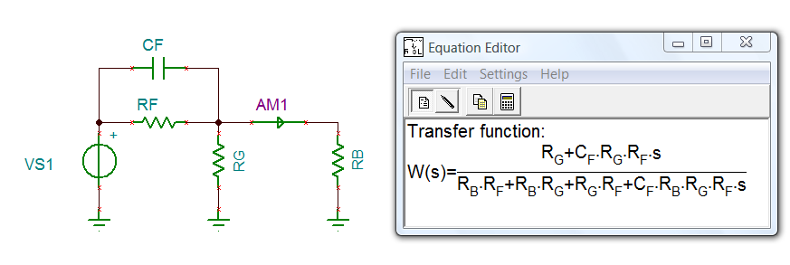
Stability and Feedback Capacitance
Tina analysis of the feedback circuit with a capacitor in parallel with R_{F} , W(s) = AM1 / VS1
Full loop gain equation is W(s) * Z.
The zero will occur before the pole, so the loop gain AB will cross unity later.
Large enough C_{F} will make AB cross unity later, thus creating instability.
Even small values of CG and CF are bad for stability, so layout is critical.

