Slide 1
Op Amps for Everyone
CH 10 – Op Amp Noise Theory and Applications

Slide 2
Noise Characterization
Signal-to-Noise Ratio:
Multiple Noise Sources

Slide 3
Noise Units
Units for noise = (V_{rms} / √Hz) or (A_{rms} / √Hz)
Example:
A TLE2027 op amp’s noise specification says 2.znV / √HZ
EIN = Equivalent input noise
Over a frequency of 20Hz to 20kHz, EIN = 2.5nV * (20,000 - 20)^{0.5} = 353.4 nV
If gain = 40 dB
Output noise = 353.4 nV * 100 = 35.34 uV
If output voltage of this op amp = 1V,
Signal to noise ratio = 20 * log₁₀ (1V / 35.34uV) = 89dB

Slide 4
Shot Noise
Other names: Schottky noise, quantum noise
Current flow is not a continuous effect. As each electron crosses a potential barrier, energy is stored and then released as the electron shoots across the barrier.
Each electron contributes a little pop as its stored energy is released.
Shot noise is:
Associated with current flow
Independent of temperature
Spectrally flat
Present in any conductor but most pronounced in semiconductors
Inversely proportional to the DC current

Slide 5
Thermal Noise
Also called Johnson noise
Heat disrupts electrons’ response to an applied potential
Thermal noise is
Spectrally flat
Independent of current flow
Directly proportional to temperature
Directly proportional to resistance – thermal noise is a problem in portable equipments that have increased the values of the resistors to reduce power consumption

Slide 6
Flicker Noise
Also called 1/f noise
May be related to imperfections in crystalline structure of semiconductors – better processing can reduce flicker noise
Flicker noise increases as frequency decreases
Flicker noise is directly proportional to DC current, so increasing resistor value can decrease it

Slide 7
Avalanche Noise
Occurs when a pn junction is operating in the reverse breakdown mode
Electrons have gained enough kinetic energy that when they collide with the crystal lattice, additional electron-hole pairs are formed
Similar to shot noise, but much more intense
The zener breakdown causes avalanche noise, so the noise is present where-ever zener diodes are.

Slide 8
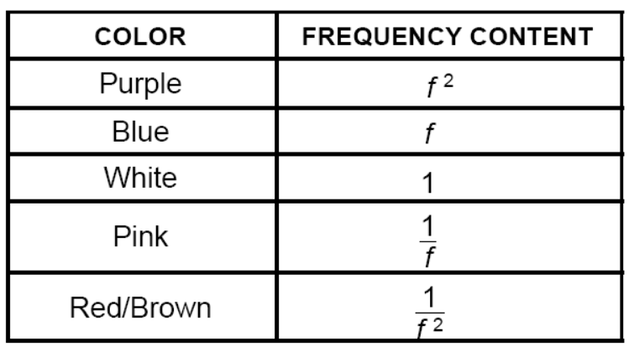
Noise Colors
1/f noise has equal energy per octave (or decade)

Slide 9
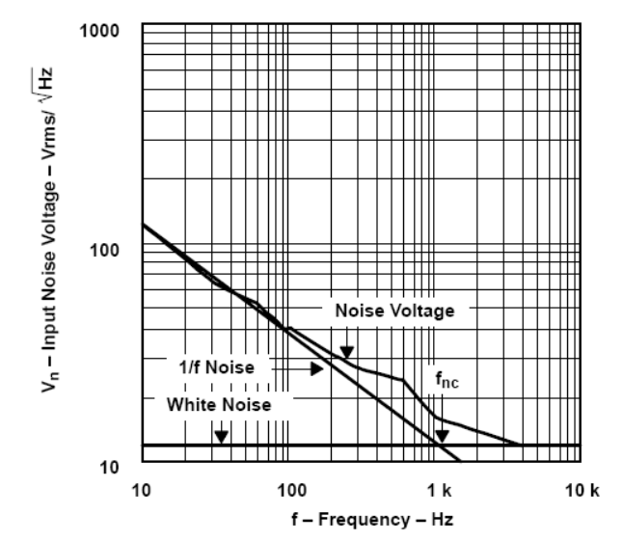
Op Amp Noise
Noise for TLV2772:
Op amp noise at low frequencies is pink noise, and at high frequencies is white

Slide 10
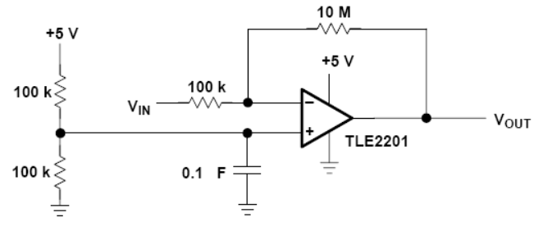
Common Circuit Problems
Large resistor values add thermal noise
Increasing input level, without increasing noise, can be used to swamp noise.
Forgetting to put bypass capacitors

