Slide 1
Op Amps for Everyone
CH 11 – Understanding Op Amp Parameters

Slide 2
Typical, Min, Max Values
Typical values are mean of the bell shape curve
Texas Instrument uses ±6 to define minimum and maximum values

Slide 3
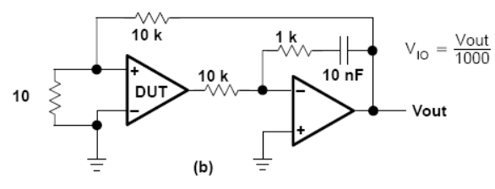
Input Offset Voltage (V_{IO})
This is whatever voltage required at the input to make the output zero.
This is of concern when DC accuracy is required
Bipolar input op amps better than JFET or CMOS input op amps in terms of input offset voltage
Measurement method:
The second op amp makes output of first op amp zero.

Slide 4
Input Current (I_{IB})
This is the current going into the Op Amp’s Input.
This is of concern when the source impedance is high. The current loads the source and changes output voltage.
CMOS and JFET inputs offer much lower input current than standard bipolar inputs.
Input offset current (I_{IO}) = I_{N} – I_{P}
In the case of bipolar inputs, offset current can be nullified by matching the impedance seen at the inputs.
CMOS and JFET input do not have offset current problem.

Slide 5
Maximum Output Voltage Swing (V_{OM±})
This is a design issue when dynamic range is lost if the op amp cannot drive to the rails. Example: input to an A to D converter.
For single supply op amps, the terminology changes to V_{OH} and V_{OL}
If op amp output is common emitter (bipolar), output swing is limited by the saturation voltage.
If op amp output is common source (CMOS), output swing is limited by the on resistance.

Slide 6
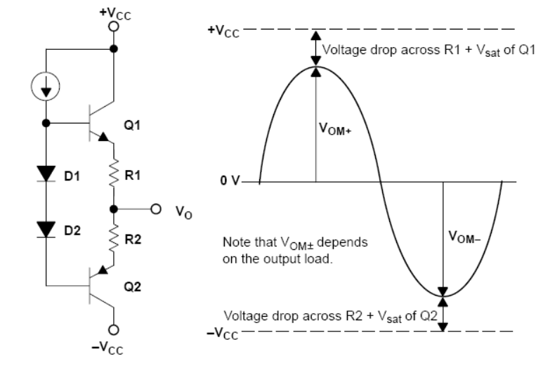
Maximum Output Voltage Swing (V_{OM±})
Emitter follower structure has reduced output range:

Slide 7
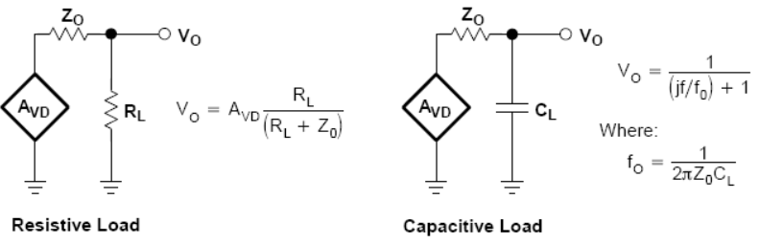
Output Impedance (Z_{O})
Emitter follower output stages have lower output impedance than common emitter (bipolar) and common source (CMOS) output stages.
If the load is resistive, output impedance limit how close to the rails the output can go.
If the load is capacitive, output impedance will combine with the load to create phase shift that might erode phase margin.

Slide 8
Common-Mode Rejection Ratio (CMRR)
Bigger is better for this ratio
This is the ratio of differential voltage amplification to common-mode voltage amplification (A_{DIF} / A_{COM})
CMRR falls off as frequency increases
Common source of common-mode interference is the 50 Hz or 60 Hz AC noise.

Slide 9
Supply Voltage Rejection Ratio (k_{SVR})
AKA power supply rejection ratio (PSRR)
Bigger is better for this ratio
The ratio of power supply change to output voltage change (ΔVDD / ΔVOS)
It falls off as the frequency increases
Switching power supplies produce noise frequencies from 50 kHz to 500 kHz and higher. k_{SVR} is so bad at these frequencies that noise from power supply will appear as noise on output.

Slide 10
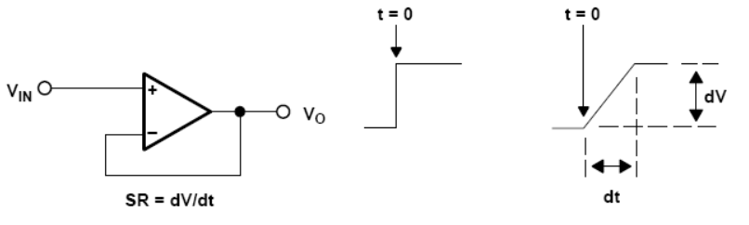
Slew Rate at Unity Gain
This is the rate of change in the output caused by a step input, in V/us or V/ms.
Having an internal compensation capacitor will greatly limit the slew rate.
Non-compensated op amps have great slew rate and bandwidth, but the designer must ensure stable operation.
Increasing op amp bias current will increase slew rate.

Slide 11
Total Harmonic Distortion Plus Noise
Ideally, if the input is a pure sine wave, the output is a pure sine wave as well.
THD+N is the ratio of all other frequency components to the fundamental:
Two major reasons for distortion are the limit on output voltage swing and slew rate.

Slide 12
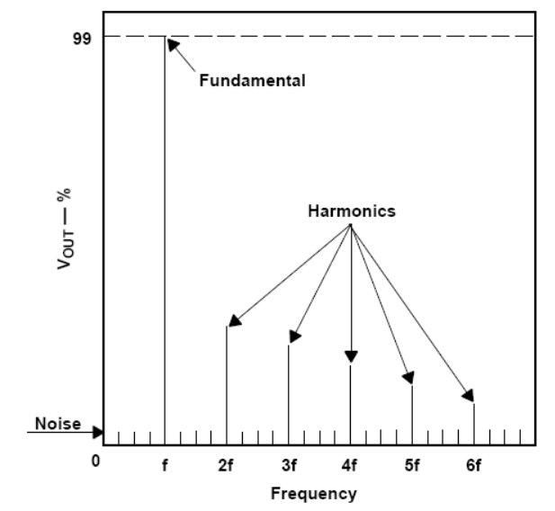
THD+N Example
In this case, fundamental is 99%, so THD+N = 1%

Slide 13
Unity Gain Bandwidth and Phase Margin
Unity Gain Bandwidth (B₁) – the frequency at which A_{VD} = 1
Gain Bandwidth Product (GBW) = A_{VD} * f
This is constant for voltage-feedback op amps
Phase Margin at Unity (φ_{m}) = 180º - φ @ B₁
Gain Margin (A_{m}) = 1 – Gain @ 180º phase shift
Maximum Output-Swing Bandwidth (B_{OM}) – the bandwidth over which the output is above a specific value
B_{OM} = f_{MAX}, while V_{O} > V_{MIN}

Slide 14
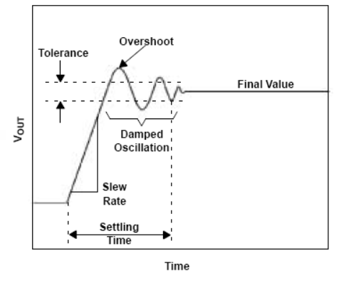
Settling Time
When the input under goes a step change, the total settling time includes the effects from the slew rate limitation and the oscillations that occur as the output approach a new value:
Step input changes can occur when the op amp input is some multiplexer’s output, and the multiplexer changes channels.

