Slide 1
Op Amps for Everyone
CH 14 --- Interfacing D/A Converters to Loads (Section 14.3.4 Only)

Slide 2
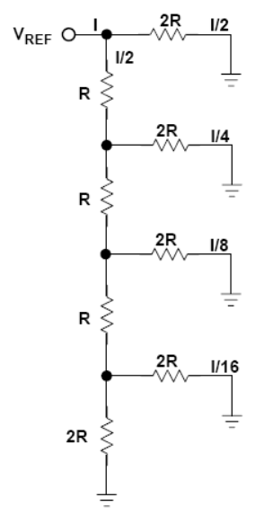
The R/2R D/A Converter (Circuit Theory)
In this resistor divider network, the current is divided by two at every junction.
RED = I/2
ORANGE = I/4
YELLOW = I/8
GREEN = I/16

Slide 3
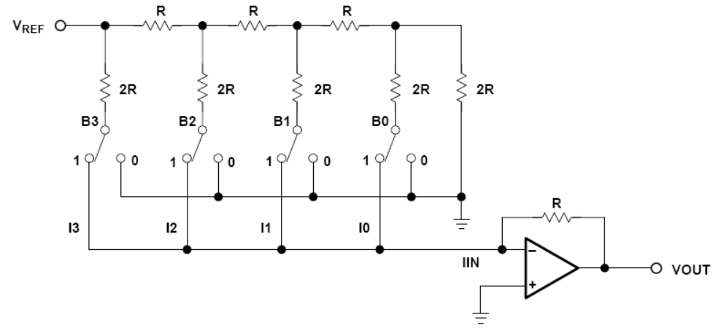
The R/2R D/A Converter (Circuit)
No matter how the switches are flipped, the gold 2R resistors are connected to actual ground or virtual ground.
The switches determine how much of the (I/2, I/4, I/8, I/16) current will flow through green resistor R to create the output.

Slide 4
Important Op Amp Parameters for Resistor Ladder D/As
Input offset voltage --- any voltage offset will add to the D/A converter’s error
Input bias current --- any bias current, times output feedback resistor, adds to output offset error
Output voltage swing --- it needs to meet or exceed the zero to full scale swing of the D/A converter
Settling time and slew rate --- needs to be at least as fast as the input to the D/A converter

