Slide 1
Input Filtering
Based on “Switch-Mode Power Supplies, SPICE Simulations and Practical Designs”, by Christophe Basso
Last updated May 28, 2009

Slide 2
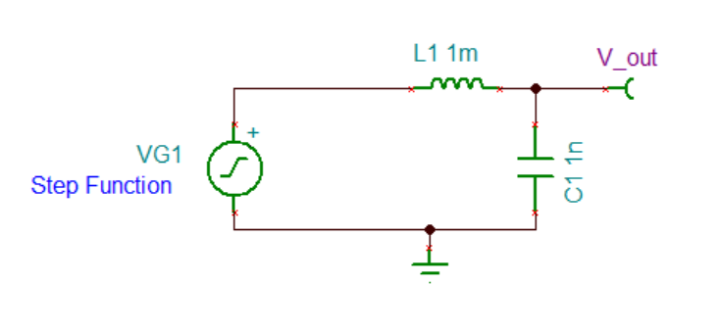
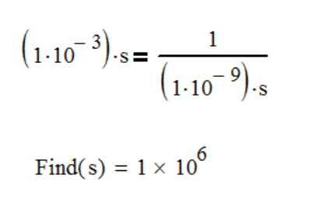
LC Oscillation
The input filter is an RLC circuit, so we start by looking at its properties.
The step response of an L and a C will oscillate at a frequency determined by (Ls) = 1/(Cs). If there is no loss, the oscillation is forever as energy moves back and forth between the L and the C. The inductor’s momentum keeps charging V_{out} as it rise from zero past V_{G1} , and also keep discharging V_{out} as it falls below V_{G1} .

Slide 3
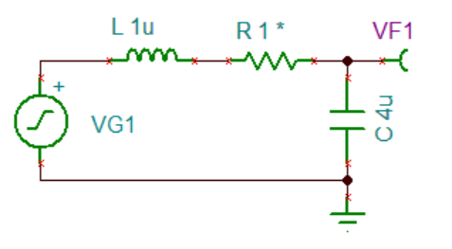
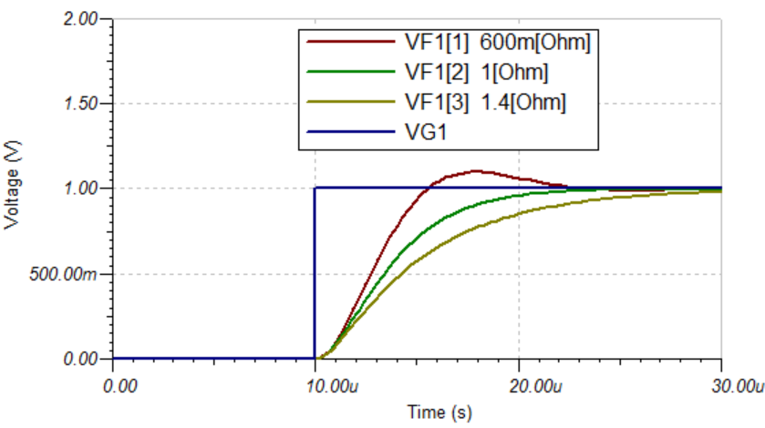
LRC Damping Factor (Zeta)
Zeta | Output
Zeta > 1 | Over damped (slow)
Zeta = 1 | Critically damped
0 < Zeta < 1 | Under damped (overshoot but decays)
Zeta = 0 | Output oscillates (no decay)
Zeta < 0 | Output diverges
If R goes negative, the response will diverge

Slide 4
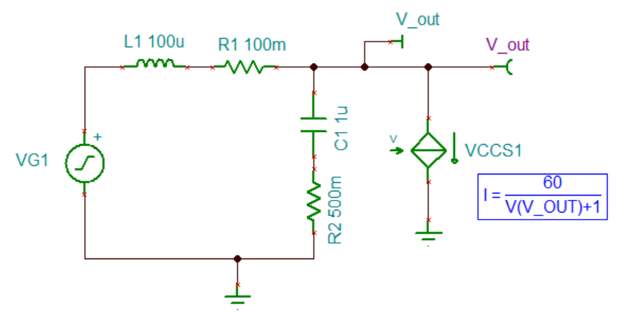
The Power Supply as a Load
The power supply acts as a negative resistor because when input voltage decrease, it will draw more current. Conversely, when the input voltage increase, it will draw less current.
The magnitude of the resistor representing the power supply is V_{in} / I_{in} . So as voltage decrease, the resistance magnitude decreases, while the sign is negative.
The power supply is simulated as a current source that draws constant power:

Slide 5
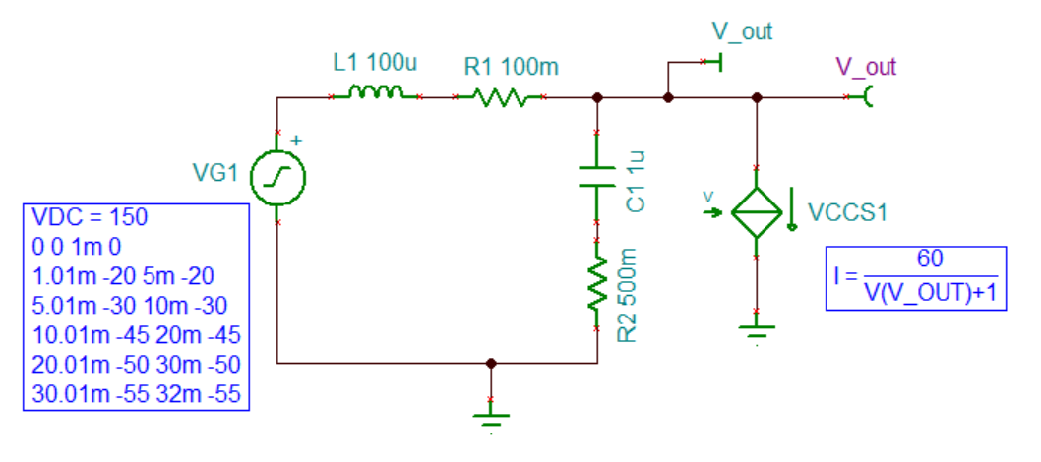
Tina 8 Simulation Settings
As the input voltage decrease, the magnitude of the resistance decrease, and eventually the V_{out} oscillates.
Below a certain input voltage, due to oscillation, there is no solution at DC. Therefore, the VG1 must be bias so that it has a sufficiently high voltage level to produce a DC bias point.
When running a transient simulation, select “calculate operating point” as a way to get initial node voltage values.

Slide 6
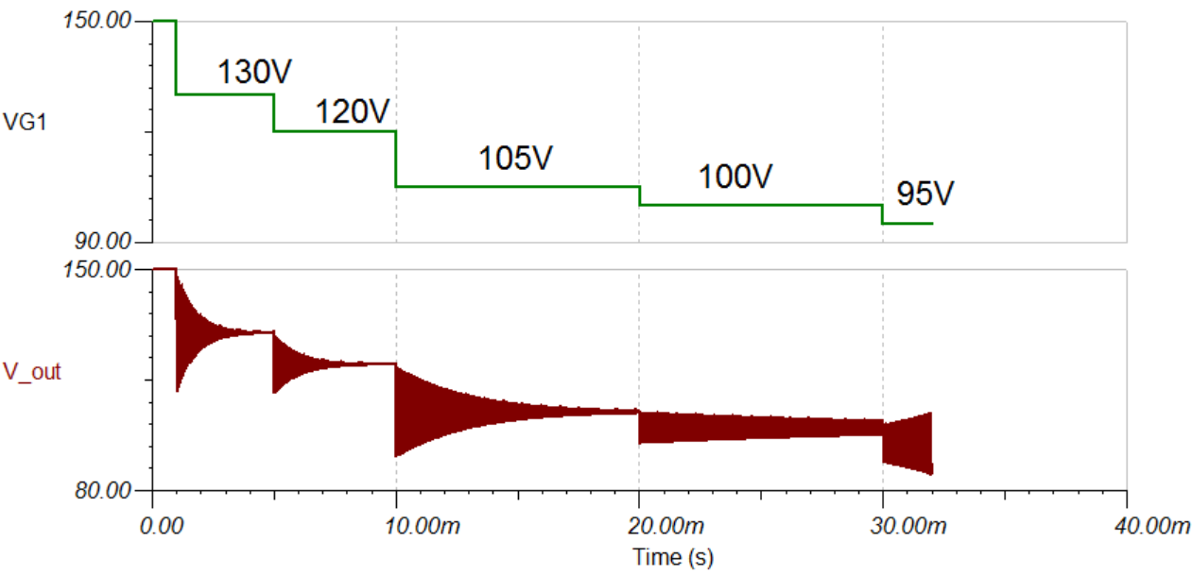
TINA 8 Simulation Results
Output starts to oscillate when input falls to 95V.

Slide 7
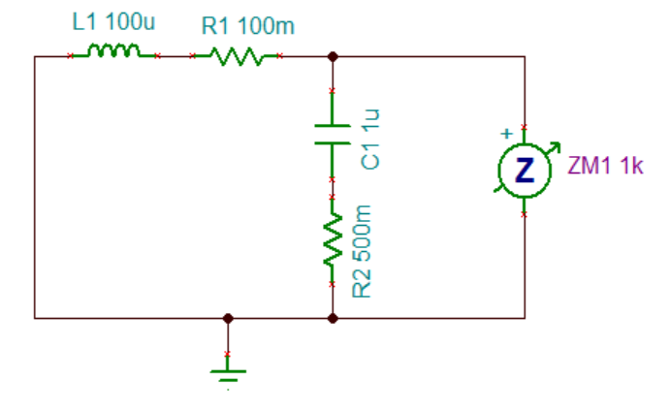
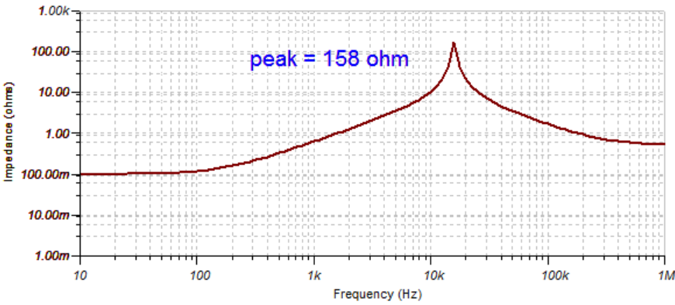
Filter Output Impedance Versus Power Supply Input Impedance
To avoid oscillations, the filter output impedance must be much smaller in magnitude than the power supply input impedance: Z_{outFilter} << Z_{inSMPS}
The total impedance of the filter is the smaller of the two impedances: (L1 + R1) // (C1 + R2). As frequency increase, the inductor leg’s impedance goes up, bringing up the total impedance. Eventually the capacitor leg’s impedance drops enough so that its decrease will bring down the total impedance.
When P = 60W, Vin = 95V, Rin = 95/(60/95) = 150 ohm. This happens to be less than the 158 ohm peak and oscillation starts.

Slide 8
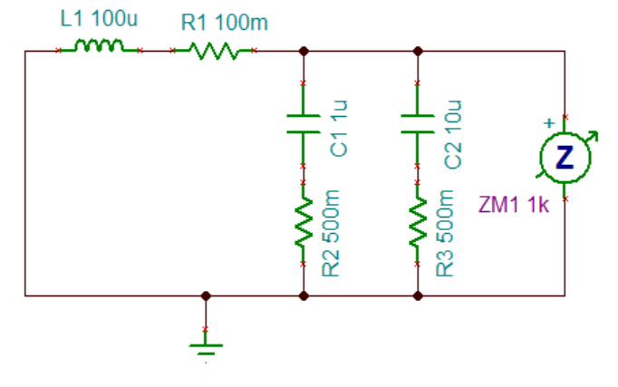
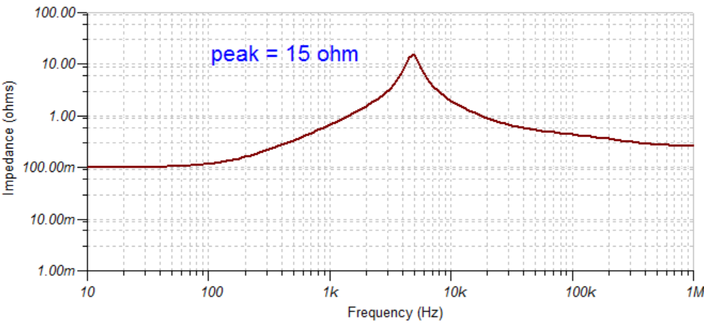
Input Filter Damping
Input filter damping can be done by decreasing L, so that the impedance grows slower with increasing frequency, or increasing C, so that the impedance falls faster with increasing frequency.
Increasing the capacitance by 10 times brings down the (C + R) curve by 10 times, resulting in a new peak impedance of 15 ohms.

Slide 9
Input Filter Attenuation
To calculate the attenuation, assume a 40 dB roll off from the corner frequency (w₀) set by the LC.
In equation form:
Attenuation A_{filter} needed at frequency w requires a corner frequency at w₀
1/100 attenuation require w₀ to be a 10 times lower frequency than w

Slide 10
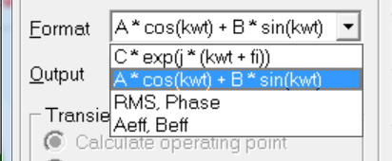
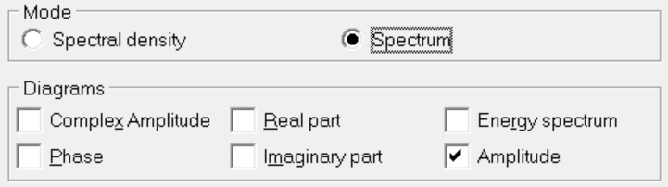
TINA 8 Fourier Series Settings
In Tina, when Fourier Analysis is used on a waveform, different output formats gives different results.
When the amplitude of a particular frequency component is wanted:
Fourier Series Window:
Fourier Spectrum Window:

Slide 11
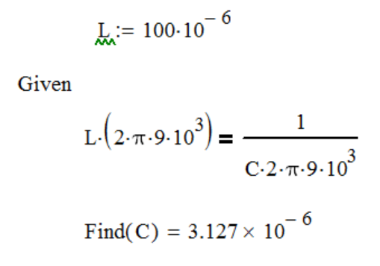
Input Filter Design Example
A Fourier analysis of the power supply input current shows an amplitude of 141mA at 100kHz, and the goal is to filter it down to 1 mA rms.
The 141mA amplitude / square root (2) = 99mA RMS. A 1mA RMS target means 100 times smaller, or 40dB attenuation
The LC corner frequency therefore needs to be at least 10 times lower than100kHz. Let’s choose 9kHz.
If L = 100uH:

