Slide 1
PWM Switch Model – The Voltage-Mode Case
Based on “Switch-Mode Power Supplies, SPICE Simulations and Practical Designs”, by Christophe Basso
Last updated May 30, 2009

Slide 2
References
Switch-Mode Power Supplies, SPICE Simulations and Practical Designs”, by Christophe Basso, CH 2.2 The PWM Switch Model – the Voltage Mode Case

Slide 3
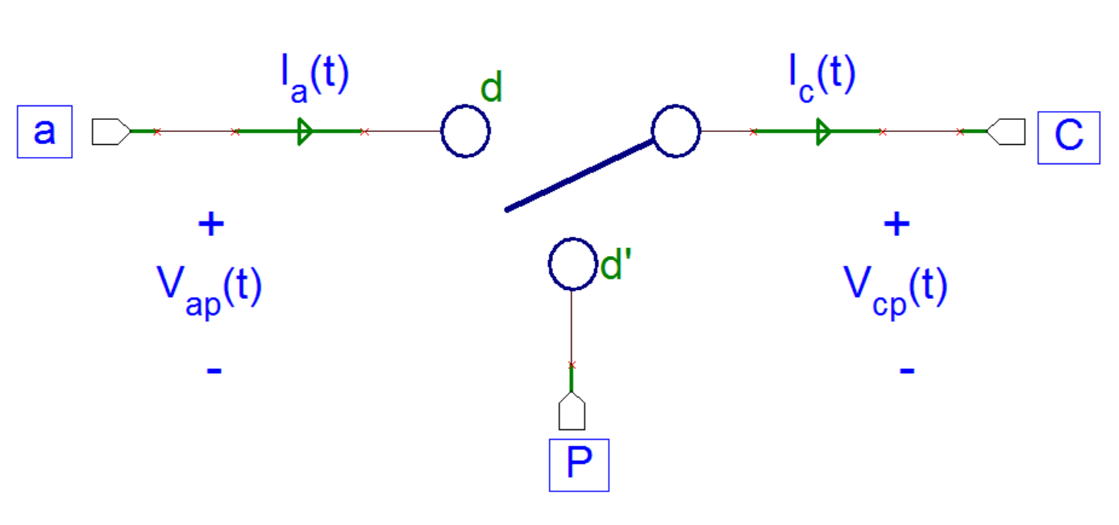
PWM Switch Model and Averaged Equations
CCM Equations:
(Continuous Conduction Mode)

Slide 4
DCM (Discontinuous Conduction Mode) Current Equations
I_{a}(t)
d₁
d₂
d₃
t
I_{c}(t)
t
Conclusion:

Slide 5
DCM Voltage Equations
d₁
V_{cp}(t)
d₃
d₂
V_{out} = V_{cp}
t
Conclusion:

Slide 6
DCM Mode d₂ Derivation
(from the “DCM Current Equations” slide)
Conclusion:

Slide 7
PWM Voltage Mode Model Equations
CCM
DCM
Limit d₂ to at most (1 – d₁), and the DCM equations will converge to the CCM equation.
To avoid dividing by zero, keep d₁ and the product d₁V_{ac} slightly above zero.

Slide 8
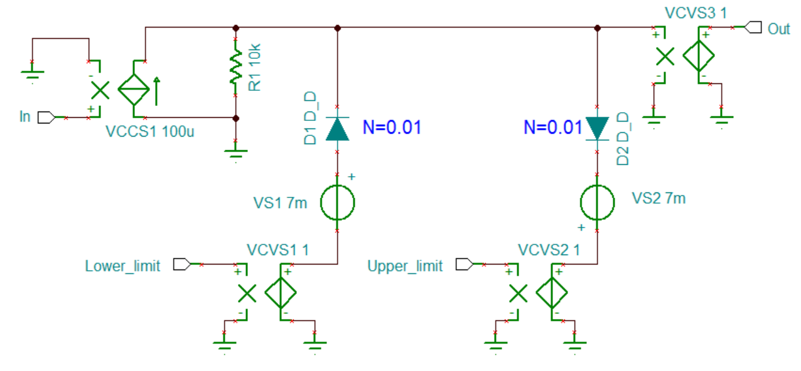
Clamping Circuit
clamp.TSC ; clamp.TSM
A general purpose clamping circuit – needed to clamp duty cycle d₁ to between 1 and 0, and d₂ to between 0 and 1-d₁

Slide 9
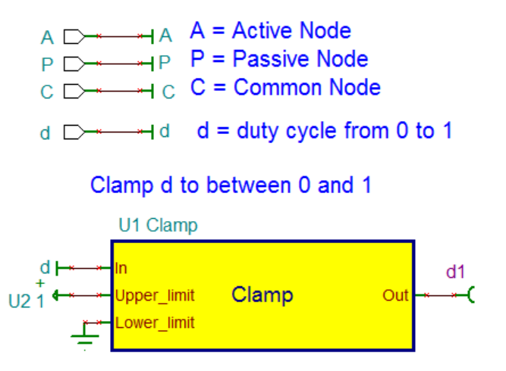
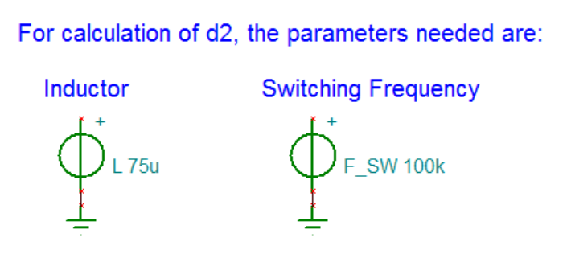
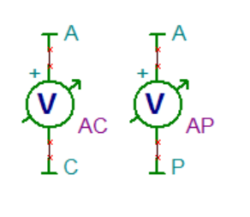
PWM Voltage Mode Model (1/2)
PWM_VM.TSC ; PWM_VM.TSM
Jumpers (like A, C, P) do not assign a value to the underlying net. Therefore, the jumper names are not accessible in the GUI for the control sources. That’s why voltage pins (like d1) and voltmeters are used. The output state of these measurement devices need to be set to “NONE”. Else they show up in the transient analysis.

Slide 10
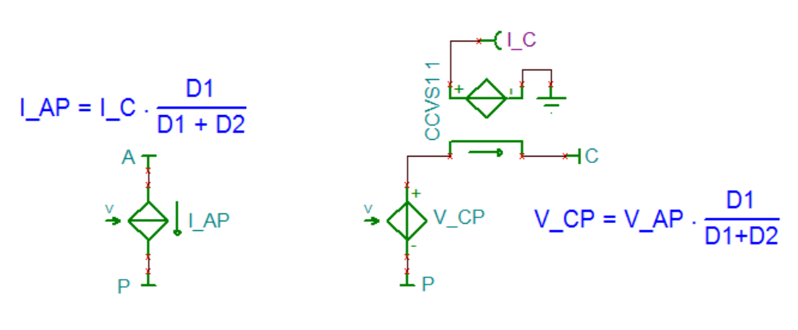
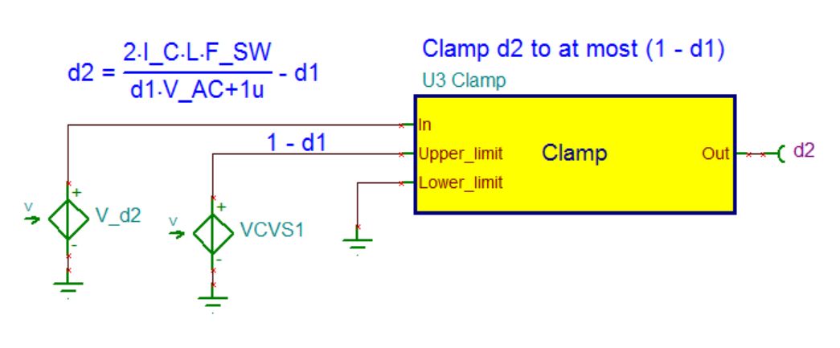
PWM Voltage Mode Model (2/2)

Slide 11
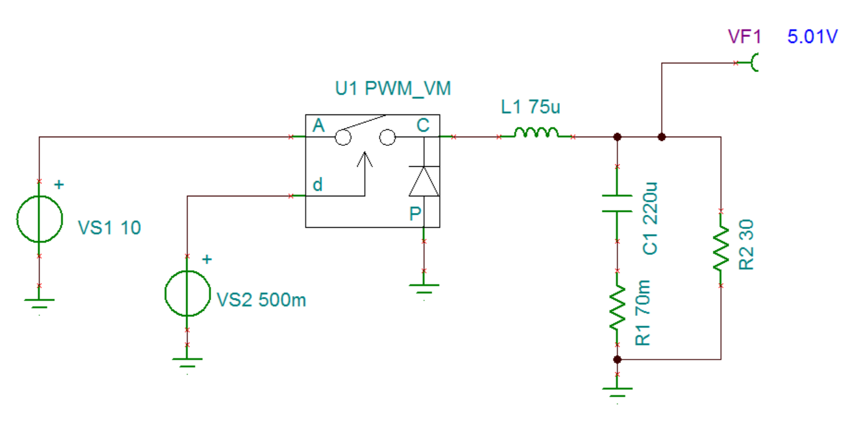
PWM Voltage Mode Test (open loop)

Slide 12
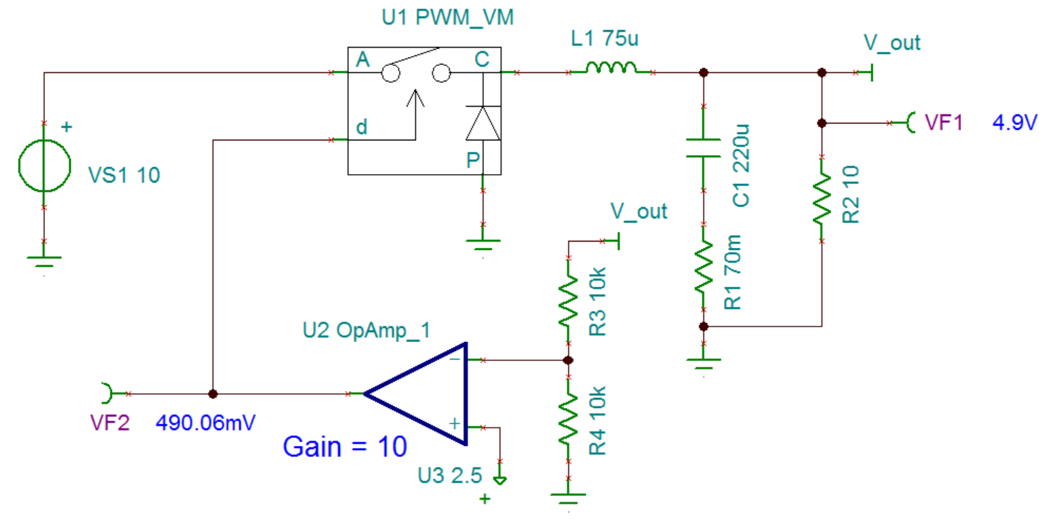
PWM Voltage Mode Test (Close loop)
The opamp gain has been reduced to 10 to illustrate that in a close loop system, the V_{out} / 2 does not match the 2.5V reference exactly. The error is amplified to drive the PWM switch.

Slide 13
PWM Modulator Gain
The model is accepting a voltage error between 0 to 1V. In an actual chip, the PWM error voltage is between 0 and the peak of the sawtooth signal used to generate the PWM.
If the peak of the sawtooth is 5V, the opamp error will go up to 5V to produce 100% duty, and the signal going into the model needs to be divided by 5 to scale it to the 0 ~ 1V range.
V_{error}
higher V_{error} produces larger duty cycle

