Slide 1
PWM Switch Model – The Current-Mode Case
Last updated May 31, 2009

Slide 2
References
“Switch-Mode Power Supplies, SPICE Simulations and Practical Designs, by Christophe P. Basso” CH 2-3

Slide 3
Current-Mode Basic Setup (1/2)
I_{L}
I_{peak}
S₁
S₂
t
dT_{sw}
d’T_{sw}
If equilibrium, then I_{L}(T_{sw}) = I_{L}(0):

Slide 4
Current-Mode Basic Setup (2/2)
I_{L}
I_{peak}
S₁
S₂
a
b
∆I_{L}(T_{sw})
∆I_{L}(0)
t
∆t

Slide 5
Current Mode Instabilities
From before:
Using S₂/S₁ = d/d’ ratio:
So when d > 0.5, the perturbation ∆I_{L}(nT_{sw}) will not die out.

Slide 6
Current Mode with a Ramp Setup (1/2)
I_{L}
V_{err}/R_{i}
b
c
S₁
S_{a}/R_{i}
S₂
∆I_{L}(0)
∆I_{L}(T_{sw})
∆t
The V_{err}/R_{i} and S_{a}/R_{i} are voltage levels (V_{err} and S_{a}) scaled to currents
For the standard line, there can be two equations from two ends of the switching period:

Slide 7
Current Mode with a Ramp Setup (2/2)
I_{L}
V_{err}/R_{i}
b
c
S₁
S_{a}/R_{i}
S₂
∆I_{L}(0)
∆I_{L}(T_{sw})
∆t
Similarly two equations for the perturbed line:
For the duration of ∆t:

Slide 8
Ramp Requirement for Preventing Instability
After much manipulation, the previous equations can give:
Once again, the ratio S₁/S₂ = d’/d, and stability is guaranteed at all operating cycles if:

Slide 9
Current-Mode in CCM Equations (1/2)
The voltage mode in CCM equations apply:
In current mode, the new issue is that the error amplifier output doesn’t get turned into duty cycle directly. Instead, the error signal sets a upper limit on the inductor current.
The current mode model uses V_{cp} = d * V_{ap} to determine the duty cycle. Then the inductor current I_{C} is computed.
A
C
d*I_{C}
I_{C}
P

Slide 10
Current-Mode in CCM Equations (2/2)
I_{L}
V_{err}/R_{i}
a
b
S_{a}/R_{i}
S₁
c
I_{C}
S₂
d’T_{sw}

Slide 11
Adding C_{s} to model sub-harmonic instability
The previously described CCM model does not produce sub-harmonic instability. The solution in the book is to put a capacitor between the C and P node. This capacitor “memorizes” the voltage level at C and P.
The capacitor C_{s} would resonate with output inductor L. The value is chosen so that the resonant frequency is at half of the switching frequency (w_{s}):
The book’s models will connect this capacitor in CCM, but disconnect it in DCM, because sub-harmonic instability does not occur in DCM.

Slide 12
Current-Mode in DCM Equations
I_{L}
V_{err}/R_{i}
a
b
S_{a}/R_{i}
S₁
S₂
I_{C}
d₁T_{sw}
d₂T_{sw}
d₃T_{sw}
Equations unique to the DCM are boxed.

Slide 13
Getting DCM Equation in CCM Format
The second ‘b’ uses a different expression than the first ‘b’
This equation becomes the CCM equation when d₂ = 1 - d₁

Slide 14
Voltage Mode Equations Recycled
The Equations for the voltage mode PWM DCM averaged state models can be used in the current mode unchanged.
What’s new in the current mode is that the duty cycle is not provided, and that doesn’t contradict with the voltage mode model.
The equation that connects the error amplifier to the duty cycle:
There is a circular relationship here. The d₂ is generated based on d₁, and d₁ is generated based on V_{cp} = V_{ap} *(d₁ …).

Slide 15
The Source of the Circular Reference
V_{err}/R_{i}
a
b
S_{a}/R_{i}
S₁
S₂
I_{C}
I_{Valley}
d₁T_{sw}
d₂T_{sw}
d₃T_{sw}
In the current mode model provided, d₁ is constrained only by:
But I_{valley} is not available without knowing d₁ because the averaged models only know I_{C}. SO there’s no way to get d₁ immediately.

Slide 16
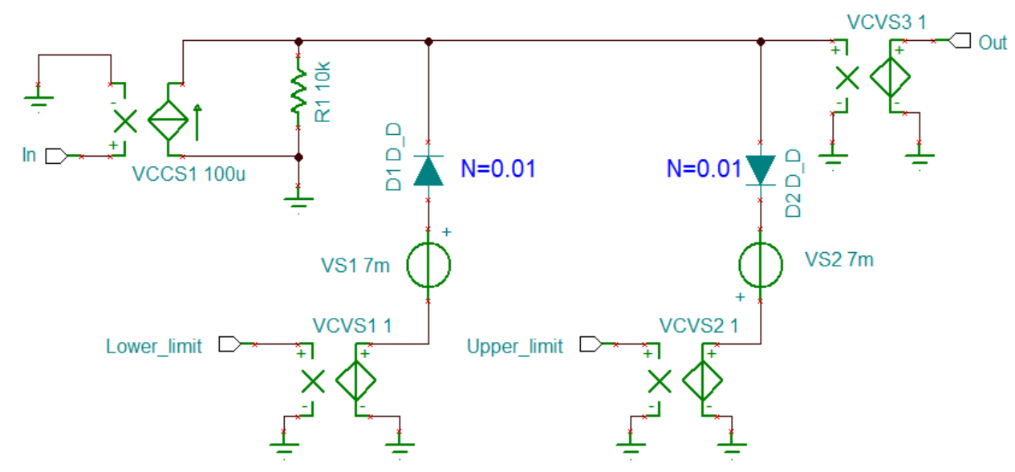
Clamping Circuit
clamp.TSC ; clamp.TSM
This is exactly the same Macro as the one used in the PWM_VM (voltage mode) circuit.

Slide 17
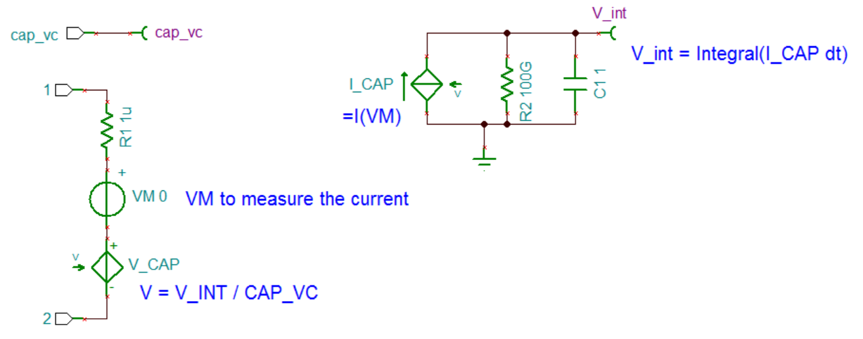
Voltage Controlled Capacitor Circuit
cap_vc.TSC ; cap_vc.TSM
This is used to implement the capacitor that goes between C and P, which is used to produce the sub-harmonic oscillation in the current mode model.
* C = cap_vc = value set by the user
* v_int produce the ∫ I dt by observing the voltage across a 1F capacitor.

Slide 18
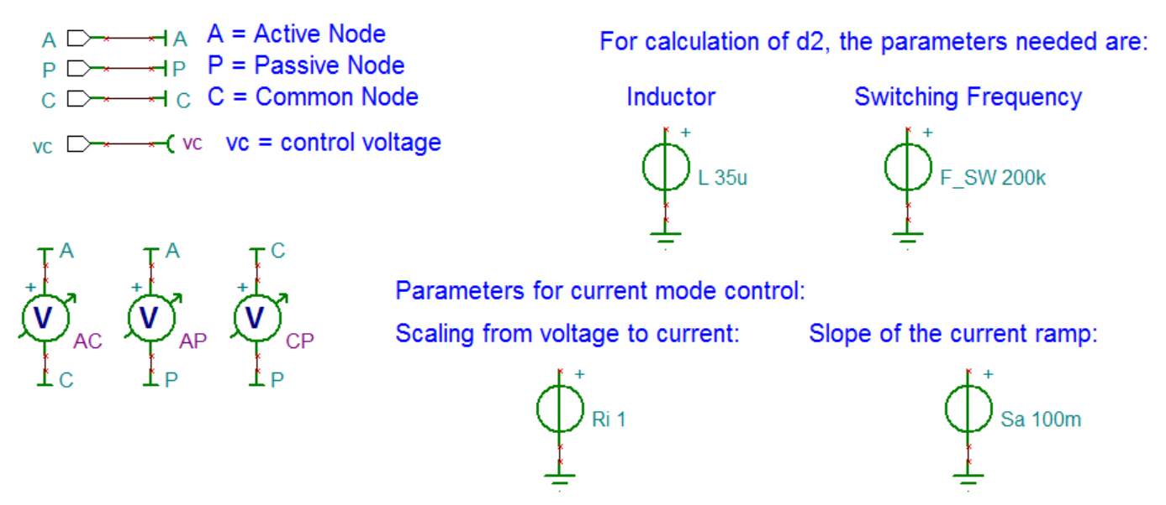
Current Mode PWM Model (1/3)
PWM_CM.TSC ; PWM_CM.TSM

Slide 19
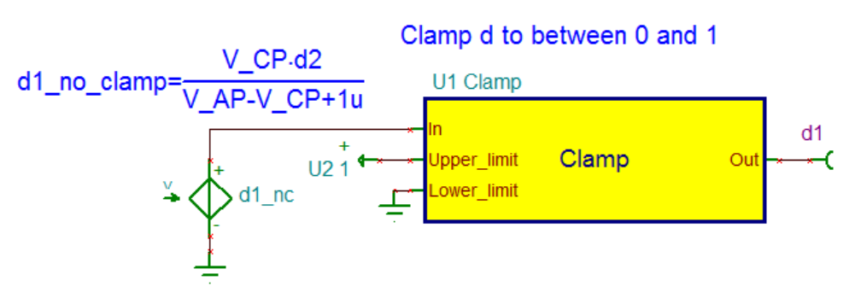
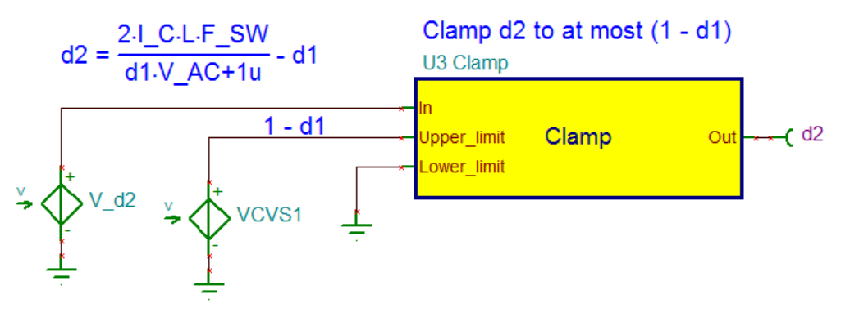
Current Mode PWM Model (2/3)

Slide 20
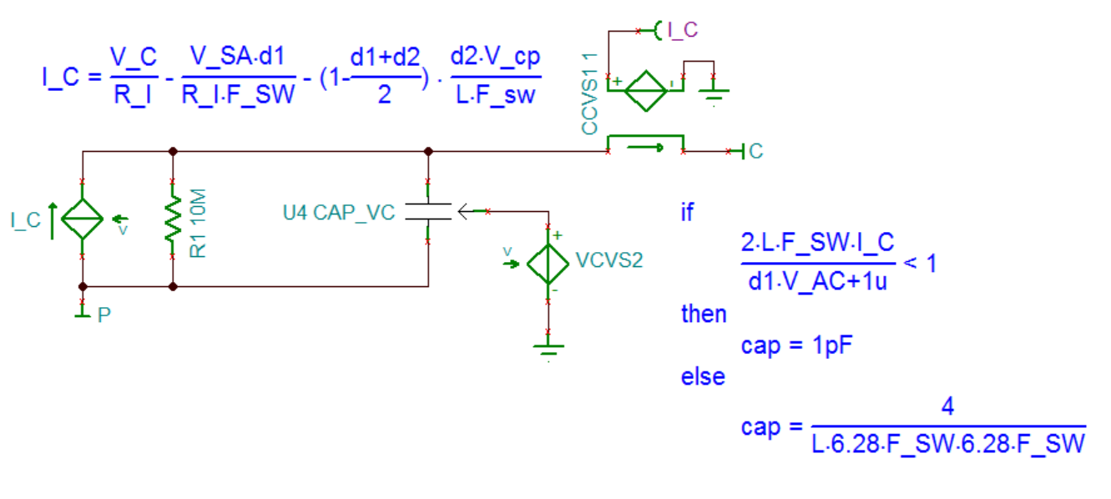
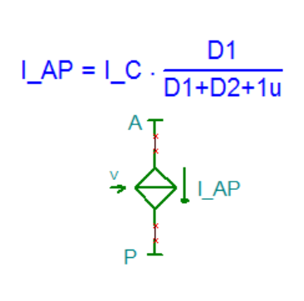
Current Mode PWM Model (3/3)
If moving between DCM and CCM, the U4 CAP_VC might cause convergence issues. If that happens, disconnect U4.

Slide 21
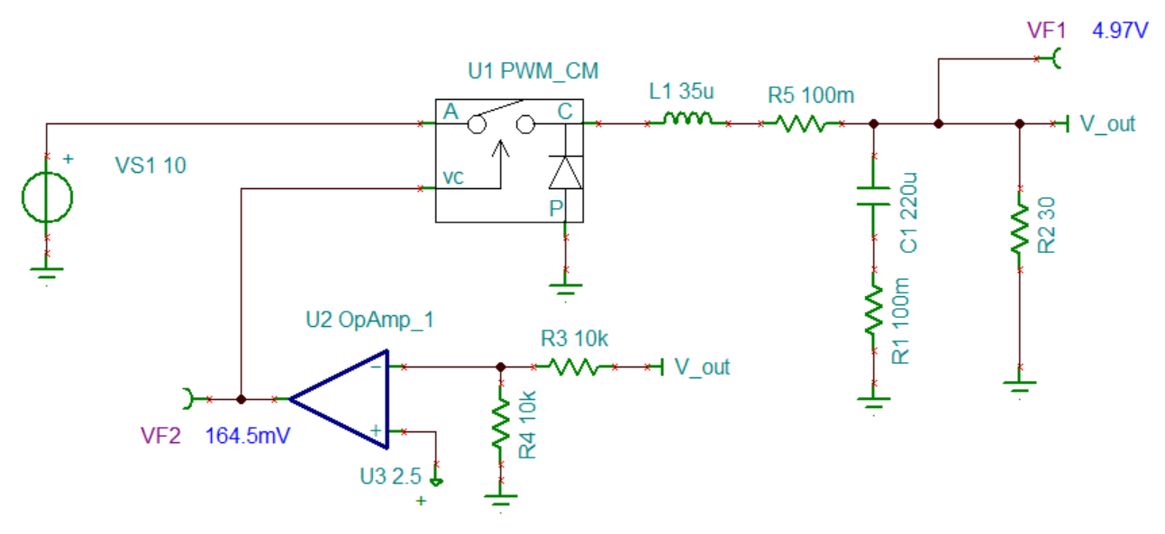
Closed Loop Test Example
Note op amp U2 gain = 10 in this example

Slide 22
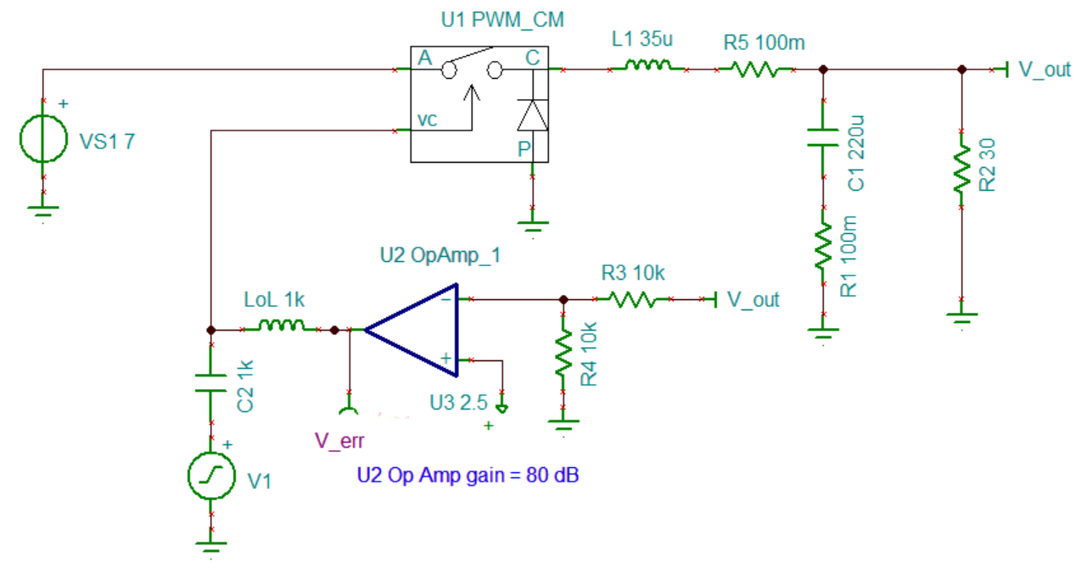
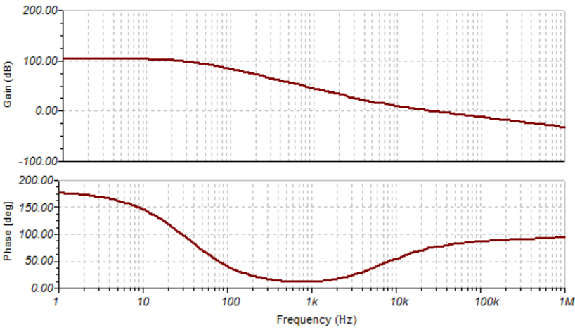
Loop Gain Test Example
The loop gain is taken from the AC excitation V1 to V_err:

