Slide 1
PWM Switch Model – The Border Line Conduction Case
Last updated July 4, 2009

Slide 2
References
Switch-Mode Power Supplies, Spice Simulations and Practical Designs, by Christophe P. Basso

Slide 3
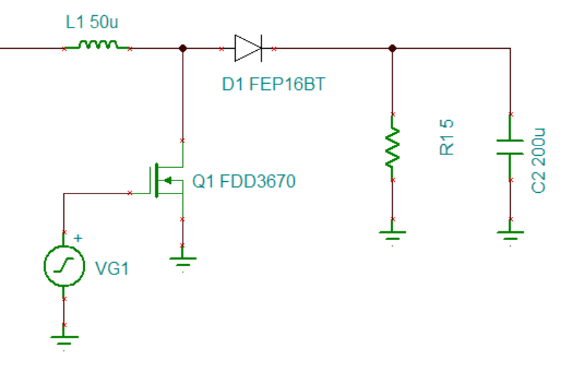
Diode Reverse Recovery Loss
Diodes have parasitic capacitances that require time to drain off when they go from on to off.
In a boost topology, this means that when the MOSFET Q1 turns on, it will see a VDS equal to output voltage until the D1 turns off (leaves forward bias).

Slide 4
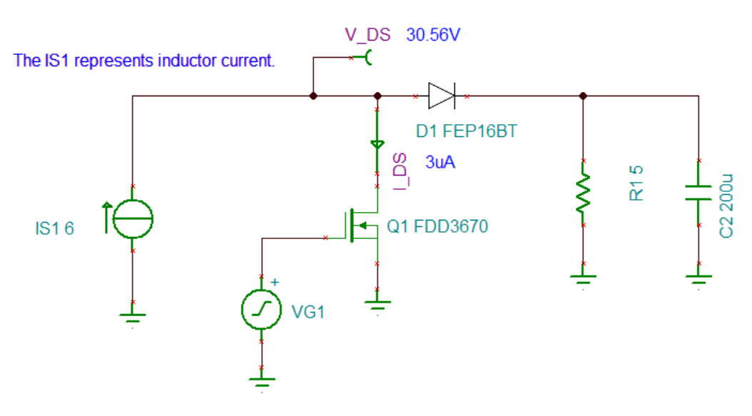
Switching Loss Example (1/2)
Diode = FEP16BT.TSM
MOSFET = FDD3670.TSM

Slide 5
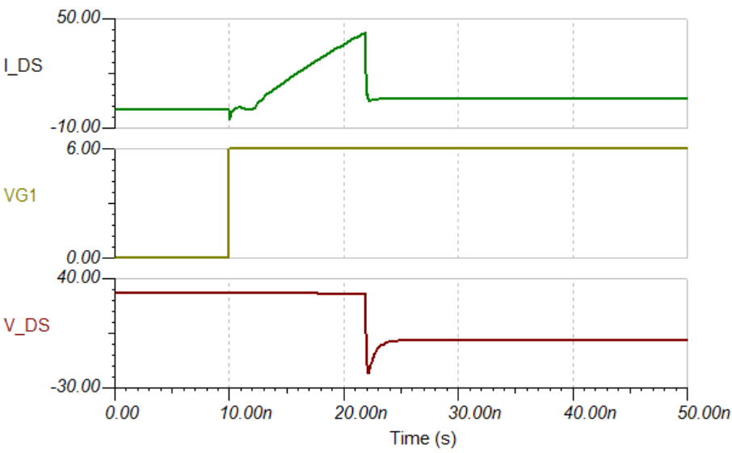
Switching Loss Example (2/2)
The diode is already an ultra-fast diode with minimum capacitance. Still, as long as even a slight current flows through the diode, the MOSFET V_DS will stay at output voltage levels.
When diode turns from off to on, the diode loss is minimum. The MOSFET loss is also minimum because it has zero voltage across it.

Slide 6
Zero Current Switching
In a boost converter, the output is greater than the input. If we wait long enough, the inductor current, which is also the diode current, will drop to zero. If the MOSFET is turned on at that point, then the diode can be switched off immediately because it will be out of its forward bias operation.
If we wait a bit longer after the inductor current goes to zero, the MOSFET parasitic interacting with the inductor can make the MOSFET V_{DS} drop, which will reduce switching loss even further. This is called valley switching.

Slide 7
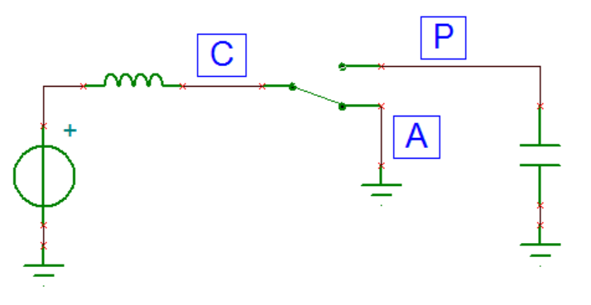
Borderline Conduction Steps
1. The power switch closes (node Active shorts to node Common)
2. In voltage mode, the switch on time is set by the error amplifier output. In current mode, the switch remains on until the inductor current reach a certain limit. The switch then opens (node Passive shorts to node Common).
3. Inductor current will decrease eventually to zero. When this current reach zero, the power switch closes again.

Slide 8
Borderline Conduction – The Voltage Mode Case
The borderline conduction mode is where the CCM meets the DCM. The CCM equations can be used as a starting point:
The error amplifier output determines the on time t_{on} . The duty cycles needs to be derived:

Slide 9
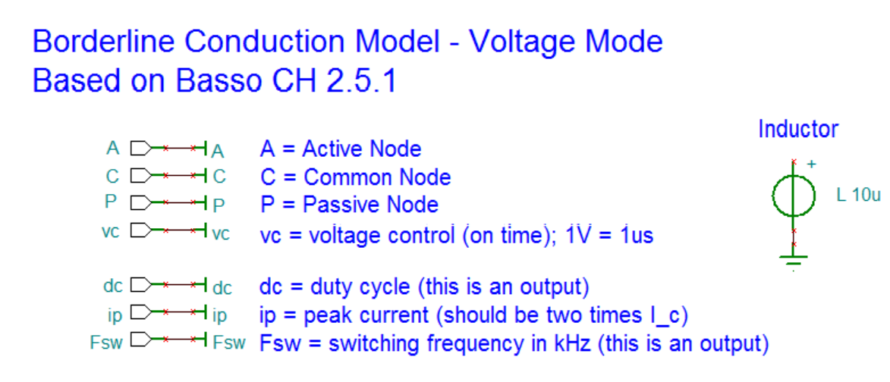
Tina Macro Implementation (1/3)
Files: PWM_BCM_VM.TSC, PWM_BCM_VM.TSM

Slide 10
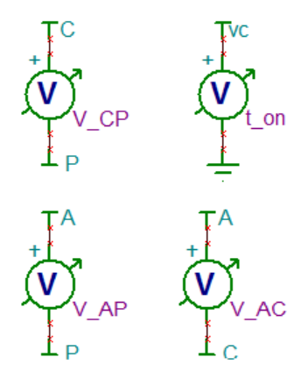
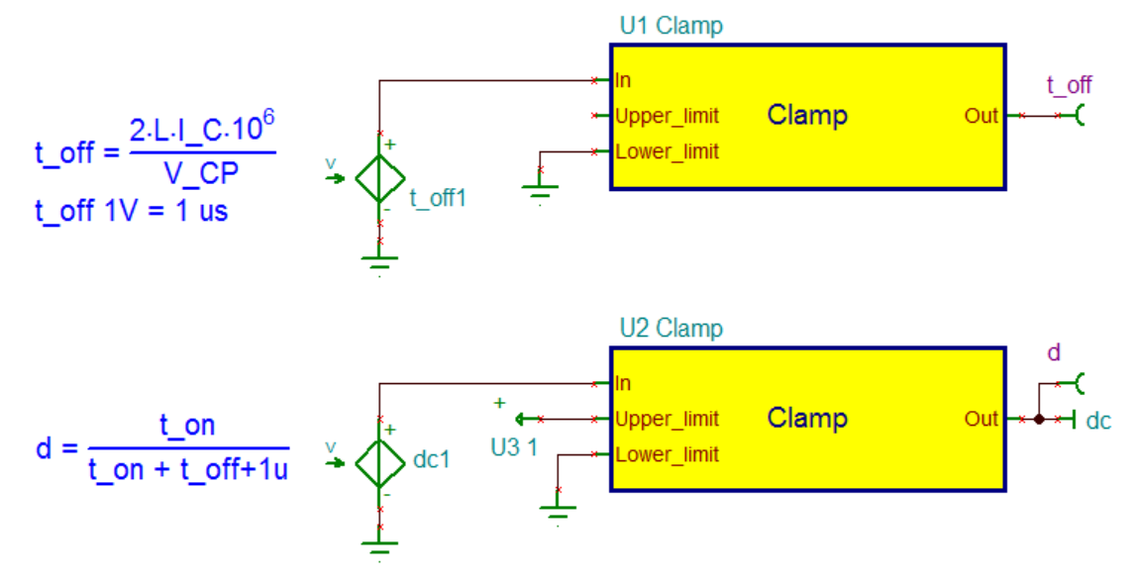
Tina Macro Implementation (2/3)

Slide 11
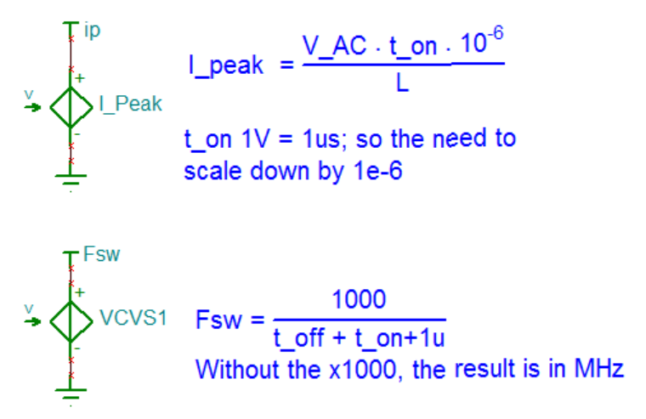
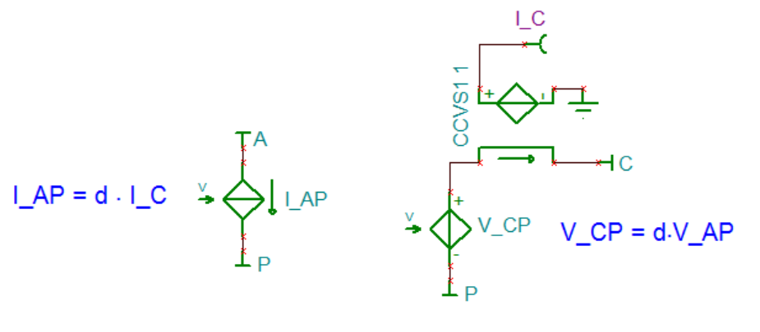
Tina Macro Implementation (3/3)

Slide 12
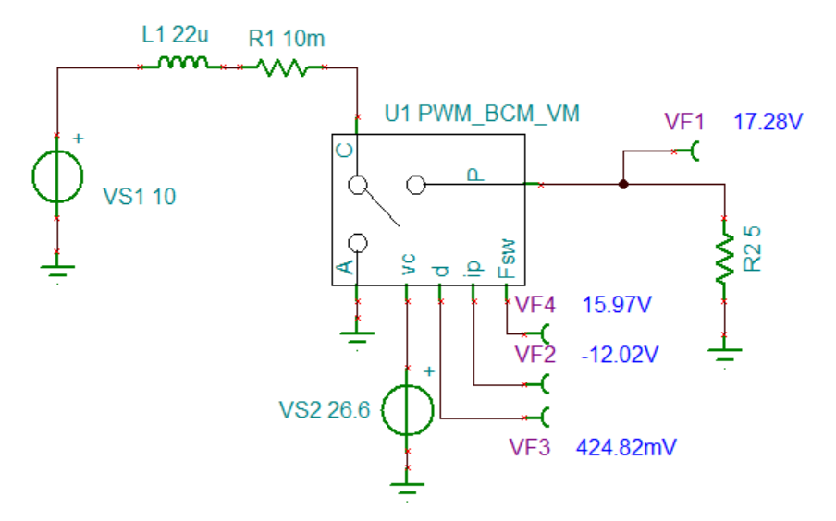
Trying out the BCM_VM Macro
F_{sw} = 15.97kHz
I_{peak} = 12A
duty cycle = 42.5%

Slide 13
Borderline Conduction – The Current Mode Case (1/3)
The current mode waveforms look just like the voltage mode waveforms, so the basic CCM model equations can be used:
The error voltage controls the peak current. The switch opens (swings to P) when the inductor current (I_{C}) reach the value set by the error voltage divided by the sense resistor (V_{err}/R_{i}).
The equation for I_{C}:
I_{C} peak value
I_{C} falling slope

Slide 14
Borderline Conduction – The Current Mode Case (2/3)
Equation for “T_{SW}”:
Equation for “d”:

Slide 15
Borderline Conduction – The Current Mode Case (3/3)
The Basso book first created a model that computes “d” and “T_{SW}”, then uses those two values to compute the I_{C}. Next the book says that this model has convergence problems. It then describes another model that uses the result:
d*T_{SW} would be the t_{on} . The second current mode model is same as the earlier voltage mode model, except the above equation is used to calculate the on t_{on} .
The “I_{C}” is assumed to be leaving the “C” node in the model derivation. In a boost configuration, the current is actually entering the “C” node. So the “R_{i}” needs to be negative in when using the model in a boost configuration.

Slide 16
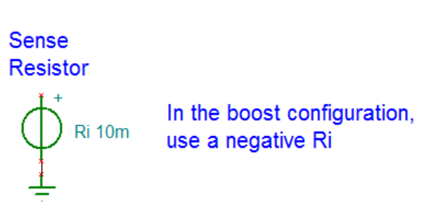
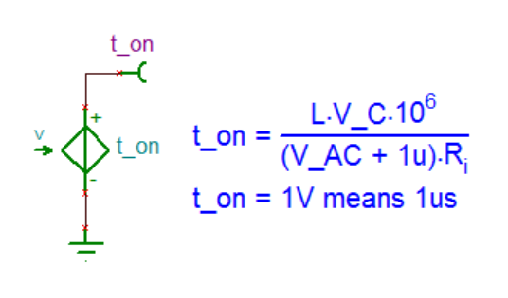
Tina Additions to the BCM-VM Model so to Create the BCM-CM Model
Files:
PWM_BCM_CM.TSC PWM_BCM_CM.TSM

Slide 17
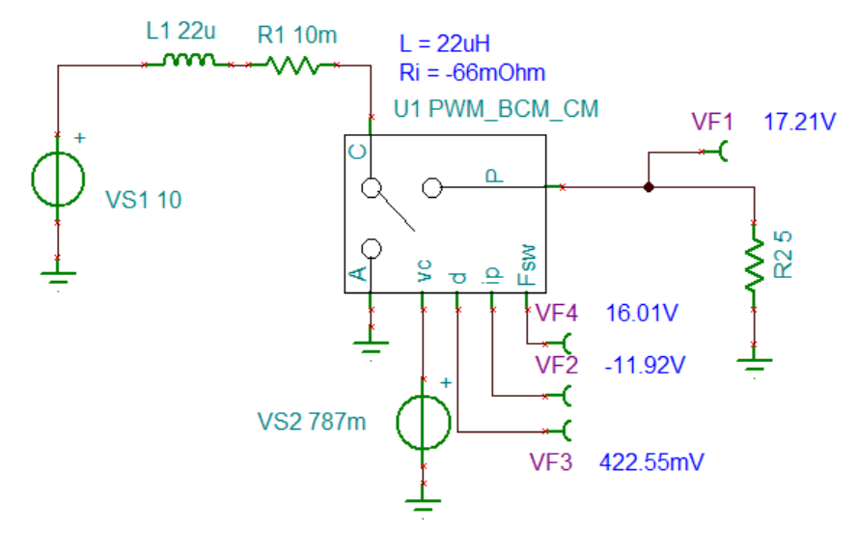
Testing out the BCM – Current Mode Model

