Slide 1
Feedback and Control Loops
Based on “Switch-Mode Power Supplies, SPICE Simulations and Practical Designs”, by Christophe Basso
Last updated Jan 28, 2009

Slide 2
References
“Switch-Mode Power Supplies, SPICE Simulations and Practical Designs”, by Christophe Basso, CH 4.2 Operational Amplifiers
“Switch-Mode Power Supplies, SPICE Simulations and Practical Designs”, by Christophe Basso, CH 3 Feedback and Control Loops

Slide 3
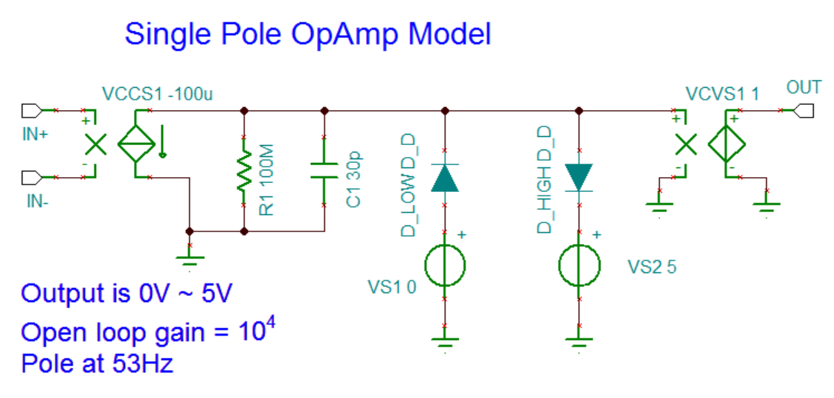
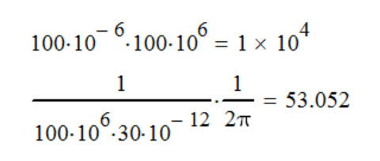
Op Amp Modeling (Single Pole)
The diodes and the voltage sources clamp the output. Use small N (0.01) for the diodes. Calculations for the open loop gain and pole:
op_amp1.tsc
op_amp1.tsm

Slide 4
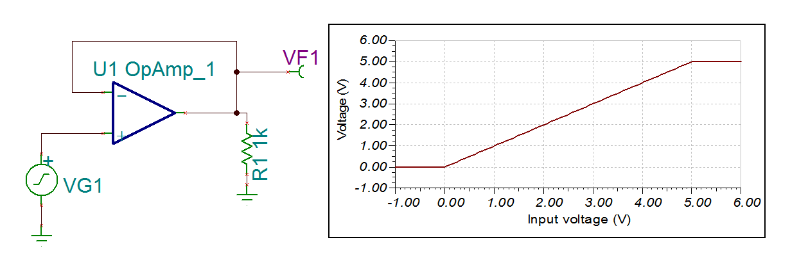
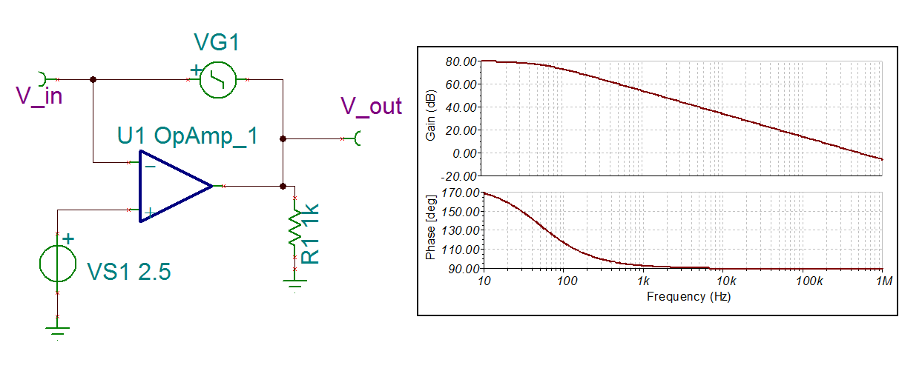
Op Amp Modeling (Test)

Slide 5
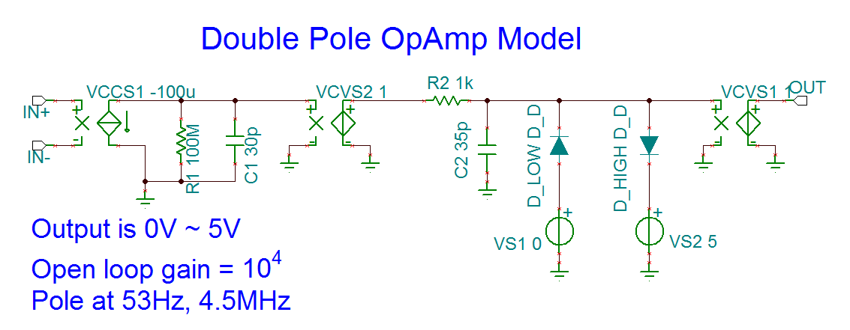
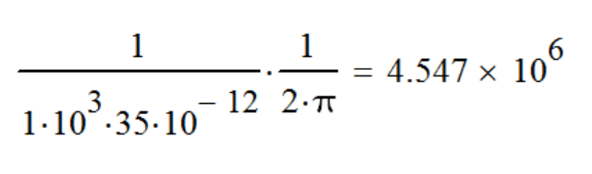
Op Amp Modeling (Two Poles)
The second RC (R2 and C2) forms a second pole.
op_amp2.tsc
op_amp2.tsm

Slide 6
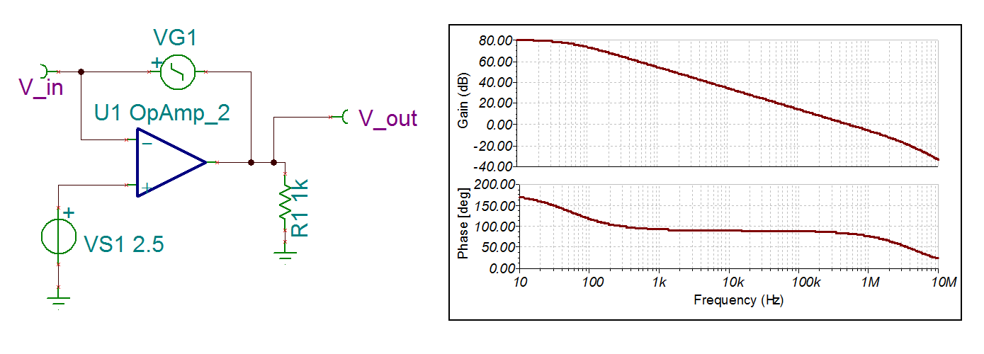
Op Amp Modeling (Test)

Slide 7
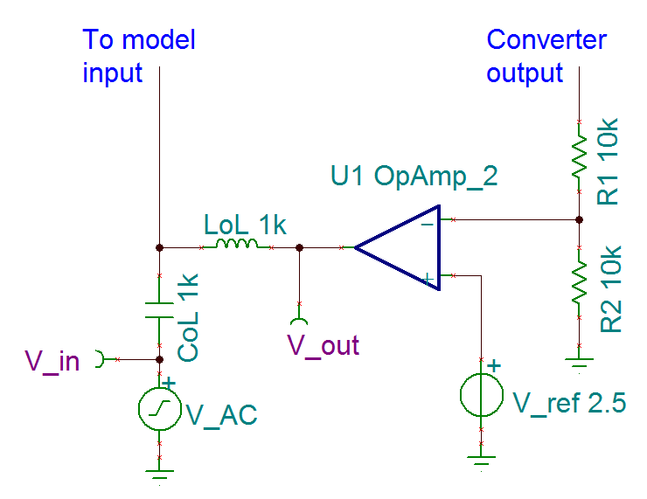
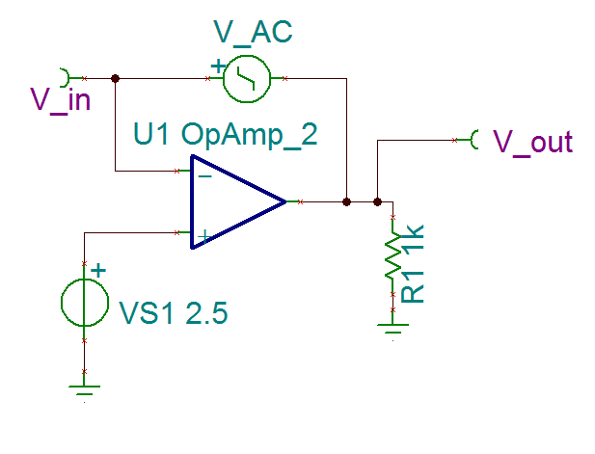
Loop Gain Measurement Observation Points
#1. One approach blocks out the AC from completing the loop and allows the DC to bias the loop. In LoL, oL means open loop.
#2. The more realistic approach simulates inserting a signal via a floating source (a transformer). The V_AC in this case needs to have the – connected to a low impedance point, and the + connected to a high impedance point.

Slide 8
Choosing the Crossover Frequency (f_{c})
Output voltage undershoot (V_{p}) due to load change (∆I_{out}) approximation:
This is true as long as the ESR is less than the reactance of C_{out} at the crossover frequency:
Higher f_{c} is less V_{p}
Undershoot depends on f_{c} , but the recovery time depends on the phase margin

Slide 9
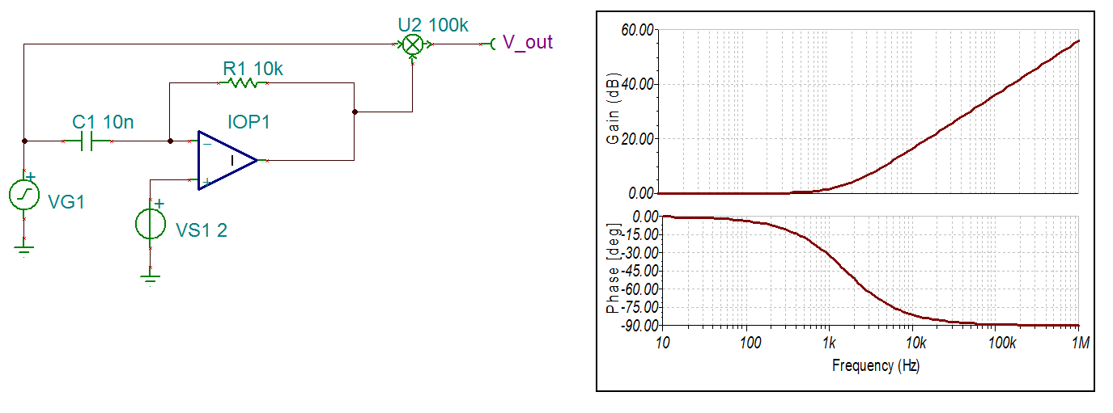
Right Half-Plane Zero
IOP1 is an ideal opamp
U2 is an adder.
These are hard to stabilize because they increase magnitude while reducing phase margin by 90 degrees. The usual approach is to roll of the gain and make the crossover frequency 30% or more lower than the zero frequency.

Slide 10
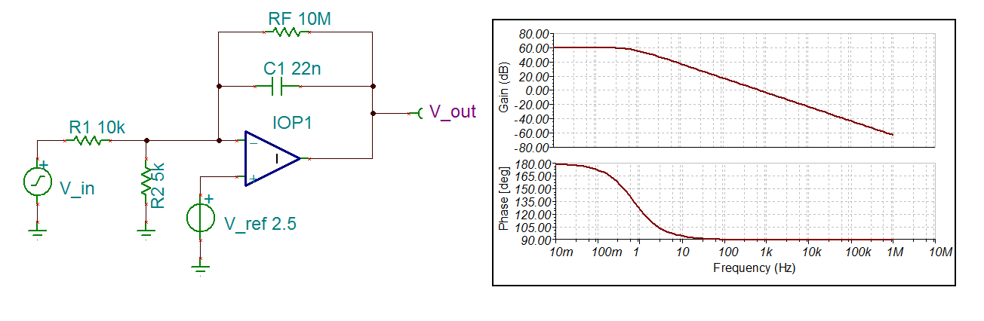
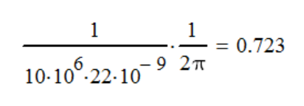
Type 1 Amplifier – Active Integrator (1/2)
V_in = 7.5V DC, plus a sine wave
IOP1 is an ideal op amp. Because it’s ideal, RF must be there to prevent gain from being infinite at DC and crashing the simulator.
The R2 disappears in the small signal analysis because both ends become virtual ground.
DC gain is 10M/10k = 10³ = 60 dB
Calculation of the pole location:

Slide 11
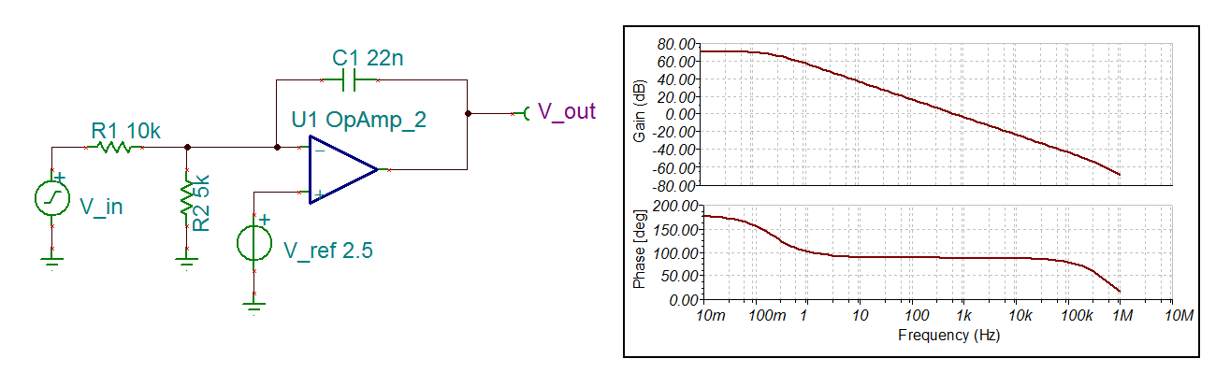
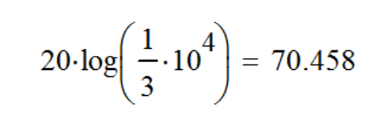
Type 1 Amplifier – Active Integrator (2/2)
The U1 is the double pole op amp from earlier, with 10⁴ (80dB) of open loop gain.
The pole is truly at the origin this time, but the max gain is limited to 70dB, computed by:

Slide 12
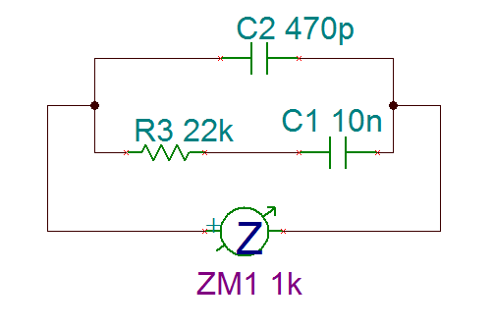
Type 2 Amplifier – Adding RC Series Network
Impedance Graph
10nF
22k
470pF
If this network is in the feedback, then the closed-loop gain will have a pole at DC, followed by a zero, followed by a second pole.

Slide 13
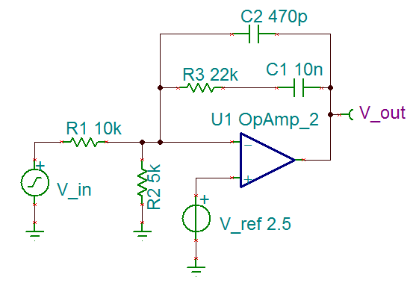
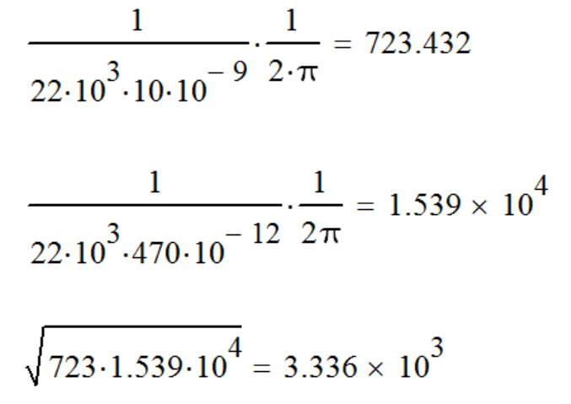
Type 2 Amplifier – Zero-Pole Pair
Zero location:
Pole location:
Max phase boost location:

Slide 14
Type 2a – Origin Pole Plus a Zero
Removing C2 removes the pole following the zero, although in this case the op amp’s own second pole kicks in.
The C2 pole’s goal is to cancel out any zero created by the ESR of the output capacitor.

Slide 15
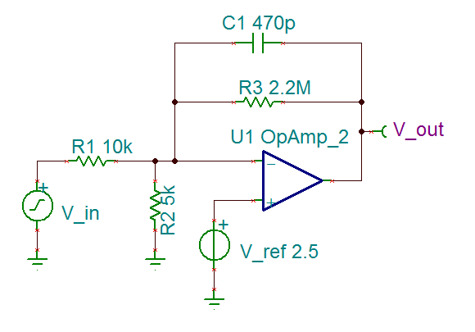
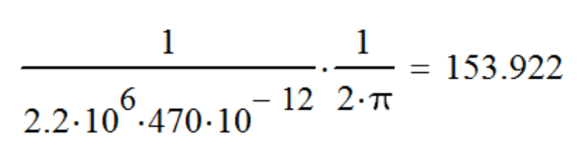
Type 2b – Proportional Plus a Pole
The close loop gain is flat up till C1 pole. Having proportional gain across a range of frequencies can improve transient response, but the reduction in DC gain will create a larger static error.
Pole location:

Slide 16
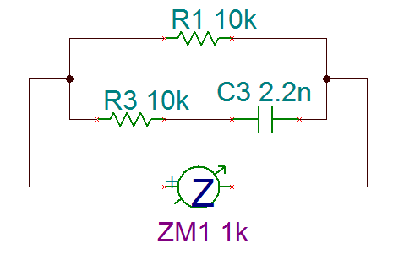
Type 3 – Origin Pole Plus Two Coincident Zero-Pole Pairs (1/2)
10k
2.2nF
5k
If this network shows up in the grounding impedance portion of the op amp, then it will show up in the denominator of the transfer function. In this case, the network creates a zero, followed by a pole.

Slide 17
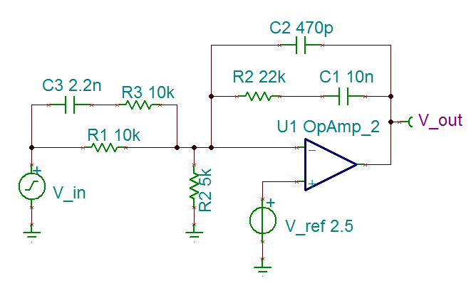
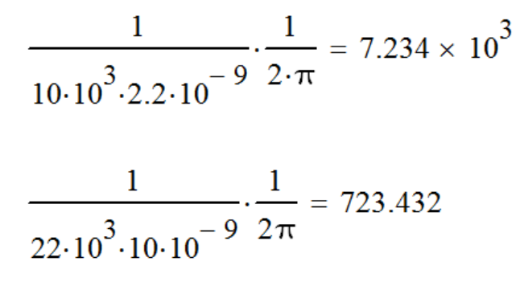
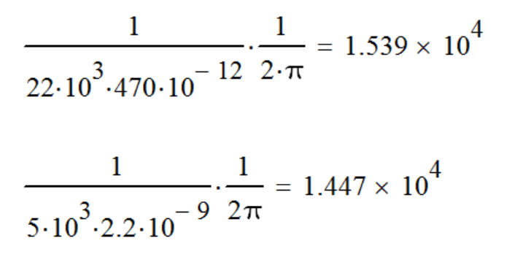
Type 3 – Origin Pole Plus Two Coincident Zero-Pole Pairs (2/2)
Zeros:
Poles:

