Slide 1
The Discontinuous Conduction Mode
Based on Fundamentals of Power Electronics, Second Edition, by Erickson and Mksimovic, CH 5; last modified Aug 5, 2007

Slide 2
References
“Fundamentals of Power Electronics”, second edition, by Robert W. Erickson and Dragan Maksimovic, CH 5

Slide 3
Discontinuous Conduction Mode (DCM) Requirement for Buck
General Requirement:
For Buck:
Result:
where

Slide 4
DCM Requirement for Boost
Result:
(Charge balance)
Solve for I_{L} to get:
where

Slide 5
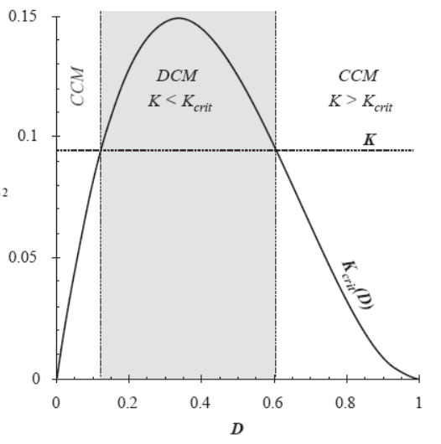
The boost is very DCM dominant

Slide 6
DCM Requirement for Buck-Boost
Result:
(Charge balance)
Solve for I_{L} to get:
where

Slide 7
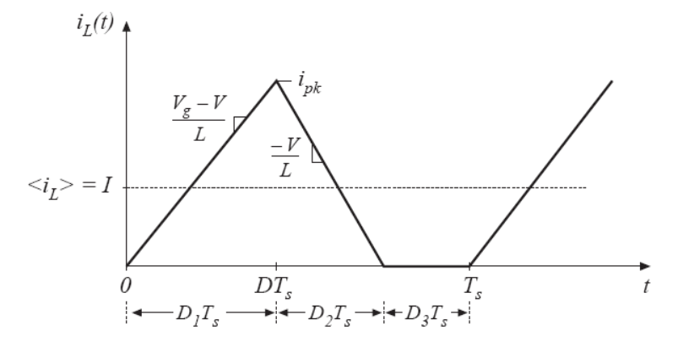
DCM Conversion Ratio for Buck
Volt-second:
Current limit on I_{L}:
Intermediate step:
Final answer:
for u = V_{g}/V

Slide 8
DCM Conversion Ratio for Boost
Volt-second:
Current limit on I_{L}:
Intermediate step:
Final answer:
For u = V/V_{g}

Slide 9
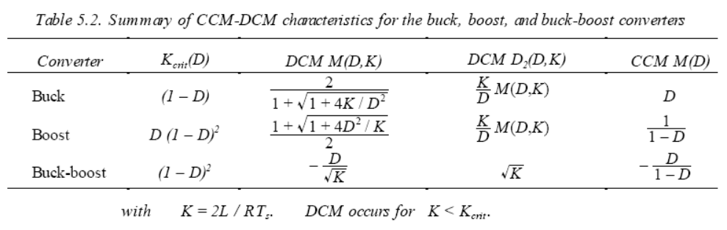
Summary Table

