Slide 1
Fundamentals of Power Electronics, Second Edition
CH13 - Basic Magnetics Theory
Last modified May 20, 2007

Slide 2
References
“Fundamentals of Power Electronics”, second edition, by Robert W. Erickson and Dragan Maksimovic, CH 13

Slide 3
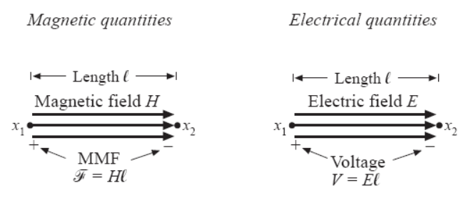
Magnetomotive Force (F)
F = magnetomotive force
H = magnetic field
Simplest case: F = H * l

Slide 4
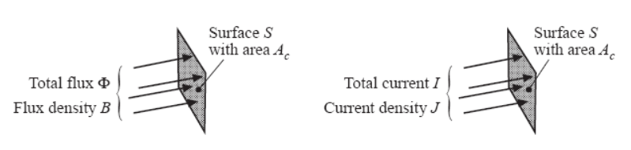
Magnetic Flux (Ф)
Ф = Magnetic flux
B = Flux density
dA = vector normal to the surface
Simplest case: Ф=BA

Slide 5
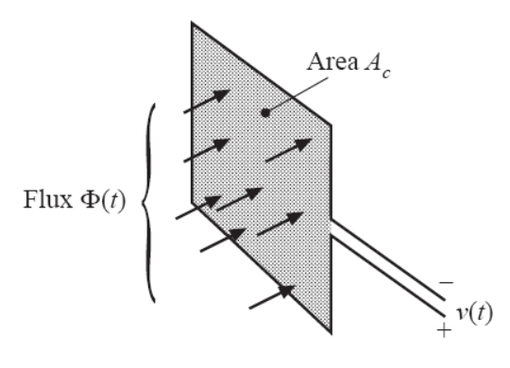
Faraday’s Law
For uniform flux distribution:
v(t) = A * dB/dt
Lenz’s law – polarity of v(t) will induce a current that will counter the flux change.

Slide 6
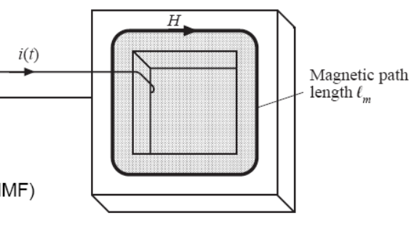
Ampere’s Law
i(t) = total current passing through interior of path
For the case of uniform H(t), F(t) = H(t)ℓ_{m} = i(t)

Slide 7
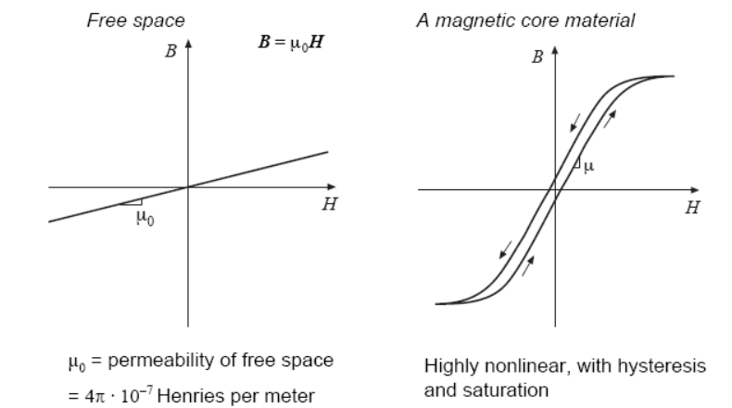
Permeability (μ)
μ₀ = permeability of free space
μ_{r} = relative permeablity

Slide 8
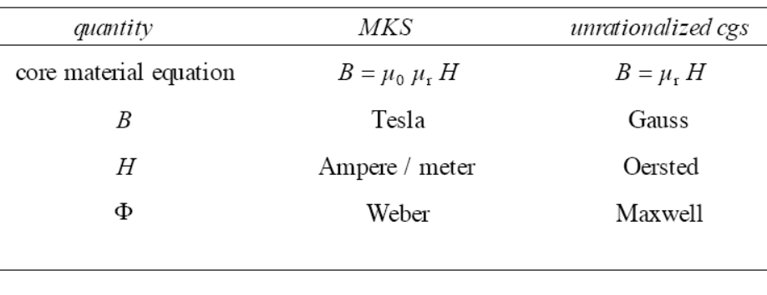
Magnetics Units

Slide 9
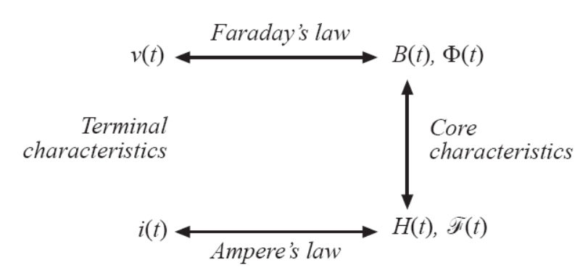
Basic Relationships Summarized

Slide 10
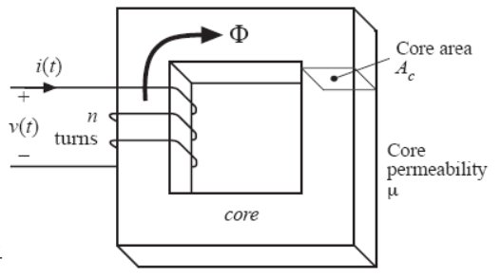
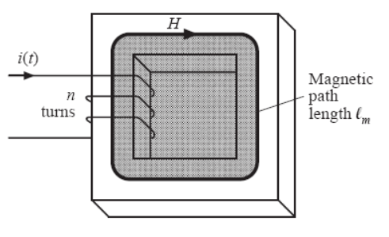
Inductance

Slide 11
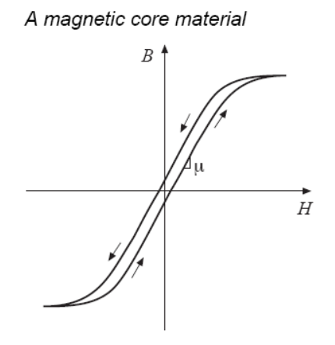
Core Saturation
When DC level of i(t) is small, di/dt → dH/dt → dB/dt → v(t)
When DC level of i(t) is sufficiently large, di/dt → dH/dt, but dH fail to produce any dB, and dB = 0. Then v(t) will be zero, and the inductor looks like it’s shorted, with L being very small.

Slide 12
Reluctance
Reluctance:
Reluctance is how easily flux flows given a certain MMF

Slide 13
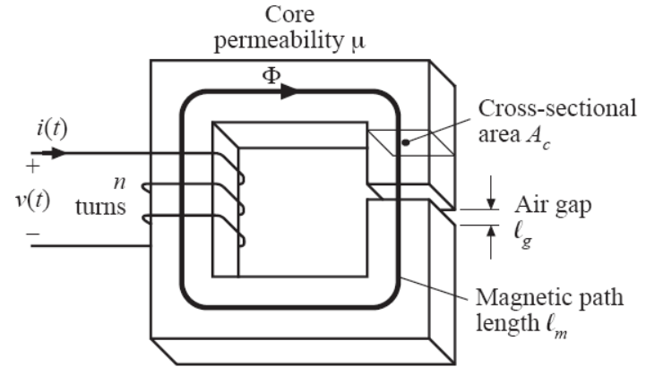
Inductor with Air Gap

Slide 14
Effect of an Air Gap
R_{g} > R_{c} , R_{g} makes L smaller
μ changes according to temperature and operating point, so R_{g} stabilize inductance value
Larger R_{g} reduce flux for the same current, so R_{g} allows inductor to operate at higher DC current.

Slide 15
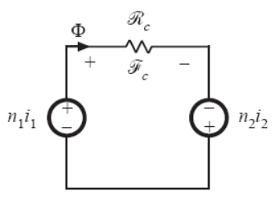
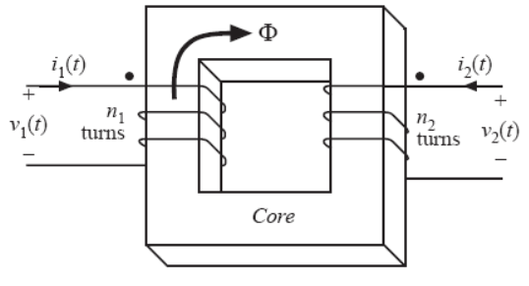
Transformer
Ideal transformer assumes infinite μ, so RФ = 0.

Slide 16
Transformer with non-infinite μ
and
together becomes:

Slide 17
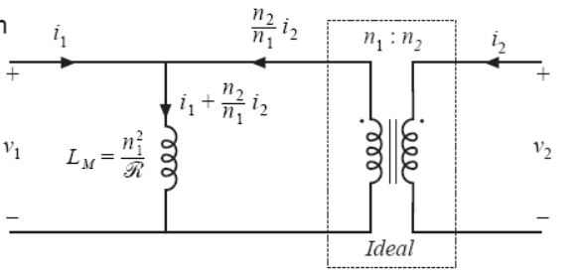
Magnetizing Inductance
Equivalent
Circuit

Slide 18
Output Inductor Saturation
Saturation can be determined based on H*ℓ = n*i
The current has a DC component that is related to the loading, and an AC component related to inductance.
Increase in n will increase inductance and reduce AC component, but increase overall “H”
The DC component being the dominant one, so the net effect of increasing n is to increase H to create saturation
Reduce n or reduce I_{dc} to solve saturation

Slide 19
Transformer Saturation
From the view of H*ℓ = n*i, the n*i is actually n₁i₁+n₂i₂, so that the total H is close to zero
The total i is mostly AC that will depend on inductance. Changing n will change i as well, so it’s not clear how increasing n will affect saturation.
The cause of saturation really comes from applying too much volt-second, or that ∫v(t) dt becomes too large.
Use n*BA_{C} = ∫v(t) dt to see that increasing n or A_{c} will reduce B
Increase n or increase A_{c} to solve saturation

Slide 20
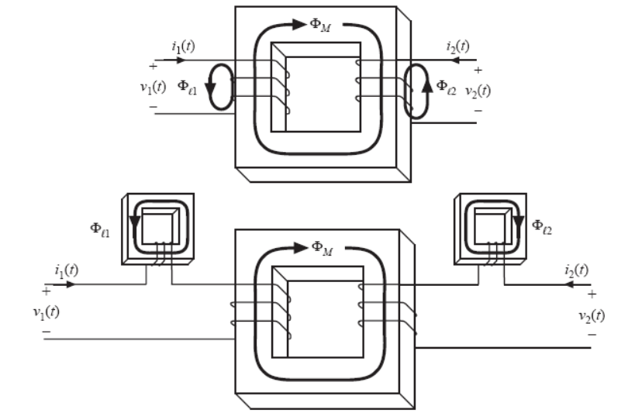
Leakage Inductance - Concept
Leakage inductance is due to flux that leaks into the air and links one winding but not the other

Slide 21
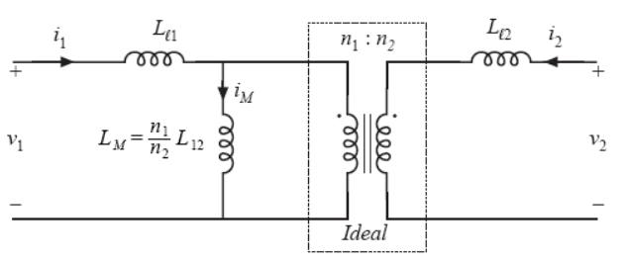
Leakage Inductance - Circuit
L₁₂ is called mutual inductance
L₁₁ and L₂₂ are called self-inductances

Slide 22
Leakage Inductance – Circuit Solution for L₁₂
When i₁(t) = 0:
There’s no voltage across L_{ℓ1}

Slide 23
Leakage Inductances – Performance Parameters
Effective turns ratio:
Coupling coefficient (0 < k < 1):
When there is no leakage inductance:
Coupling coefficient = 1
Effective turns ratio becomes n₂/n₁

Slide 24
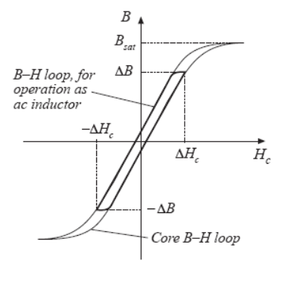
Core Loss – The Equation
During one cycle, v(t) is positive some of the time and negative rest of the time.
Combines into:
The above is loss per cycle; so total power dissipation gets higher for higher switching frequency.

Slide 25
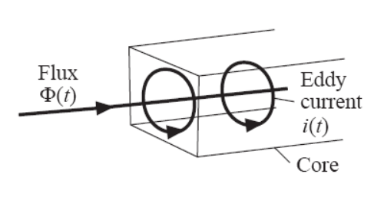
Eddy Currents
Main flux generates eddy currents, which generates flux that oppose the main flux.
Eddy current lost is related to i²R, and in reality changes faster than frequency².
Materials that allows high flux density also has high core loss.

Slide 26
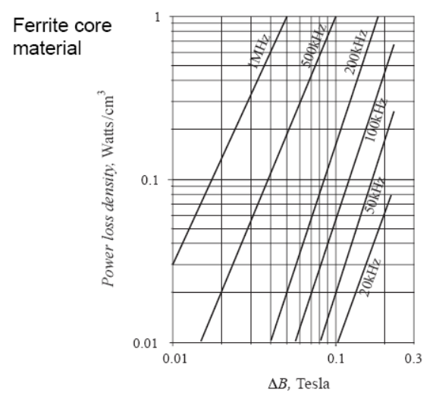
Example Core Loss Data Plot

Slide 27
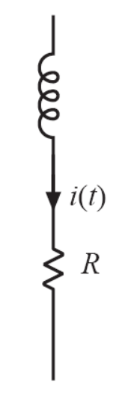
Low Frequency Copper Loss
At low frequency, the copper winding loss is just due to resistance.
A_{w} is the wire cross-sectional area
ℓ_{b} is the length of the wire
The resistivity p increases with higher temperature

Slide 28
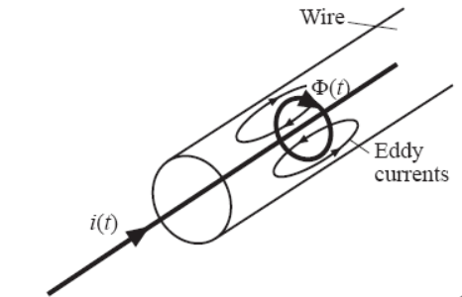
Skin Effect
The current induce flux, which induces eddy currents in the conductor
The eddy currents cancel out at the middle of the conductor
As frequency increase, there is less and less current at the center and more and more at the edge
This increases the resistance of the wire by decreasing its effective cross-sectional area

Slide 29
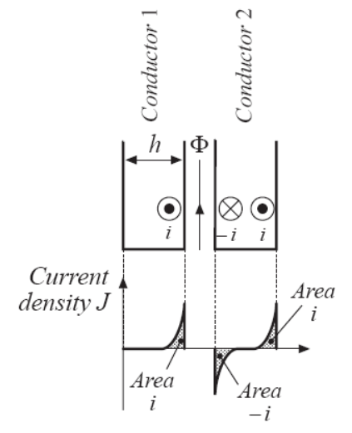
Proximity Effect
Conductor 1 and 2 are foils
If #1 has a high frequency current i, and #2 is open, #1 will create a flux that induce a –i and a +i current in #2.
DC component of current doesn’t contribute to proximity loss

Slide 30
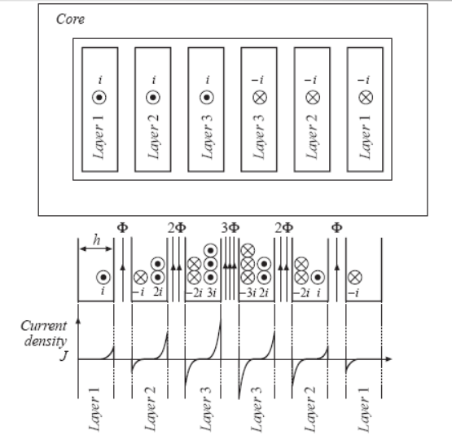
Proximity Effect Example
Each layer carries current i
Layer 1’s power loss is P
Layer 2’s power loss is P due to –i, plus 4P due to +2i, for a total loss of 5P
Layer 3’s loss is 13P

Slide 31
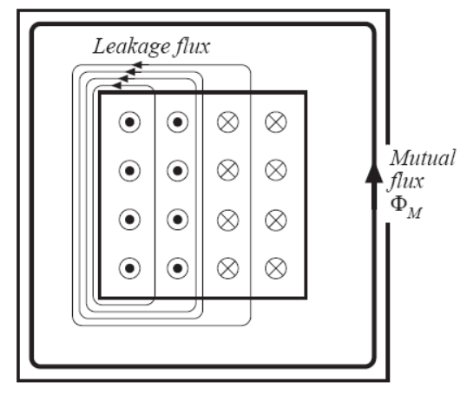
Leakage Flux in Windings
Most of the leak MMF will be across the open air
Where ℓ_{w} = height of the window
Red area enclose 4i
Orange area enclose 8i
Green area enclose 4i

Slide 32
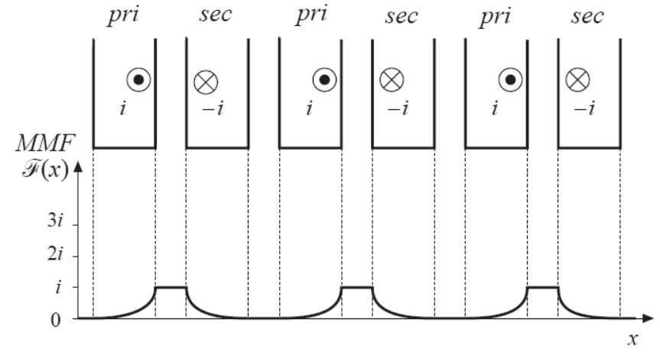
Interleaving Windings
Interleaving greatly reduces peak MMF, leakage flux, and proximity losses

Slide 33
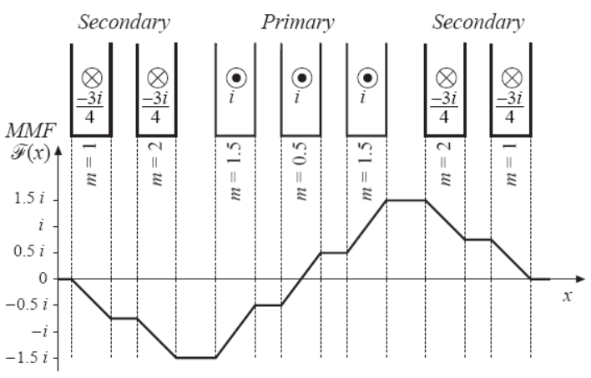
Partially-Interleaved Transformer
Partial interleaving gives partial benefits
Interleaving is only useful if primary and secondary currents are in phase – not useful for sepic or flyback due to currents being out of phase
Primary side current = 3i; secondary side current = 3i/4

Slide 34
Magnetic Device Constraints
Maximum flux density must not saturate the core
Peak ac flux density should be sufficiently small to keep core losses low
Wire size should be small enough to fit in the core window; yet as large as possible to reduce copper loss
Air gap needed if the device is to store energy

Slide 35
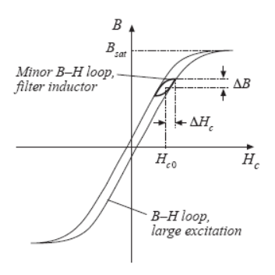
Filter Inductor
Negligible core loss and proximity loss
DC copper loss dominates
Flux density needs to simply avoid saturation
Air gap is employed
Can use core material with high saturation flux density and high core loss

Slide 36
Coupled Inductor
This is multiple windings sharing the same core
Same guide line as filter inductor
The magnetic equation for this inductor:

Slide 37
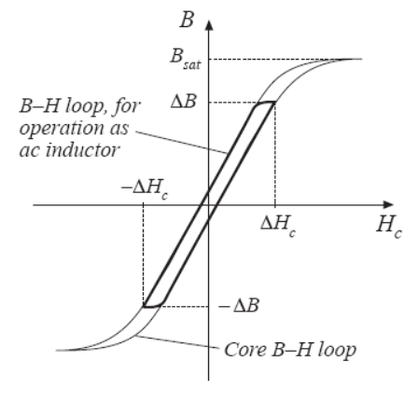
AC Inductor
Core loss, copper loss, proximity loss, are all significant
Flux density is chosen to reduce core loss
Air gap is employed
A high-frequency material (ferrite) must be employed

Slide 38
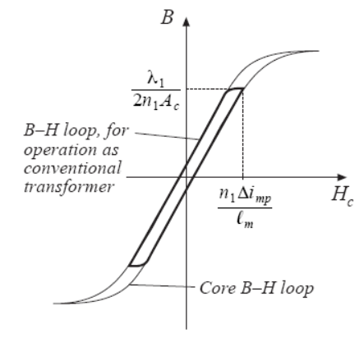
Conventional Transformer
Core loss, copper loss, and proximity loss are usually significant
Flux density is chosen to reduce core loss
No air gap employed
A high-frequency material (ferrite) must be employed

Slide 39
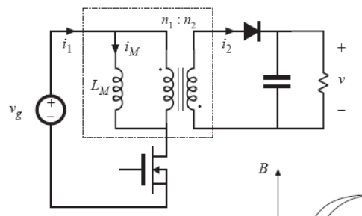
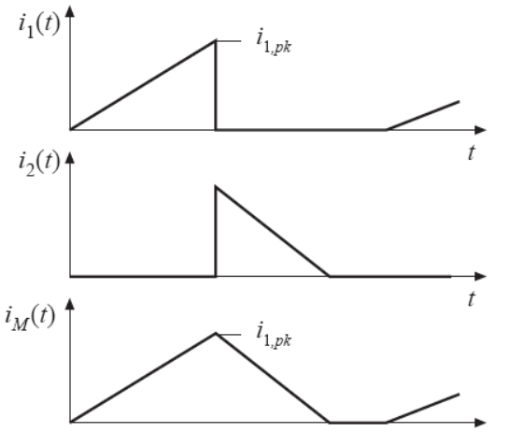
Flyback Transformer - Circuit
When switch is on, i_{M} = i₁, and no current goes into the ideal transformer
When switch is off, i_{M} goes into the ideal transformer

Slide 40
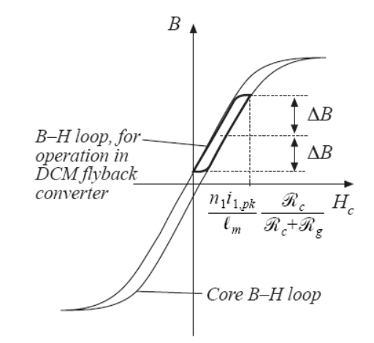
Flyback Transformer
B-H loop like a regular transformer except that it has a DC component
Air gap is used because it’s an inductor for part of the switching cycle
Ferrite material used for the core to reduce core loss
Interleaving the windings have little impact because the primary and secondary windings are out of phase

