Slide 1
Converters in Equilibrium
Fundamentals of Power Electronics, Second Edition
last updated June 17, 2007

Slide 2
References
“Fundamentals of Power Electronics”, second edition, by Robert W. Erickson and Dragan Maksimovic, Part 1
National’s “Online University” POWER 200 - Switching Regulator Fundamentals

Slide 3
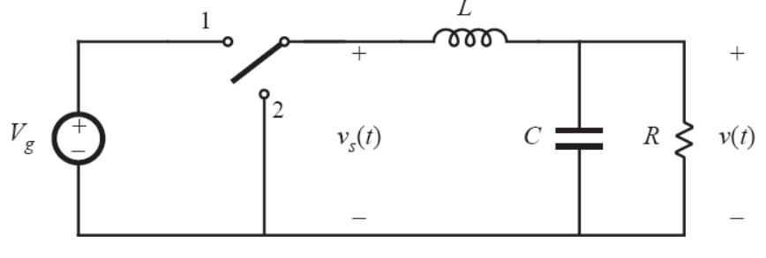
Buck Equilibrium Equation

Slide 4
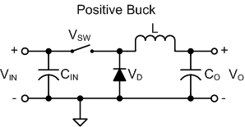
Buck (with MOSFET and diode loss)

Slide 5
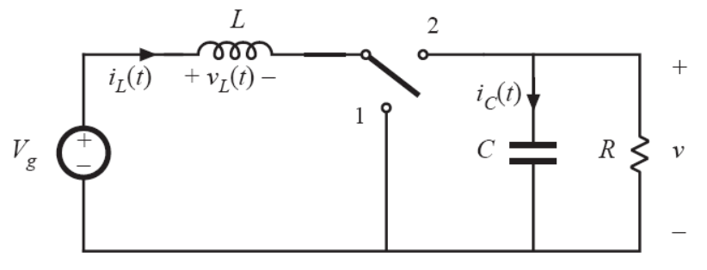
Boost Equilibrium Equation

Slide 6
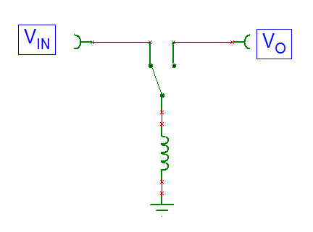
Inverter Equilibrium Equation

Slide 7
Conversion Ratio in terms of t_{on} and t_{off}
Using:
The Buck Conversion Ratio:
The Boost Conversion Ratio:
The Inverter Conversion Ratio:
and

Slide 8
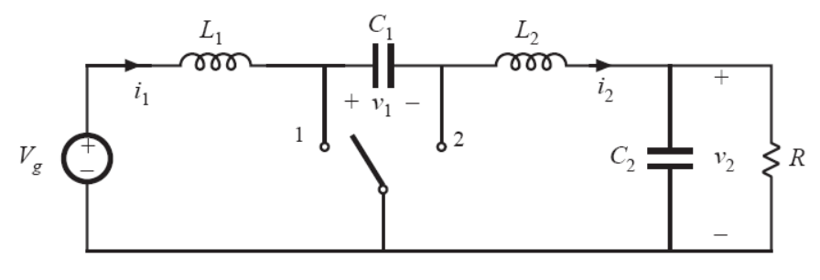
Cuk (Equation Setup)
L₁:
C₁:
L₂:

Slide 9
Cuk (Results)

Slide 10
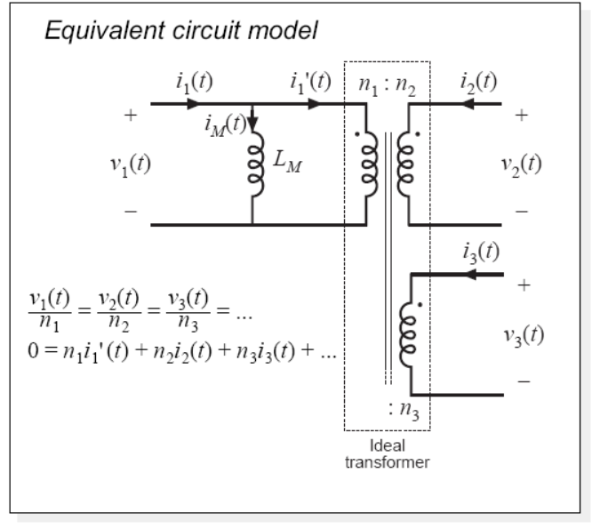
Transformer Equations

Slide 11
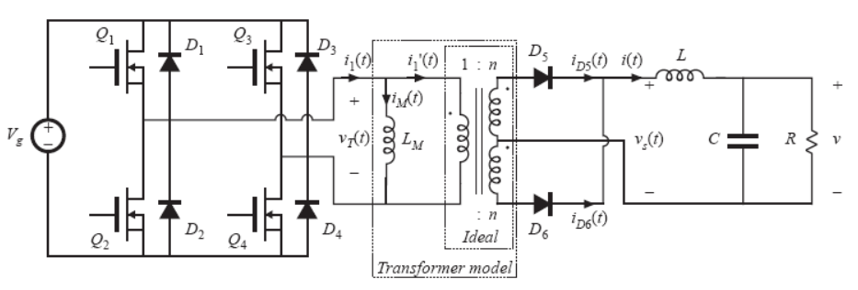
Full Bridge (Primary Side Switching)
Q1 and Q4 conducts in first switching period
Q2 and Q3 conducts in second switching period

Slide 12
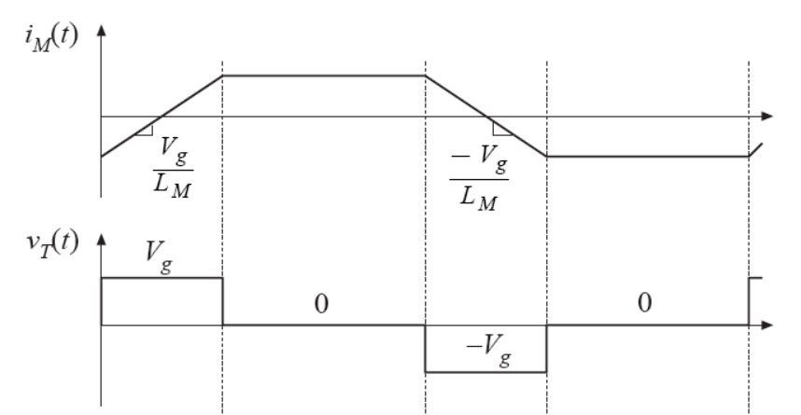
Full Bridge (Primary Side Waveforms)
Transformer get +V_{g} in first switching period and –V_{g} in second switching period.
Q1 and Q4 ON
Q1, Q2, Q3, and Q4 are all OFF
Q1, Q2, Q3, and Q4 are all OFF
Q2 and Q3 ON

Slide 13
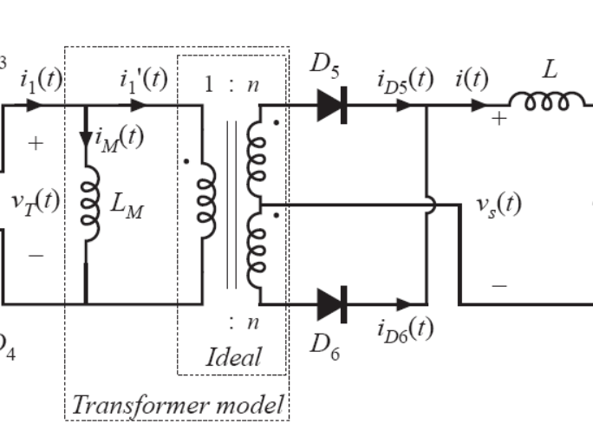
Full Bridge (When Primary Current = 0)
In the second and fourth switching stage, V_{T}(t) = 0, i₁(t) = 0

Slide 14
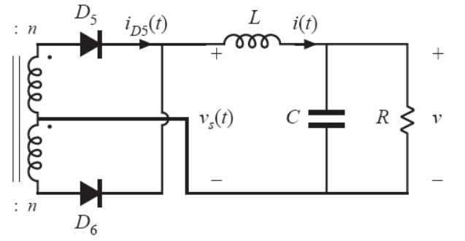
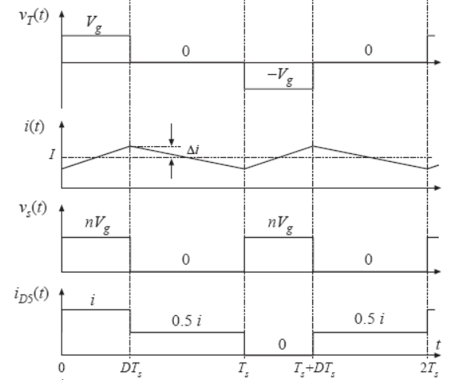
Full Bridge (Secondary Side)

Slide 15
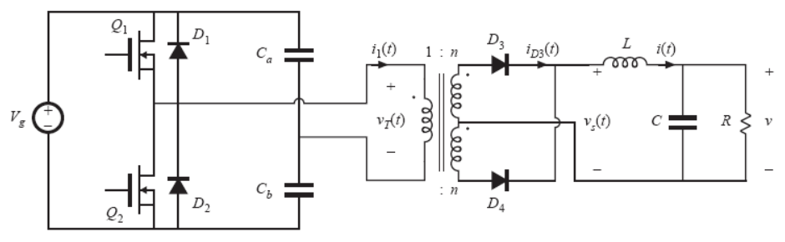
Half Bridge
One period charges capacitors while the other period discharges it

Slide 16
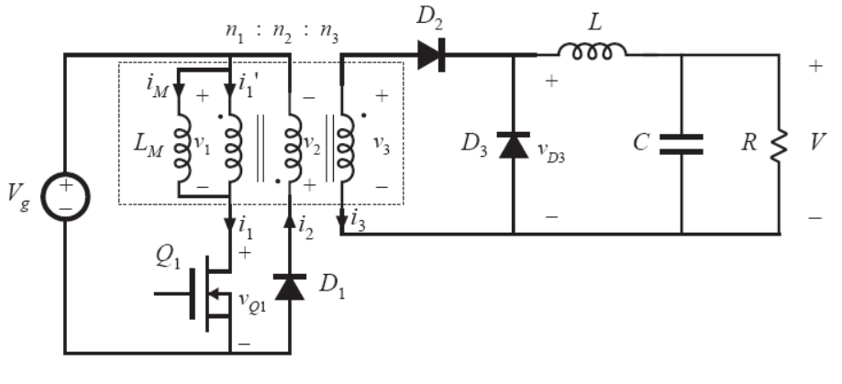
Forward Converter (interval 1)
ON
Transformer gets V_{g}
D₃ gets V_{g} * n₃ / n₁

Slide 17
Forward Converter (interval 2)
OFF
Transformer gets -V_{g} * n₁ / n₂
D₃ gets 0 Volts
i_{M} eventually becomes zero

Slide 18
Forward Converter (interval 3)
Transformer winding currents eventually become zero:

Slide 19
Forward Converter (Volt-Seconds)
If n₁ = n₂
D < 0.5

Slide 20
Forward Converter (Maximum Stress on Q₁)
Maximum stress occurs during interval 2:
V_{g}
Larger n₁/n₂ reduce
transformer reset time, but increase stress on Q1

Slide 21
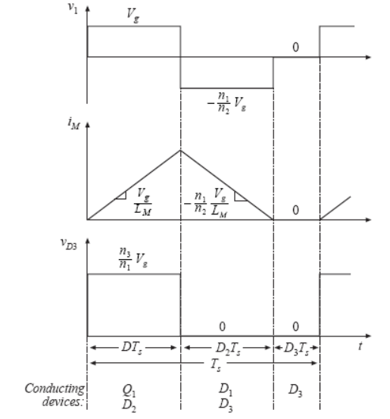
Forward Converter (Waveforms)

Slide 22
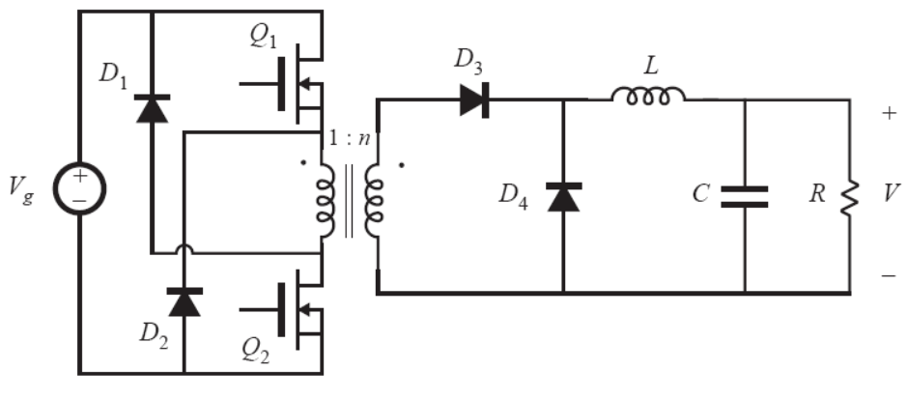
Two Transistor Forward Converter
During interval 1, Q₁ and Q₂ are both on and I_{M} increases
During interval 2, Q₁ and Q₂ are both off and transistor sees –V_{g}, causing I_{M} to decrease
D₂ = D, as if n₁ = n₂; but transistor stress is V_{g}

Slide 23
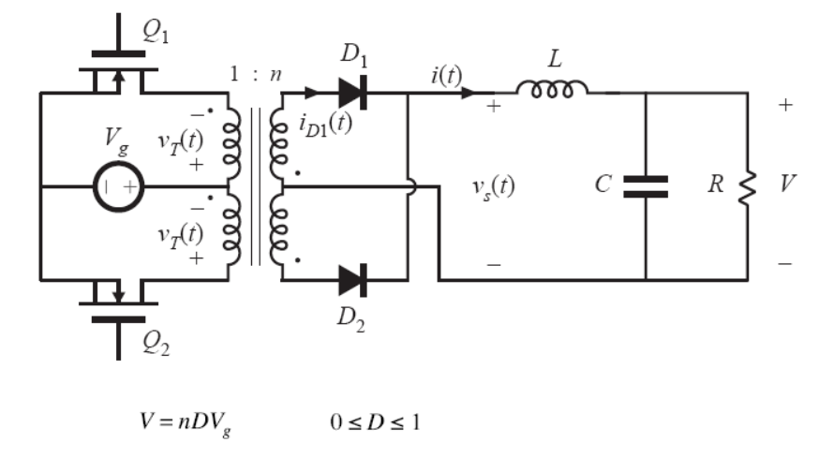
Push-Pull Converter
Q₁ goes on for time DT_{S} , then off; Q₂ goes on for time DT_{S} , then off
Waveforms are the same as the full bridge

Slide 24
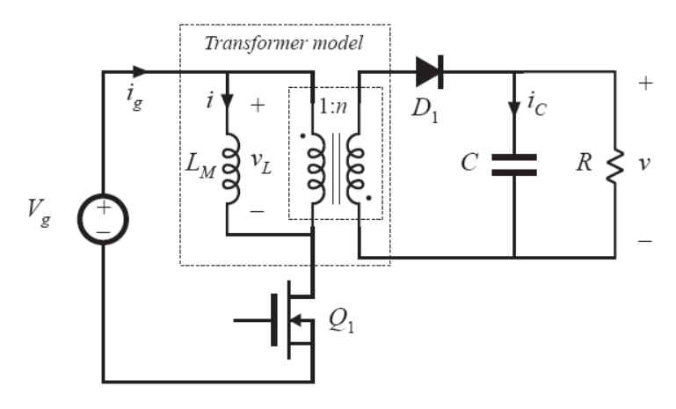
CCM Flyback Converter (Interval 1)
ON

Slide 25
CCM Flyback Converter (Interval 2)

Slide 26
CCM Flyback Converter (Volt-second and Amp-second)
Q1 stress during interval 2 is: V_{g} + V/n
DCM flyback when implemented is quite small, but more stress

Slide 27
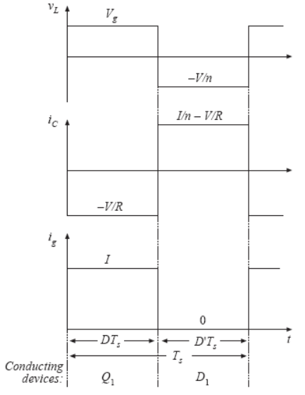
CCM Flyback (Waveforms)

