Slide 1
PCBs and Layout
Last modified July 23, 2008

Slide 2
References
“Switching Power Supply Design and Optimization”, by Sanjaya Maniktala, CH 12

Slide 3
Critical Traces
In these traces, the current is a square wave that suddenly goes from flowing to stopping.
These traces are identified by highlighting the current flow during different operating conditions of the converter and looking for differences.

Slide 4
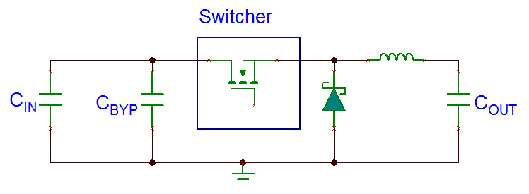
Trace Analysis Example (1/2)
On time current:
Off time current:

Slide 5
Trace Analysis Example (2/2)
The difference between the two previous drawings show the critical traces:
All traces have a nonzero inductance, of stored energy (1/2) * L I² .
Sudden current changes creates a voltage spike. The height of the spike depends on the L * dI/dt.

Slide 6
Trace Inductance
Slower BJT switchers will always have less “layout issues” because there’s less dI/dt.
Bring the associated components closer to the switcher IC to reduce trace length, and hence trace inductance.
Rule of thumb: every inch of trace is about 20nH.

Slide 7
RC Snubber
This is really a band-aid for a bad layout. Resistor is about 10 to 100 ohm. Ceramic capacitor should be 470pF to 2.2nF.
Be sure resistor dissipation is okay: (1/2) * C * V² * f
The RC must be close to the switching pin and ground pin of the switcher IC to be effective

Slide 8
Inductance of Via
Inductance of a via:
h = height of the via in mm
d = diameter of the via in mm
Several vias in parallel will yield better results. Larger diameter also helps.

Slide 9
Inductance of Trace
Inductance of a trace:
l and w are in centimeters
L hardly depends on thickness of the copper
Halving trace length halves the inductance, but decrease in trace width by 10 times is needed to half inductance. So wider trace / plane can be bad in that inductance is not decreased by much, and the trace can act as an antenna.

Slide 10
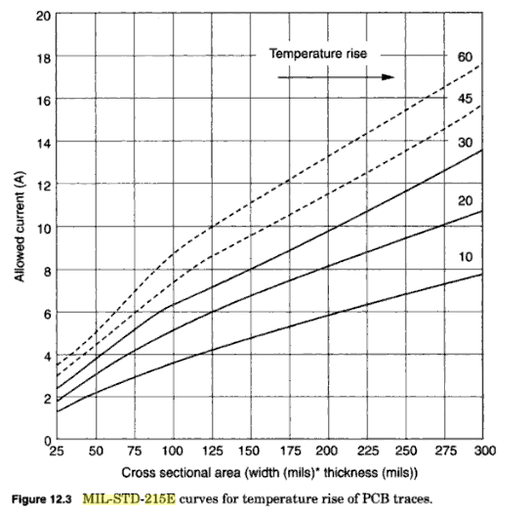
Current Handling Capability of Traces
One rule to go by is the MIL-STD-215E. They recommend a maximum 10ºC rise in temperature
1oz copper = 1.4 mil copper thickness; 2oz = 2.8mil.
So very conservatively, (< 10ºC rise in temperature), 100 mil for 4A, 1oz copper.
Less conservatively, (< 30ºC rise in temperature), 12 mil for 1A, 1oz copper.

Slide 11
Routing the Feedback Trace
Keep trace short to reduce pickup.
Keep trace away from noise sources: switch, diode, and even inductor.
If necessary, drop the trace into a ground plane and route it there.
Noisy power trace should not run even a few millimeters parallel to the feedback trace, directly above or below.
Noisy traces should pass the feedback trace at right angles.

Slide 12
The Ground Plane
Low frequency return signal will take the shortest path.
High frequency return signal will try to return directly under the signal path to minimize the loop and minimize trace inductance. Slots in the ground plane hurt this process.
Ground can capacitively link to noisy traces above it, reducing noise and EMI. But then the plane can end up radiating the noise to other places.
Make the plane below the component side the ground plane. The closer the ground plane is, the better it couples and the shorter the vias are.

Slide 13
Component Side
If possible, avoid placing SMD components on both sides of a board to reduce cost.
If components are on a single side, they can stay in place with the help of gravity and solder paste.
If components are on both sides, adhesives will become necessary to ensure components on one side do not fall off.

