Slide 1
Simulation of Converters
mainly based on Erickson’s power supply book appendix B and includes part 2 as necessary; last modified Aug 16, 2007

Slide 2
References
“Fundamentals of Power Electronics”, second edition, by Robert W. Erickson and Dragan Maksimovic, Appendix B, and some of part 2

Slide 3
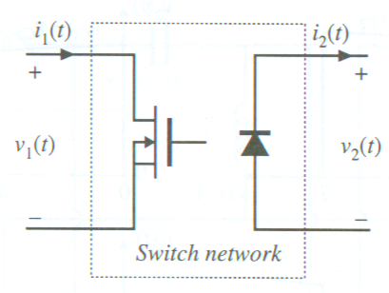
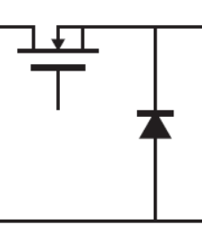
Switch Average State Modeling (1/3)
Buck converter switch:
General switch model:
Switch properties:
V₁ = 0 when switch is on; = V_{g} when switch is off
V₂ = V_{g} when switch is on; = 0 when switch is off
Average State Equations:

Slide 4
Switch Average State Modeling (2/3)
Buck converter switch:
General switch model:
Switch properties:
I₁ = I_{L} when switch is on; = 0 when switch is off
I₂ = 0 when switch is on; = I_{L} when switch is off
Average State Equations:

Slide 5
Switch Average State Modeling (3/3)
The four equations:
Solve to be:

Slide 6
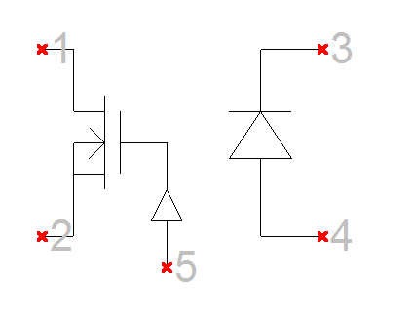
Spice Model for Switch Average State
.subckt CCM1 1 2 3 4 5
Et 1 2 value={(1-v(5))*v(3,4)/v(5)}
Gd 4 3 value={(1-v(5))*i(Et)/v(5)}
.ends
d = 0 to 1V
File: CMM1.cir

Slide 7
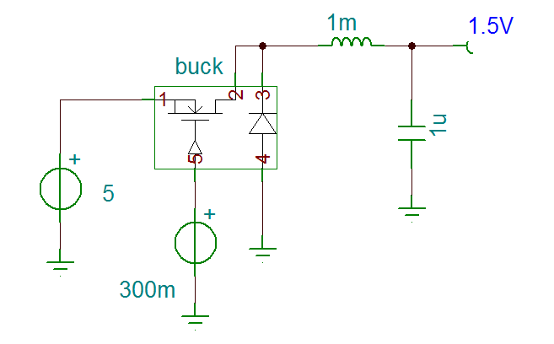
Switch – Buck Orientation

Slide 8
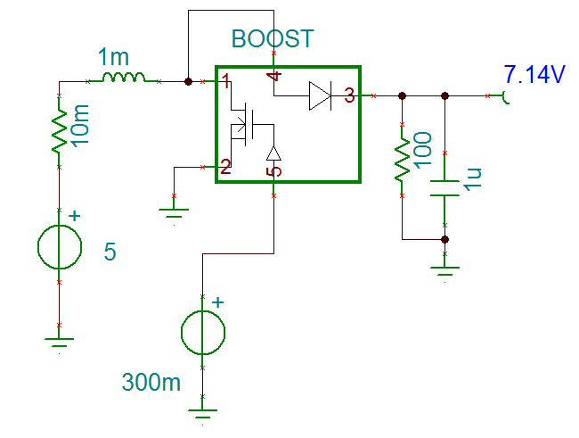
Switch – Boost Orientation

Slide 9
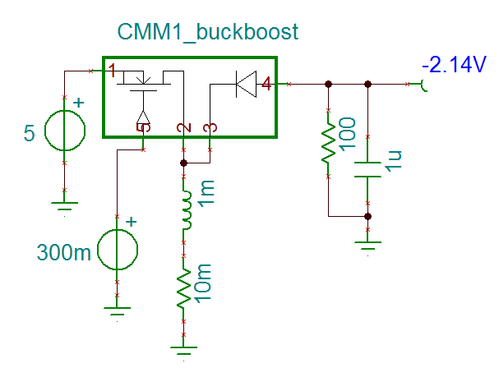
Switch – Buck Boost Orientation

Slide 10
CCM Switch Model with Losses Included (1/2)
Losses:
MOSFET loss R_{on}
Diode voltage drop V_{D}
Diode loss R_{D}
Equations for current remain the same:
Use “V₁ + V₂ = V_{g}” and “i_{L} = i₁ / d” to simplify

Slide 11
CCM Switch Model with Losses Included (2/2)
.subckt CCM2 1 2 3 4 5
+params: Ron=0 VD=0 RD=0
Er 1 1x value={i(Et)*(Ron+(1-v(5))*RD/v(5))/v(5)}
Et 1x 2 value={(1-v(5))*(v(3,4)+VD)/v(5)}
Gd 4 3 value={(1-v(5))*i(Et)/v(5)}
.ends
File: CMM2.cir

Slide 12
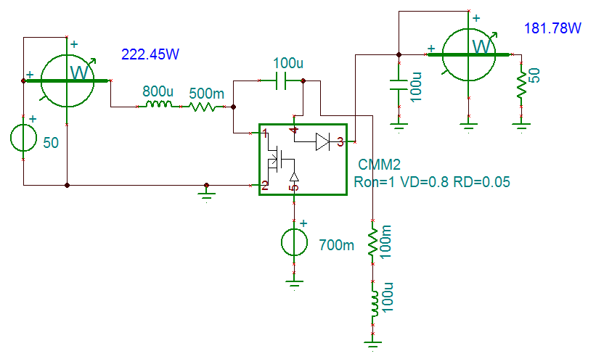
SEPIC Converter Efficiency simulation using “CMM2” switch
Tina file:
SEPIC_efficiency

Slide 13
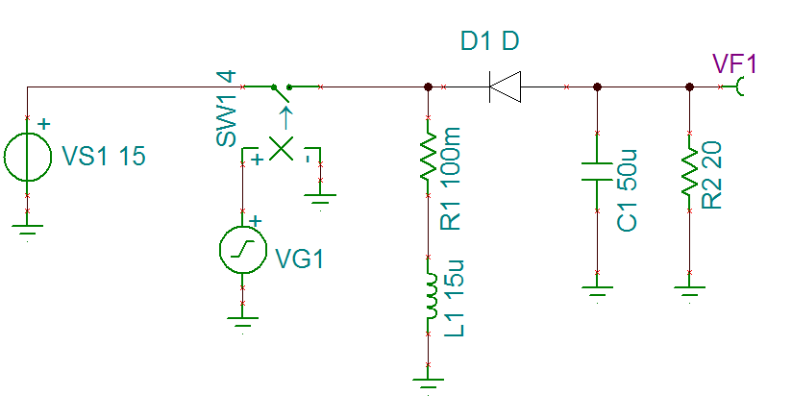
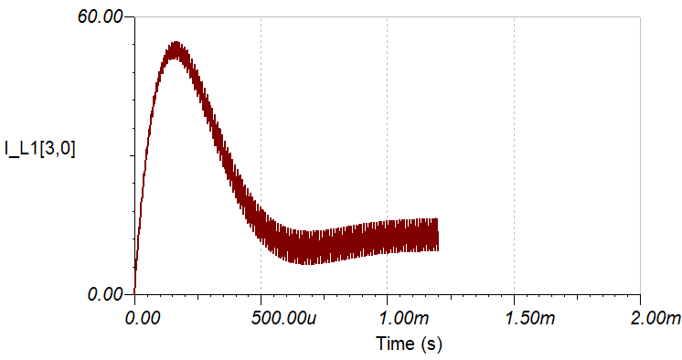
Transient Response of Buck-Boost Converter (switching model)
Inductor startup current
Tina file: buck_boost_switch

Slide 14
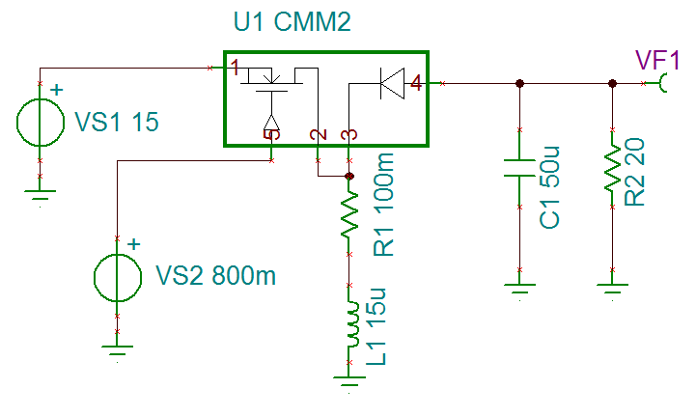
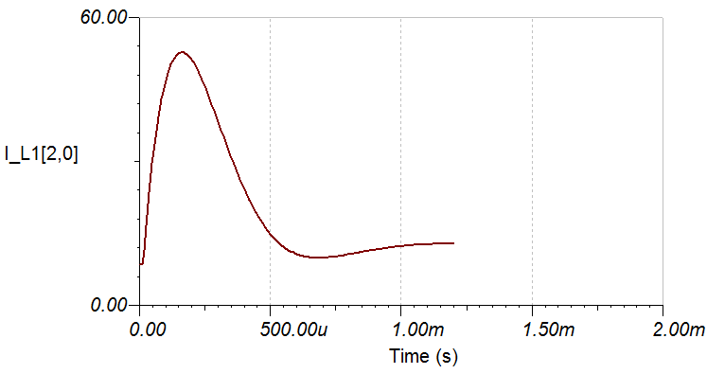
Transient Response of Buck-Boost Converter (averaged circuit model)
Inductor startup current
Tina file:
buck_boost_averaged

Slide 15
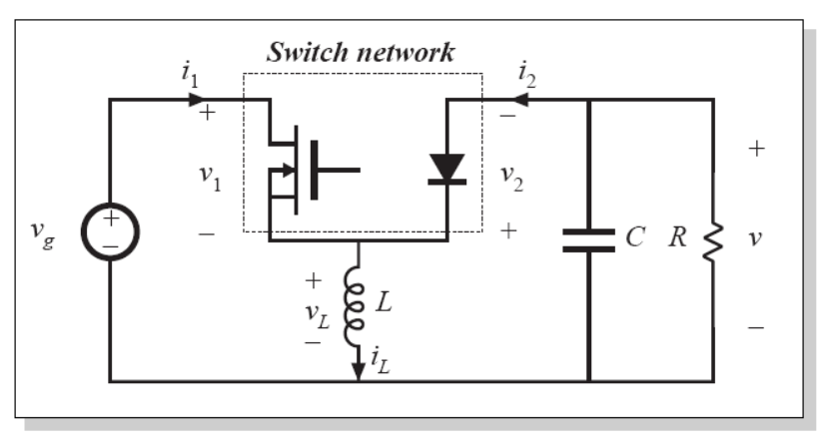
DCM Averaged Switch Model (1/4)

Slide 16
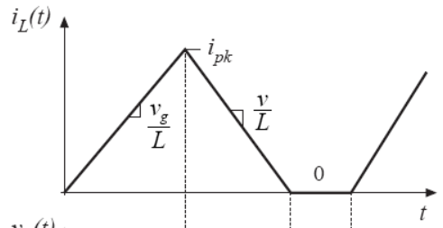
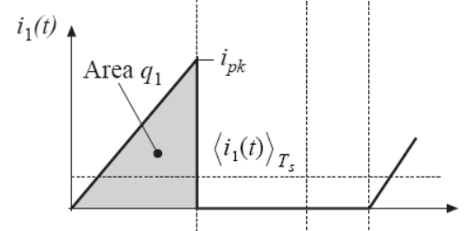
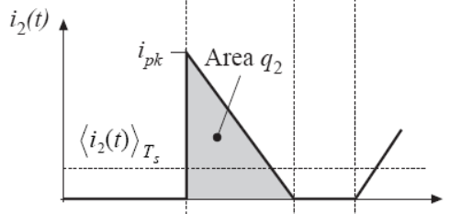
DCM Averaged Switch Model (2/4)
Because inductor current resets to zero every period, the following is always true:

Slide 17
DCM Averaged Switch Model (3/4)
Conclusions:
Alternatively:
Input port is a resistor
Output port is a power source

Slide 18
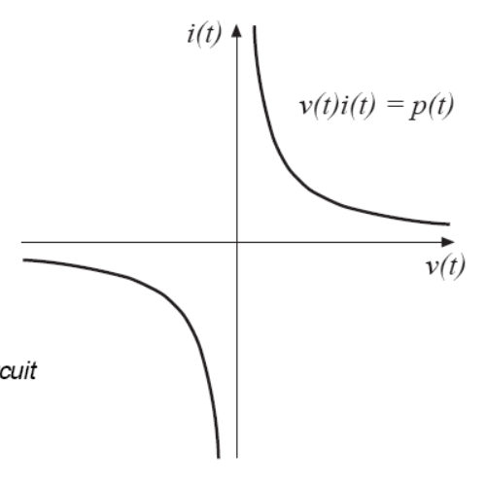
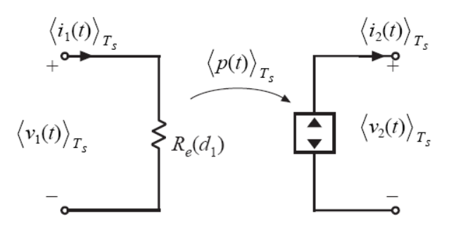
DCM Averaged Switch Model (4/4)
The loss-free resistor model:
The power being transmitted is not related to the load, because R_{e} is not related to the load.
The output is an ideal power source that must not be short-circuited or open-circuited

Slide 19
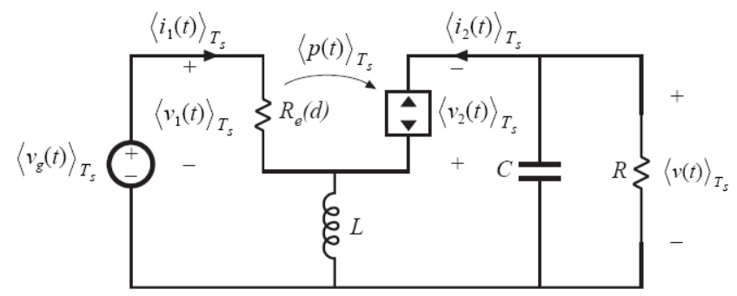
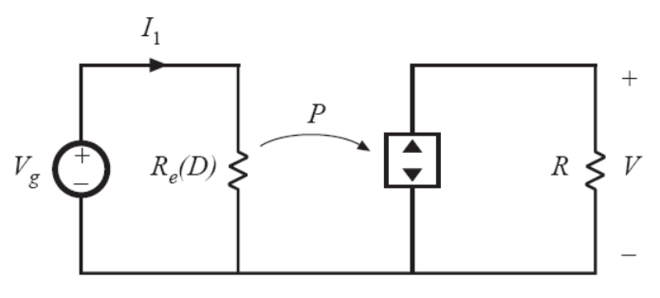
Conversion Ratio
Applying the model to the buck-boost circuit:
The analysis is done at DC, so:
Conclusion:

Slide 20
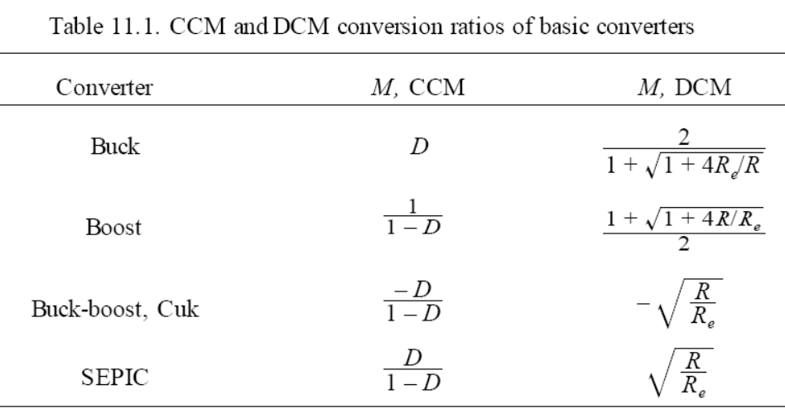
Application of the Loss-Free Resistor Model to Various Topologies
For buck, boost, and buck-boost
For Cuk and SEPIC

Slide 21
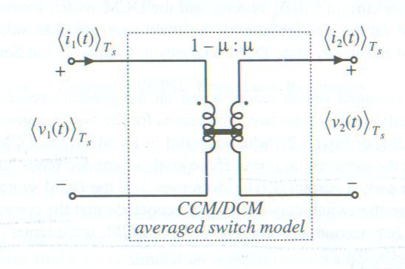
Combined CCM/DCM Averaged Switch Model (1/3)
For CCM, μ = d
We use:
To get:
The larger of the two conversion ratios is the valid one.

Slide 22
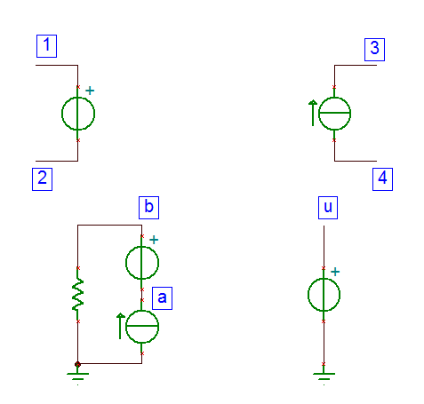
Combined CCM/DCM Averaged Switch Model (2/3)
The circuit diagram behind the SPICE model:
I₁
I_{x}
Note that I_{x} is kept to be > 0.
Max(0, I₁)

Slide 23
Combined CCM/DCM Averaged Switch Model (3/3)
Actual Spice Code:
.subckt CCM-DCM1 1 2 3 4 5
+ params: L=100u fs=1E5
Et 1 2 value={(1-v(u))*v(3,4)/v(u)}
Gd 4 3 value={(1-v(u))*i(Et)/v(u)}
* Ga 0 a value={MAX(i(Et),0)}
Ga 0 a value={i(Et)}
Va a b
Ra b 0 10k
Eu u 0 table {MAX(v(5),
+ v(5)*v(5)/(v(5)*v(5)+2*L*fs*i(Va)/v(3,4)))} (0 0) (1 1)
.ends
The (0 0) and (1 1) on the last line is to make u 0 at least and 1 at most - in case “v(5)*v(5) / …” produce something less than 0 or greater than 1
Tina File: CCM-DCM1.cir

Slide 24
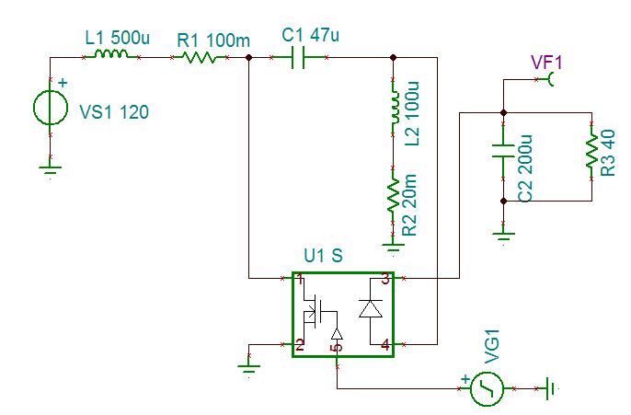
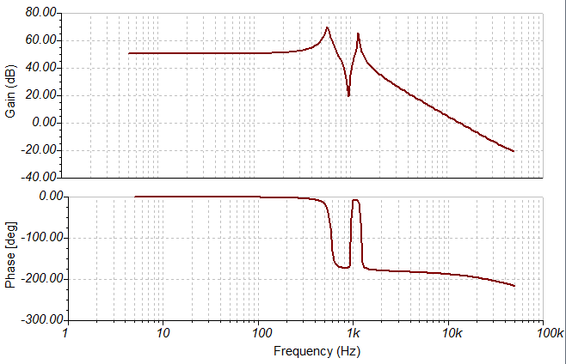
SEPIC Frequency Response (CCM)
Loading: R=40 (CCM)
Plot of V_{out}(s)/d(s):
Tina File: SEPIC_freq

Slide 25
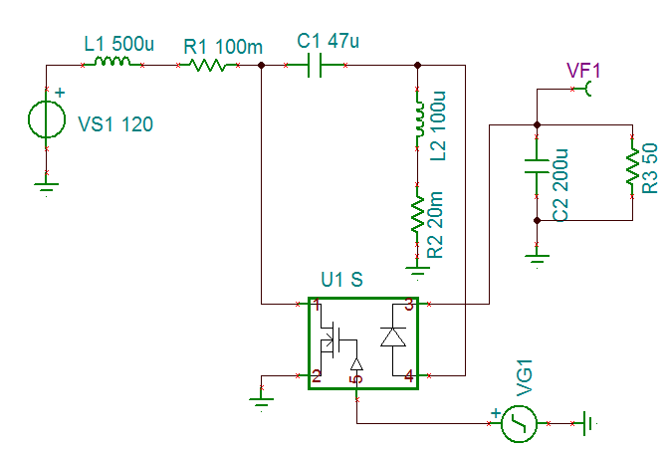
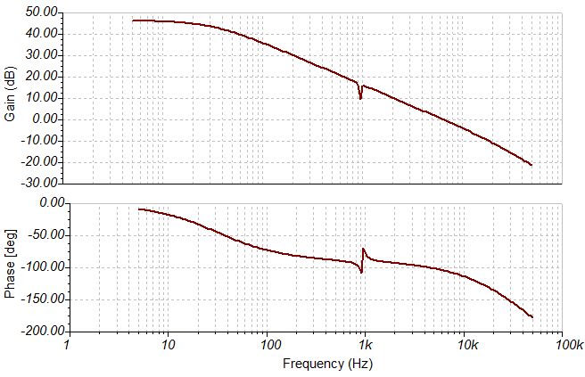
SEPIC Frequency Response (DCM)
Loading: R=50 (DCM)
Plot of V_{out}(s)/d(s):
Tina File: SEPIC_freq

Slide 26
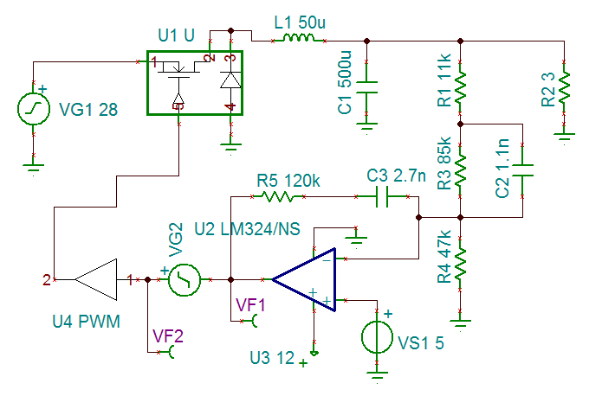
Loop Gain of a Buck Voltage Regulator (1/2)
Loading:
R=3 ohm (CCM)
R=25 ohm (DCM)
TINA file: buck_close_loop
To detect close loop response:
VG2 = sine wave source
VF1 = output
VF2 = input
The PWM is a saw-tooth from 0V to 4V.
Spice model limits duty cycle to 10% ~ 90%:
.subckt PWM 1 2
Epwm 2 0 value={LIMIT(V(1)*0.25,0.1,0.9)}
.ends
TINA file: PWM.cir

Slide 27
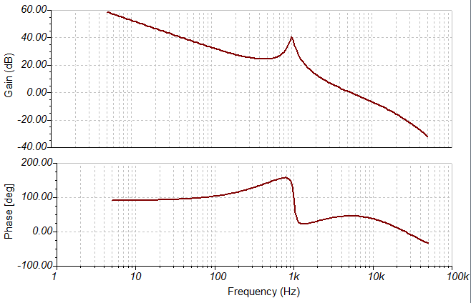
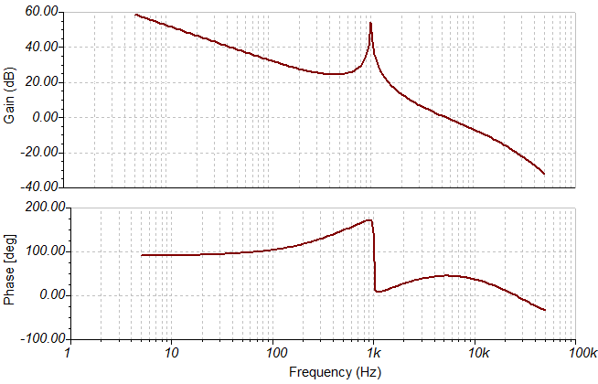
Loop Gain of a Buck Voltage Regulator (2/2)
R = 3 Ω (CCM)
R = 25 Ω (DCM)
The phase should actually be shifted down 180 degrees. The op-amp LM324 introduce negative feedback that made the phase 0 to 180 degrees. But really, the loop gain’s phase should be -180 to 0 degrees (negative feedback’s minus sign should not be counted in the phase)

Slide 28
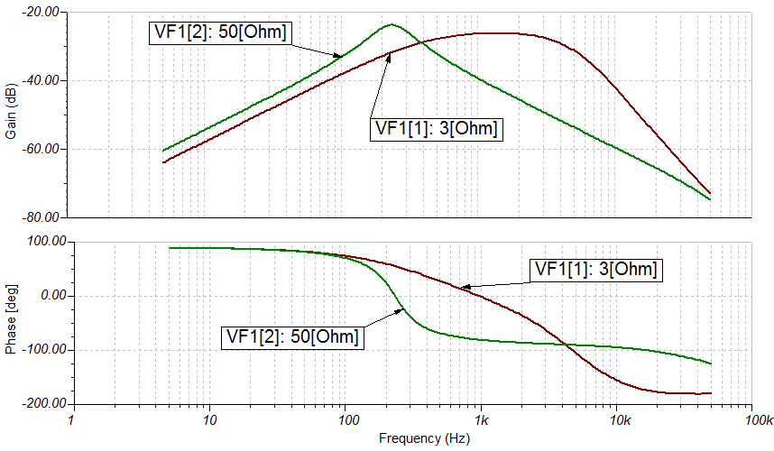
Line to Output Transfer function
Plot of V_{out}(s) / V_{g}(s) for different loads:

Slide 29
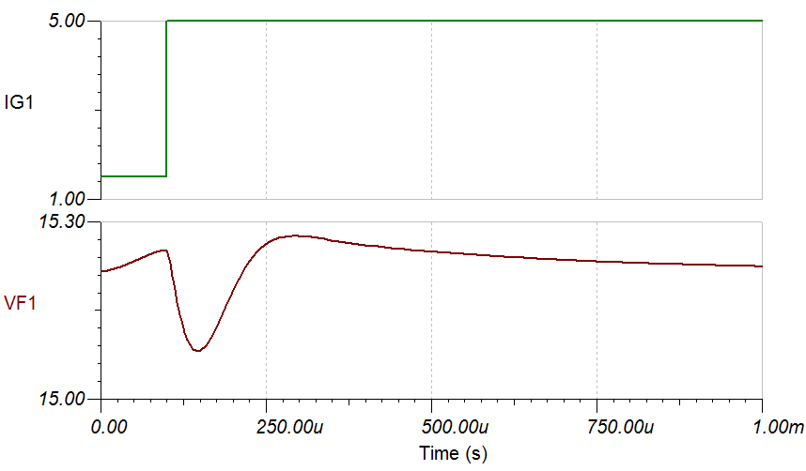
Transient Response
The following came from adding a current generator load (IG1) to the schematics. It goes from 1.5A to 5A.

Slide 30
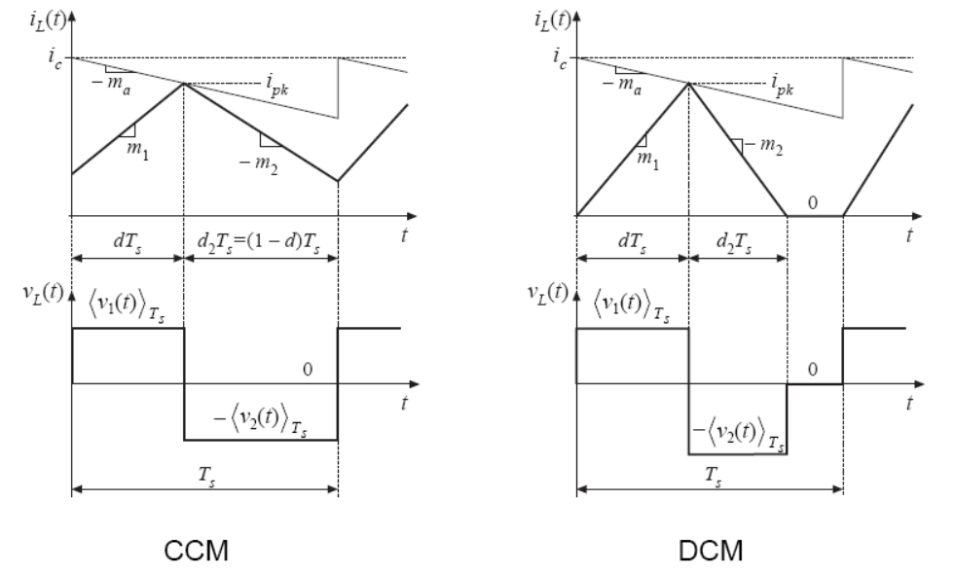
Current Programmed Mode Model for Simulation (1/5)
Waveforms for CCM and DCM:
V₁ and V₂ are voltages applied to the inductor (not the voltage across MOSFET and diode)

Slide 31
Current Programmed Mode Model for Simulation (2/5)
Inductor current slope:
The peak inductor current:
The duty cycle (d₂) is the smaller value of:
OR

Slide 32
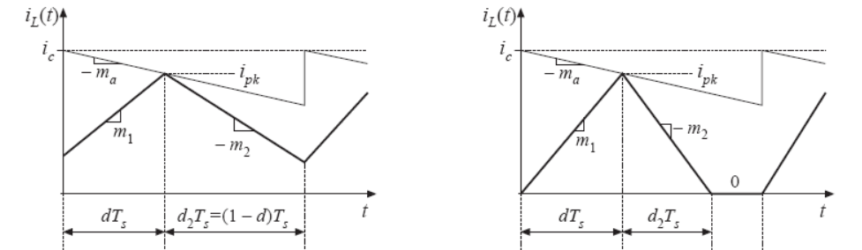
Current Programmed Mode Model for Simulation (3/5)

Slide 33
Current Programmed Mode Model for Simulation (4/5)
Conclusion to be implemented in SPICE:
Note this is an implicit expression, with “d” on both sides of the equal sign.
Additional modifications in SPICE code:
Spice code has a “V_{a}” such that: V_{a} = m_{a}T_{s}
Spice code has a “m₁” such that: m_{1,spice} = m₁T_{S} = (V₁/L)*(1/f_{S})*R_{f}
Similar formula for m₂
R_{f} is the current sense resistor, a scale factor for m₁ m₂

Slide 34
Current Programmed Mode Model for Simulation (5/5)
.subckt CPMold control current 1 2 d
+params: L=100e-6 fs=1e5 Va=0.5 Rf=1
Ed2 d2 0 table
+ {MIN(
+ L*fs*(v(control)-va*v(d))/Rf/(v(2)),
+ 1-v(d)
+ )} (0.01,0.01) (0.99,0.99)
Em1 m1 0 value={Rf*v(1)/L/fs}
Em2 m2 0 value={Rf*v(2)/L/fs}
Eduty d 0 table
+ {
+ 2*(v(control)*(v(d)+v(d2))
+ -v(current)-v(m2)*v(d2)*v(d2)/2)
+ /(v(m1)*v(d)+2*va*(v(d)+v(d2)))
+ } (0.01,0.01) (0.99,0.99)
.ends
According to the website, the previously presented model is actually old, but is numerically very close to the new model.
Tina File: CPMold

Slide 35
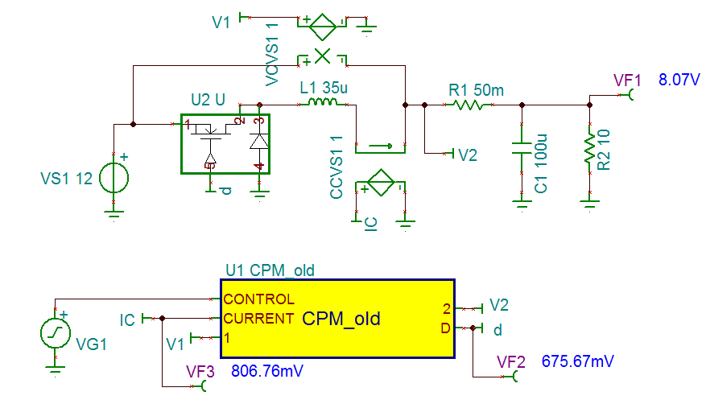
Buck Converter with Current Programmed Mode (1/2)
Note: output voltage will change with loading (R2)
Tina File: buck_cpm

Slide 36
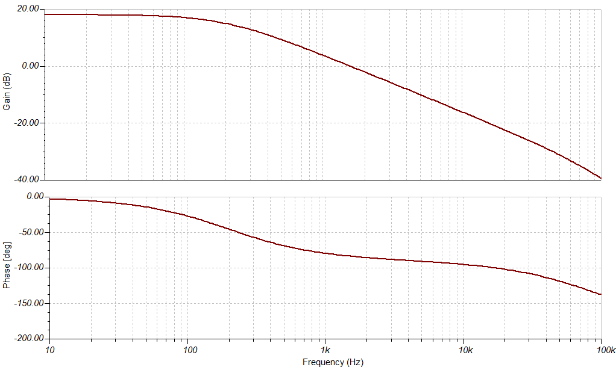
Buck Converter with Current Programmed Mode (2/2)
Bode plot of v_{out}(s) / v_{c}(s):
Phase is around 90 degrees at unity gain

