Slide 1
Converter Dynamics and Control Basics
Selected sections from Fundaments of Power Electronics, by Erickson and Maksimovic
CH 3.1 The DC Transformer Model
CH 3.3 Construction of Equivalent Circuit Model
CH 7.2 The Basics of AC Modeling Approach
CH 7.6 Modeling the Pulse-Width Modulation
CH 8.2 Analysis of Converter Transfer Functions
CH 9.2 Controller Design
CH 9.5 Regulator Design
Problem 9.5 part B
Last modified: July 4, 2007

Slide 2
References
“Fundamentals of Power Electronics”, second edition, by Robert W. Erickson and Dragan Maksimovic, CH 7 ~ 9

Slide 3
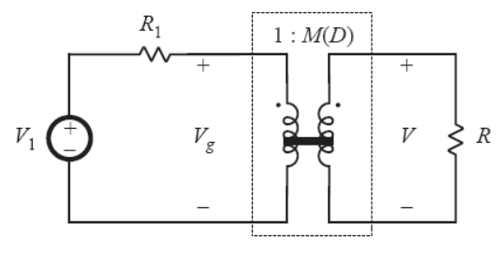
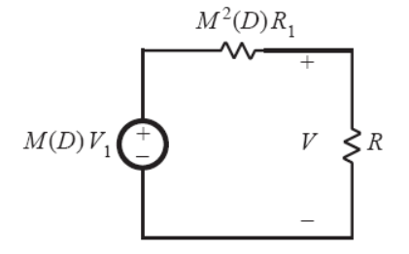
DC Transformer Circuit Manipulations
To push the voltage source V₁ from left to write, multiply by the winding ratio M.
When going from left to right, the voltage will increase by M, and the current will decrease by M. The resistance R will increase by M².

Slide 4
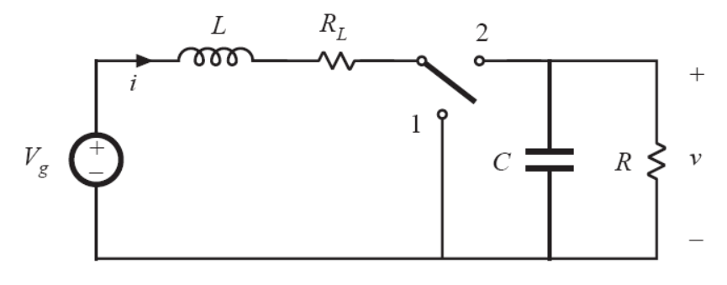
Construction of Equivalent Circuit Model (Boost Example 1/3)
Simplifies to:

Slide 5
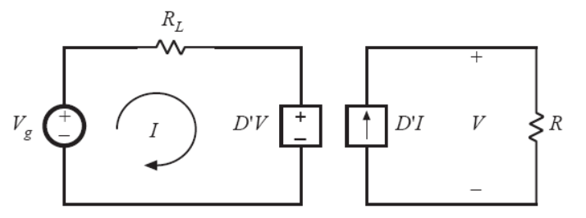
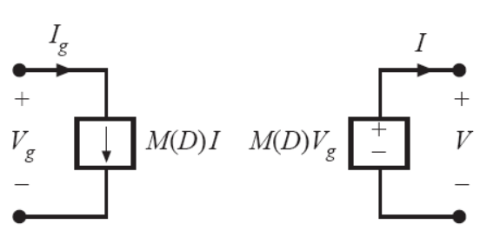
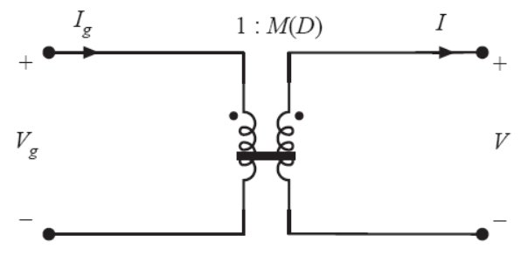
Construction of Equivalent Circuit Model (Boost Example 2/3)
Relationship between dependent sources and DC transformer models:

Slide 6
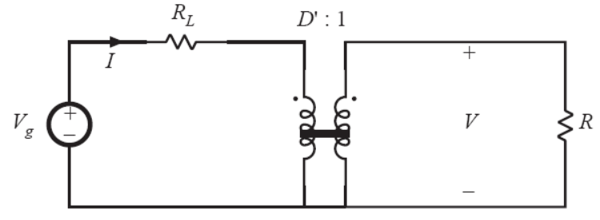
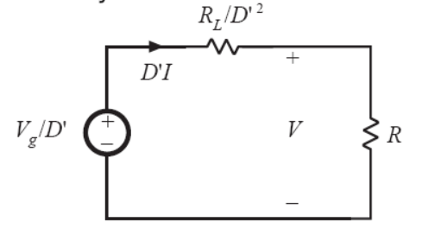
Construction of Equivalent Circuit Model (Boost Example 3/3)
Final answers:

Slide 7
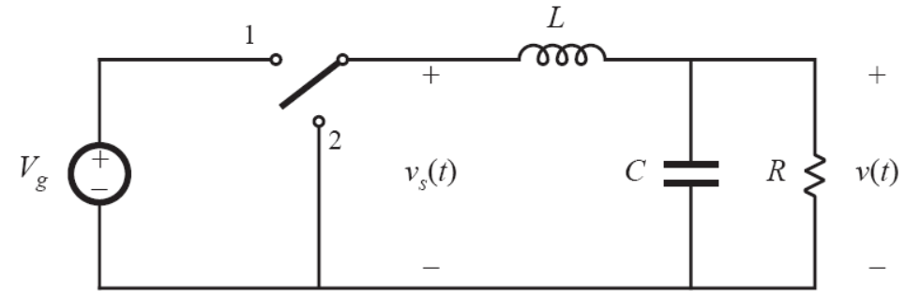
Buck Converter Modeling
I
The plan is to model the dashed line as a DC transformer.
The DC equations:
Note that V_{S} is used, not V_{L}

Slide 8
Converting DC Equations to AC
Step 1: Expand to include small signal components
Step 2: Collect the first order small signals

Slide 9
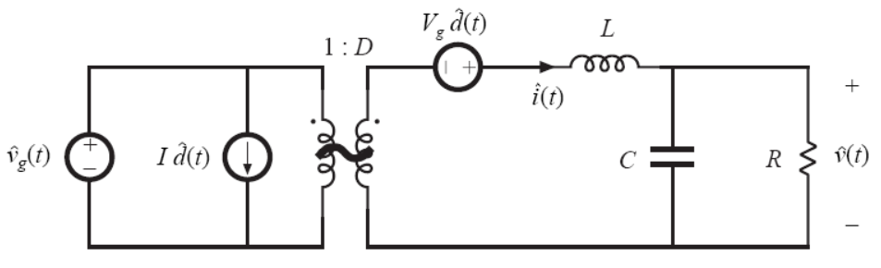
Buck Converter Small Signal Model
i_{g}(t)

Slide 10
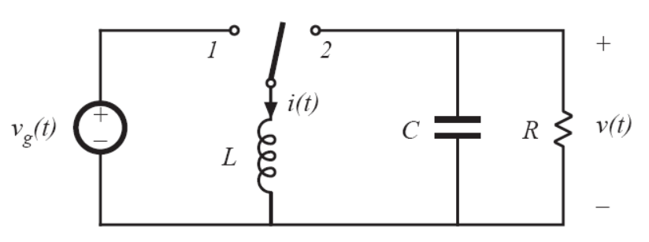
Buck Boost Converter Small Signal Model (1/3)
I_{C}
I
DC Equations:

Slide 11
Buck Boost Converter Small Signal Model (2/3)
AC Equations:

Slide 12
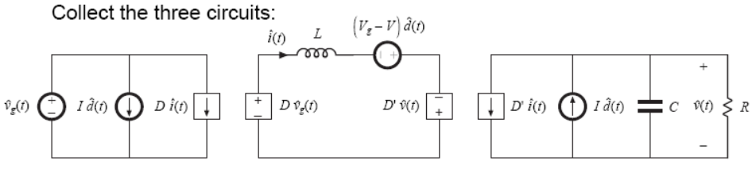
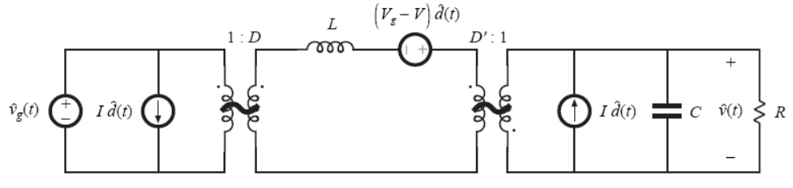
Buck Boost Converter Small Signal Model (3/3)

Slide 13
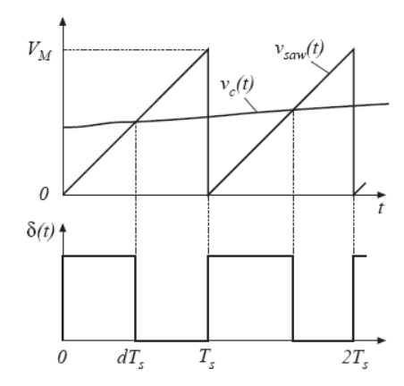
Modeling the Pulse-Width Modulation
Output pulse can be modeled as a result of comparing the saw-tooth signal with peak voltage V_{M} and a slightly changing V_{C}
DC Equation:
AC Equation:
Small Signal Equation:

Slide 14
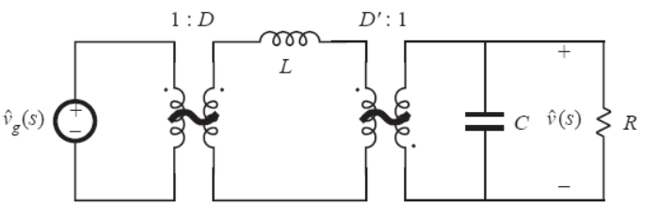
Line to Output Transfer Function (G_{vg}(s) hand calculation 1/2)
Model for the buck boost converter:
Make d(t) = 0

Slide 15
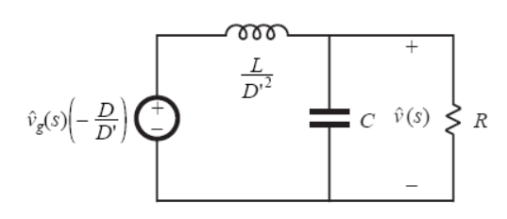
Line to Output Transfer Function (G_{vg}(s) hand calculation 2/2)

Slide 16
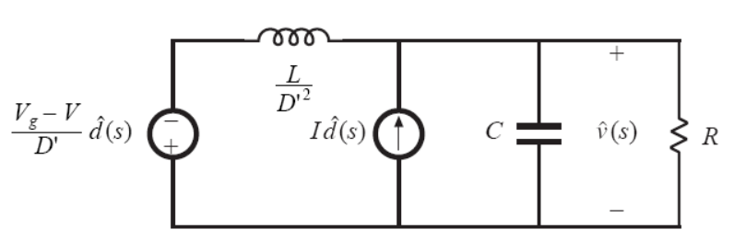
Control to Output Transfer Function (G_{vd}(s) hand calculation 1/3)
Buck boost model:
Make the v_{g}(t) = 0:
0V
0V

Slide 17
Control to Output Transfer Function (G_{vd}(s) hand calculation 2/3)
Use superposition to get G_{vd}(s):
Final Answer

Slide 18
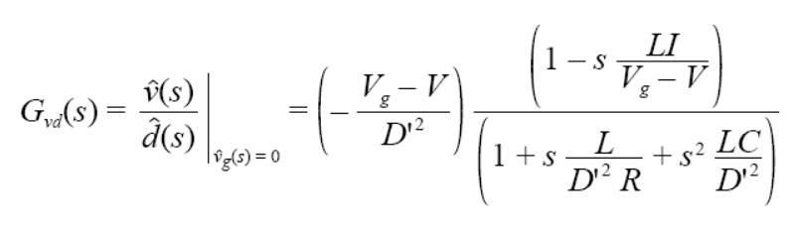
Control to Output Transfer Function (G_{vd}(s) hand calculation 3/3)
Simplified Answer:
Note the presence of the right half-plane zero.
Buck has no such zero, but boost and buck-boost has this zero. These two are harder to stabilize.
Eventual Magnitude =
Eventual Phase =

Slide 19
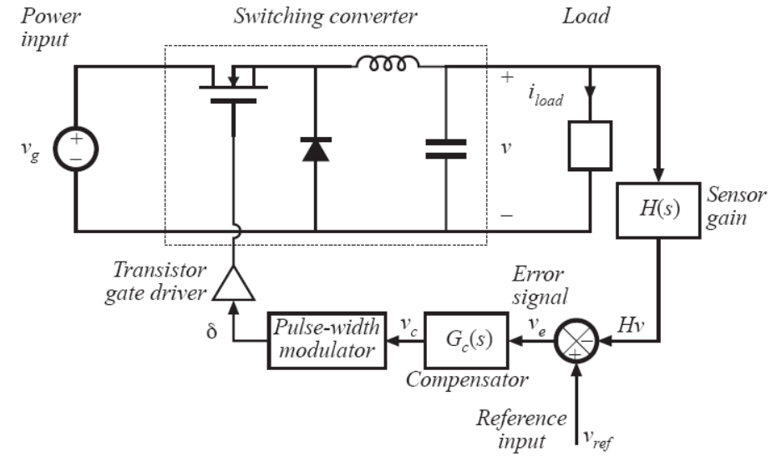
Switching Regulator Model with Feedback

Slide 20
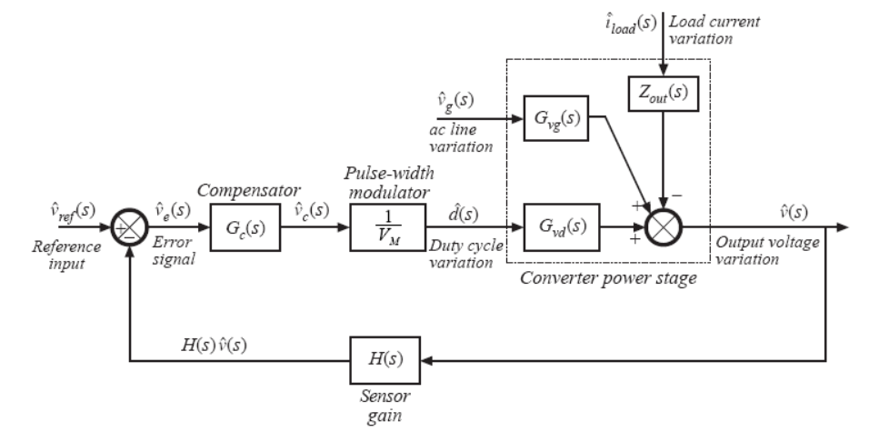
General Small-Signal Model

Slide 21
Transfer Function Including Feedback
Less variation in output due to variation in v_{g} and i_{load}

Slide 22
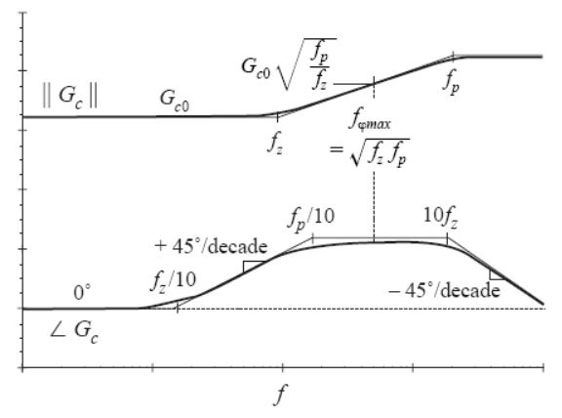
Lead (PD) Compensator
This extends the crossover frequency f_{c} while attempting to maintain an acceptable phase margin
There’s a frequency at which phase gain is maximum. Make this the f_{c}.
Also make f_{c} < 10% of the switching frequency to avoid amplifying switching harmonics.

Slide 23
Lead Compensator Equations
The maximum phase boost is at f_{φmax}:
To place the zero and the pole so to obtain phase boost θ:
Transfer function magnitude at f_{φmax}:

Slide 24
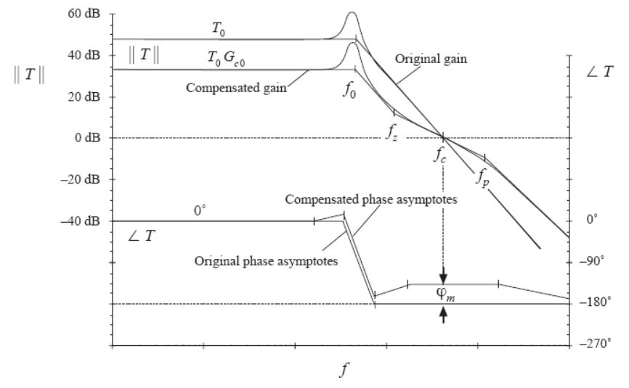
Lead Compensation Example
Here the f_{c} is unchanged while boosting phase margin

Slide 25
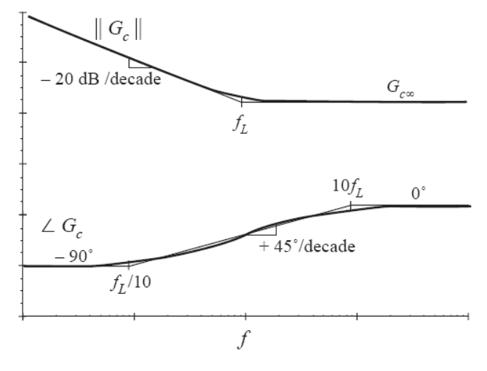
Lag (PI) Compensator
The goal is to increase DC gain, so DC and low frequency disturbances don’t affect output.

Slide 26
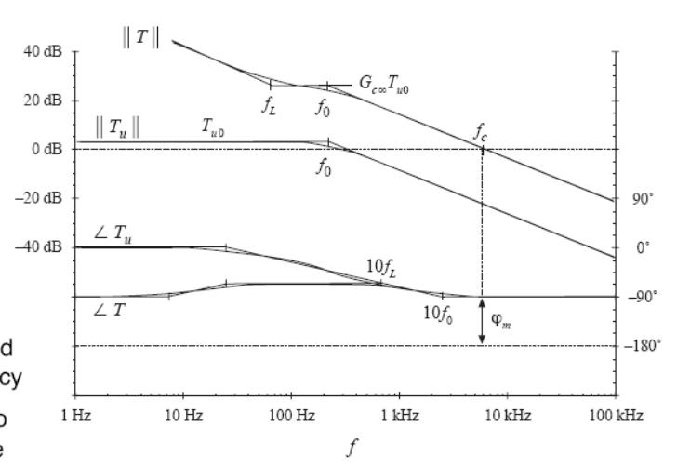
Lag Compensation Example
T_{u} is the uncompensated transfer function
If f_{L} is sufficiently small, there’s no effect on the phase graph
Here the G_{C∞} is chosen to make f_{c} higher

Slide 27
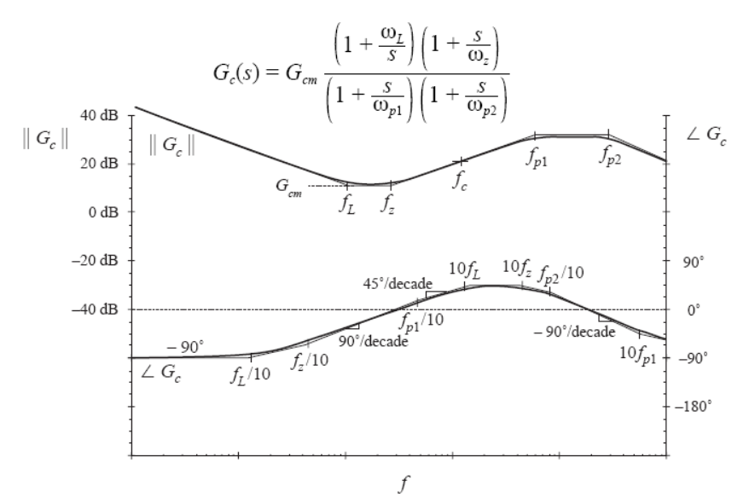
Combined (PID) Compensator

Slide 28
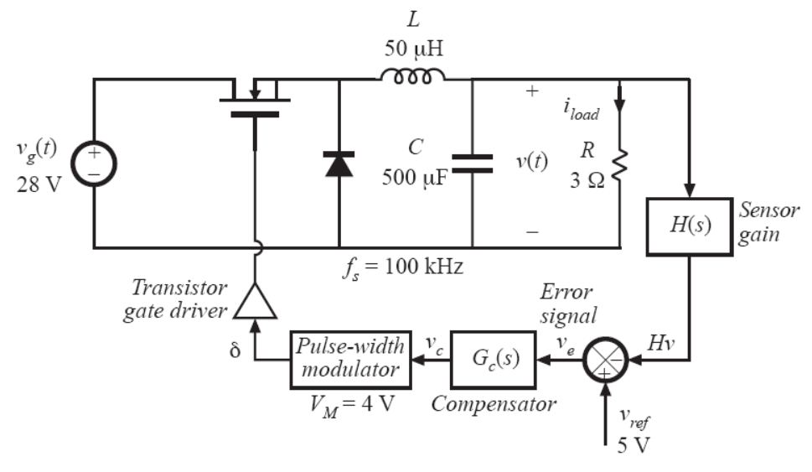
Buck Design Example (1/6)
+15V
1/3

Slide 29
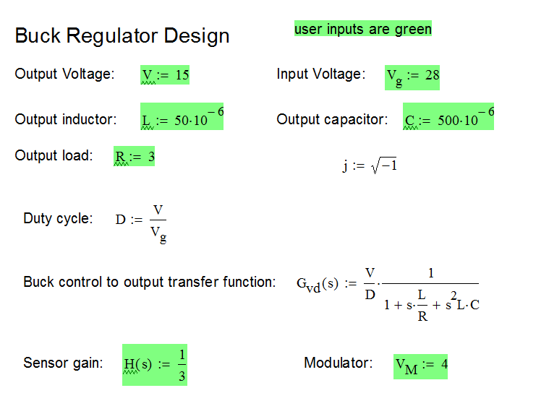
Buck Design Example (2/6)
hint:
v_{s} = dV_{g}
v_{s} = d(V/D)

Slide 30
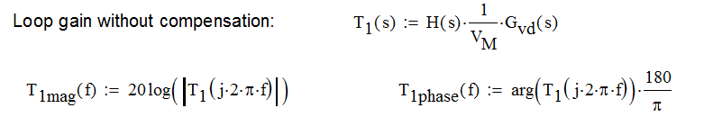
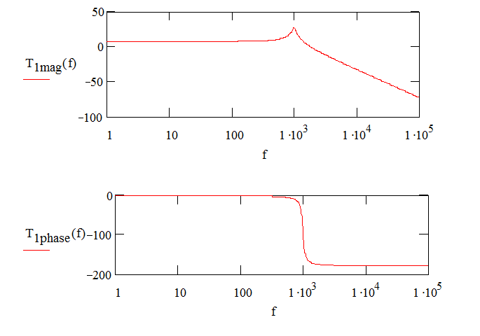
Buck Design Example (3/6)

Slide 31
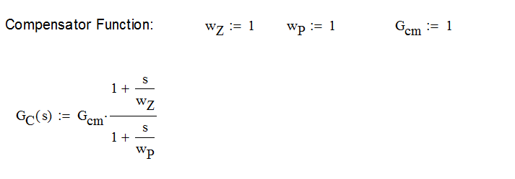
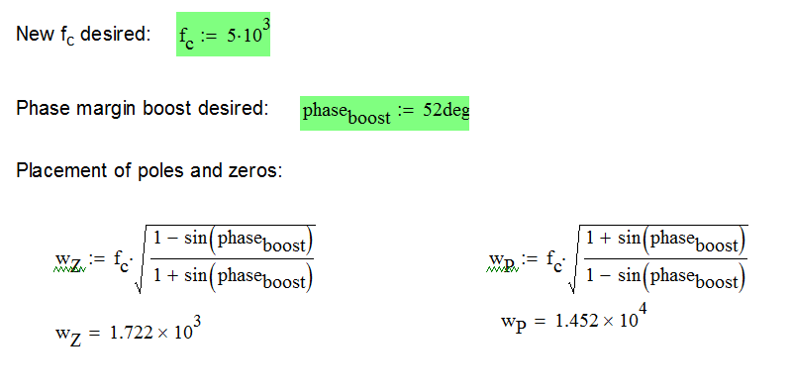
Buck Design Example (4/6)
Locate w_{z} and w_{p} based on the required boost in phase margin

Slide 32
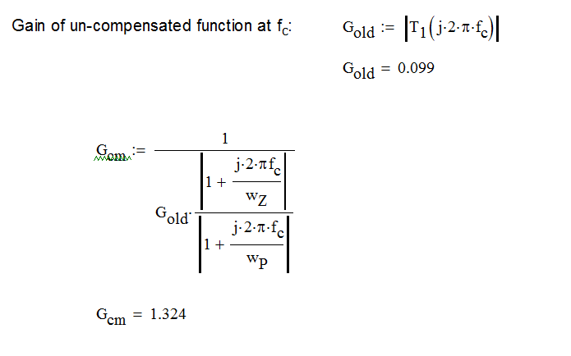
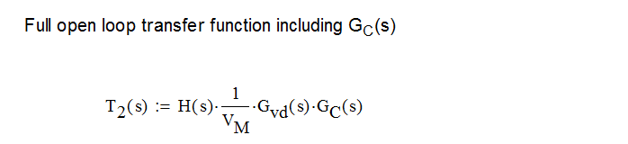
Buck Design Example (5/6)

Slide 33
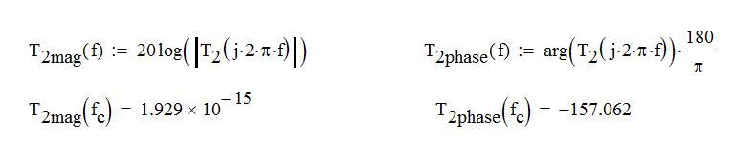
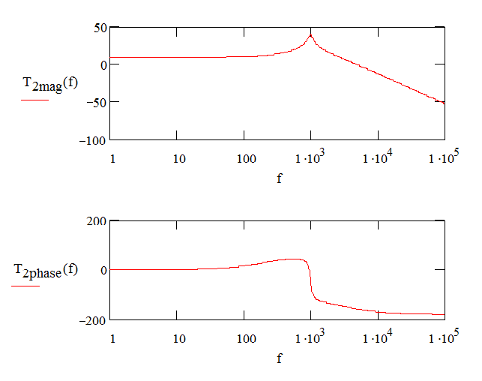
Buck Design Example (6/6)
Phase margin is not the 52 degrees previously estimated
Check that gain at f_{c} is indeed 0dB

Slide 34
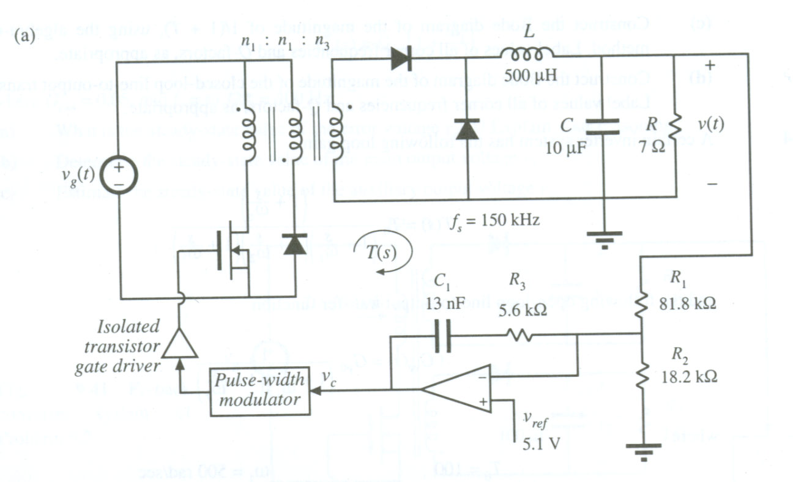
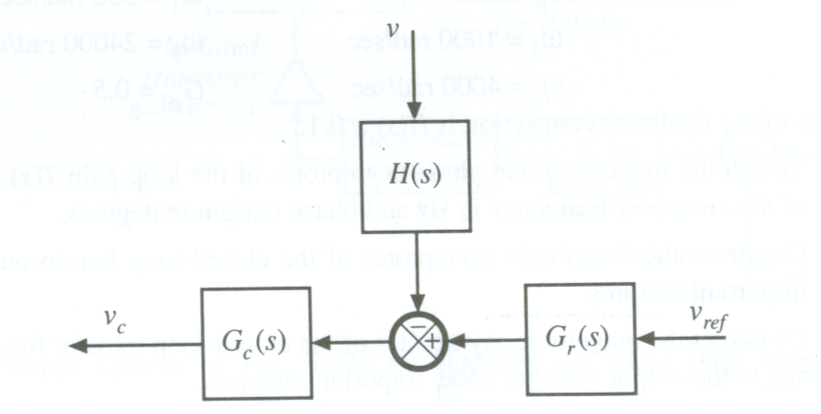
Obtaining the G_{C}(s) by Algebra (1/4)
This is CH 9’s problem 5, part B
Find G_{c}(s) and G_{r}(s)

Slide 35
Obtaining the G_{C}(s) by Algebra (2/4)
Overall Relationship
Superposition Conclusions
If v_{ref} = 0:
If v = 0:

Slide 36
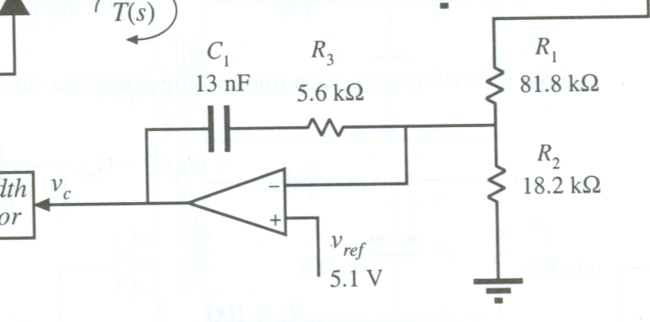
Obtaining the G_{C}(s) by Algebra (3/4)
When v_{ref} = 0
v
0
0
Final answer:

Slide 37
Obtaining the G_{C}(s) by Algebra (4/4)
When v = 0
0
Final answer:

