Slide 2
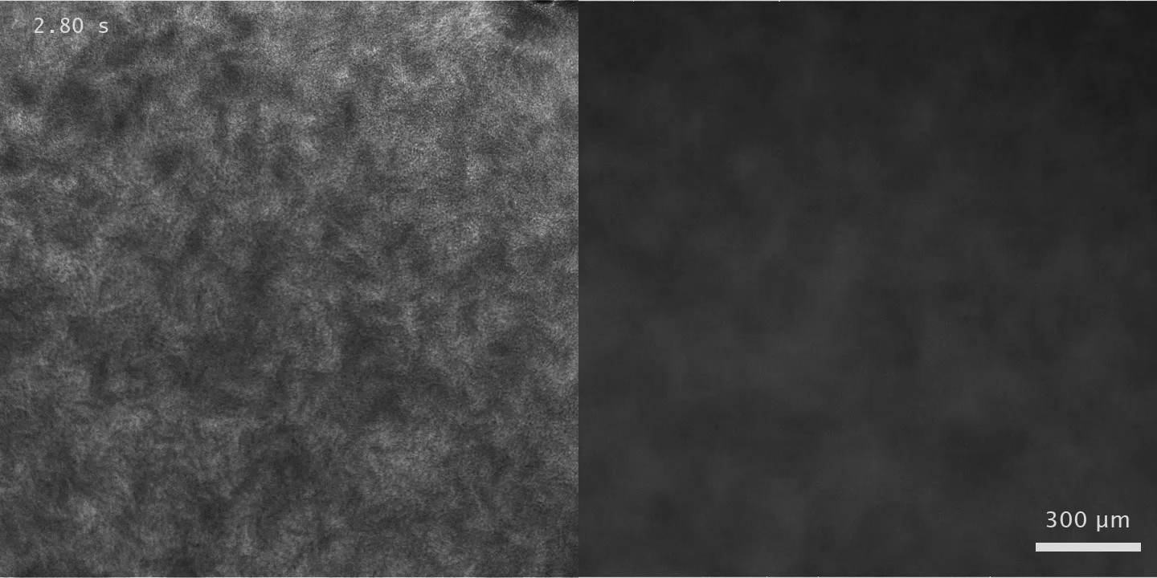
Time stamp
Phase contrast
Fluorescent image
Length of shortest side:
720 px
Text of scale bar
Scale bar

Slide 3
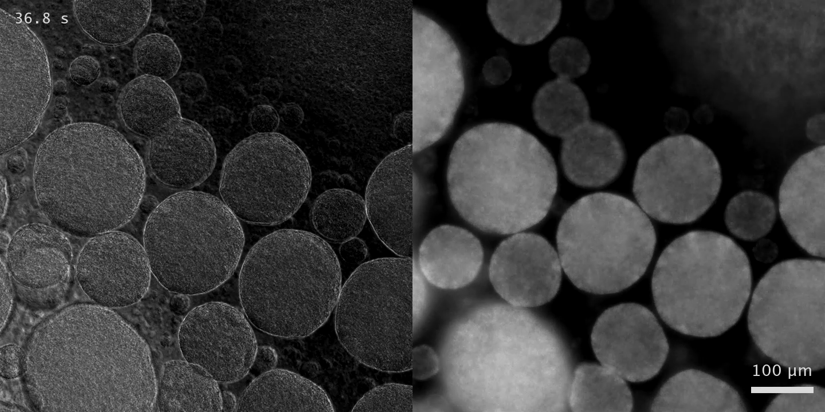
Time stamp
Phase contrast
Fluorescent image
Length of shortest side:
720 px
Text of scale bar
Scale bar

Slide 4
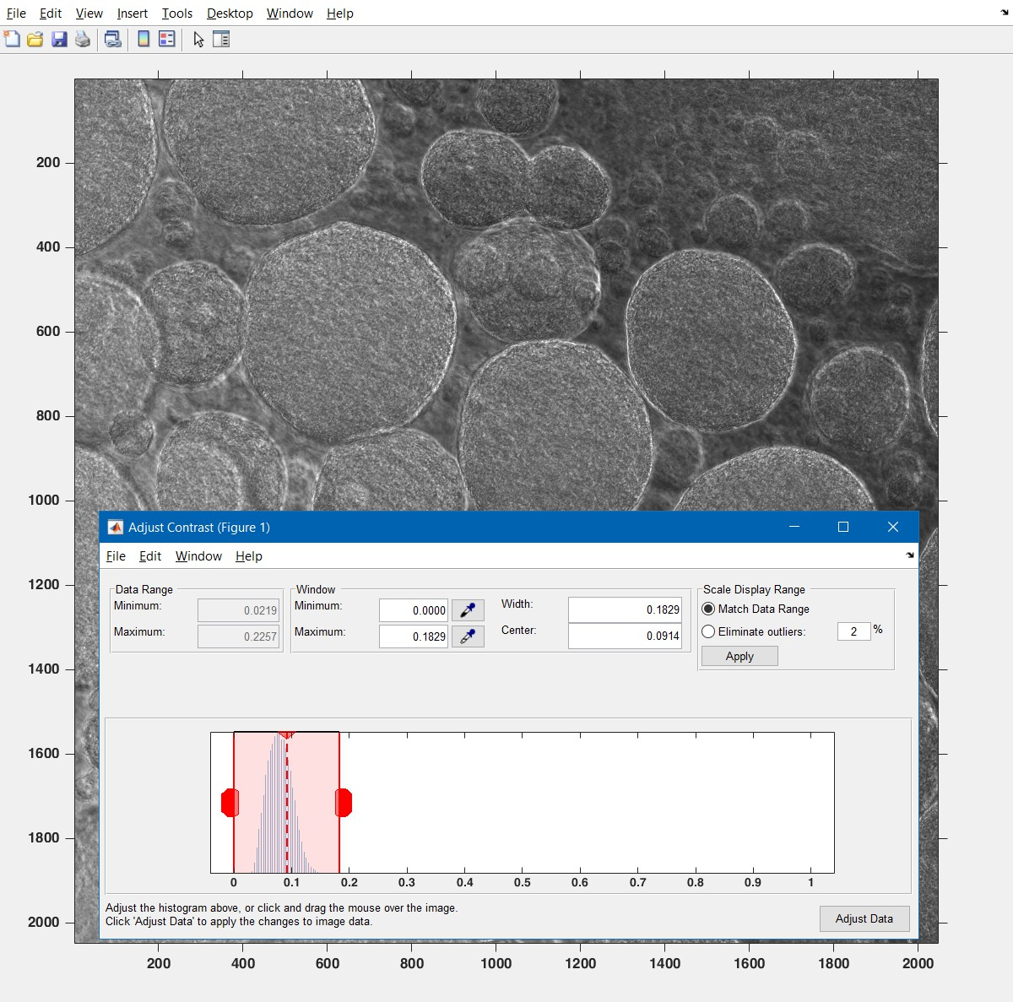
NO CLICKING IT!

