Slide 1

Differentially Private Location-based Histogram Publication
Student: CHAN, Lo Yuet
Supervisor:LOUKIDES, Grigorios

Slide 2
MOTIVATION
Social plaform is part of our life
Private, sensitive information
Valuable data about life pattern and behaviour
Privacy infringement
Blur datasets into each other
Preserving important pattern in datasets

Slide 3
PROBLEM
Apply i.i.d. Laplace noise
Lap (μ, b)

Slide 4
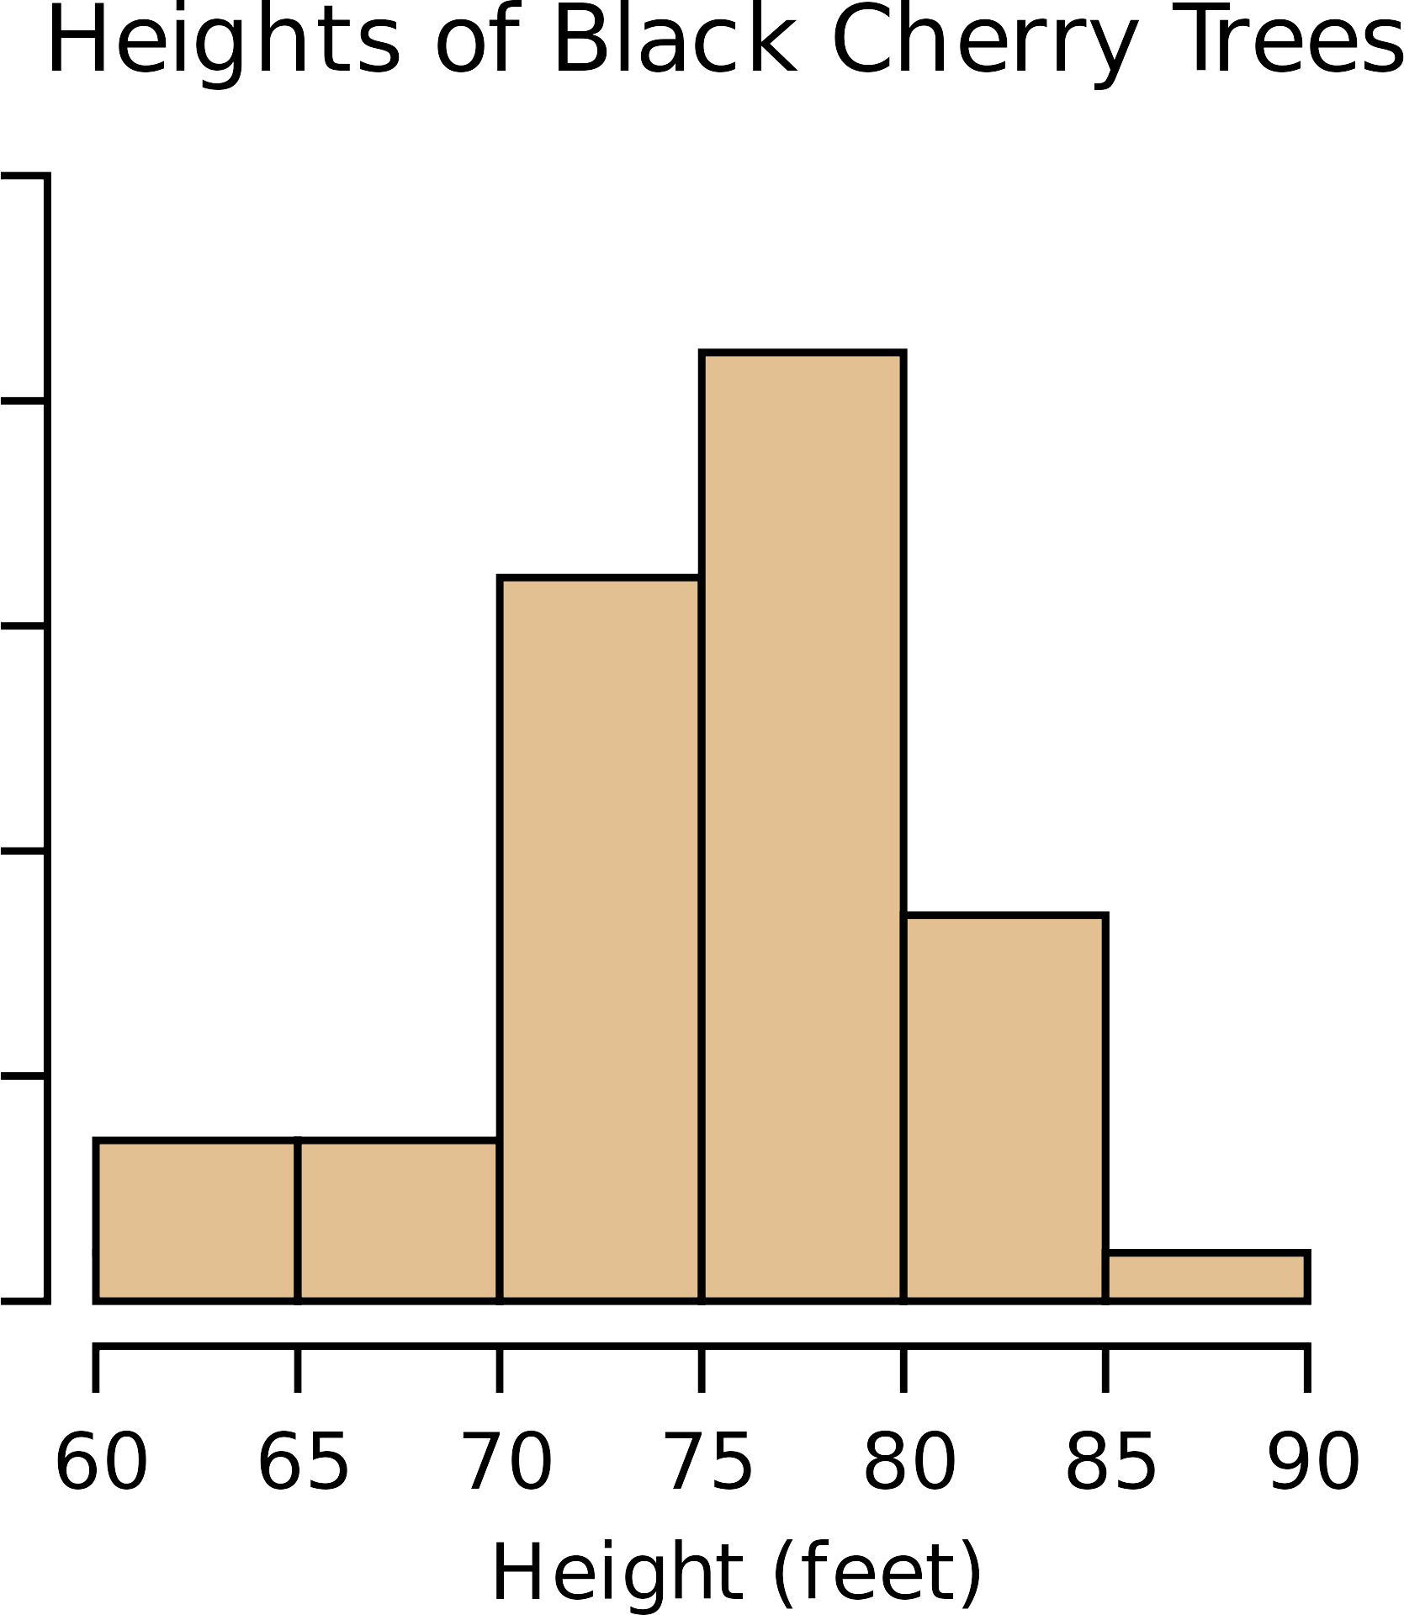
PROBLEM
Apply i.i.d. Laplace noise

Slide 5
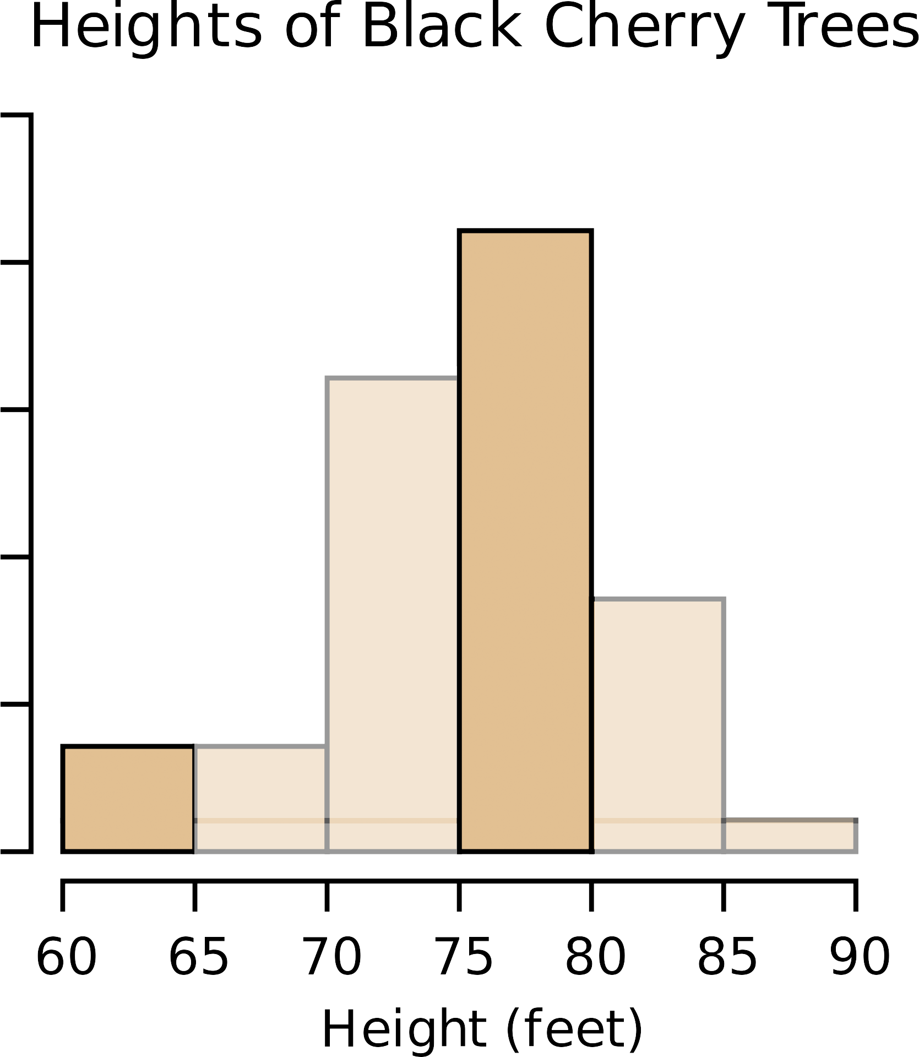
PROBLEM
Apply i.i.d. Laplace noise

Slide 6
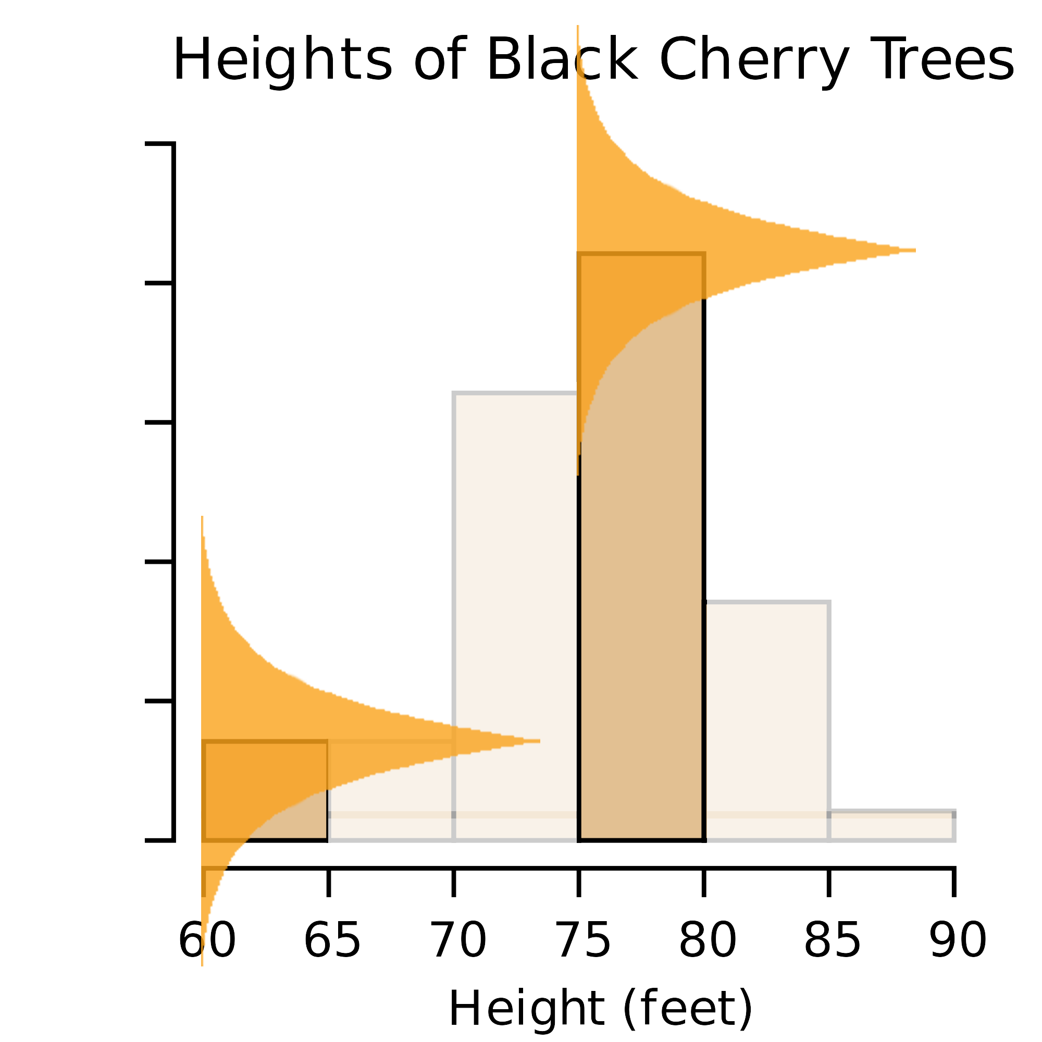
PROBLEM
Apply i.i.d. Laplace noise

Slide 7

PROBLEM
Apply i.i.d. Laplace noise
Result in high chance of getting
invalid values
Invalid Values

Slide 8
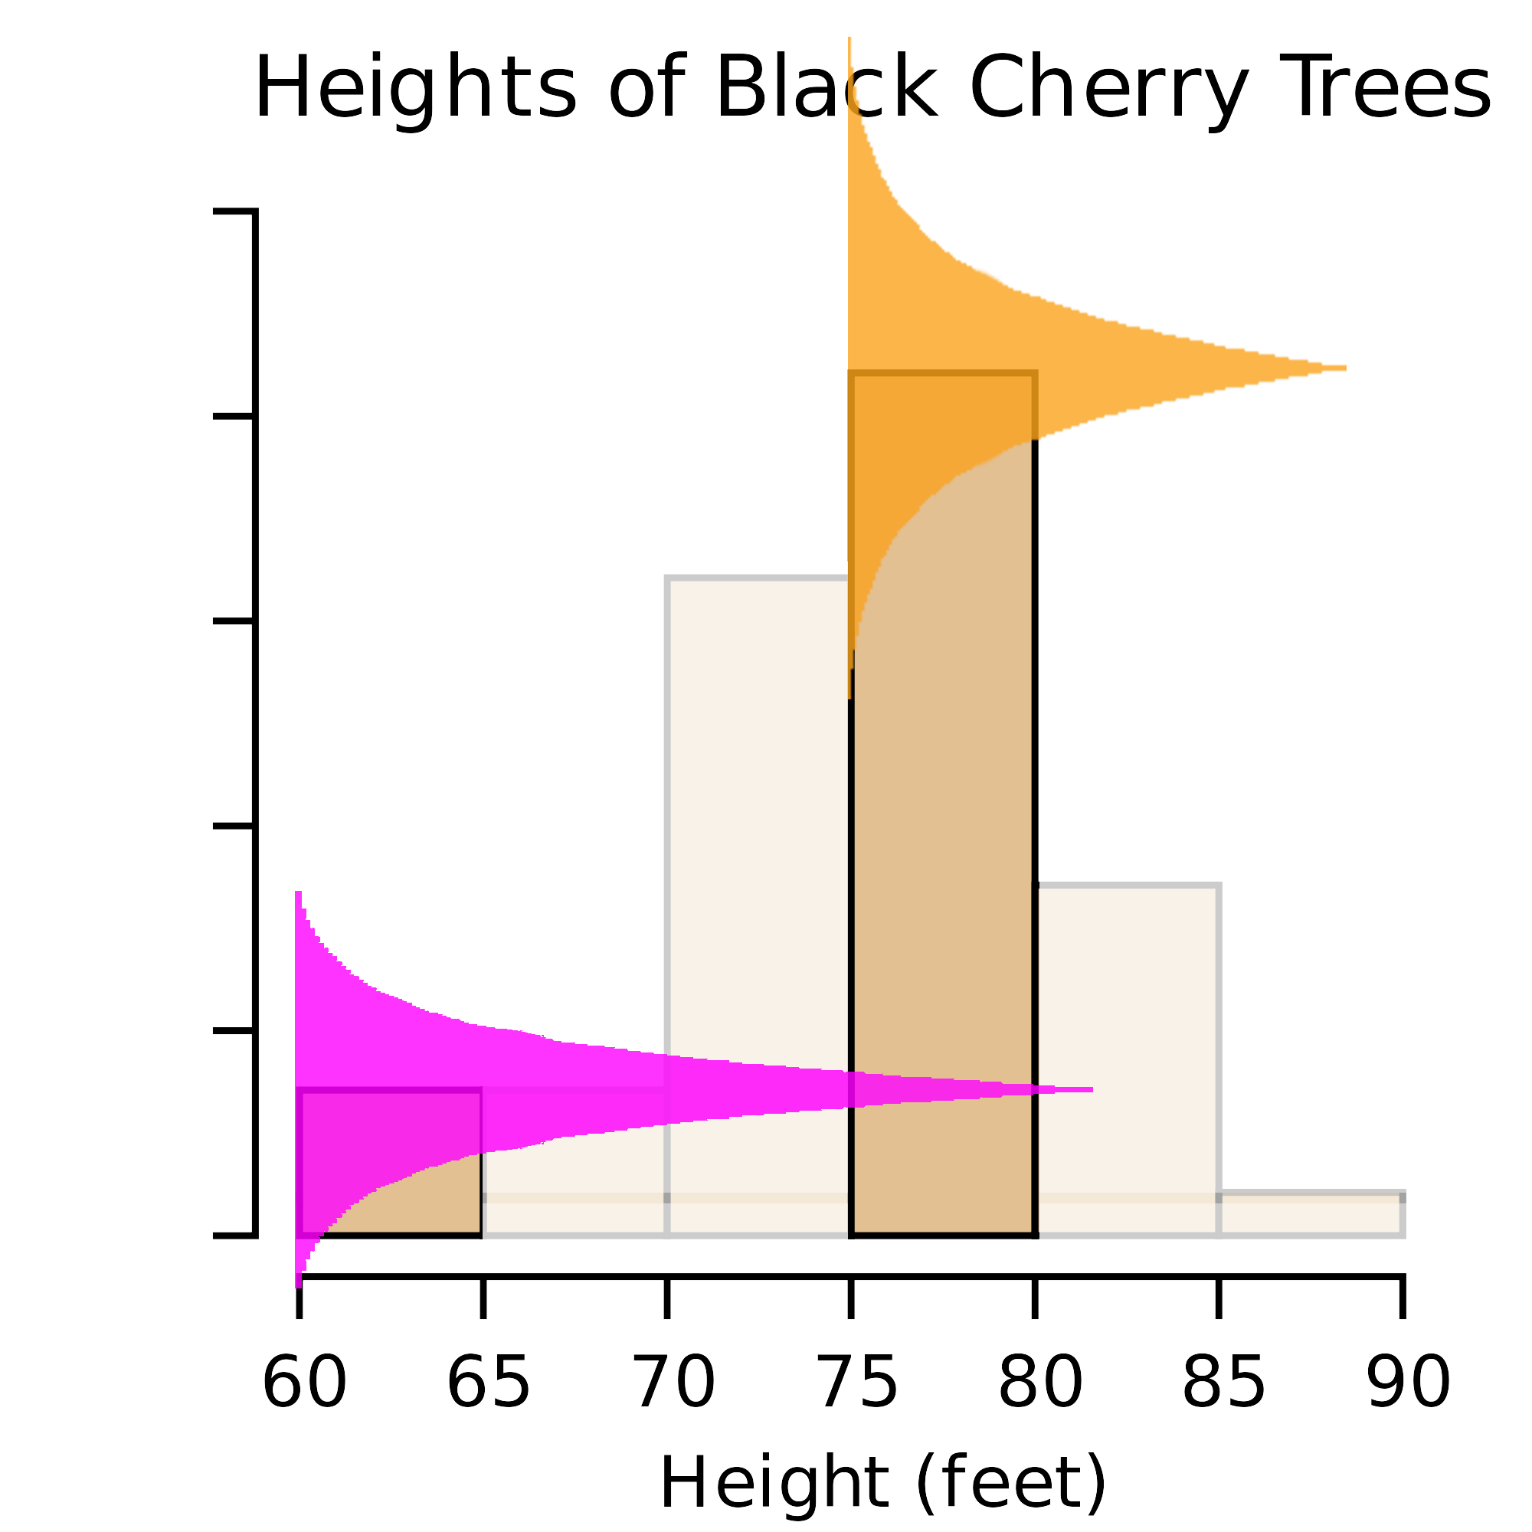
PROBLEM
Apply i.i.d. Laplace noise
Result in high chance of getting
invalid values
Apply i.d. Laplace noise
Minimise/reduce the change of
getting invalid values
Invalid Values

Slide 9
APPROACH
Statistical proof
Test & Experiment
  Four open datasets from FourSquares
Apply Laplacian noise with scale (b) relative to the count
Apply Laplacian noise after testing all possible combinations
Apply Laplacian noise according to sorted rank

Slide 10
APPROACH
Statistical proof
Test & Experiment
  Four open datasets from FourSquares
Apply Laplacian noise with scale (b) relative to the count
Apply Laplacian noise after testing all possible combinations
Apply Laplacian noise according to sorted rank

Slide 11
APPROACH
Statistical proof
Test & Experiment
  Four open datasets from FourSquares
Apply Laplacian noise with scale (b) relative to the count
Apply Laplacian noise after testing all possible combinations
Apply Laplacian noise according to sorted rank

Slide 12
RESULT
Two Utility Metrics
  KLD (measuring preservation of data distribution)
  MSE (measuring error of range queries)
Anticipate to outperform on both KLD and MSE

Slide 13
Q & A SECTION

