Slide 1
Playing Notes by Image Processing
Activity 9 Short Report
Lou Josef S. Tan

Slide 2
Tasks
Integration of image processing skills learned to determine the notes from a musical score sheet
Play the notes with proper frequency and duration

Slide 3

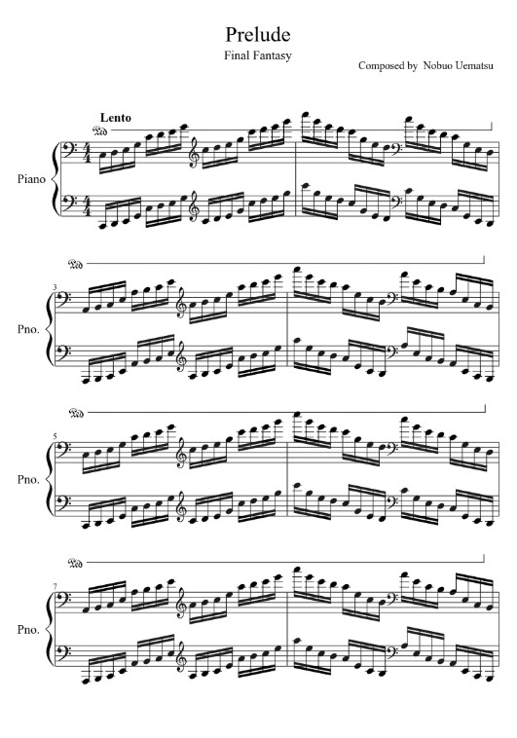
Musical Score Sheet
Shown in Fig. 1 is the musical score sheet that I would want to play. This one is an opening song from one of my favorite video games, Final Fantasy.
Figure 1. Prelude – Final Fantasy score sheet. Taken from: https://musescore.com/user/205967/scores/373116

Slide 4
Proposed Methodology
In extracting and determining the proper frequencies and durations of the notes from the score sheet, I present below the outline of the procedure that I have used:
Step 1: Binarizing the score sheet image
Step 2: Segmenting the lines from the score sheet
Step 3: Segmenting the notes (note heads and note bars) from the score sheet

Slide 5
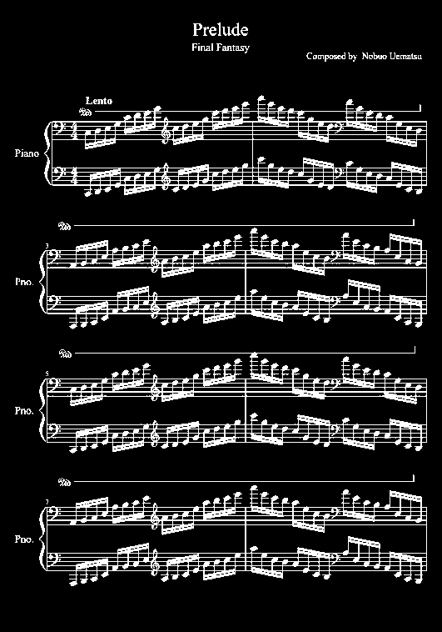
Binarizing Score Sheet
STEP 1
Here, we simply take the grayscale histogram of the image, and then segment the image via grayscale thresholding. In this way, we would be able to apply morphological operations to get the lines and notes.
Figure 2. Binarized musical score sheet.

Slide 6
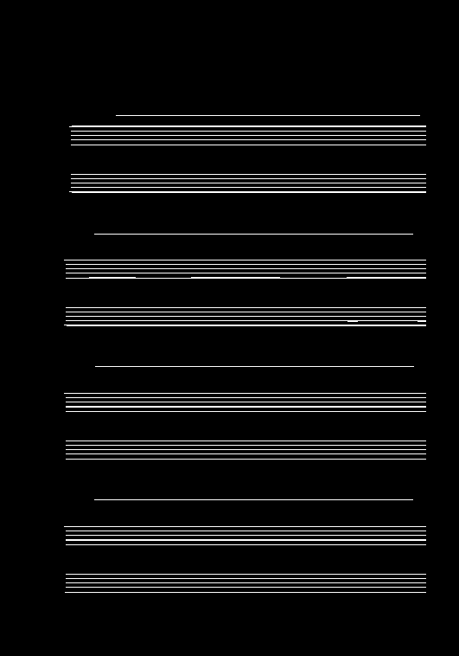
Segmenting the Lines
STEP 2
To segment the lines from the binarized score sheet, morphological operations proved to be useful. I used a long-enough horizontal line structuring element to erode the image and retain the lines.
Figure 3. Segmented lines from the score sheet.

Slide 7
Segmenting the Lines
STEP 2
However, other unnecessary lines were retained upon erosion. To remedy this, I obtained the areas of the lines to threshold the image into having the staff lines only.
Figure 4. Segmented lines from the score sheet. Enclosed in red boxes are the unnecessary lines.

Slide 8
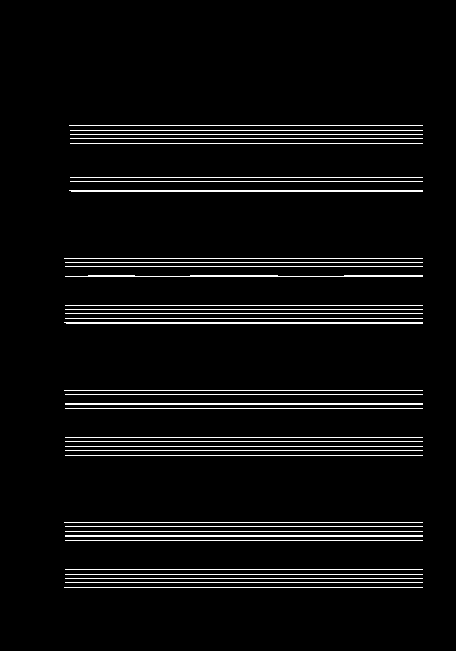
Segmenting the Lines
STEP 2
However, other unnecessary lines were retained upon erosion. To remedy this, I obtained the areas of the lines to threshold the image into having the staff lines only.
I then obtained the centroids of the lines to get the y-coordinates, which I would use later on in determining the note frequencies.
y
x
Figure 5. Segmented staff lines from score sheet.

Slide 9
Segmenting the Lines
STEP 2
Additionally, I took the distances between lines (within a single staff), which I would use to determine my confidence values (range) in determining the note frequencies.
y
x
Figure 5. Segmented staff lines from score sheet.

Slide 10
Segmenting the Notes
STEP 3
Going back to our binarized image, we segment the notes by eroding the image with the following structuring elements: a vertical line to remove the staves, and a diagonal line short enough to include both note heads and note bars.
Figure 2. Binarized musical score sheet.

Slide 11
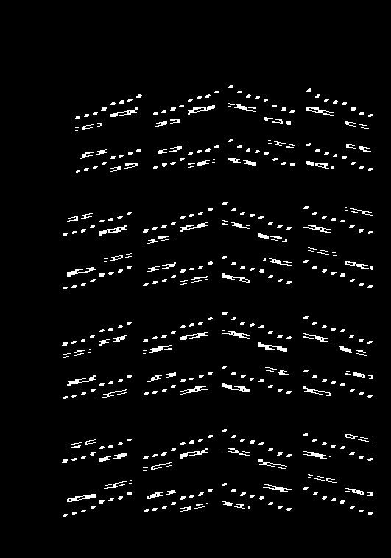
Segmenting the Notes
STEP 3
Going back to our binarized image, we segment the notes by eroding the image with the following structuring elements: a vertical line to remove the staves, and a diagonal line short enough to include both note heads and note bars.
Figure 6. Note heads and note bars from score sheet.

Slide 12
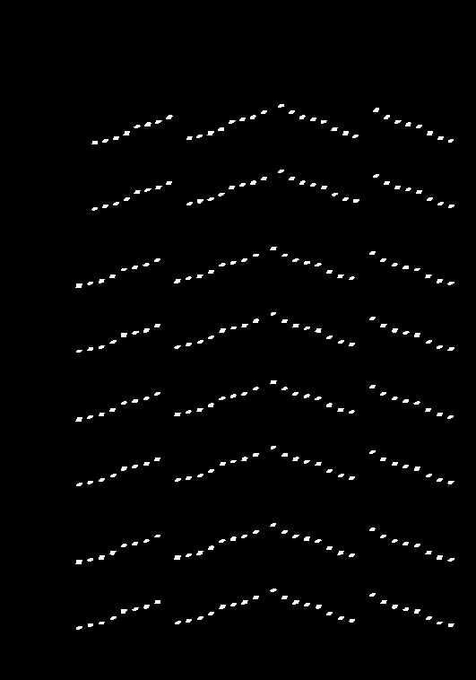
Segmenting the Notes
STEP 3
I further split Fig. 5 into:
Note heads only (for determining the note frequencies)
Figure 7. Note heads only.

Slide 13
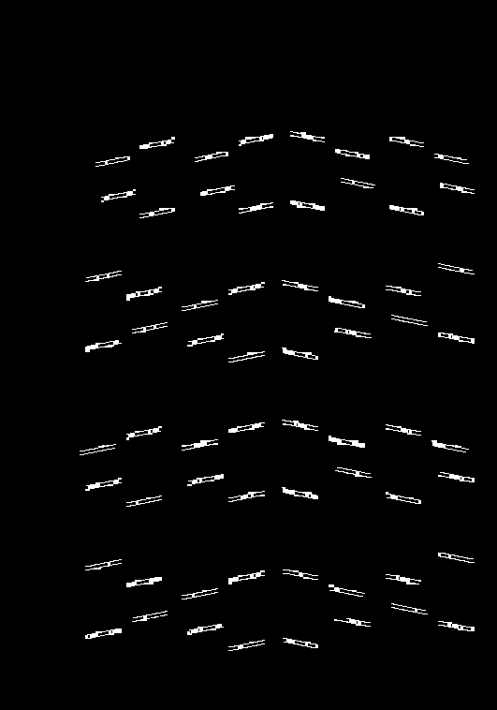
Segmenting the Notes
STEP 3
I further split Fig. 5 into:
Note heads only (for determining the note frequencies)
Note bars only (for determining the note durations)
Figure 8. Note bars only.

Slide 14
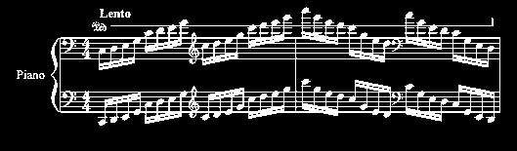
Segmenting the Notes
STEP 3
To ease things up, I decided to split the determination of frequencies and durations by staff such as in Fig. 9.
Figure 9. First staff of score sheet.

Slide 15
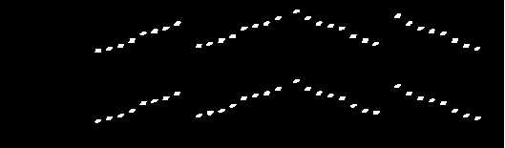
Segmenting the Notes
STEP 3
Likewise, here are the note heads from the first staff.
To determine the frequencies, I obtained the centroids of the note heads to get the y-coordinates. I then matched these to their closest values from the line locations (Slide 8), and thereby assigning their corresponding frequencies.
Figure 10. Note heads from the first staff.

Slide 16
Segmenting the Notes
STEP 3
Note that for my score sheet, staves were divided into three clefs.
F-clef
F-clef
G-clef
Figure 10. Note heads from the first staff.

Slide 17
Segmenting the Notes
STEP 3
As for the determination of the note durations, I utilized the note bars. To do so, I obtained the extrema of the bars. If the note heads fall within the range (in x) of the bars, they must either be eighth or sixteenth notes. Furthermore, if there were 2 bars (2 y’s in 1 x), then they must be sixteenth notes.
Figure 10. Note heads from the first staff.

Slide 18
Segmenting the Notes
STEP 3
However, this method only applies to my score sheet where there are no half and/or full notes (hollow note heads).
Figure 10. Note heads from the first staff.

Slide 19

Playing the Notes
Play the notes by clicking the audio file below:
You can listen to the original sound here: https://open.spotify.com/track/6pyZvQbImZOmzXfJhXNA4a?si=W2XsXqsfStOn9f57afHPlw

Slide 20
Evaluation
I give myself an overall score of 10/10 for this activity for producing all required output.
I enjoyed this activity because the song gives me much nostalgia, I get to relive my childhood, and being able to play it through image processing is such an achievement.
I would like to thank Andy for all the brainstorming about determining the frequencies and the durations of notes.

