Slide 1
Feature Extraction
Activity 12 Short Report
Lou Josef S. Tan

Slide 2
Tasks
Feature extraction of apparent visual features from a sample dataset of different fruits (oranges, banana, and mangoes)
Plotting these feature points to see if class clustering can be observed

Slide 3
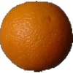
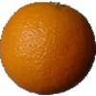
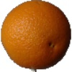
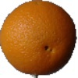
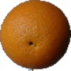
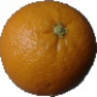
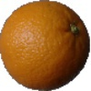
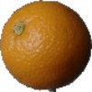
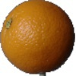
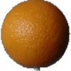
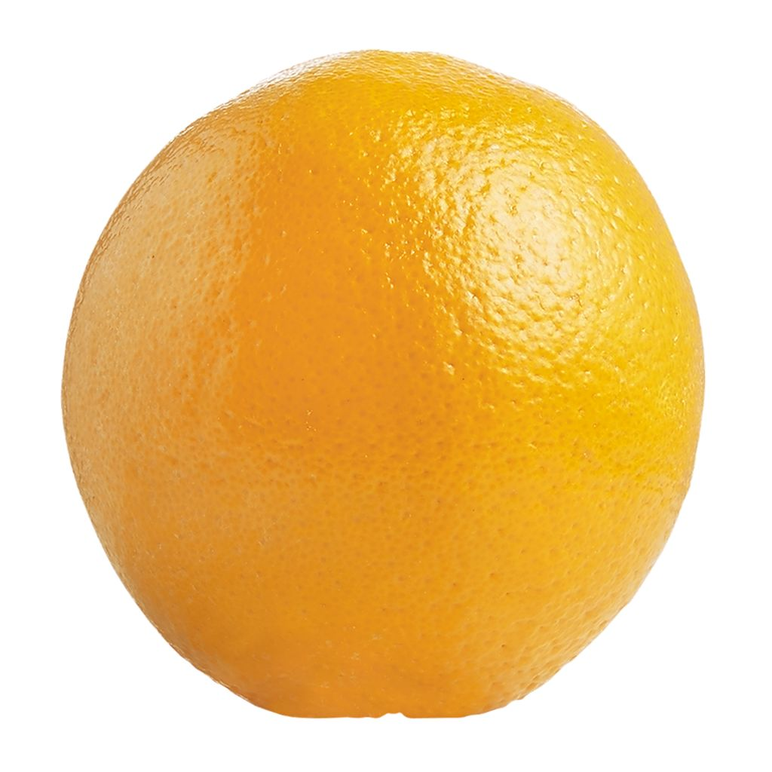
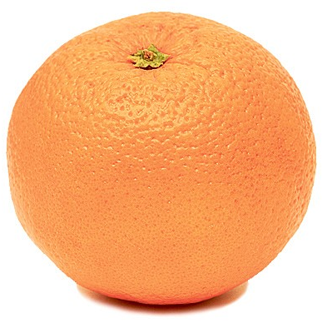
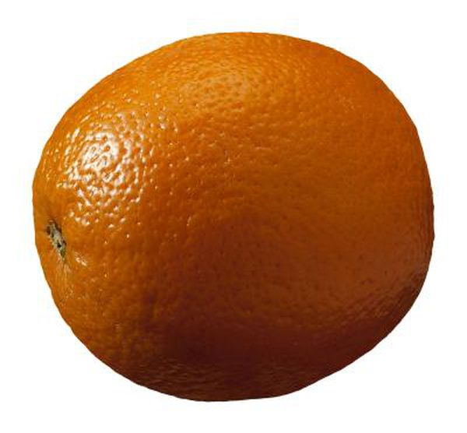
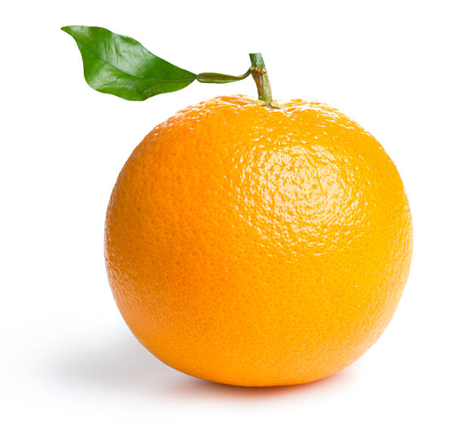
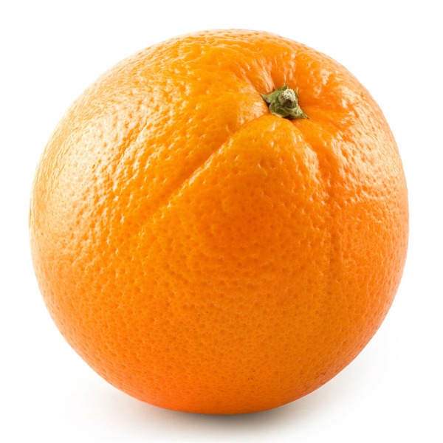
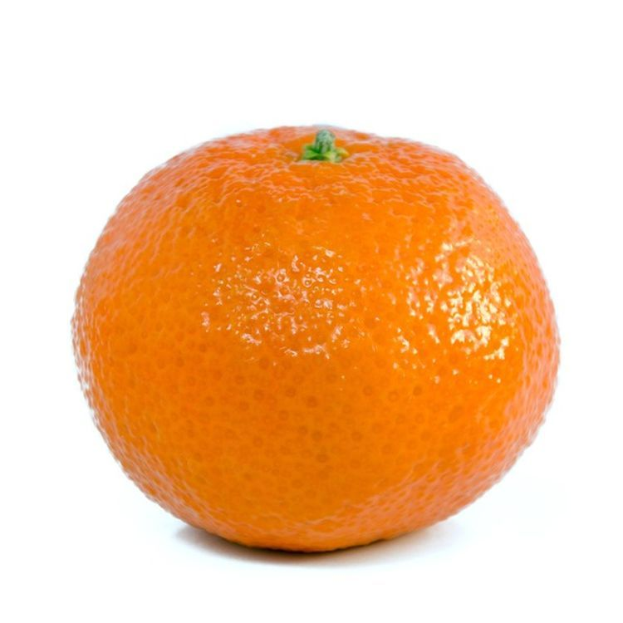
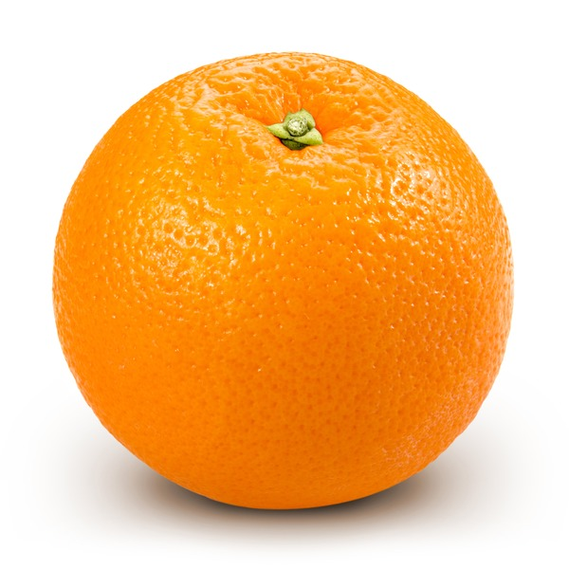
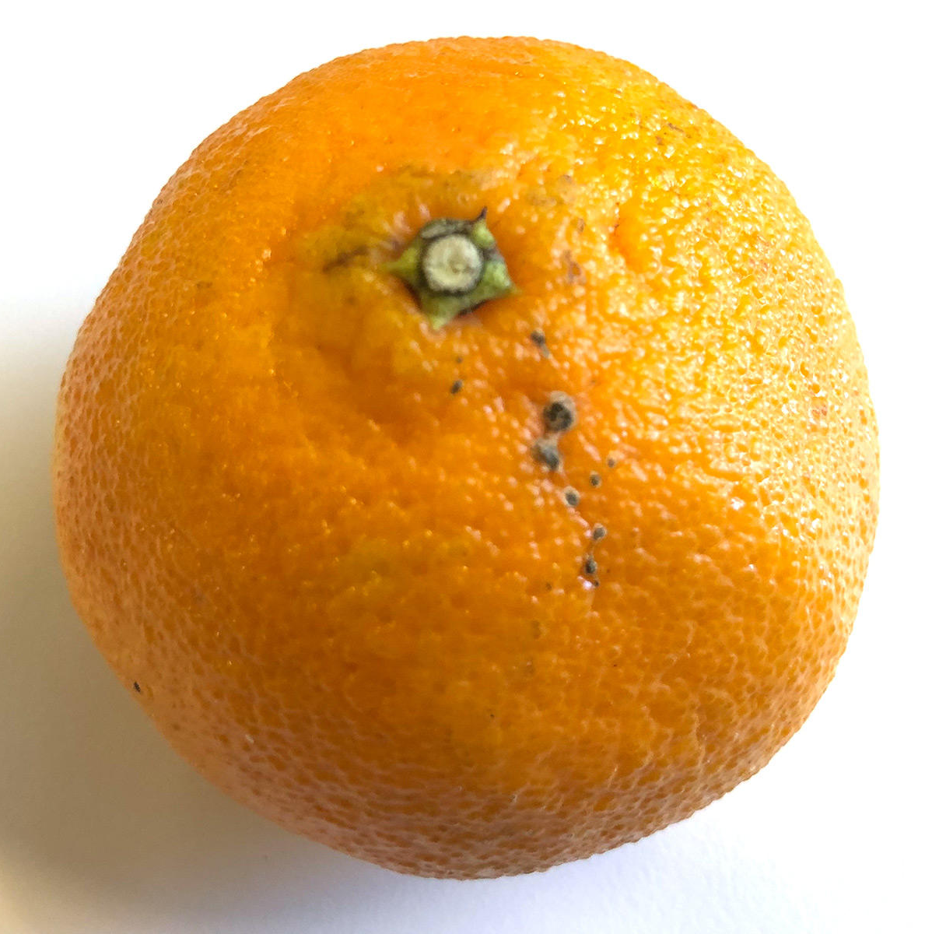
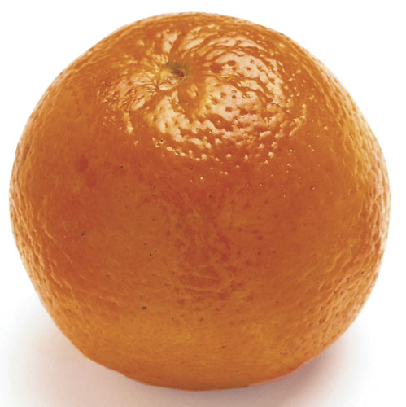
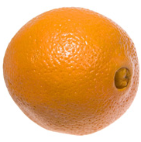
Dataset - Oranges
Figure 1. Oranges dataset. Images were taken from Fruits-360 dataset (https://github.com/Horea94/Fruit-Images-Dataset), and Google Images.

Slide 4
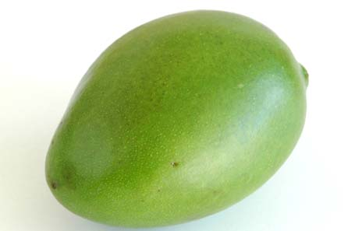
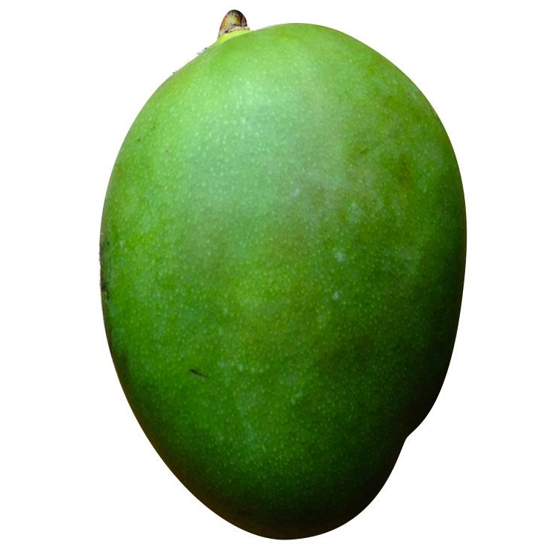
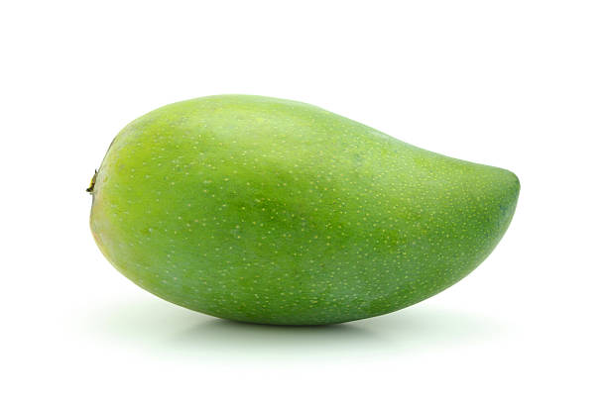
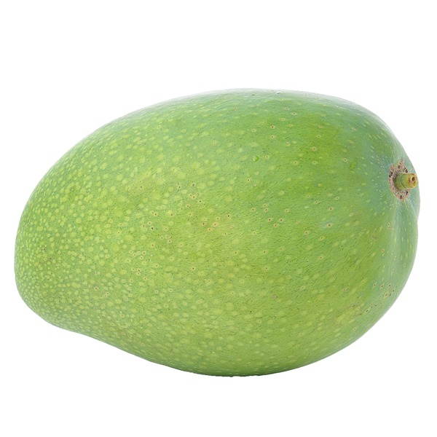
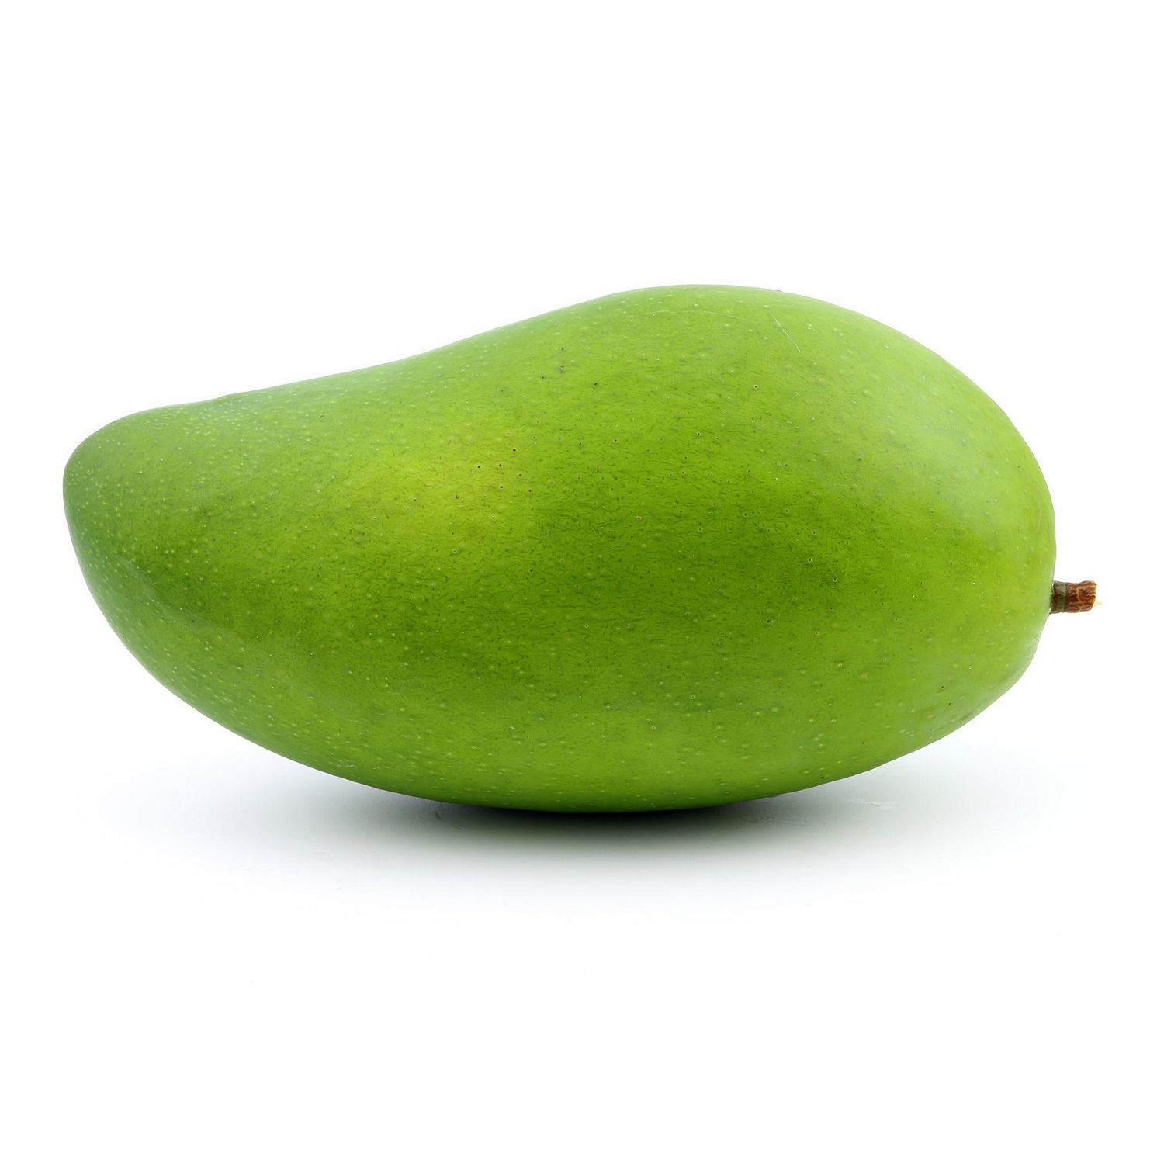
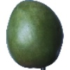
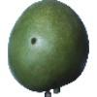
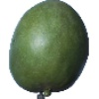
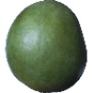
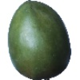
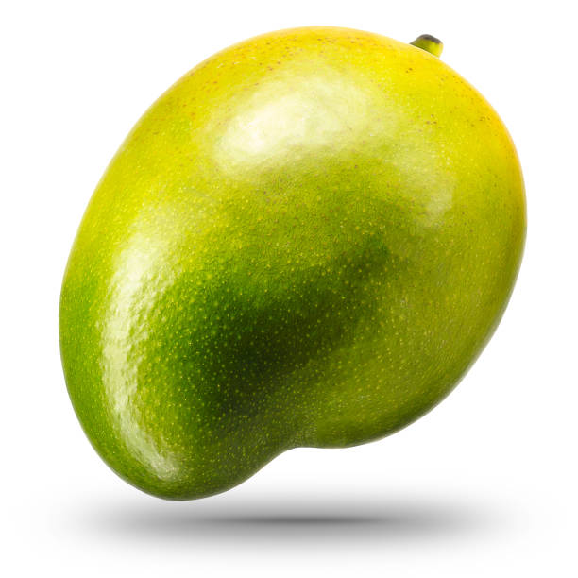
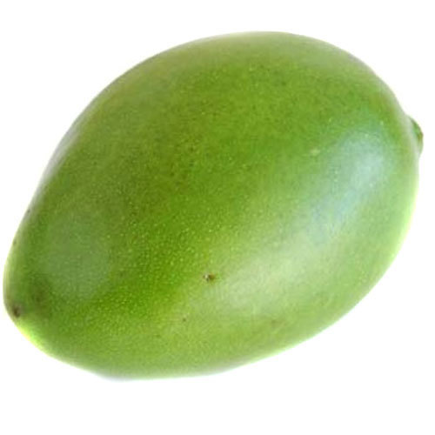
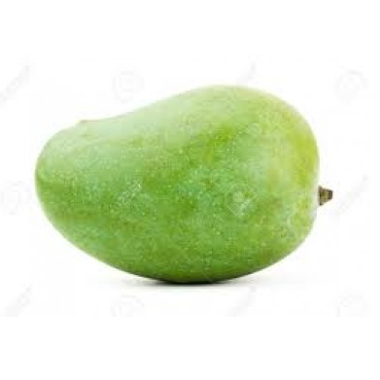
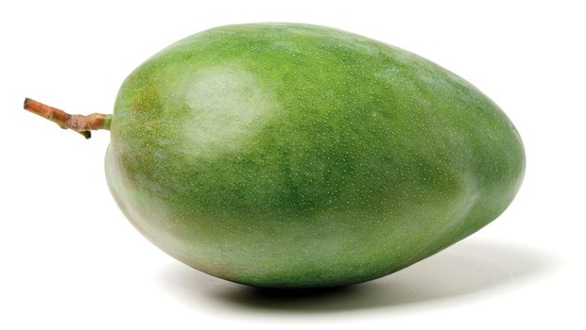
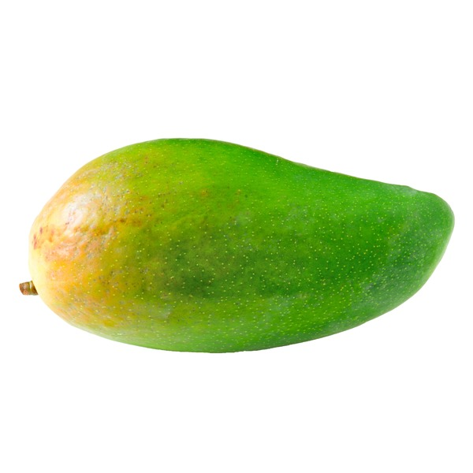
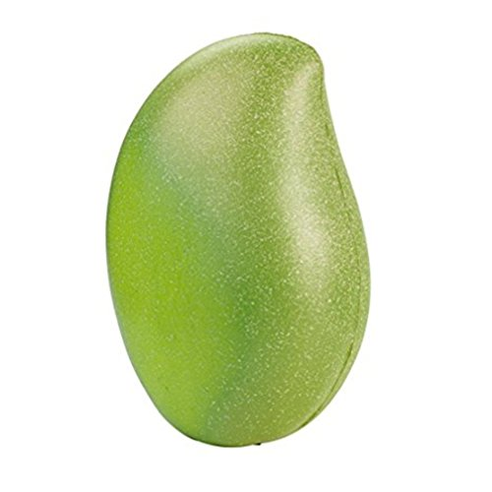
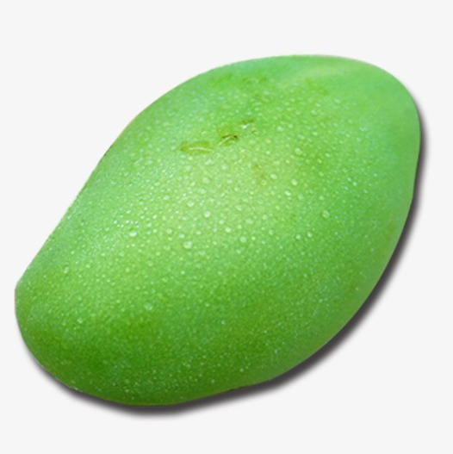
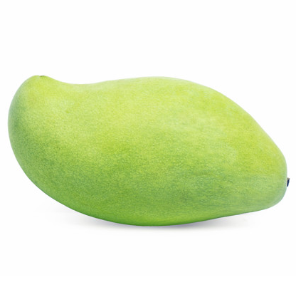
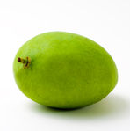
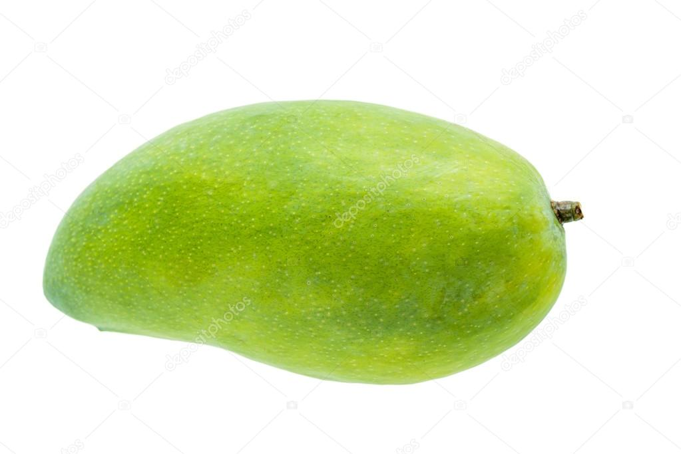
Dataset - Mangoes
Figure 2. Mangoes dataset. Images were taken from Fruits-360 dataset (https://github.com/Horea94/Fruit-Images-Dataset), and Google Images.

Slide 5




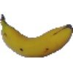


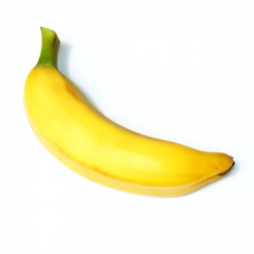
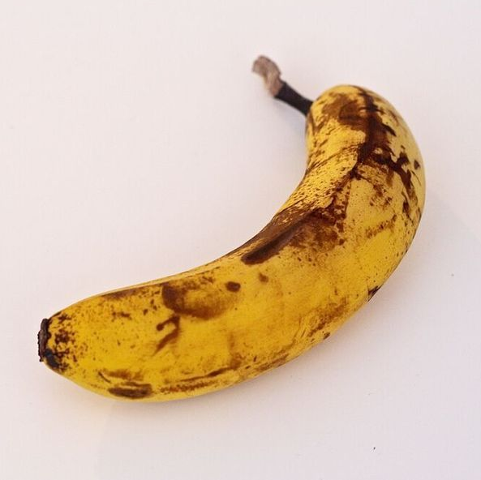
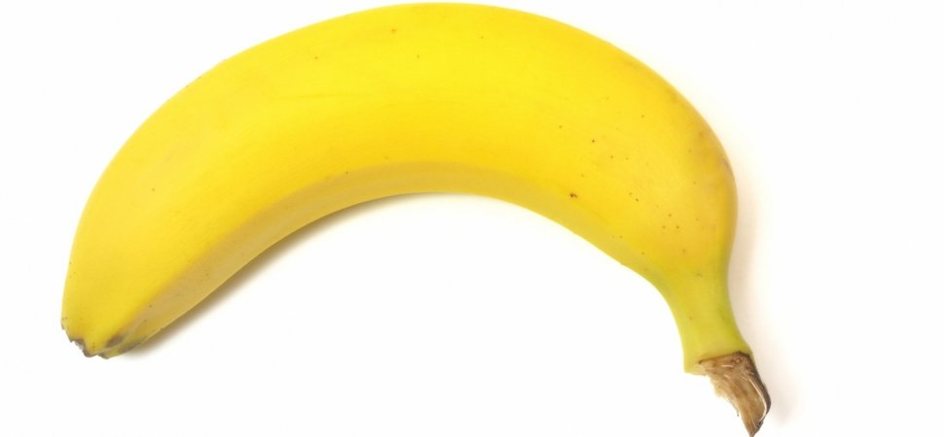
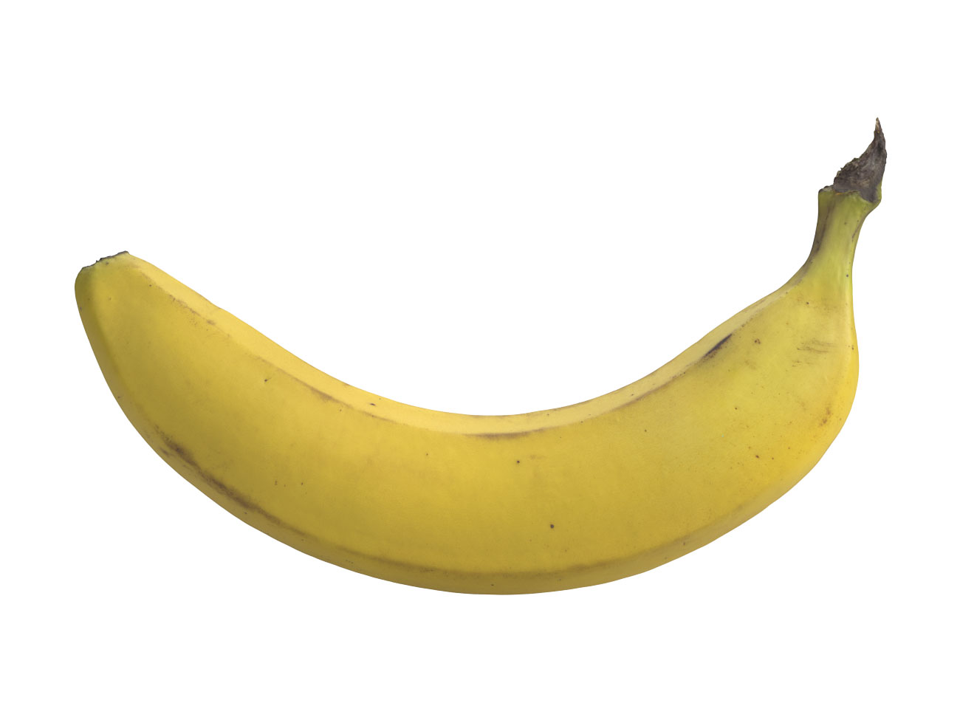
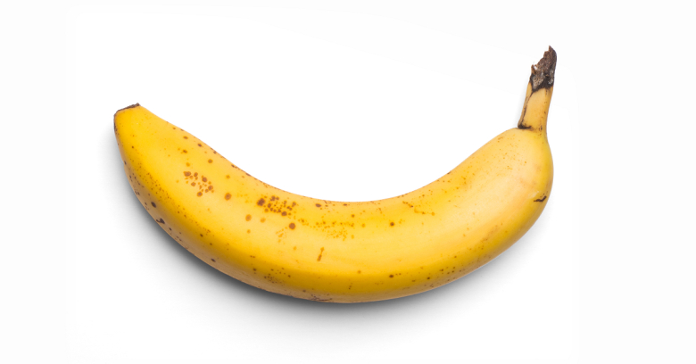
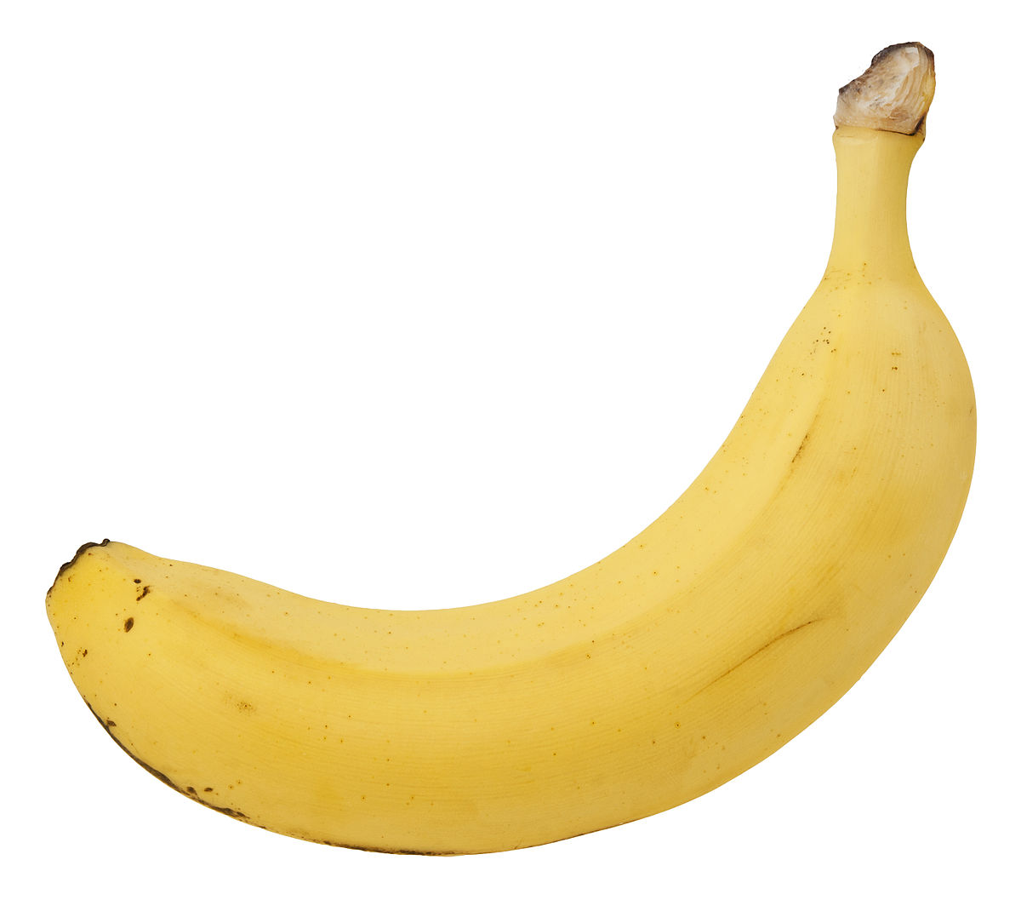
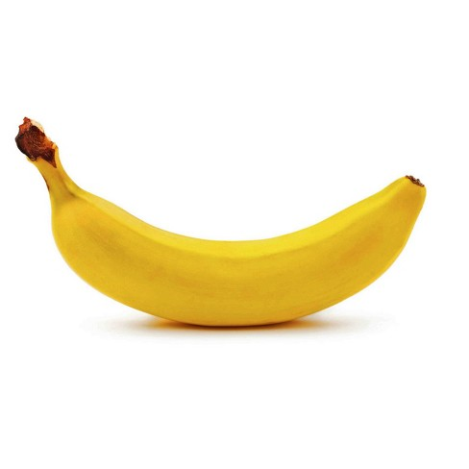
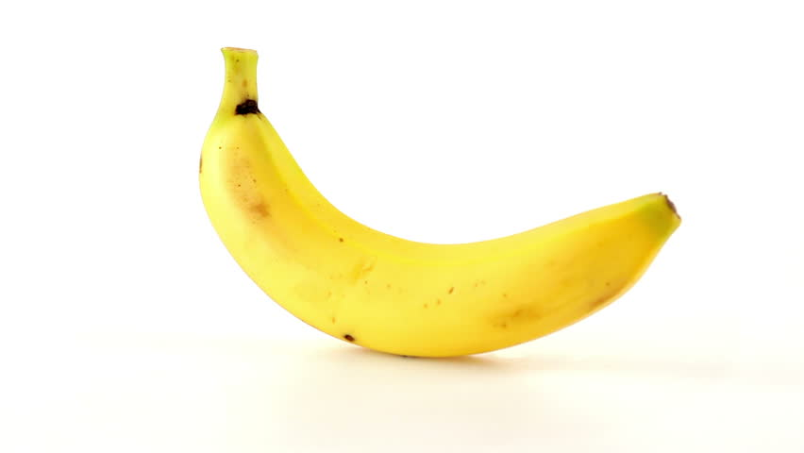
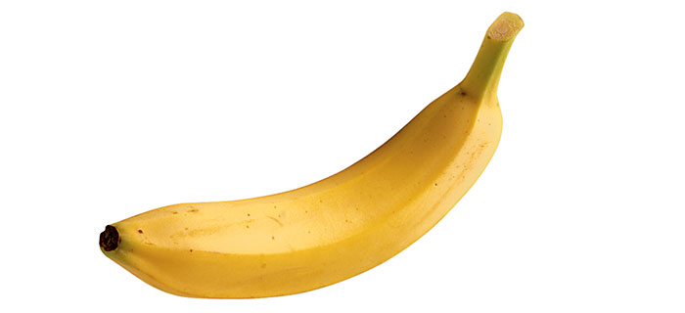




Dataset - Bananas
Figure 3. Bananas dataset. Images were taken from Fruits-360 dataset (https://github.com/Horea94/Fruit-Images-Dataset), and Google Images.

Slide 6
Feature Extraction
I used two (2) visual features for this activity, namely: eccentricity, and hue values. The methodology used to obtain these features is shown below:

Slide 7
Feature Extraction
I used two (2) visual features for this activity, namely: eccentricity, and hue values. The methodology used to obtain these features is shown below:
Image

Slide 8
Feature Extraction
I used two (2) visual features for this activity, namely: eccentricity, and hue values. The methodology used to obtain these features is shown below:
ROI
Image

Slide 9
Feature Extraction
HUE
I used two (2) visual features for this activity, namely: eccentricity, and hue values. The methodology used to obtain these features is shown below:
ROI image was converted into HSV via rgb2hsv().
ROI
Image

Slide 10
Feature Extraction
HUE
I used two (2) visual features for this activity, namely: eccentricity, and hue values. The methodology used to obtain these features is shown below:
ROI image was converted into HSV via rgb2hsv().
Hue channel was taken and then averaged.
ROI
Image

Slide 11

Feature Extraction
ECCENTRICITY
I used two (2) visual features for this activity, namely: eccentricity, and hue values. The methodology used to obtain these features is shown below:
2D Histogram
ROI
Image

Slide 12

Feature Extraction
ECCENTRICITY
I used two (2) visual features for this activity, namely: eccentricity, and hue values. The methodology used to obtain these features is shown below:
2D Histogram
ROI
Image
Non-parametric segmentation

Slide 13
Feature Extraction
ECCENTRICITY
I used two (2) visual features for this activity, namely: eccentricity, and hue values. The methodology used to obtain these features is shown below:
Obtaining eccentricity via regionprops()
2D Histogram
ROI
Image
Non-parametric segmentation

Slide 14

Plot of Feature Points
Shown in Fig. 4 is the plot of the feature points for oranges, mangoes, and bananas. Class clustering is pretty much apparent for the three classes of fruits. As expected, we see the eccentricities of oranges relatively nearer to 0 (a circle), and of bananas relatively nearer to 1 (an ellipse), and mangoes somewhere in between. Hue, on the other hand, runs from 0 to 1, corresponding to the order of colors: red, yellow, green, cyan, blue, and magenta.
Figure 4. Plot of feature points in 2D space for the three classes of fruits

Slide 15
Evaluation
I rate myself a score of 10/10 for this activity for producing all required output. I’d like to acknowledge my seatmates Rhei and Andy for brainstorming of ideas.
Link to Fruits-360 dataset: https://github.com/Horea94/Fruit-Images-Dataset
Background image was taken from: http://www.4usky.com/download/164575152.html

