Slide 1
Blob Analysis
Activity 10 Short Report
Lou Josef S. Tan

Slide 2
Tasks
Integration of image processing skills (image segmentation, morphological operations, labelling, etc.)
Measure several properties of cells (e.g., areas, centroids, eccentricities) using blob analysis

Slide 3
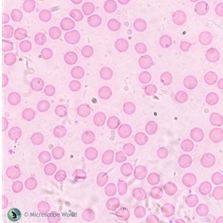
Segmentation of Cells
Given the image in Fig. 1, we were to segment the cells perfectly (i.e., no overlaps, no fused blobs), so that we could subject them to blob analysis and measure several properties.
Figure 1. Image of cells

Slide 4
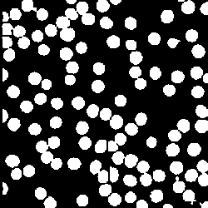
Segmentation of Cells
Upon segmentation, we get the resulting image displayed in Fig. 2. At first glance, the initial result might seem good enough. However, some of the blobs are connected, when in reality, they should be completely separated. Blob analysis here would be erroneous.
We then attempt to separate these connected blobs.
Figure 2. Segmented image of cells

Slide 5
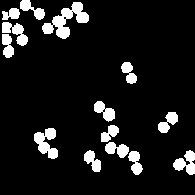
Segmentation of Cells
To do this, we take only the connected blobs from the segmented image as in Fig. 3. To separate the blobs, we use a segmentation technique known as watershed segmentation.
Figure 3. Connected blobs from segmented image.

Slide 6
Segmentation of Cells
Watershed Segmentation^{[1]}
Watershed segmentation makes use of the idea of watersheds and catchment basins. In its literal definition, watersheds are ridges that divide different catchment basins, and catchment basins are areas that drain into rivers or reservoirs.
[1] – For more info about watershed segmentation, visit: https://www.mathworks.com/company/newsletters/articles/the-watershed-transform-strategies-for-image-segmentation.html

Slide 7
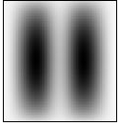
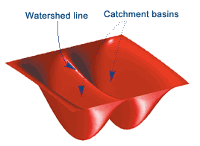
Segmentation of Cells
Watershed Segmentation^{[1]}
Watershed segmentation makes use of the idea of watersheds and catchment basins. In its literal definition, watersheds are ridges that divide different catchment basins, and catchment basins are areas that drain into rivers or reservoirs.
Relating this to image processing, say, we have two dark blobs, its corresponding watershed and catchment basin is shown in Fig. 4.
Figure 4. L: Two dark blobs R: Corresponding watershed and catchment basin.
[1] – For more info about watershed segmentation, visit: https://www.mathworks.com/company/newsletters/articles/the-watershed-transform-strategies-for-image-segmentation.html

Slide 8

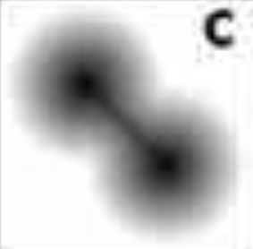
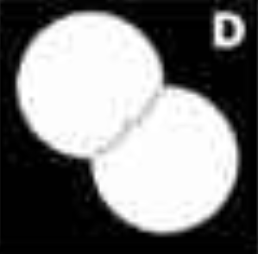
Segmentation of Cells
Watershed Segmentation^{[1]}
The watershed() function is then able to find the watershed lines and catchment basins for grayscale images. The general procedure for watershed segmentation is presented below:
Watershed Transform
Initially, there are two touching objects to be separated via watershed segmentation
The distance transform of the image is taken. This now resembles the two dark blobs in the previous slide: we have two catchment basins
The watershed transform is taken, which outputs a label matrix containing (+) integers for the locations of catchment basins, and watersheds (zero-valued).
Using the zero-valued elements (watershed lines) of the watershed transform, we separate the blobs.
[1] – For more info about watershed segmentation, visit: https://www.mathworks.com/company/newsletters/articles/the-watershed-transform-strategies-for-image-segmentation.html

Slide 9
Segmentation of Cells
Going back to our image of connected blobs. We now take its distance transform.
Figure 3. Connected blobs from segmented image.

Slide 10
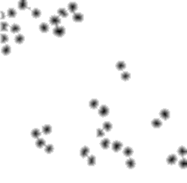
Segmentation of Cells
Going back to our image of connected blobs. We now take its distance transform. From Fig. 5, the catchment basins are very apparent.
Figure 5. Distance transform of connected blobs

Slide 11

Segmentation of Cells
Going back to our image of connected blobs. We now take its distance transform. From Fig. 5, the catchment basins are very apparent. We could now take the watershed transform, and then completely separate the connected blobs.
Figure 6. Separation of connected blobs via watershed segmentation.

Slide 12

Segmentation of Cells
Going back to our image of connected blobs. We now take its distance transform. From Fig. 5, the catchment basins are very apparent. We could now take the watershed transform, and then completely separate the connected blobs.
Finally, we combine the newly-separated blobs with the already-separated blobs from before. Our segmented image is now ready for blob analysis.
Figure 7. Segmented image with completely separate blobs

Slide 13
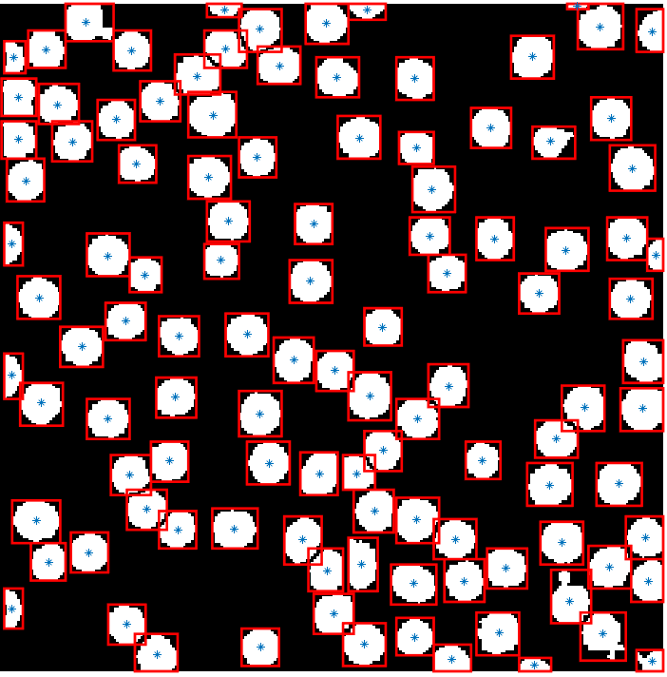
Blob Analysis
Centroid and Bounding boxes
First off, we use regionprops() to take the centroids and bounding boxes of each blobs in our image. In total, there are 111 cells in our image.
Figure 8. Blobs (cells) marked by the centroids and enclosed in bounding boxes.

Slide 14
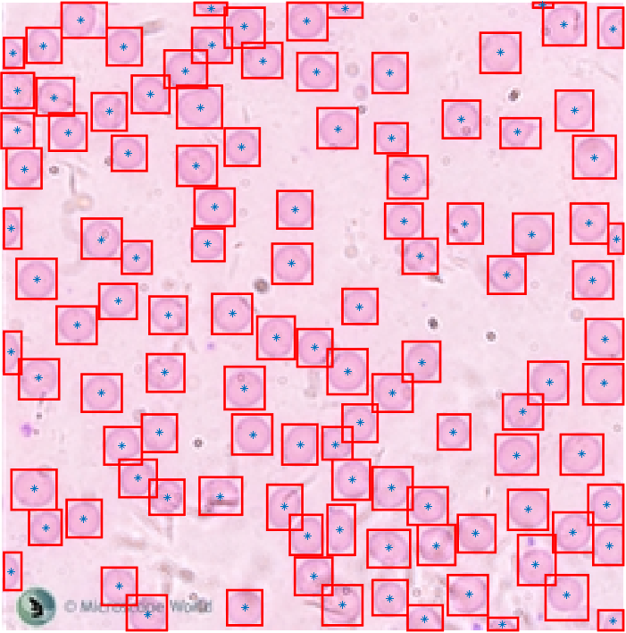
Blob Analysis
Centroid and Bounding boxes
First off, we use regionprops() to take the centroids and bounding boxes of each blobs in our image. In total, there are 111 cells in our image.
Figure 8. Blobs (cells) marked by the centroids and enclosed in bounding boxes.

Slide 15
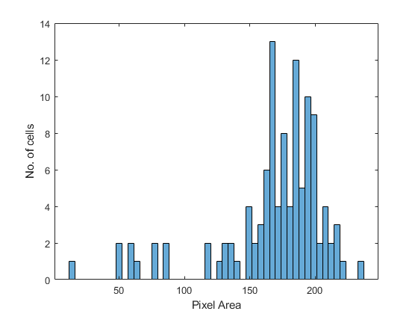
Blob Analysis
Area
Shown to the right is the histogram of the pixel area of the cells. The left region of the histogram (Area < 120) comprises the half-cells at the borders of the image. These half-cells were excluded in computing the average cell size. The best estimate for the average cell size is 179.7 ± 21.4 sq. pixels.
Figure 9. Histogram of the pixel area of cells.

Slide 16
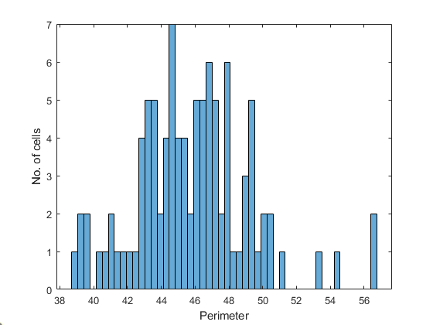
Blob Analysis
Perimeter
On the other hand, the best estimate for the average perimeter of the cells is 45.9 ± 3.4 pixels.
Figure 10. Histogram of the perimeter of cells.

Slide 17
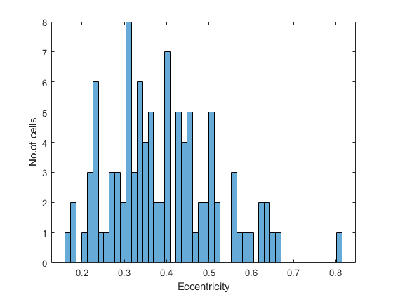
Blob Analysis
Eccentricity
Here we have the histogram of the eccentricity of the cells. We can see that majority of the cells have eccentricities below 0.5, leaning towards being nearly circular. Computing for the average eccentricity we have 0.39 ± 0.13.
Figure 11. Histogram of the eccentricity of cells.

Slide 18
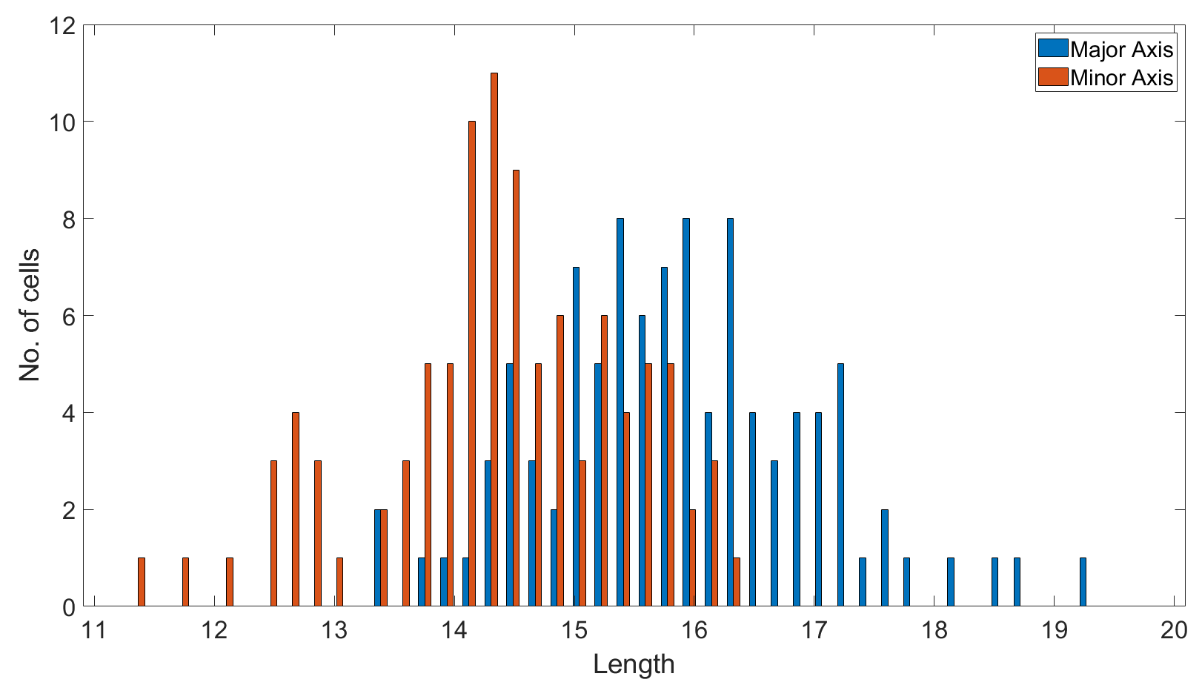
Blob Analysis
Major and Minor Axis Length
The average major axis length of the cells is 16.0 ± 1.1 pixels, while the average minor axis length is 14.5 ± 1.0 pixels. The values for both averages are near, indicating that the cells may be nearly circular. This agrees with what we previously observed for the average eccentricity.
Figure 12. Histogram of major and minor axis lengths of cells.

Slide 19
Evaluation
I give myself a score of 11/10 for producing all required output, and applying advanced techniques for image segmentation (watershed segmentation).
References:
[1] – The Watershed Transform: Strategies for Image Segmentation. https://www.mathworks.com/company/newsletters/articles/the-watershed-transform-strategies-for-image-segmentation.html
[2] – Watershed transform question from tech support. https://blogs.mathworks.com/steve/2013/11/19/watershed-transform-question-from-tech-support/
[3] – Color-Based Segmentation Using K-means Clustering. https://www.mathworks.com/help/images/color-based-segmentation-using-k-means-clustering.html;jsessionid=ffc56fe3a1ed3900594bba3fbde3

