Slide 1
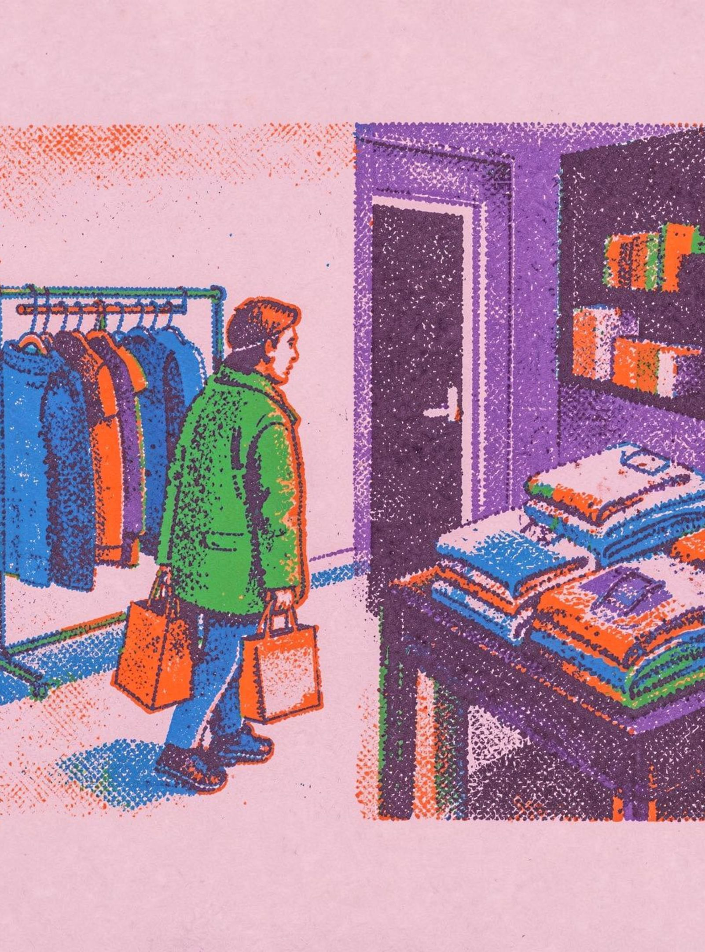
SHOPPER ANALYSIS
What shoppers are telling us

Slide 2



THE DATA SET
We analyzed 3,900 purchases
18 columns
$59.76
3.75 / 5
Customer details, products, spending, shipping, discounts, reviews, and subscriptions.
Average purchase
Average review

Slide 3
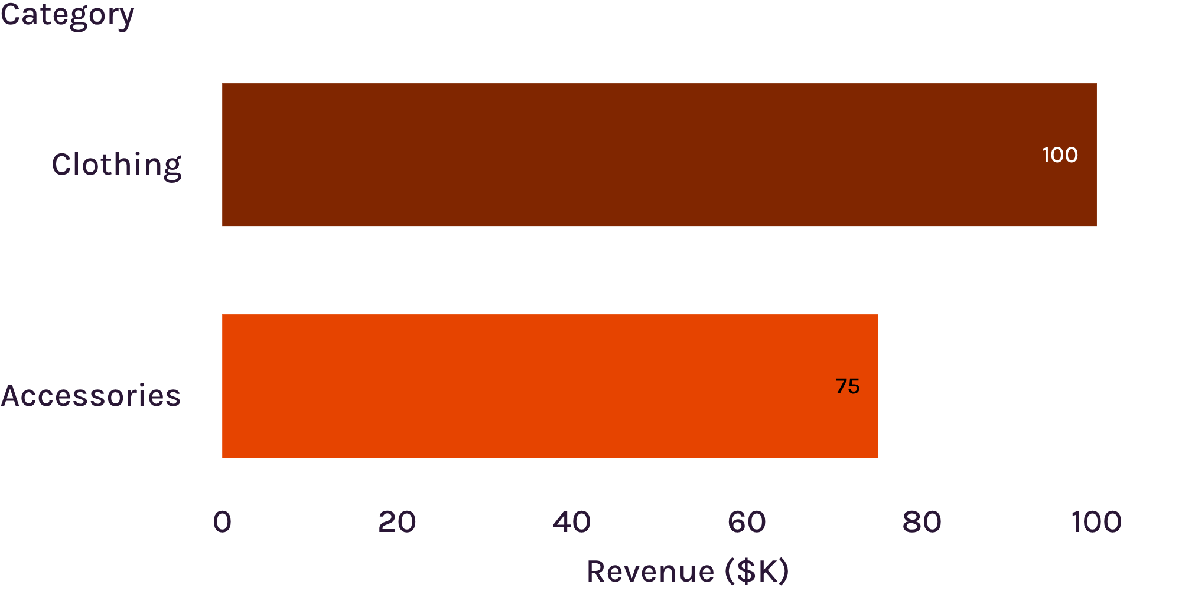
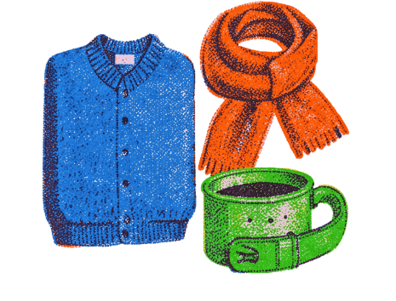
REVENUE BY CATEGORY
Clothing brings in the most revenue
Clothing: about $100K in revenue and roughly 1,700 sales.
Accessories: about $75K and 1,200 sales.
Footwear and outerwear trail behind.

Slide 4
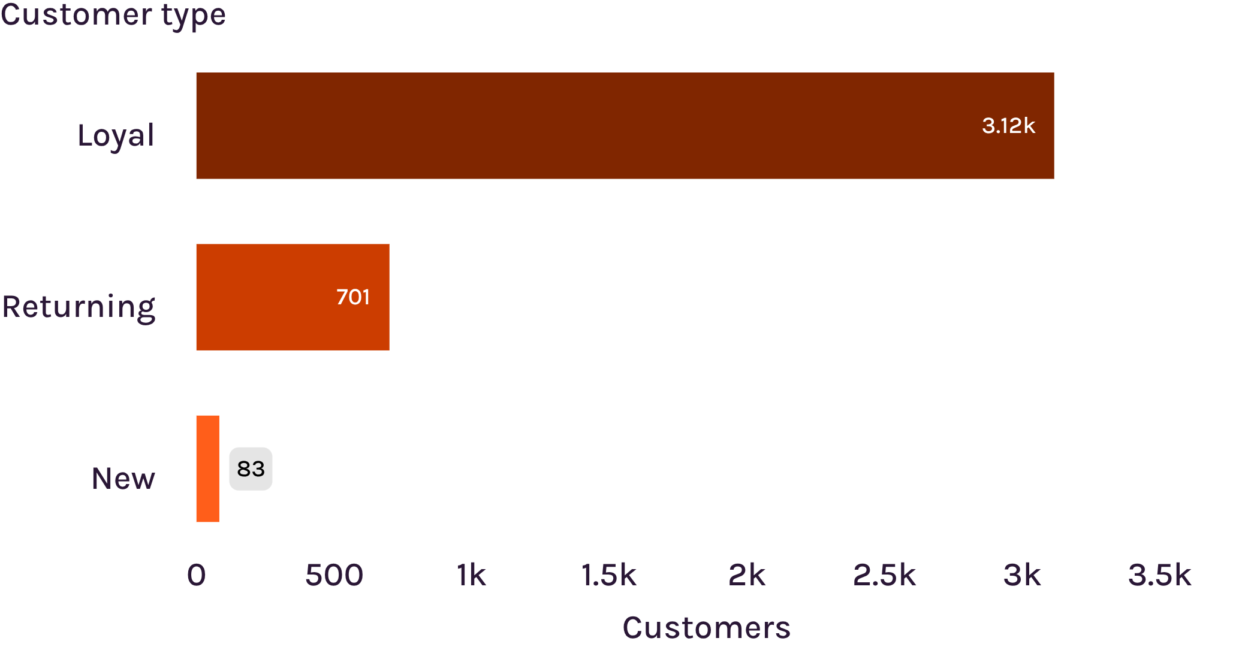
CUSTOMER TYPE
Loyal shoppers are the biggest group
The opportunity is to turn more returning shoppers into loyal ones.

Slide 5
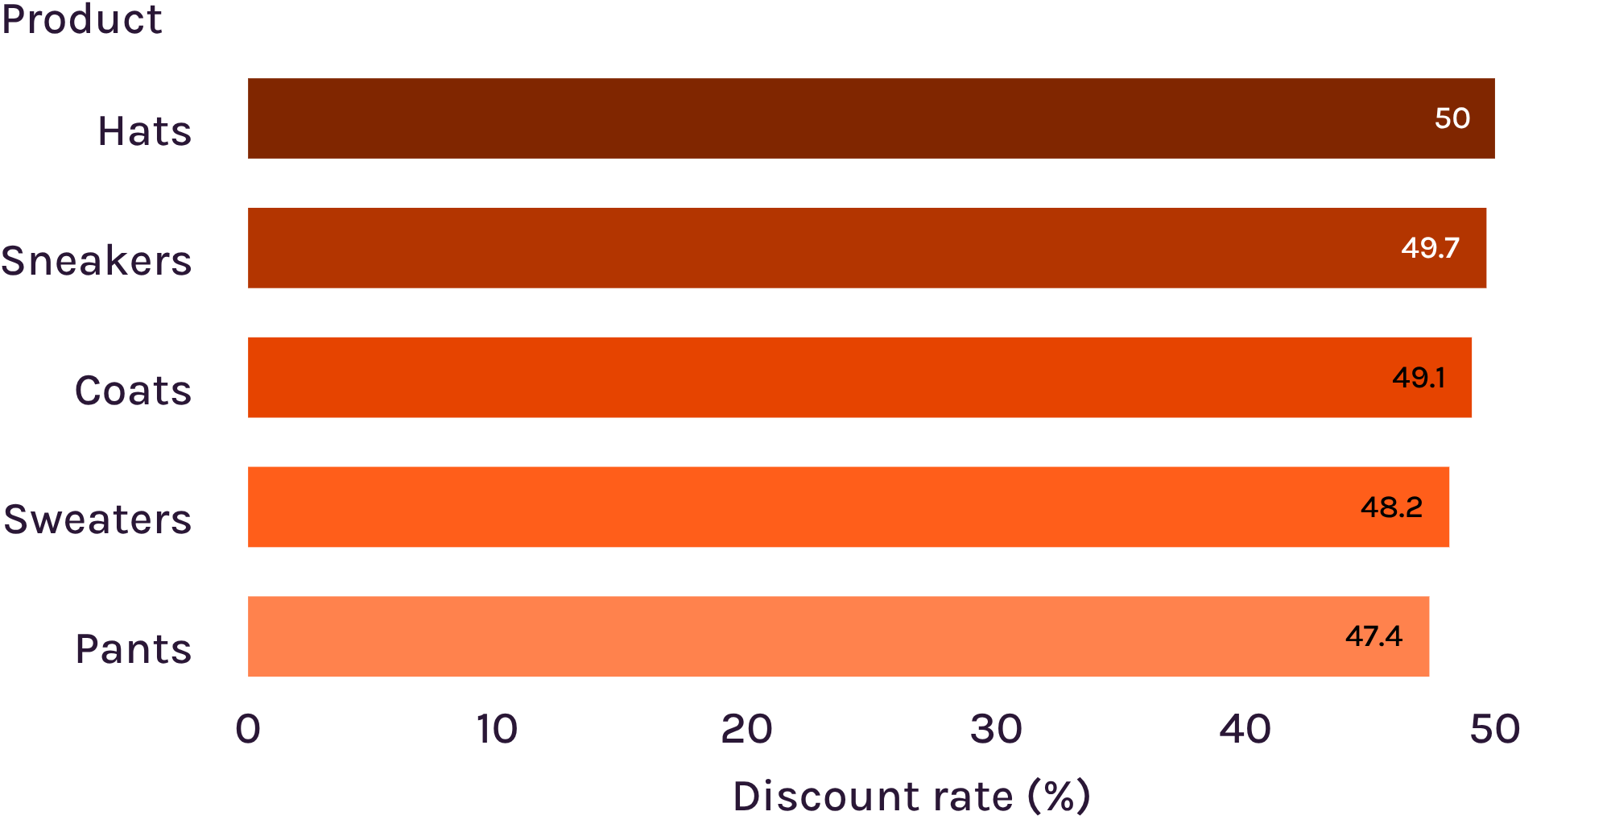
DISCOUNT PATTERNS
Discounts help sales, but some products depend on them
About 839 shoppers used discounts and still spent above the average purchase amount.
Use discounts to grow demand without giving away too much margin.

Slide 6
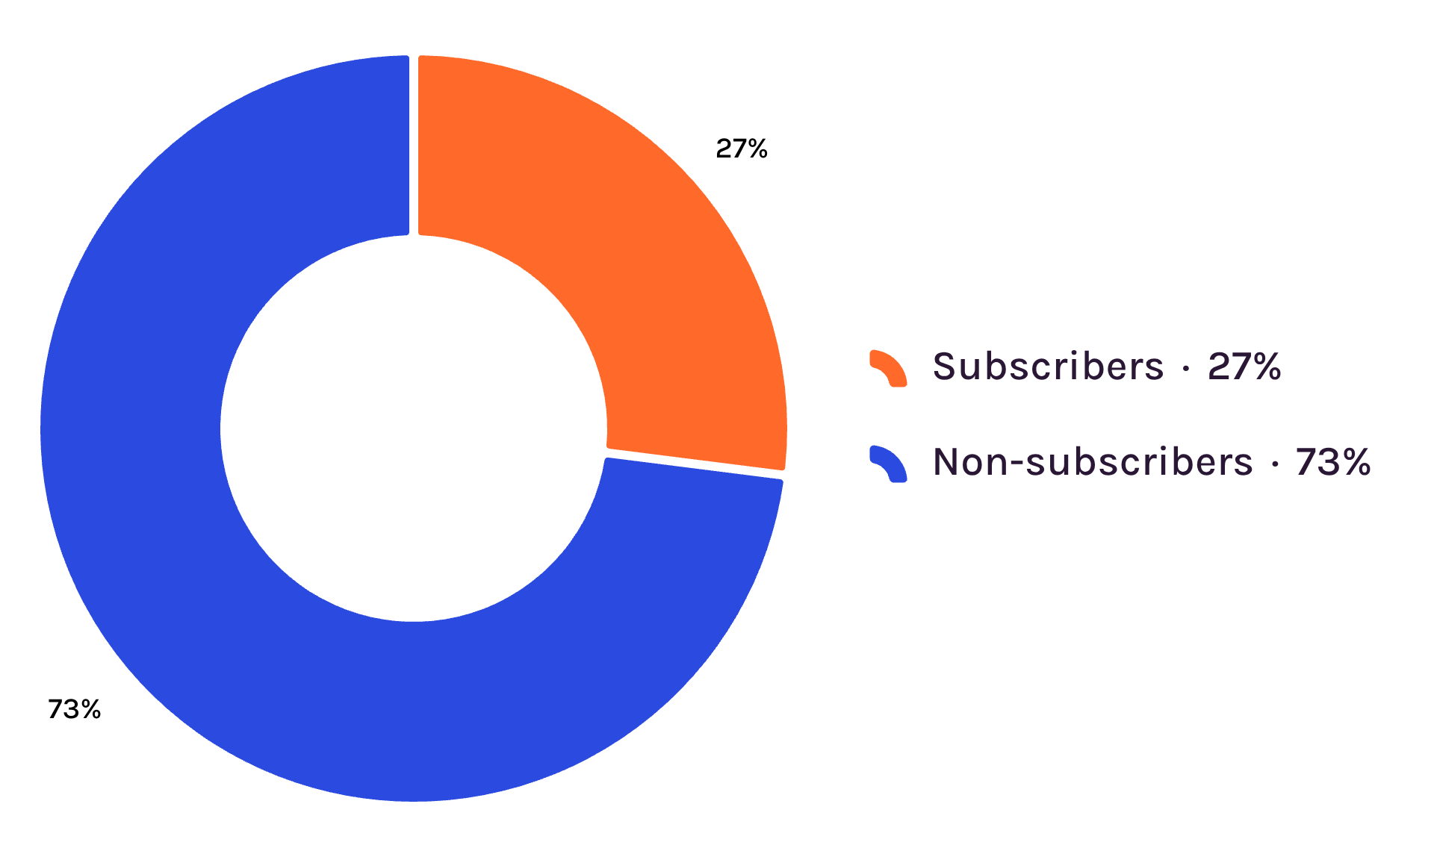
SUBSCRIPTION STATUS
Subscriptions are still a small slice
Subscribers: 1,053 customers, or 27% of the base.
Non-subscribers: 2,847 customers, or 73%.
Average spend is almost the same: $59.49 for subscribers vs. $59.87 for non-subscribers.

Slide 7
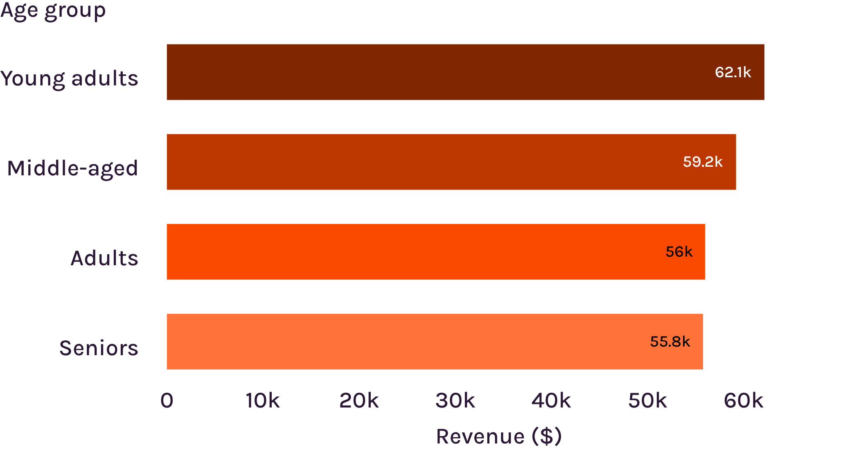
REVENUE BY AGE GROUP
Young adults lead revenue by age group
Age is useful for targeting, but the gap is not huge.

Slide 8
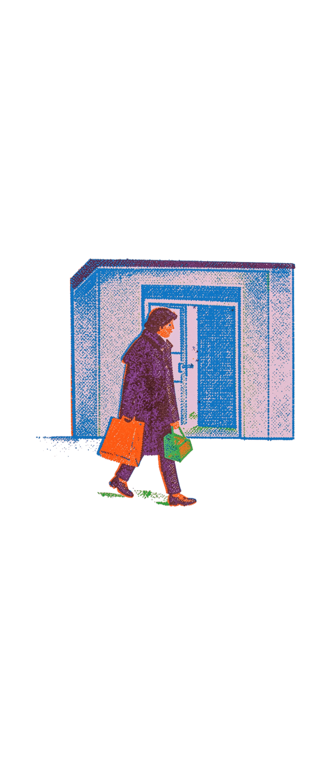
WHAT TO DO NEXT
Five actions stand out
1
Give subscribers benefits people can feel.
2
Reward repeat buyers and move them toward loyalty.
3
Review discount-heavy products and protect margin.
4
Feature top-rated products such as gloves, sandals, boots, hats, and skirts.
5
Target young adults and shoppers who choose faster shipping.

