Slide 1
Regularization & Model Selection
Justin M. Rao, MSR-NYC

Slide 2
Validation set methodology
Train the model with a subset of the data
Test the model on the remaining data (the validation set)
What data to choose for training vs. test?
In a time-series dimension, it is natural to hold out the last year (or time period) of the data, to simulate predicting the future based on all past data. In most settings, however, we’ll randomly select our training/test sets.

Slide 3
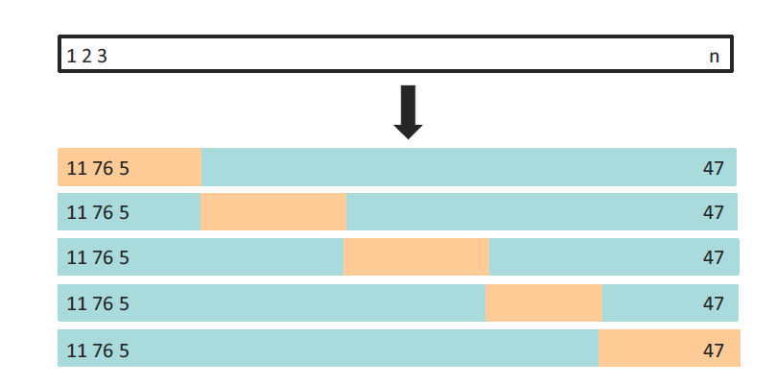
Cross-validation
A class of methods to do many training/test splits and average over all the runs
Here is a simple example of 5-fold cross validation. Gives 5 test sets → 5 estimates of MSE.
The 5-fold CV estimate is obtained by averaging these values.

Slide 4
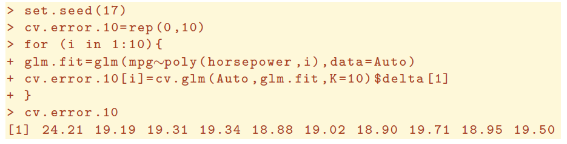
K-fold cross-validation
Split the data up into K “folds”. Iteratively leave fold k out of the training data and use it to test.
The more folds, the smaller each testing set is (more training data), but the more times we need to run the estimation procedure. Using rules of thumb like 5—10 folds is often utilized in practice. This can be done with a simple for loop in R
For generalized linear models, the cv.glm() function can be used to perform k-fold cross validation. For example, this code loops over 10 possible polynomial orders and computes the 10-fold cross-validated error in each step

Slide 5
Validation sets in practice
The validation set methodology works when we specify a class of models
Examples:
Linear models with p-order polynomials
A set of related models such as LDA, QDA and Logit
Non-parametric models with a smooth parameter
Once I have a class of models, I loop over the class to try each one, and compute a validation set error on each pass. K-fold CV methods helps ensure my estimates will be stable

Slide 6
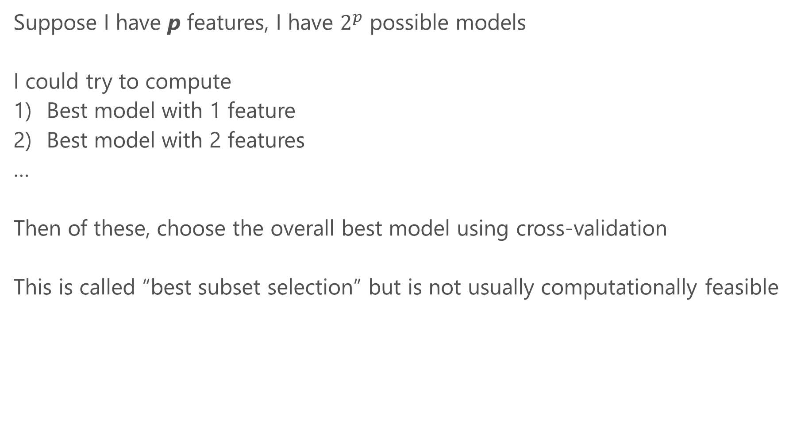
The variable selection problem
Suppose I have p features, I have $2^{p}$ possible models
I could try to compute
Best model with 1 feature
Best model with 2 features
…
Then of these, choose the overall best model using cross-validation
This is called “best subset selection” but is not usually computationally feasible

Slide 7
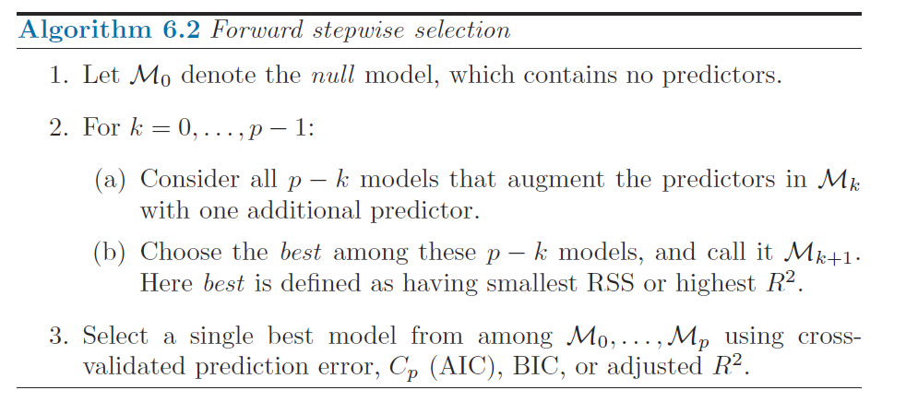
Forward stepwise selection
Start with 0 features. At each step, add the feature that improves the model the most. This produces p-models, we can then choose the best one

Slide 8
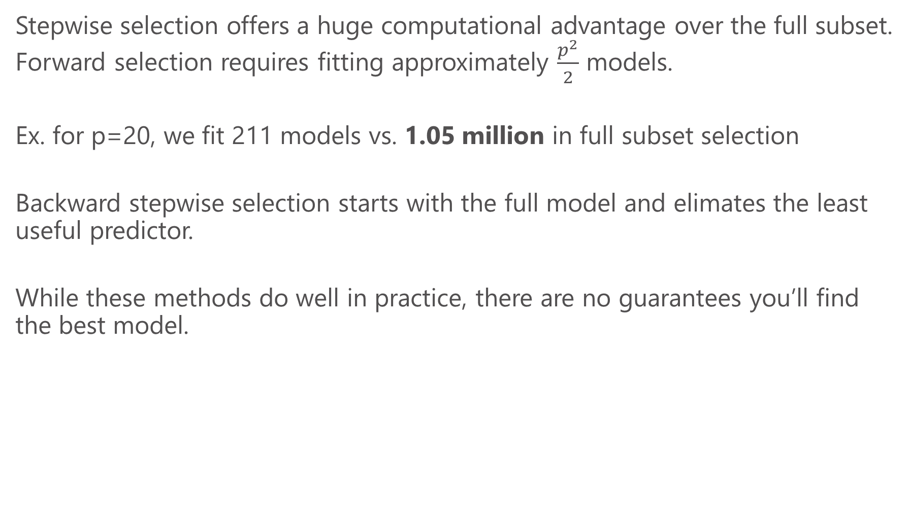
Stepwise selection
Stepwise selection offers a huge computational advantage over the full subset. Forward selection requires fitting approximately $\frac{p^{2}}{2}$ models.
Ex. for p=20, we fit 211 models vs. 1.05 million in full subset selection
Backward stepwise selection starts with the full model and elimates the least useful predictor.
While these methods do well in practice, there are no guarantees you’ll find the best model.

Slide 9
Regularization and shrinkage
An alternative to the approach of fitting many models and picking the best is to fit a single model using all the predictors and throw out the less useful ones in one step.
This could also help pare down my feature set into a more manageable set before trying out fancy models and deeper analysis
Helps guard against overfitting or have higher model interpretability
Regularization helps achieve these aims!

Slide 10
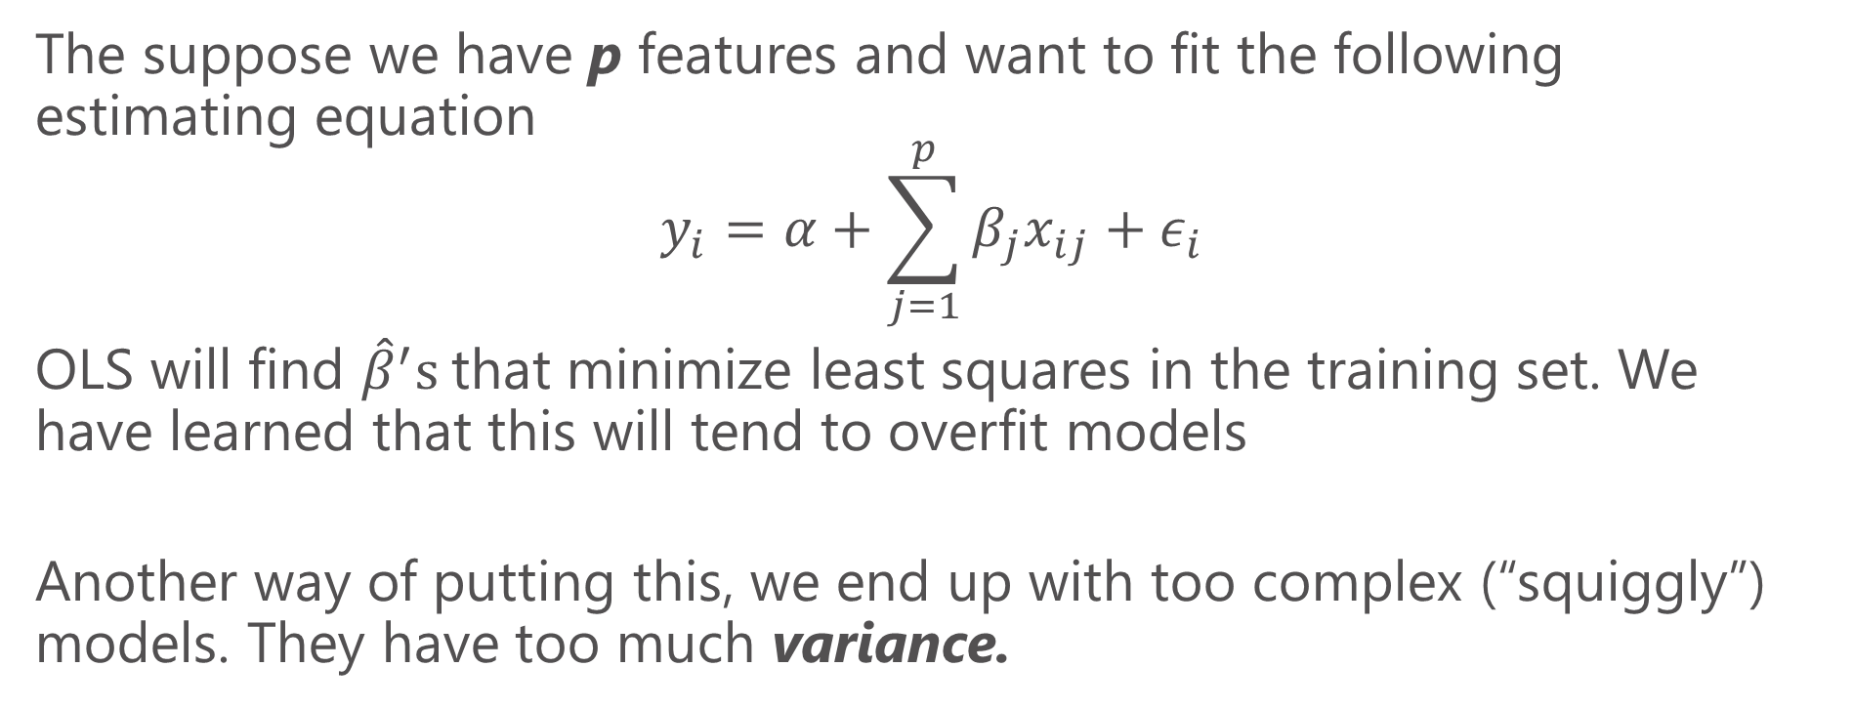
Limits of OLS
The suppose we have p features and want to fit the following estimating equation
$$y_{i}=α+\sum_{j=1}^{p}{β_{j}x_{ij}}+ε_{i}$$
OLS will find ${\hat{β}}^{′}s$that minimize least squares in the training set. We have learned that this will tend to overfit models
Another way of putting this, we end up with too complex (“squiggly”) models. They have too much variance.

Slide 11
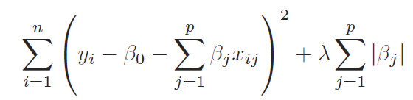
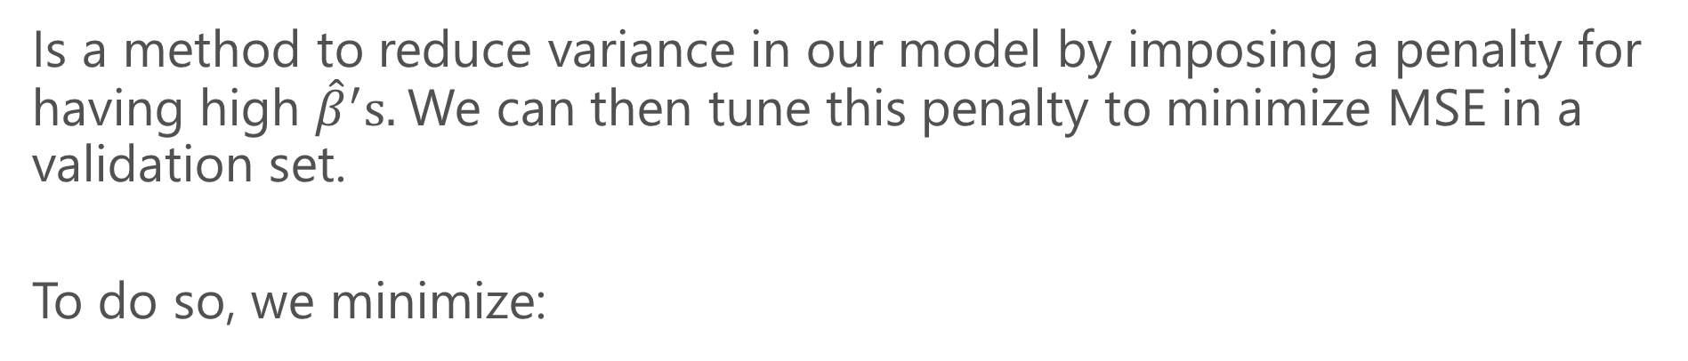
Lasso regression
Is a method to reduce variance in our model by imposing a penalty for having high ${\hat{β}}^{′}s.$We can then tune this penalty to minimize MSE in a validation set.
To do so, we minimize:
OLS minimizes this part
penalty

Slide 12
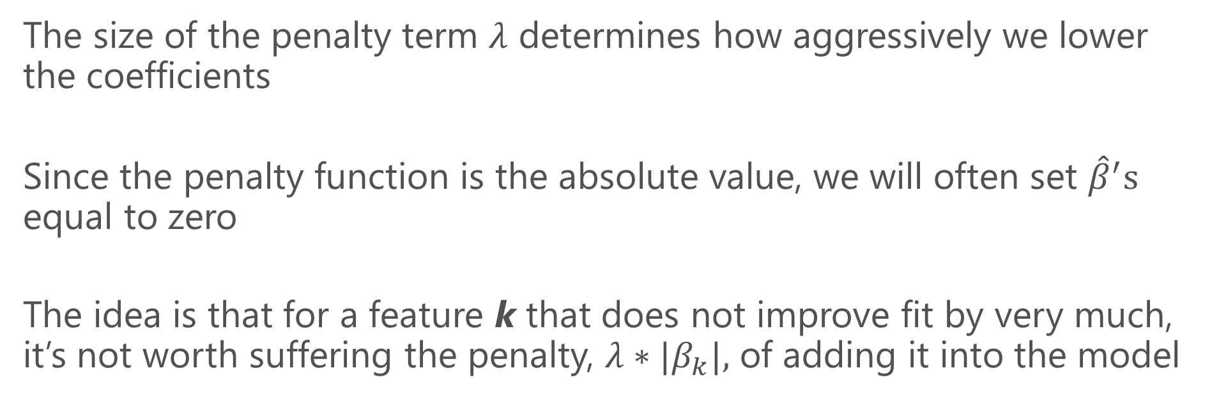
Lasso penalty function
The size of the penalty term $λ$ determines how aggressively we lower the coefficients
Since the penalty function is the absolute value, we will often set ${\hat{β}}^{′}s$ equal to zero
The idea is that for a feature k that does not improve fit by very much, it’s not worth suffering the penalty, $λ∗|β_{k}|,$ of adding it into the model

Slide 13
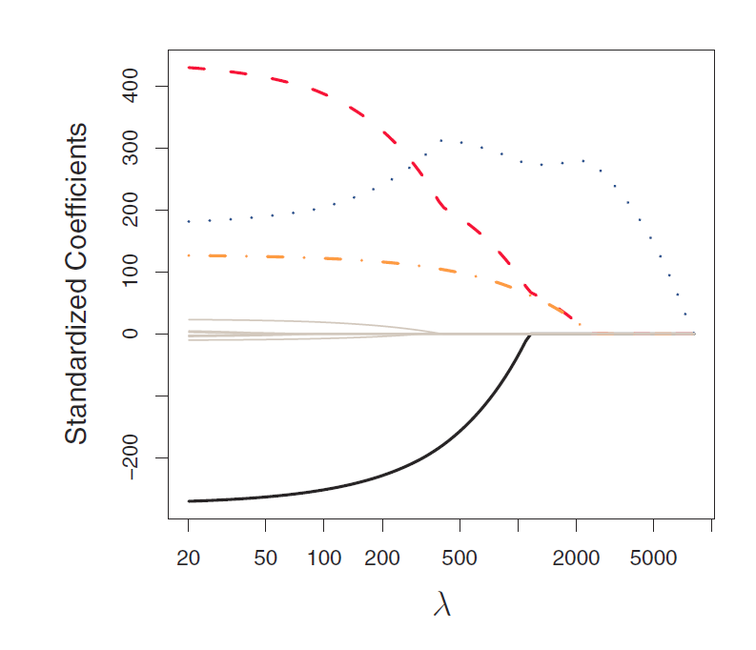
How lasso works
As we increase the penalty, we force more coefficients to zero

Slide 14
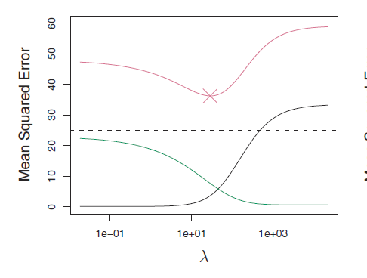
Selecting a penalty
We try out different ones on a test set
Purple line gives MSE for a test set
Green: estimator variance
Grey: estimator bias

Slide 15
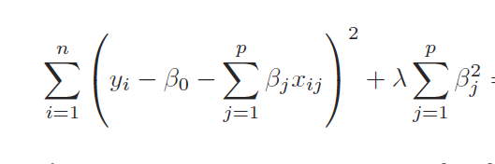

Ridge regression
Similar to lasso, the difference is the penalty function squares the coefficients
This means when $β^{′}s$ are very small (<1), squaring them makes them even smaller. Thus there is no reason to set them to exactly zero.

Slide 16
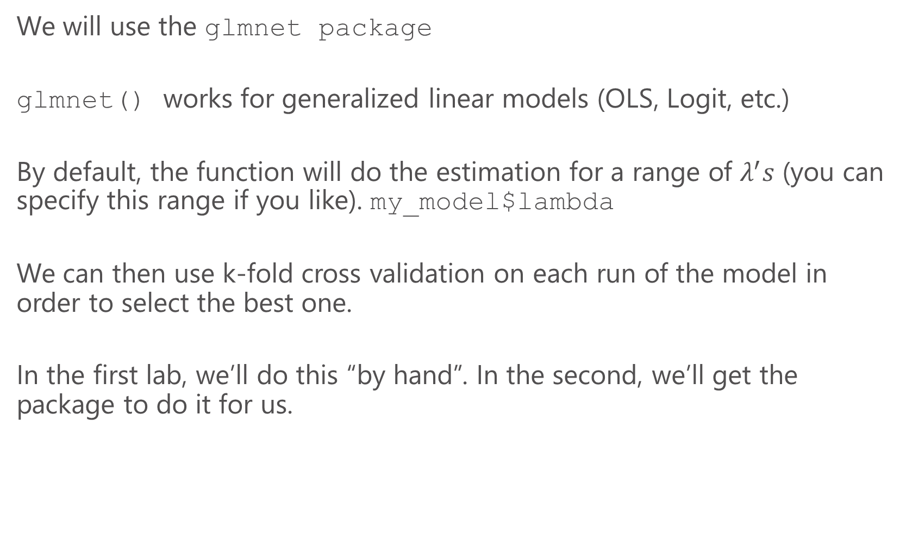
Ridge and Lasso in R
We will use the glmnet package
glmnet() works for generalized linear models (OLS, Logit, etc.)
By default, the function will do the estimation for a range of $λ^{′}s$ (you can specify this range if you like). my_model$lambda
We can then use k-fold cross validation on each run of the model in order to select the best one.
In the first lab, we’ll do this “by hand”. In the second, we’ll get the package to do it for us.

