Slide 1
Estimators and Sampling
Justin M. Rao, MSR-NYC

Slide 2
Outline
Basics of estimation
Samples vs. populations
Sampling theory, IID assumptions and departures
Regression: linear and non-parametric

Slide 3
Population vs. samples
Population: every object in a specified set
Set must be well-defined.
Ex. Americans, all internet users, all lab rats with lymphoma, all high school students, etc.
Sample: a subset of the population selected in some way

Slide 4
Ex. Population vs. samples
Population: heights of all US-located people age 18-65
Some samples:
Heights of the instructors
Heights of all the ppl in this room
Stop people on campus & measure.
How do these samples differ from the population?

Slide 5
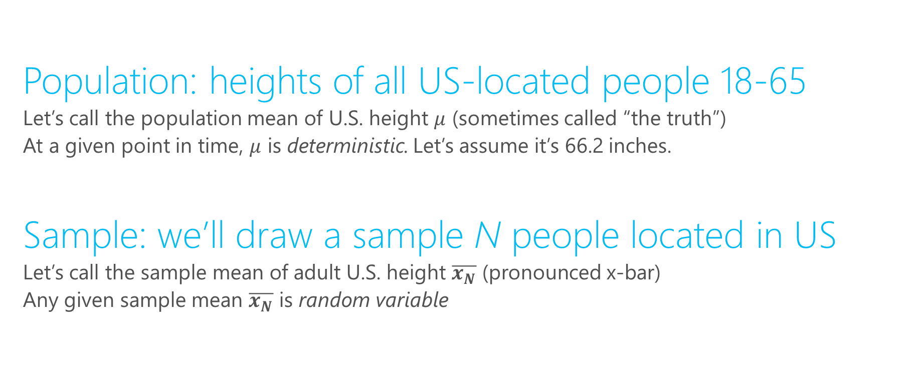
Population mean vs. sample mean
Population: heights of all US-located people 18-65
Let’s call the population mean of U.S. height $μ$ (sometimes called “the truth”)
At a given point in time, $μ$ is deterministic. Let’s assume it’s 66.2 inches.
Sample: we’ll draw a sample N people located in US
Let’s call the sample mean of adult U.S. height $\overline{x_{N}}$ (pronounced x-bar)
Any given sample mean $\overline{x_{N}}$ is random variable

Slide 6
What is a “random variable”
Deterministic: not influenced by chance
In measurement: every time you measure, you get the same answer.
In models: for same input, you always get same output. Ex. Planetary motion
Stochastic: there is some element of randomness
In measurement: every time you “measure”, you expect a different outcome
In models: the same input leads to different output. Ex. Identical twins tend can have different medical outcomes due to differential gene expression and different enviroment
In both cases: you cannot perfectly predict what will happen

Slide 7
Examples: deterministic vs. stochastic
Baseball: outcome (hit or not)
Stochastic: batting avg. gives probability of a hit. Batting avg. can be modeled for specific conditions (e.g. facing pitcher X, in ballpark Y, with conditions Z).
Subway: trip time between Station X and Station Y
Stochastic: delays lead to small departures from schedule
Weight of a quarter
Technically stochastic: all quarters differ by microscopic amounts. Practically speaking it is deterministic
Length of a day
Deterministic: although days are getting slightly longer, this can be predicted perfectly

Slide 8
$\overline{x_{N}}$ as a random variable
Determine sample size, N
Determine sampling procedure
How are we going to get N observations?
Provided N is less than total population, then each sample will tend to differ. Imagine we conduct two samples:
All statistics we measure will tend to differ between the two samples
Statistical theory will tell us the degree to which we should expect them to differ

Slide 9
$\overline{x}$ is an estimator for $μ$
Samples are used to estimate population parameters
Statistical properties of how the sample is drawn will determine how useful the estimator is
Observe heights in the sample to make inference about heights in the population

Slide 10
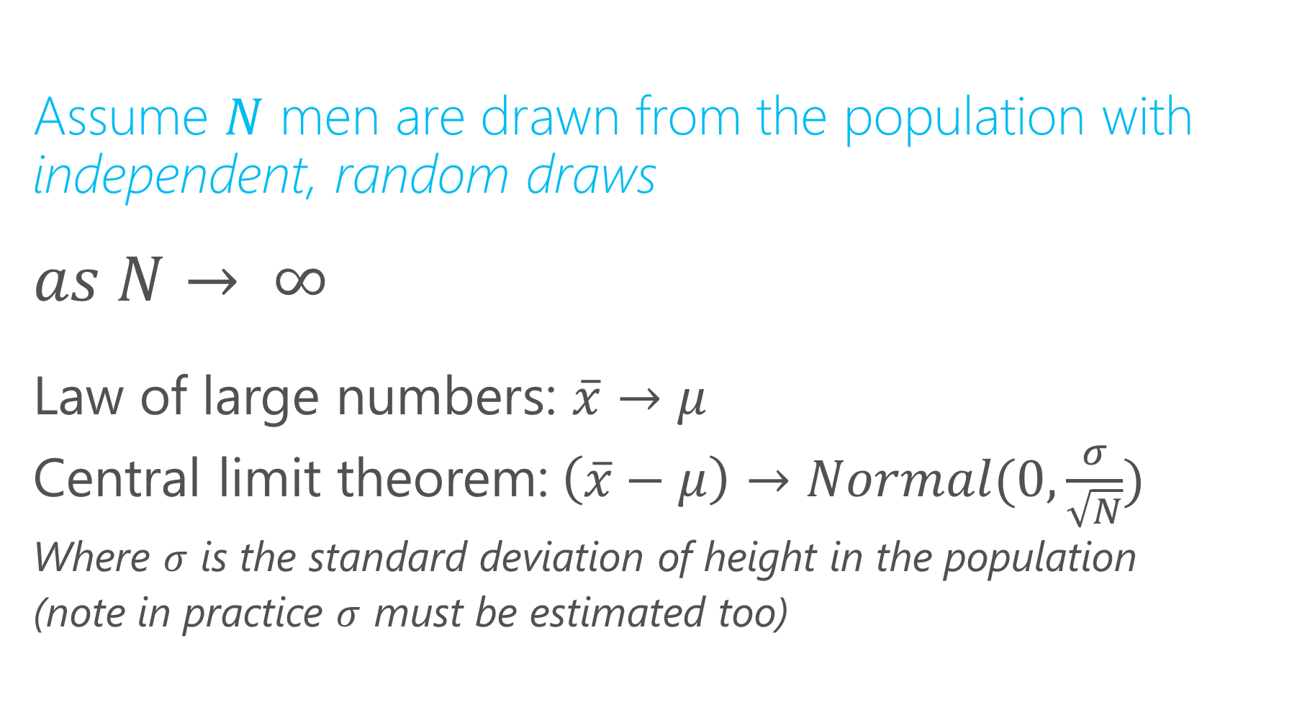
Properties of the sample mean
Assume $N$ men are drawn from the population with independent, random draws
$$as N→ ∞$$
Law of large numbers: $\overline{x}→μ$
Central limit theorem:$\left(\overline{x}−μ\right)→Normal(0,\frac{σ}{\sqrt{N}})$
Where $σ$ is the standard deviation of height in the population
(note in practice $σ$ must be estimated too)

Slide 11
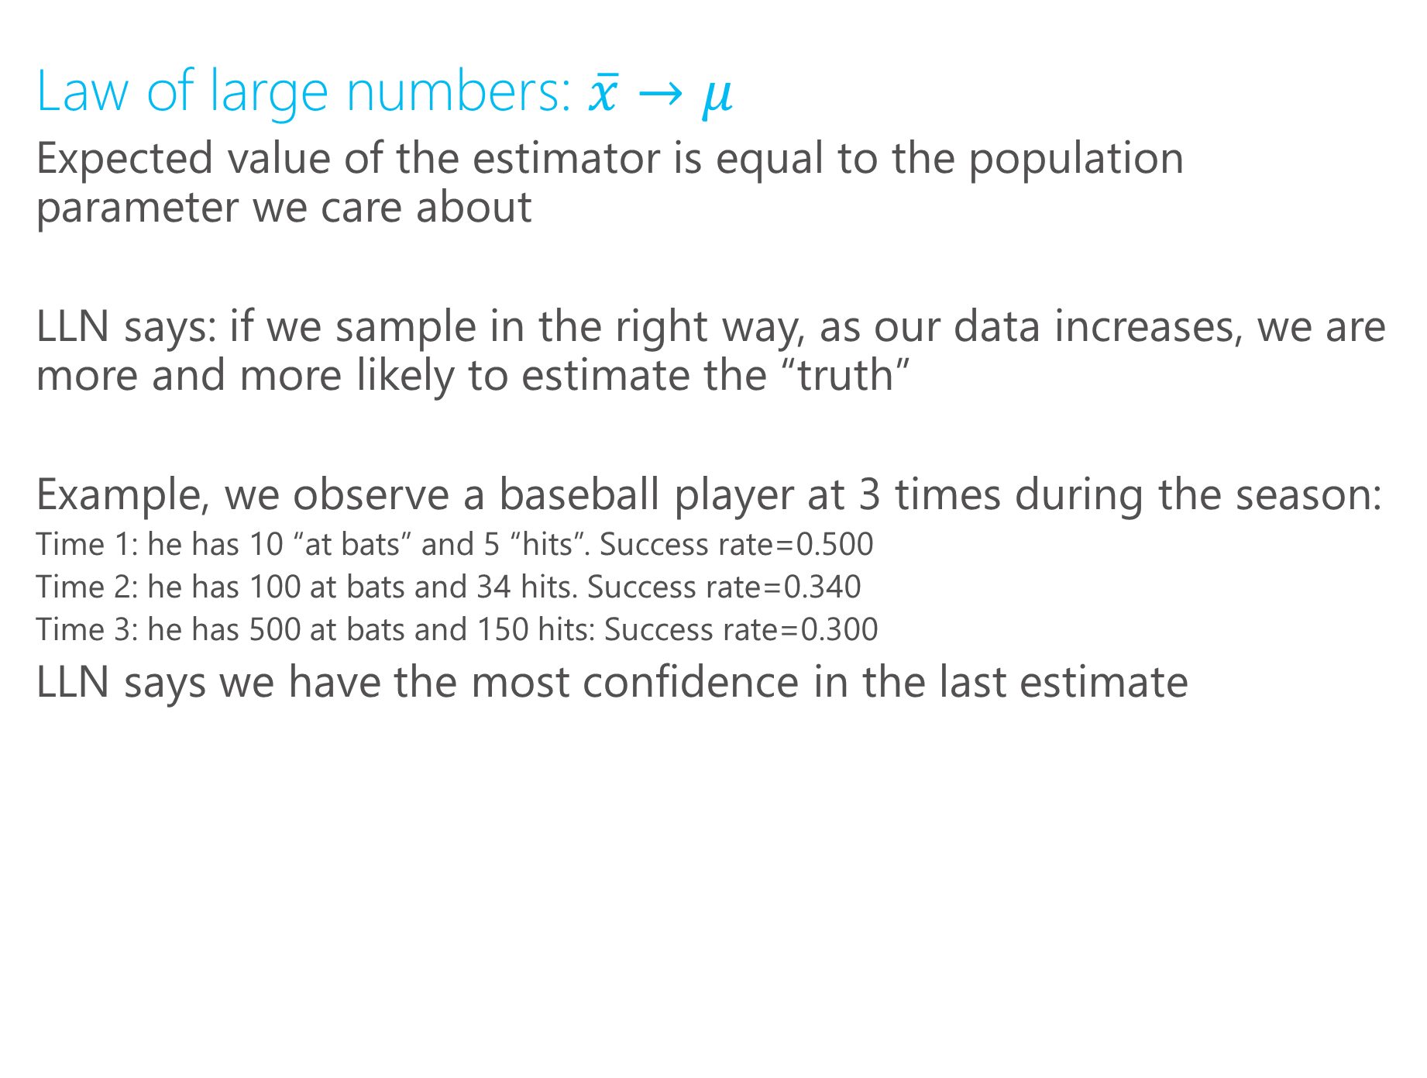
Properties of the sample mean
Law of large numbers: $\overline{x}→μ$
Expected value of the estimator is equal to the population parameter we care about
LLN says: if we sample in the right way, as our data increases, we are more and more likely to estimate the “truth”
Example, we observe a baseball player at 3 times during the season:
Time 1: he has 10 “at bats” and 5 “hits”. Success rate=0.500
Time 2: he has 100 at bats and 34 hits. Success rate=0.340
Time 3: he has 500 at bats and 150 hits: Success rate=0.300
LLN says we have the most confidence in the last estimate

Slide 12
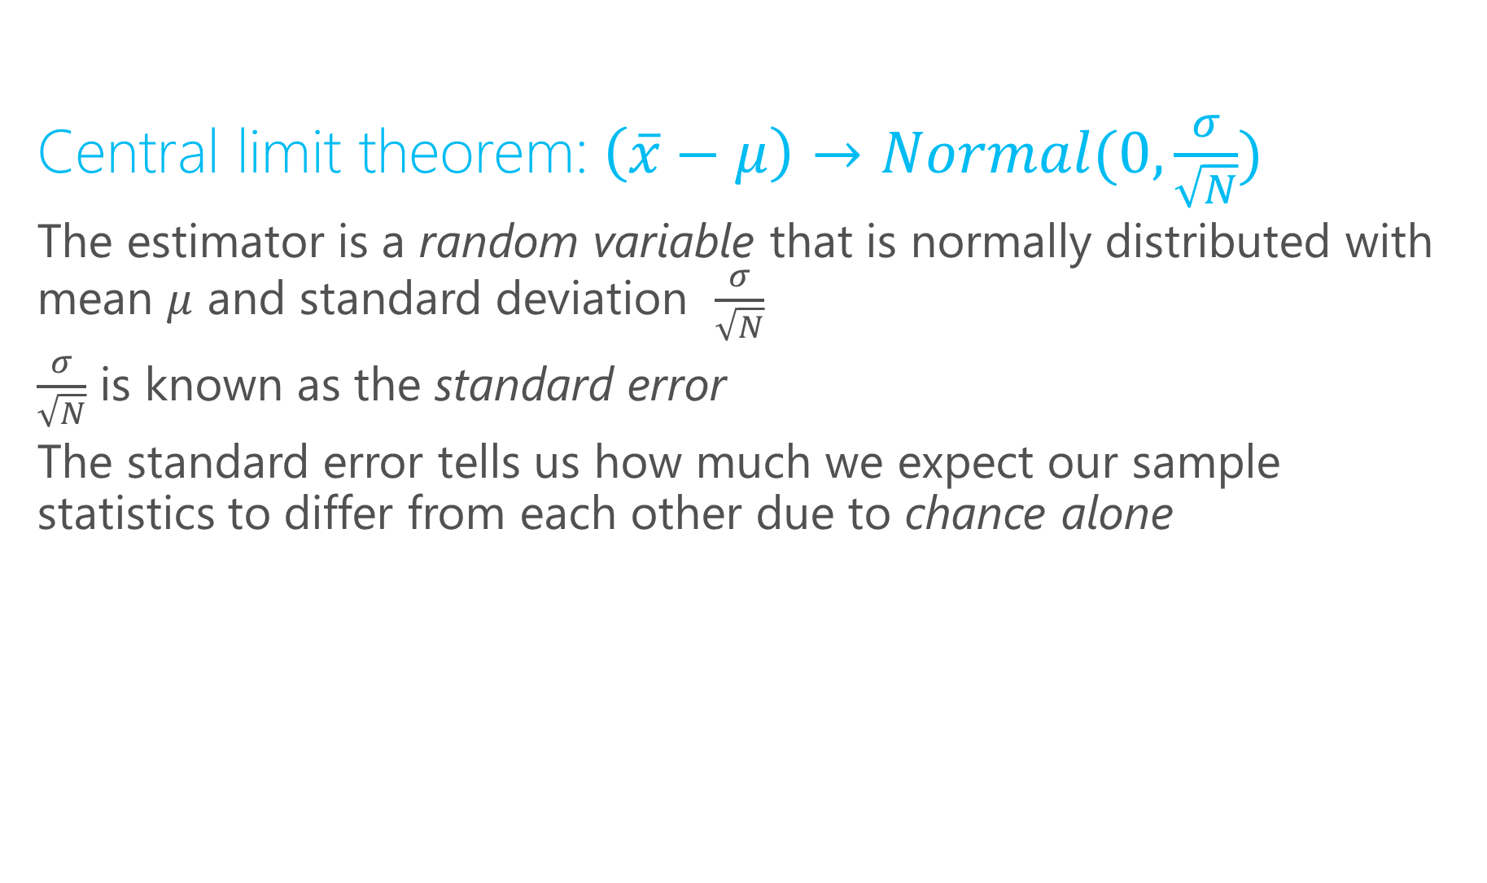
Properties of the sample mean
Central limit theorem:$\left(\overline{x}−μ\right)→Normal(0,\frac{σ}{\sqrt{N}})$
The estimator is a random variable that is normally distributed with mean $μ$ and standard deviation $\frac{σ}{\sqrt{N}}$
$\frac{σ}{\sqrt{N}}$ is known as the standard error
The standard error tells us how much we expect our sample statistics to differ from each other due to chance alone

Slide 13
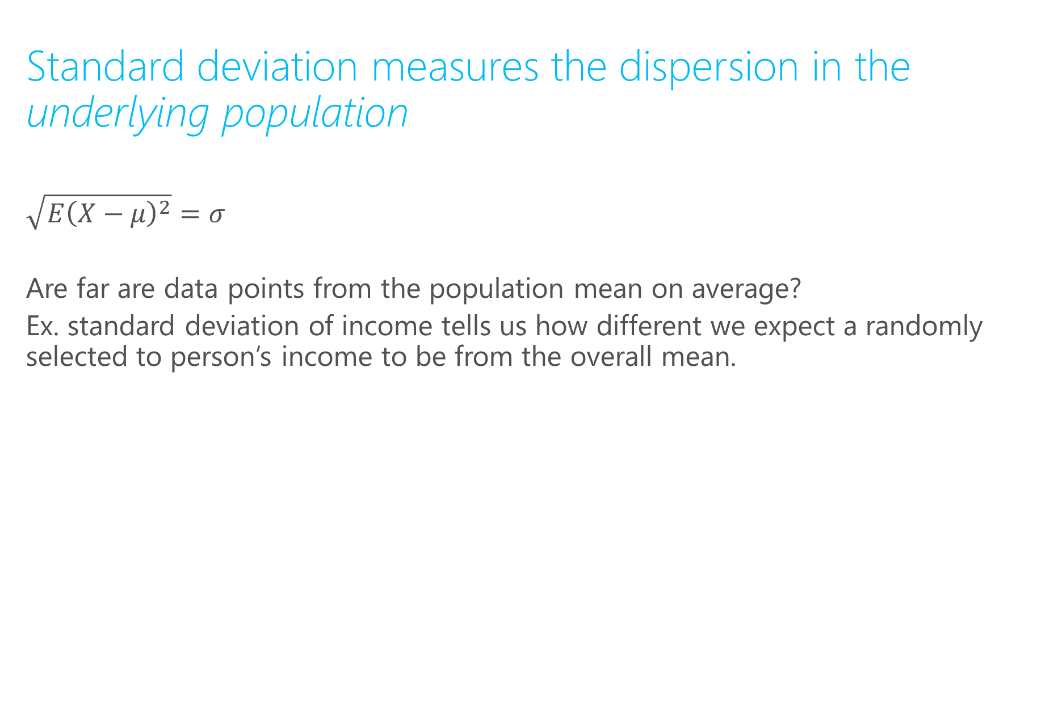
Standard error vs. standard deviation
Standard deviation measures the dispersion in the underlying population
$$\sqrt{E{\left(X−μ\right)}^{2}}=σ$$
Are far are data points from the population mean on average?
Ex. standard deviation of income tells us how different we expect a randomly selected to person’s income to be from the overall mean.

Slide 14

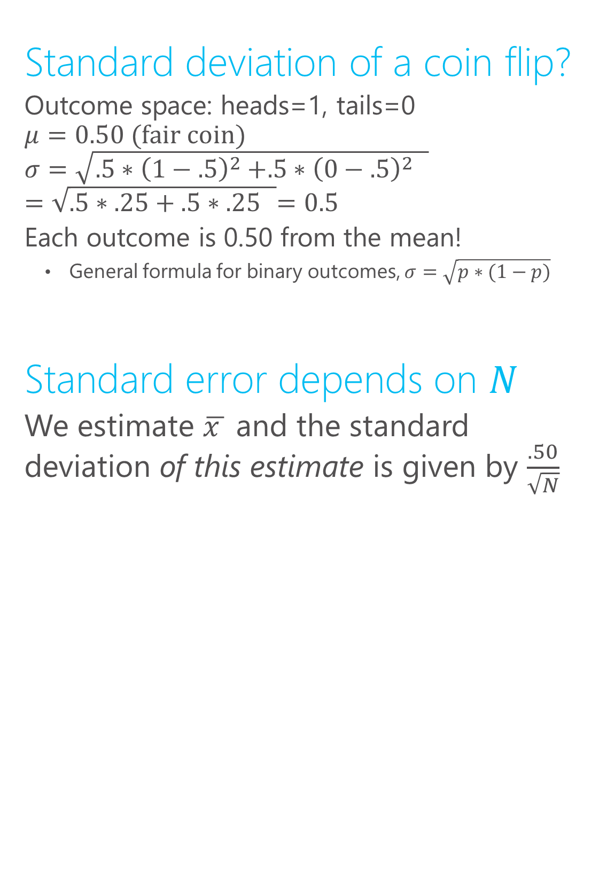
Coin flipping: s.e. vs. s.d.
Standard deviation of a coin flip?
Outcome space: heads=1, tails=0
$$μ=0.50 (\text{fair} \text{coin})$$
$$σ=\sqrt{.5{∗\left(1−.5\right)}^{2}+.5{∗{\left(0−.5\right)}^{2} }^{ }}$$
$$=\sqrt{.5∗.25+.5{∗.25 }^{ }}=0.5$$
Each outcome is 0.50 from the mean!
General formula for binary outcomes, $σ=\sqrt{p∗(1−p)}$
Standard error depends on $N$
We estimate $\overline{x }$ and the standard deviation of this estimate is given by $\frac{.50}{\sqrt{N}}$

Slide 15

Standard error vs. standard deviation
Standard error measures the dispersion in the estimator (ex. sample mean) for a given sample size
The central limit theorem tells us how the variance in the population links up with the variance in our estimator: $\frac{σ}{\sqrt{N}}$
Ex. fair coin flip. Heads=1, Tails=0.
$μ$=0.5 $σ=0.5$
s.e. = 0.5/$\sqrt{N}$
$N$=4 → 0.25
$N$=25 → 0.1
$N$=100 → 0.05

Slide 16

s.e. vs. s.d.
Central limit theorem says the distribution of the estimator will be Guassian for any population distribution with finite mean and variance
The distribution of the sample mean is bell-shaped, “no matter what” the distribution of the underlying variable
As $N$ increases, the distribution will “collapse” to the true population mean

Slide 17

Statistical uncertainty and $\sqrt{N}$
Ex. fair coin flip. Heads=1, Tails=0.
$μ$=0.5 $σ=0.5$
s.e. = 0.5/$\sqrt{N}$
Ex. Points
$$\sqrt{100}=10$$
$$\sqrt{400}=20$$
$$\sqrt{1000}=33$$

Slide 18

Standard error and sample size
Ex. fair coin flip. Heads=1, Tails=0.
$μ$=0.5 $σ=0.5$
s.e. = 0.5/$\sqrt{N}$
To reduce my standard error
factor 2, I need to increase
sample size by $2^{2}$
Ex.
s.e.(N=40)=0.04
s.e.(N=160)=0.02
s.e.(N=640)=0.01

Slide 19
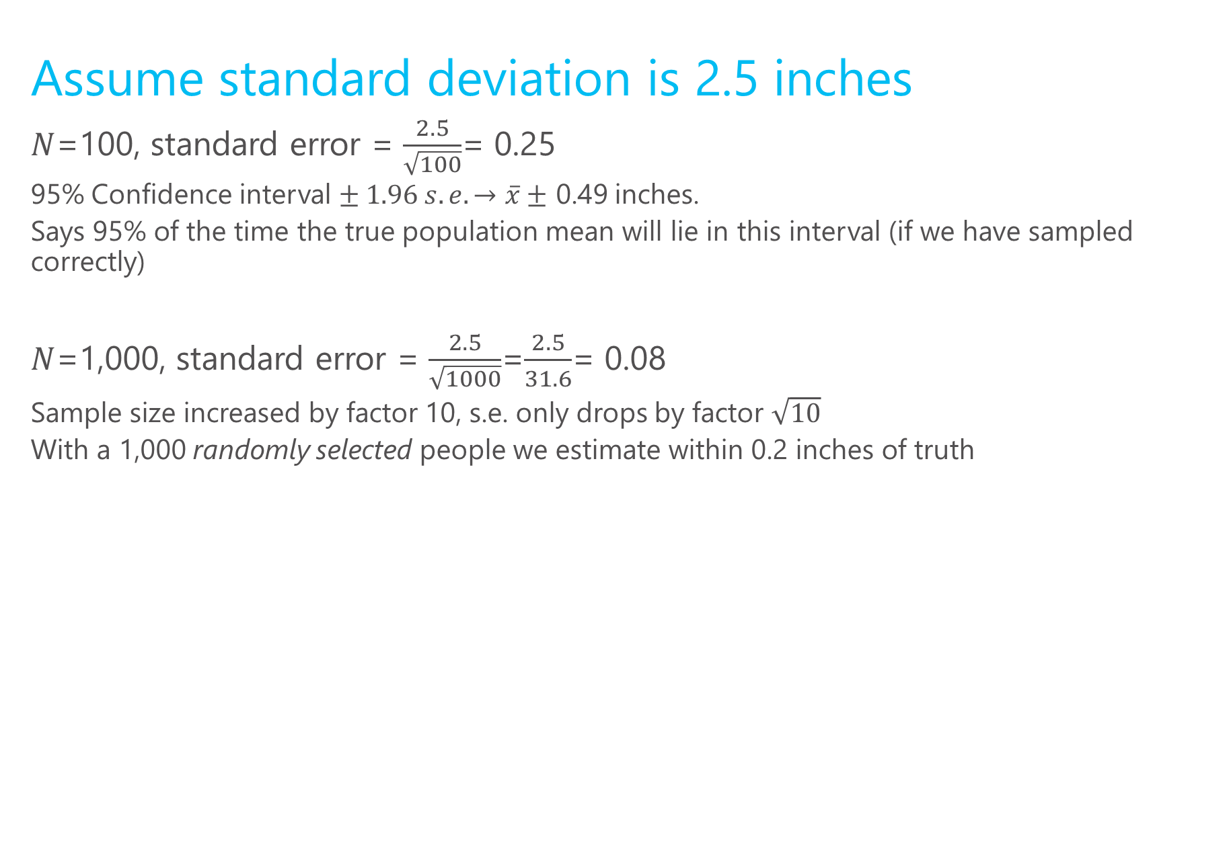
Height example cont.
Assume standard deviation is 2.5 inches
$N$=100, standard error = $\frac{2.5}{\sqrt{100}}$= 0.25
95% Confidence interval $± 1.96 s.e. →\overline{x}±$ 0.49 inches.
Says 95% of the time the true population mean will lie in this interval (if we have sampled correctly)
$N$=1,000, standard error = $\frac{2.5}{\sqrt{1000}}$=$\frac{2.5}{31.6}$= 0.08
Sample size increased by factor 10, s.e. only drops by factor $\sqrt{10}$
With a 1,000 randomly selected people we estimate within 0.2 inches of truth

Slide 20
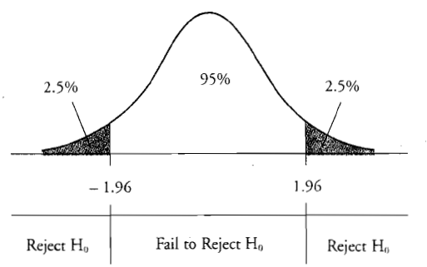

Constructing confidence intervals
1) Estimate sigma: $s$ =$\sqrt{{\frac{1}{N−1}\sum_{i=1}^{N}{{(x}_{i}−\overline{x}})}^{2}}$
Intuition, use average differences from the sample mean.
2) Compute standard error= $\frac{s}{\sqrt{N}}$
3) +/- 1.96 captures 95% of
the Normal distribution

Slide 21
What does this mean?
Your estimate is your best guess of the truth
2) 95% confidence interval: 95% of the time the truth is in this range
3) If wide, indicates lots of uncertainty in best guess
4) In practice, you only have 1 sample. Statistical theory quantifies your uncertainty in this estimate

Slide 22
Visualizing the CLT
N=4
Fair coin
http://blog.vctr.me/posts/central-limit-theorem.html

Slide 23
What does standard error capture?
Standard error captures how much our estimator will move around due the chance involved in sampling
This is known as sampling variation, it captures the degree to which small samples are different from the population.
It does not capture model uncertainty or bias in the sampling procedure
What if I have a non-random sample?
The “margin for error” you see on polls usually assumes they have a representative sample, and thus only reports sampling variation

Slide 24
Sampling and estimation
Sampling is the way we generate “observations”
I.e. it is the way we construct datasets
Any dataset that is not a “complete census” is a sample (and even a complete census only represents one point in time, so can be view as a sample too)

Slide 25
Returning to our example
Some samples:
Heights of the course instructors
Heights of all the people in the room
All MSFT employees
MSFT employees that will stop and talk to us
The samples are all biased, (3) will have the lowest s.e.

Slide 26
Random sampling for unbiasedness
s.e.’s are not very meaningful if the estimator is biased
Random sampling ensures that the sample mean will equal the population mean in expectation
In big data applications, bias is much more important than sampling variation!

Slide 27
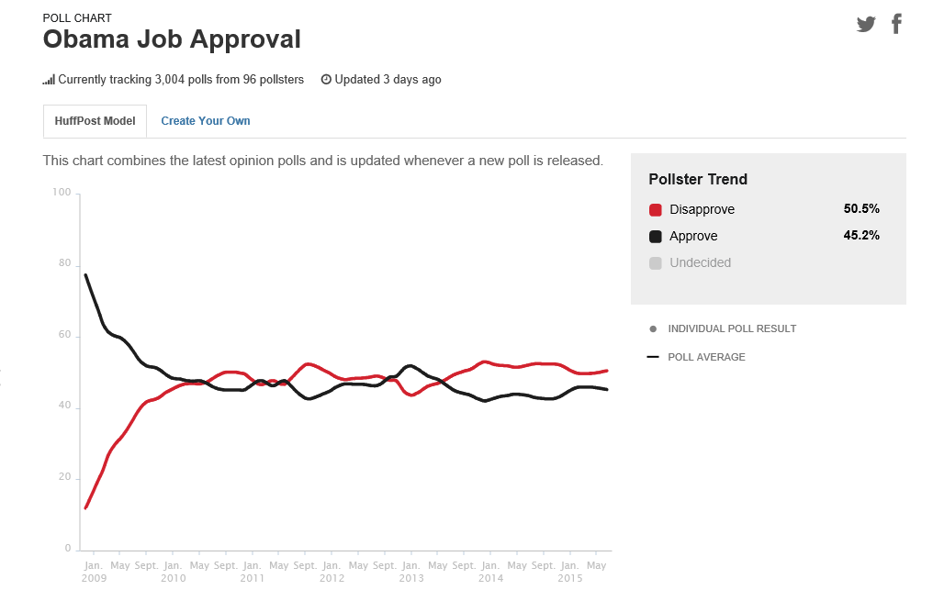
Example: polls

Slide 28
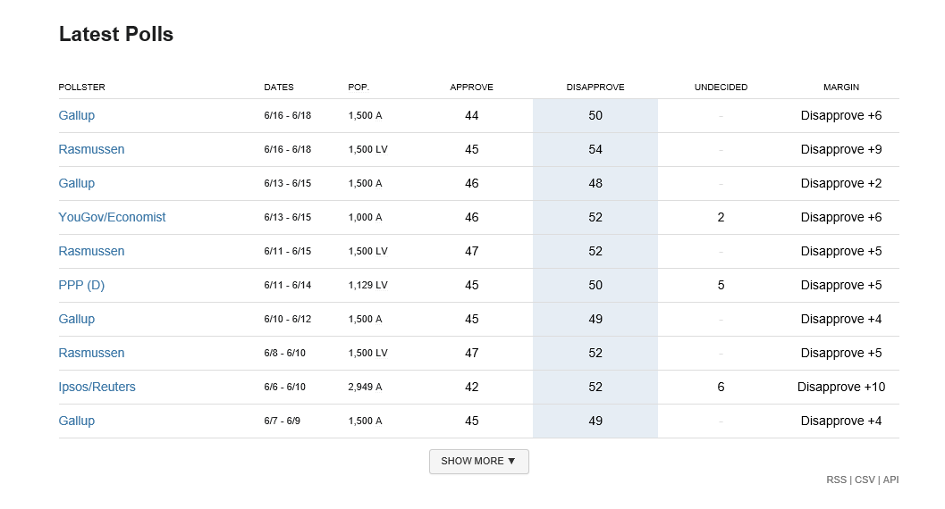
Why do these numbers differ?

Slide 29
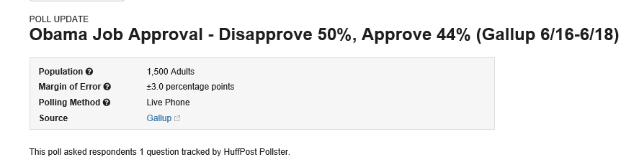
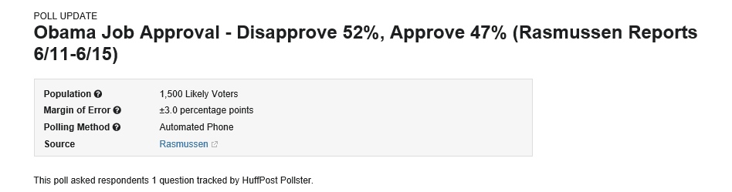

Different target populations
Different methods → different biases in sample selection
Different times → different “populations”
Different random samples→ sampling variation

Slide 30

Two key properties of an estimator
Bias: if $E\left[\hat{β}\right]=β$ then the estimator is said to be unbiased. “with a very large sample we expect to uncover the truth”
Variance: the degree to which the estimator jumps around
In more complicated settings, different estimators of the same underlying quantity can have different s.e.’s

Slide 31
Returning to the height example
A fully random sample of 25 U.S. adults will be unbiased but have relatively high variance
A large sample of all MSFT employees will have a very low variance, but is likely biased
Later in the course, we will see how methods trade-off bias vs. variance

Slide 32
What determines properties of an estimator?
The estimation method or algorithm
The sample mean is an estimator that is unbiased if the sampling is done correctly
Other more complicated estimators have different properties, we will see this in later lectures
How the sample was drawn
Even “good estimators” are lousy with poor samples.

Slide 33

Hypothesis testing
$$H_{o}:null hypothesis −→population parameter=μ_{0}$$
$$t=\frac{\overline{x}−μ_{0}}{s/\sqrt{N}}$$
$s$=sample standard deviation
$\overline{x}$=sample mean or anything that “behaves like a sample mean”

Slide 34
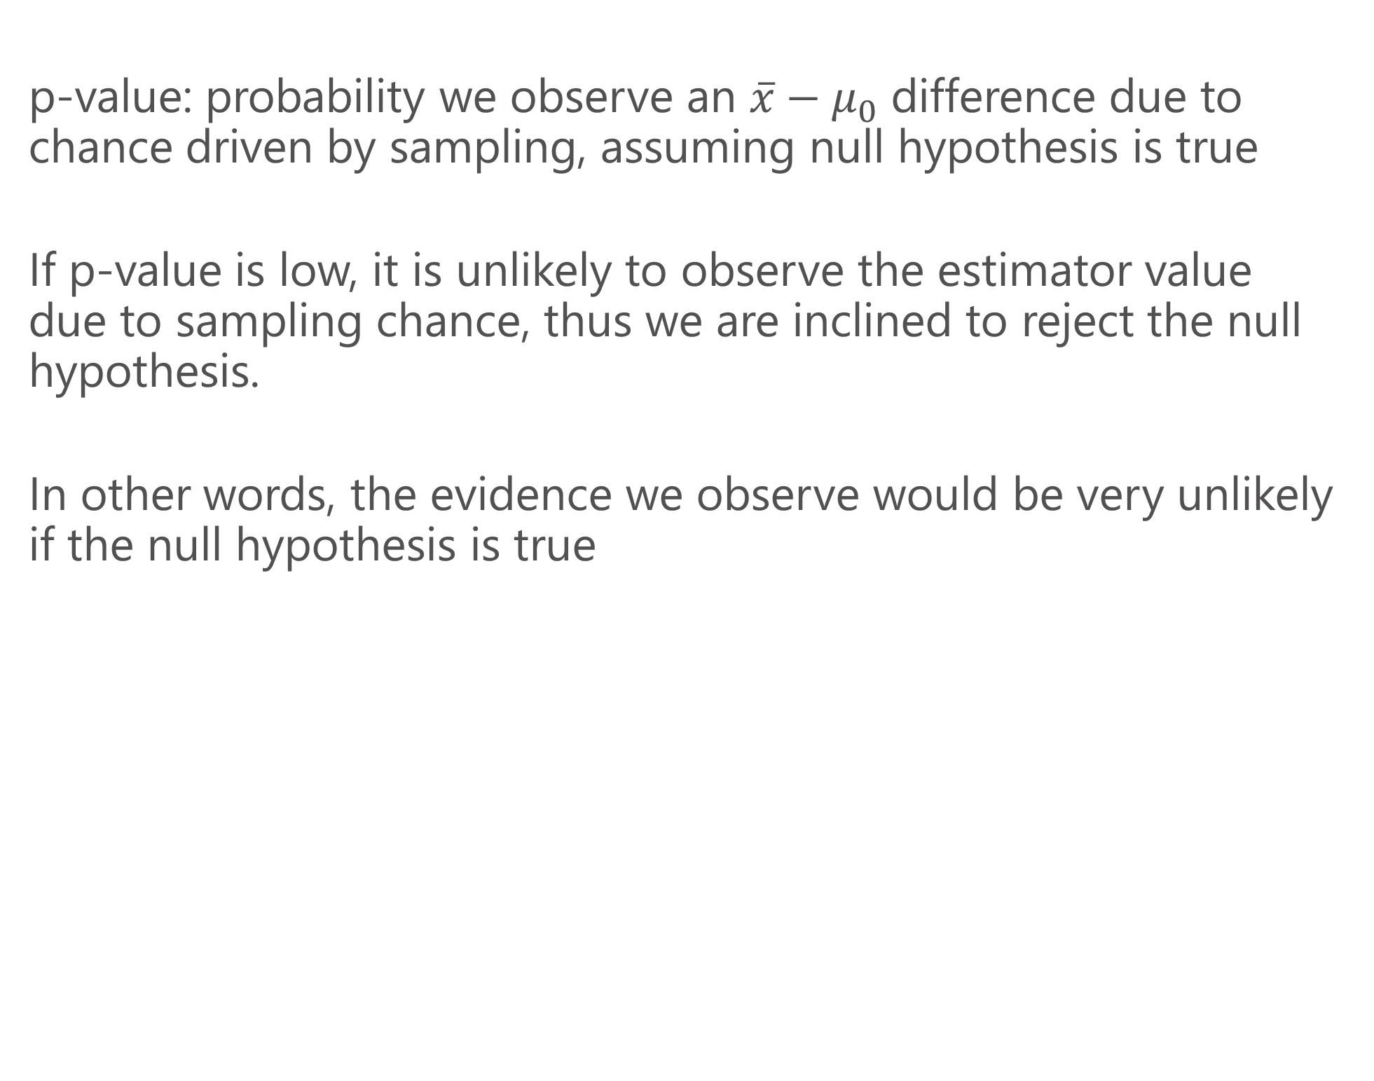
Hypothesis testing: p values
p-value: probability we observe an $\overline{x}−μ_{0}$ difference due to chance driven by sampling, assuming null hypothesis is true
If p-value is low, it is unlikely to observe the estimator value due to sampling chance, thus we are inclined to reject the null hypothesis.
In other words, the evidence we observe would be very unlikely if the null hypothesis is true

Slide 35

Hypothesis testing
$$H_{o}:null hypothesis −→population parameter=μ_{0}$$
$$t=\frac{\overline{x}−μ_{0}}{s/\sqrt{N}}$$

