Slide 1

Introduction to Cassandra
Loup Meurice

Slide 2

The CAP Theorem

Slide 3

Any distributed data store can provide two of the following guarantees: (1) Consistency, (2) Availibility, (3) Partition tolerance

Slide 4
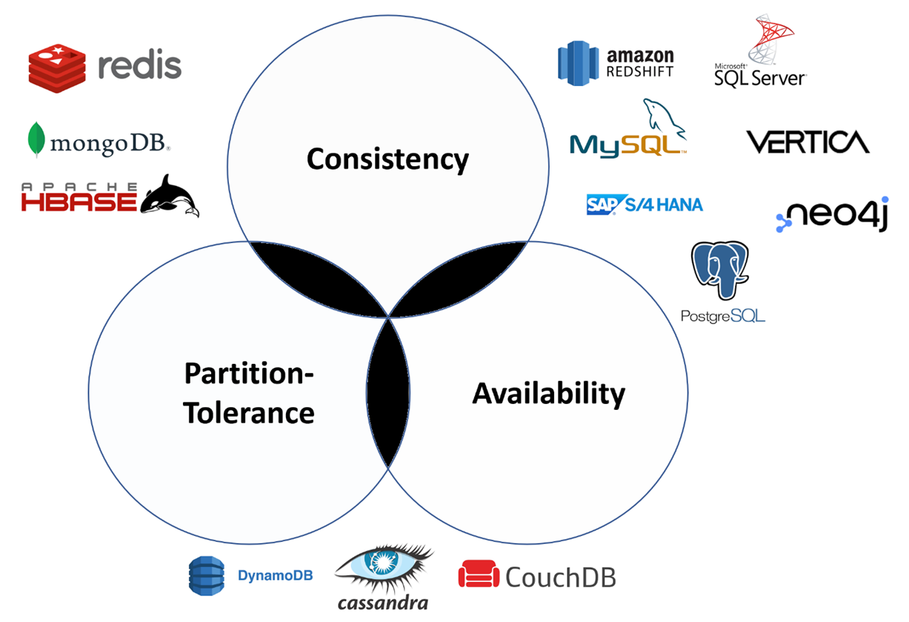
Any distributed data store can provide two of the following guarantees: (1) Consistency, (2) Availibility, (3) Partition tolerance

Slide 5
Consistency
Every read receives the most recent write (or an error)

Slide 6
Consistency
Every read receives the most recent write (or an error)
m1
m2
d
Data d is stored on two different machines, m1 and m2 (data duplication strategy)
d
m3

Slide 7

Consistency
Every read receives the most recent write (or an error)
m1
m2
updates
d'
d
A client app updates d, what will provoke simultaneously an update on m1 and then m2
m3

Slide 8
Consistency
Every read receives the most recent write (or an error)
m1
m2
updates
d’
reads
d
If a second client app reads d before the update on m2 happens, (s)he risks to read an outdated value
m3

Slide 9
Availibility
Every request receives a (non-error) response, without the guarantee that it contains the most recent write (see consistency)

Slide 10
Availibility
Every request receives a (non-error) response, without the guarantee that it contains the most recent write (see consistency)
m1
m2
If a user updates data d which is duplicated on m1 and m2, the user reading d will be blocked until the update is fully propagated. In this case, the availibility is sacrified to ensure data consistency
updates
sync
d’
reads
d
m3

Slide 11
Partition tolerance
The system continues to operate despite network failure

Slide 12
Partition tolerance
The system continues to operate despite network failure
m1
m2
The following master-slave architecture cannot ensure partition tolerance if the communication between the master and slaves fails
master
m3

Slide 13

Cassandra and the CAP theorem
Availability: Cassandra ensures high data availability
Partition tolerance: no «single point of failure». If a machine does not respond, the show goes on. Avaibility > Consistency Every request receives a (non-error) response, without the guarantee that it contains the most recent write

Slide 14
It’s all about the CAP theorem

Slide 15
It’s all about the CAP theorem

Slide 16
It’s all about the CAP theorem
Document database

Slide 17
It’s all about the CAP theorem
Column-oriented database

Slide 18

Cassandra architecture

Slide 19
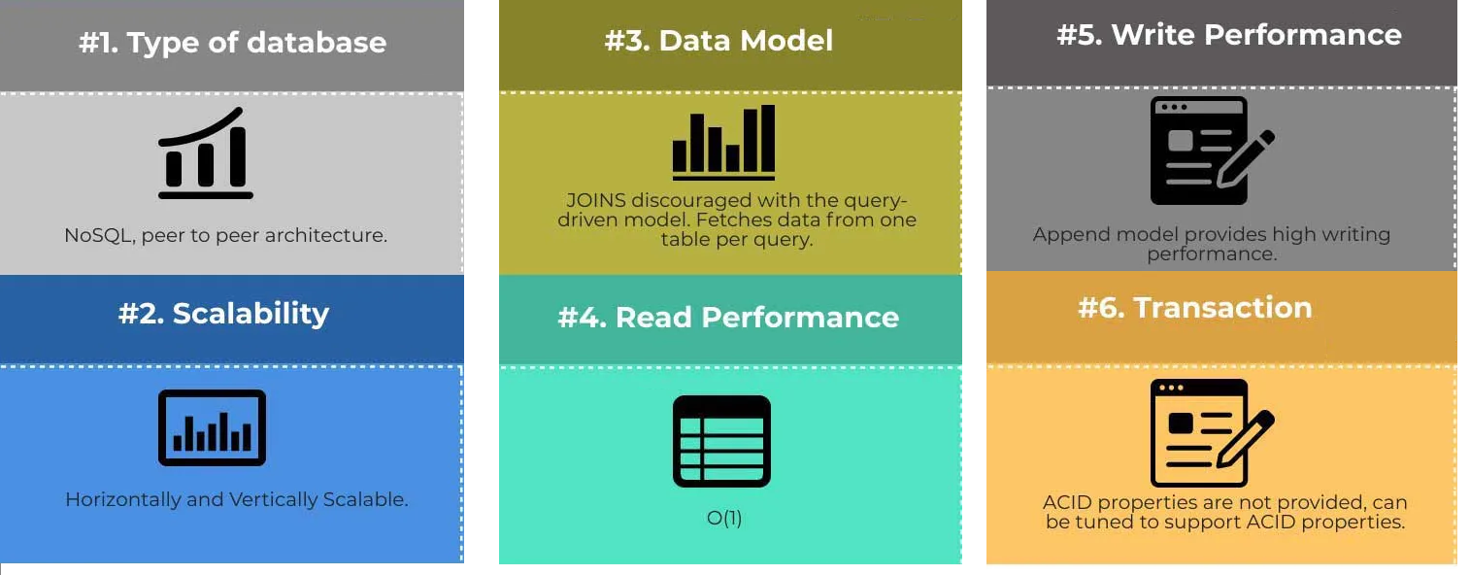
Cassandra – the outlines

Slide 20
Cassandra – the outlines

Slide 21
Cassandra – the outlines

Slide 22
Cassandra – the outlines

Slide 23
Cassandra – the outlines

Slide 24
Cassandra – the outlines

Slide 25
Cassandra – #1 Type of database
A Cassandra cluster is composed of keyspaces.
A keyspace is a data container, similar to schema in RDBMS.
In a Cassandra cluster, a keyspace is an outermost object that determines how data replicates on nodes (see Cassandra – #2 Scalability)

Slide 26
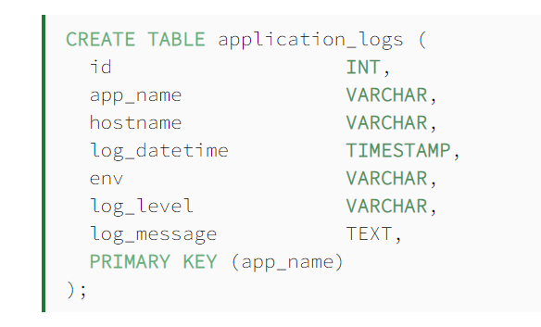
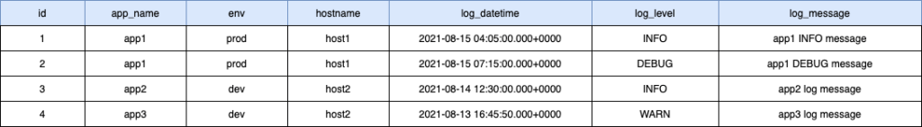
Cassandra – #1 Type of database
Keyspaces consist of core objects called column families or tables

Slide 27
Cassandra – #1 Type of database
Cassandra Query Language (CQL) allows manipulating entities
INSERT INTO MyTable (id, firstName, lastName) values (1, ‘John’, ‘Doe’);
SELECT * FROM MyTable WHERE id = 1;

Slide 28
Cassandra – #2 Scalability
CLUSTER
DC1
Node: machine which stores some portion of your entire database
Data center: logical grouping of Nodes which communicate together
Cluster:
The sum total of all machines (nodes) in your database including all datacenters. There is no cross-cluster replication. Two clusters represent two independent databases.
DC2
DC3
https://stackoverflow.com/a/28197651

Slide 29
Cassandra – #2 Scalability
CLUSTER
DC1
Node: machine which stores some portion of your entire database
Data center: logical grouping of Nodes which communicate together
Cluster:
The sum total of all machines (nodes) in your database including all datacenters. There is no cross-cluster replication. Two clusters represent two independent databases.
DC2
DC3
https://stackoverflow.com/a/28197651

Slide 30
Cassandra – #2 Scalability
CLUSTER
DC1
Node: machine which stores some portion of your entire database
Data center: logical grouping of Nodes which communicate together
Cluster:
The sum total of all machines (nodes) in your database including all datacenters. There is no cross-cluster replication. Two clusters represent two independent databases.
DC2
DC3
https://stackoverflow.com/a/28197651

Slide 31
Cassandra – #2 Scalability
CLUSTER
DC1
Node: machine which stores some portion of your entire database
Data center: logical grouping of Nodes which communicate together
Cluster:
The sum total of all machines (nodes) in your database including all datacenters. There is no cross-cluster replication. Two clusters represent two independent databases.
DC2
DC3
https://stackoverflow.com/a/28197651

Slide 32
Cassandra – #2 Scalability
CLUSTER
DC1
Node: machine which stores some portion of your entire database
Data center: logical grouping of Nodes which communicate together
Cluster:
The sum total of all machines (nodes) in your database including all datacenters. There is no cross-cluster replication. Two clusters represent two independent databases.
DC2
DC3
https://stackoverflow.com/a/28197651

Slide 33
Cassandra – #2 Scalability
CLUSTER
DC1
Data replication strategy
A Cassandra cluster is composed of either a single data center or multiple data centers
Single data center: SimpleStrategy
Multiple data centers: NetworkTopologyStrategy
A replication strategy must be specified for each declared keyspace. All the tables from a same keyspace share the same replication strategy
DC2
DC3
https://docs.datastax.com/en/cassandra-oss/3.0/cassandra/architecture/archDataDistributeReplication.html

Slide 34
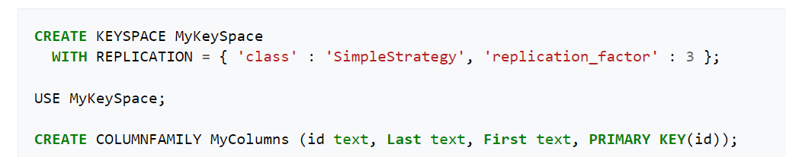
Cassandra – #2 Scalability
CLUSTER
Cassandra cluster composed of a single data center
MyKeySpace consists of one column family (or table).
DC

Slide 35
Cassandra – #2 Scalability
CLUSTER
Cassandra cluster composed of a single data center
MyKeySpace consists of one column family (or table).
DC

Slide 36
Cassandra – #2 Scalability
CLUSTER
Cassandra cluster composed of a single data center
MyKeySpace consists of one column family (or table).
Data (rows) from MyColumns are stored and replicated in 3 nodes.
DC

Slide 37
Cassandra – #2 Scalability
CLUSTER
Cassandra cluster composed of a single data center
MyKeySpace consists of one column family (or table).
Data (rows) from MyColumns are stored and replicated in 3 nodes.
DC

Slide 38
Cassandra – #2 Scalability
CLUSTER
Cassandra cluster composed of a single data center
MyKeySpace consists of one column family (or table).
Data (rows) from MyColumns are stored and replicated in 3 nodes.
➔ Data replication strategy defined at the intra- data center level
DC

Slide 39
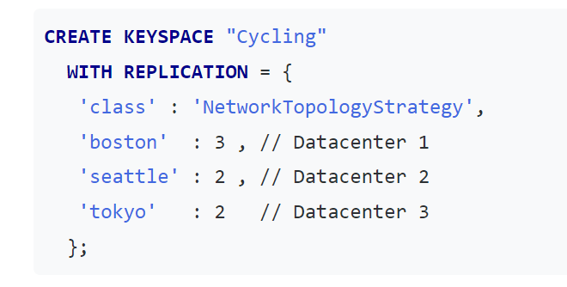
CLUSTER
Cassandra – #2 Scalability
Cassandra cluster composed of 3 data centers
T
DC3
DC2
DC1

Slide 40
CLUSTER
Cassandra – #2 Scalability
Cassandra cluster composed of 3 data centers
T
DC3
DC2
DC1

Slide 41
CLUSTER
Cassandra – #2 Scalability
Cassandra cluster composed of 3 data centers
T
Keyspace Cycling data are stored and replicated across the 3 data centers:
Data center 1: each row is replicated on 3 nodes
Data center 2: each row is replicated on 2 nodes
Data center 3: each row is replicated on 2 nodes
DC3
DC2
DC1

Slide 42
CLUSTER
Cassandra – #2 Scalability
Cassandra cluster composed of 3 data centers
Keyspace Cycling data are stored and replicated across the 3 data centers:
Data center 1: each row is replicated on 3 nodes
Data center 2: each row is replicated on 2 nodes
Data center 3: each row is replicated on 2 nodes
➔ Data replication strategy defined at the inter- and intra- data center level
DC3
DC2
DC1

Slide 43
Cassandra – #2 Scalability
Intra- data center replication:
Data are stored in multiple nodes of a same data center.
Increased Availibility (CAP): if a node does not respond, data are still available by querying the replicates.
Inter- data center replication:
Data are stored in multiple data centers
➔ Optimization of the access time through the different geographical areas (e.g., one data center per geographical area)
➔ Increased Avaibility: if a data center does not respond, data are still available by querying the replicated data centers (latency possible according to the area)

Slide 44
Cassandra – #3 Data model and #4,5 Query performance
Partitioning and clustering keys

Slide 45
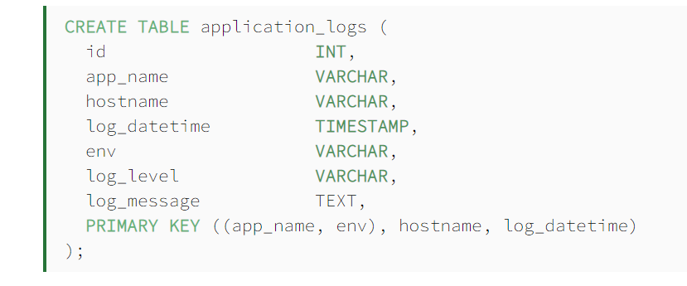
Cassandra – #3 Data model and #4,5 Query performance
Partitioning and clustering keys

Slide 46
Cassandra – #3 Data model and #4,5 Query performance
1. Partitioning key

Slide 47
Cassandra – #3 Data model and #4,5 Query performance
1. Partitioning key
Cassandra uses a consistent hashing technique to generate the hash value of the partition key (app_name) and assign the row data to a partition range inside a node. Each row with the same partition key value will be stored in the same node.

Slide 48
Cassandra – #3 Data model and #4,5 Query performance
1. Partitioning key
Cassandra uses a consistent hashing technique to generate the hash value of the partition key (app_name) and assign the row data to a partition range inside a node. Each row with the same partition key value will be stored in the same node.

Slide 49
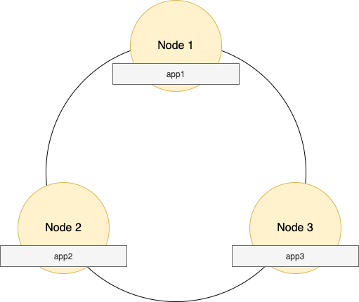
Cassandra – #3 Data model and #4,5 Query performance
1. Partitioning key
Cassandra uses a consistent hashing technique to generate the hash value of the partition key (app_name) and assign the row data to a partition range inside a node. Each row with the same partition key value will be stored in the same node.

Slide 50
Cassandra – #3 Data model and #4,5 Query performance
1. Partitioning key
A data fetch query without a partition key in the where clause results in an inefficient full cluster scan.

Slide 51
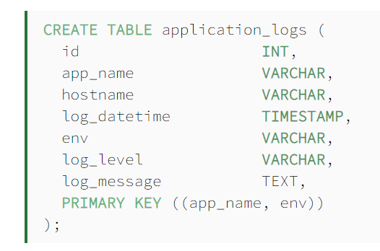
Cassandra – #3 Data model and #4,5 Query performance
1. Partitioning key (composite)

Slide 52
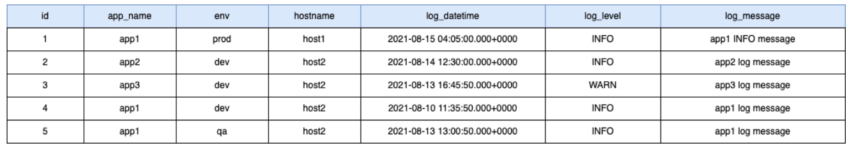
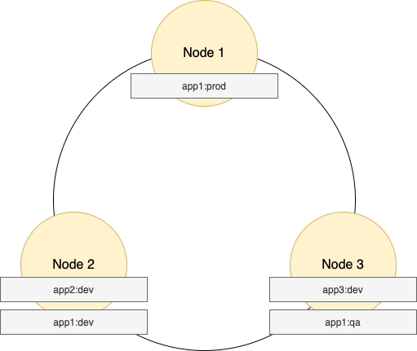
Cassandra – #3 Data model and #4,5 Query performance
1. Partitioning key (composite)

Slide 53
Cassandra – #3 Data model and #4,5 Query performance
1. Partitioning key (composite)
A data fetch query without a partition key in the where clause results in an inefficient full cluster scan.

Slide 54
Cassandra – #3 Data model and #4,5 Query performance
2. Clustering key

Slide 55
Cassandra – #3 Data model and #4,5 Query performance
2. Clustering key
partitioning is the process of identifying the partition range within a node the data is placed into. In contrast, clustering is a storage engine process of sorting the data within a partition and is based on the columns defined as the clustering keys.

Slide 56
Cassandra – #3 Data model and #4,5 Query performance
2. Clustering key
partitioning is the process of identifying the partition range within a node the data is placed into. In contrast, clustering is a storage engine process of sorting the data within a partition and is based on the columns defined as the clustering keys.

Slide 57
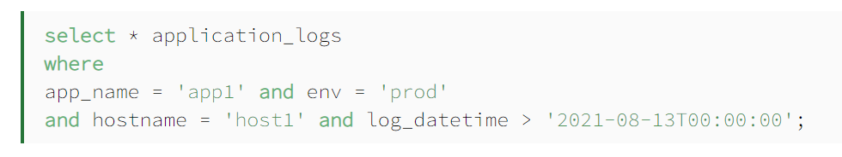
Cassandra – #3 Data model and #4,5 Query performance
2. Clustering key
partitioning is the process of identifying the partition range within a node the data is placed into. In contrast, clustering is a storage engine process of sorting the data within a partition and is based on the columns defined as the clustering keys.

Slide 58
Cassandra – #3 Data model and #4,5 Query performance
2. Clustering key
partitioning is the process of identifying the partition range within a node the data is placed into. In contrast, clustering is a storage engine process of sorting the data within a partition and is based on the columns defined as the clustering keys.
node identification (partitioning key)

Slide 59
Cassandra – #3 Data model and #4,5 Query performance
2. Clustering key
partitioning is the process of identifying the partition range within a node the data is placed into. In contrast, clustering is a storage engine process of sorting the data within a partition and is based on the columns defined as the clustering keys.
node identification (partitioning key)
Rows identification inside the node (clustering key)

Slide 60
Cassandra – #3 Data model and #4,5 Query performance
3. Denormalization

Slide 61
Cassandra – #3 Data model and #4,5 Query performance
3. Denormalization
CQL language permits neither joins nor sub-queries (unlike SQL)
Each CQL query accesses a single table

Slide 62
Cassandra – #3 Data model and #4,5 Query performance
3. Denormalization
CQL language permits neither joins nor sub-queries (unlike SQL)
Each CQL query accesses a single table
Data denormalization is thus encouraged

Slide 63
Cassandra – #3 Data model and #4,5 Query performance
3. Denormalization
CQL language permits neither joins nor sub-queries (unlike SQL)
Each CQL query accesses a single table
Data denormalization is thus encouraged
Data modelling depends on business needs and functionnalities (unlike RDBMS)

Slide 64
Cassandra – #3 Data model and #4,5 Query performance
3. Denormalization
CQL language permits neither joins nor sub-queries (unlike SQL)
Each CQL query accesses a single table
Data denormalization is thus encouraged
Data modelling depends on business needs and functionnalities (unlike RDBMS)
Research question: are a conceptual schema and a set of conceptual queries sufficient to recommend schema?

Slide 65
Cassandra – #6 Transaction
ACID properties

Slide 66
Cassandra – #6 Transaction
ACID properties (recall)

Slide 67
Cassandra – #6 Transaction
ACID properties (recall)
Atomicity
Transactions are often composed of multiple statements. Atomicity guarantees that each transaction is treated as a single "unit", which either succeeds completely, or fails completely: if any of the statements constituting a transaction fails to complete, the entire transaction fails and the database is left unchanged. An atomic system must guarantee atomicity in each and every situation, including power failures, errors and crashes.[A guarantee of atomicity prevents updates to the database occurring only partially, which can cause greater problems than rejecting the whole series outright. As a consequence, the transaction cannot be observed to be in progress by another database client. At one moment in time, it has not yet happened, and at the next it has already occurred in whole (or nothing happened if the transaction was cancelled in progress).
An example of an atomic transaction is a monetary transfer from bank account A to account B. It consists of two operations, withdrawing the money from account A and saving it to account B. Performing these operations in an atomic transaction ensures that the database remains in a consistent state, that is, money is neither debited nor credited if either of those two operations fail.

Slide 68
Cassandra – #6 Transaction
ACID properties (recall)
Consistency
Consistency ensures that a transaction can only bring the database from one valid state to another, maintaining database invariants: any data written to the database must be valid according to all defined rules, including constraints, cascades, triggers, and any combination thereof. This prevents database corruption by an illegal transaction, but does not guarantee that a transaction is correct. Referential integrity guarantees the primary key – foreign key relationship.

Slide 69
Cassandra – #6 Transaction
ACID properties (recall)
Isolation
Transactions are often executed concurrently (e.g., multiple transactions reading and writing to a table at the same time). Isolation ensures that concurrent execution of transactions leaves the database in the same state that would have been obtained if the transactions were executed sequentially. Isolation is the main goal of concurrency control; depending on the method used, the effects of an incomplete transaction might not even be visible to other transactions.

Slide 70
Cassandra – #6 Transaction
ACID properties (recall)
Durability
Durability guarantees that once a transaction has been committed, it will remain committed even in the case of a system failure (e.g., power outage or crash). This usually means that completed transactions (or their effects) are recorded in non-volatile memory.

Slide 71
Cassandra – #6 Transaction
ACID properties in Cassandra?

Slide 72
Cassandra – #6 Transaction
ACID properties in Cassandra?
Cassandra does not use RDBMS ACID transactions with rollback or locking mechanisms, but instead offers atomic, isolated, and durable transactions with eventual/tunable consistency that lets the user decide how strong or eventual they want each transaction’s consistency to be.

Slide 73
Cassandra – #6 Transaction
ACID properties in Cassandra?
Cassandra does not use RDBMS ACID transactions with rollback or locking mechanisms, but instead offers atomic, isolated, and durable transactions with eventual/tunable consistency that lets the user decide how strong or eventual they want each transaction’s consistency to be.
As a non-relational database, Cassandra does not support joins or foreign keys, and consequently does not offer consistency in the ACID sense. For example, when moving money from account A to B the total in the accounts does not change. Cassandra supports atomicity and isolation at the row-level, but trades transactional isolation and atomicity for high availability and fast write performance. Cassandra writes are durable.

Slide 74
Cassandra – #6 Transaction
ACID properties in Cassandra?
Cassandra does not use RDBMS ACID transactions with rollback or locking mechanisms, but instead offers atomic, isolated, and durable transactions with eventual/tunable consistency that lets the user decide how strong or eventual they want each transaction’s consistency to be.
As a non-relational database, Cassandra does not support joins or foreign keys, and consequently does not offer consistency in the ACID sense. For example, when moving money from account A to B the total in the accounts does not change. Cassandra supports atomicity and isolation at the row-level, but trades transactional isolation and atomicity for high availability and fast write performance. Cassandra writes are durable.

Slide 75
Cassandra – #6 Transaction
Tunable consistency at the application level

Slide 76
Cassandra – #6 Transaction
Tunable consistency at the application level
By default, Cassandra offers Partition-tolerance and data Availability at the detriment of the data Consistency
➔ AP > C

Slide 77
Cassandra – #6 Transaction
Tunable consistency at the application level
By default, Cassandra offers Partition-tolerance and data Availability at the detriment of the data Consistency
➔ AP > C
However, consistency levels in Cassandra can be configured to manage availability vs. data consistency.

Slide 78
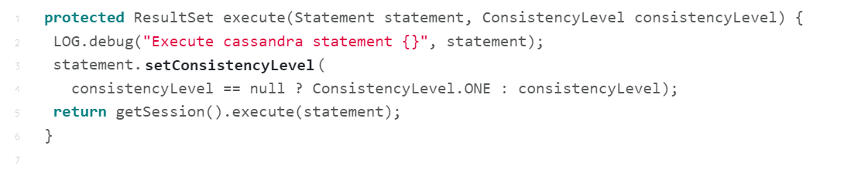
Cassandra – #6 Transaction
Tunable consistency at the application level
By default, Cassandra offers Partition-tolerance and data Availability at the detriment of the data Consistency
➔ AP > C
However, consistency levels in Cassandra can be configured to manage availability vs. data consistency.

Slide 79
Cassandra – #6 Transaction
Tunable consistency at the application level
By default, Cassandra offers Partition-tolerance and data Availability at the detriment of the data Consistency
➔ AP > C
However, consistency levels in Cassandra can be configured to manage availability vs. data consistency.
« insert into Customer (…) values (…); »

Slide 80
Cassandra – #6 Transaction
Tunable consistency at the application level
By default, Cassandra offers Partition-tolerance and data Availability at the detriment of the data Consistency
➔ AP > C
However, consistency levels in Cassandra can be configured to manage availability vs. data consistency.
« insert into Customer (…) values (…); »
Consistency level that the insert statement execution has to respect

Slide 81
Write Consistency Levels
Level | Description | Usage
ALL | A write must be written to the commit log and memtable on all replica nodes in the cluster for that partition. | Provides the highest consistency and the lowest availability of any other level.
EACH_QUORUM | Strong consistency. A write must be written to the commit log and memtable on a quorum of replica nodes in each datacenter. | Used in multiple datacenter clusters to strictly maintain consistency at the same level in each datacenter. For example, choose this level if you want a write to fail when a datacenter is down and the QUORUM cannot be reached on that datacenter.
QUORUM | A write must be written to the commit log and memtable on a quorum of replica nodes across all datacenters. | Used in either single or multiple datacenter clusters to maintain strong consistency across the cluster. Use if you can tolerate some level of failure.
LOCAL_QUORUM | Strong consistency. A write must be written to the commit log and memtable on a quorum of replica nodes in the same datacenter as the coordinator. Avoids latency of inter-datacenter communication. | Used in multiple datacenter clusters with a rack-aware replica placement strategy, such as NetworkTopologyStrategy, and a properly configured snitch. Use to maintain consistency locally (within the single datacenter). Can be used with SimpleStrategy.
ONE | A write must be written to the commit log and memtable of at least one replica node. | Satisfies the needs of most users because consistency requirements are not stringent.
TWO | A write must be written to the commit log and memtable of at least two replica nodes. | Similar to ONE.
THREE | A write must be written to the commit log and memtable of at least three replica nodes. | Similar to TWO.
LOCAL_ONE | A write must be sent to, and successfully acknowledged by, at least one replica node in the local datacenter. | In a multiple datacenter clusters, a consistency level of ONE is often desirable, but cross-DC traffic is not. LOCAL_ONE accomplishes this. For security and quality reasons, you can use this consistency level in an offline datacenter to prevent automatic connection to online nodes in other datacenters if an offline node goes down.
ANY | A write must be written to at least one node. If all replica nodes for the given partition key are down, the write can still succeed after a hinted handoff has been written. If all replica nodes are down at write time, an ANY write is not readable until the replica nodes for that partition have recovered. | Provides low latency and a guarantee that a write never fails. Delivers the lowest consistency and highest availability.
Cassandra – #6 Transaction
Tunable consistency at the application level
By default, Cassandra offers Partition-tolerance and data Availability at the detriment of the data Consistency
➔ AP > C
However, consistency levels in Cassandra can be configured to manage availability vs. data consistency.
« insert into Customer (…) values (…); »
Consistency level that the insert statement execution has to respect

Slide 82
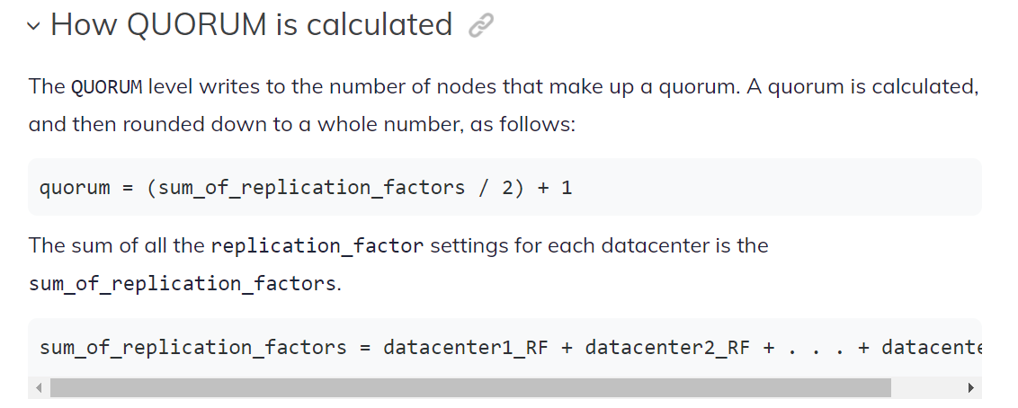
Write Consistency Levels
Level | Description | Usage
ALL | A write must be written to the commit log and memtable on all replica nodes in the cluster for that partition. | Provides the highest consistency and the lowest availability of any other level.
EACH_QUORUM | Strong consistency. A write must be written to the commit log and memtable on a quorum of replica nodes in each datacenter. | Used in multiple datacenter clusters to strictly maintain consistency at the same level in each datacenter. For example, choose this level if you want a write to fail when a datacenter is down and the QUORUM cannot be reached on that datacenter.
QUORUM | A write must be written to the commit log and memtable on a quorum of replica nodes across all datacenters. | Used in either single or multiple datacenter clusters to maintain strong consistency across the cluster. Use if you can tolerate some level of failure.
LOCAL_QUORUM | Strong consistency. A write must be written to the commit log and memtable on a quorum of replica nodes in the same datacenter as the coordinator. Avoids latency of inter-datacenter communication. | Used in multiple datacenter clusters with a rack-aware replica placement strategy, such as NetworkTopologyStrategy, and a properly configured snitch. Use to maintain consistency locally (within the single datacenter). Can be used with SimpleStrategy.
ONE | A write must be written to the commit log and memtable of at least one replica node. | Satisfies the needs of most users because consistency requirements are not stringent.
TWO | A write must be written to the commit log and memtable of at least two replica nodes. | Similar to ONE.
THREE | A write must be written to the commit log and memtable of at least three replica nodes. | Similar to TWO.
LOCAL_ONE | A write must be sent to, and successfully acknowledged by, at least one replica node in the local datacenter. | In a multiple datacenter clusters, a consistency level of ONE is often desirable, but cross-DC traffic is not. LOCAL_ONE accomplishes this. For security and quality reasons, you can use this consistency level in an offline datacenter to prevent automatic connection to online nodes in other datacenters if an offline node goes down.
ANY | A write must be written to at least one node. If all replica nodes for the given partition key are down, the write can still succeed after a hinted handoff has been written. If all replica nodes are down at write time, an ANY write is not readable until the replica nodes for that partition have recovered. | Provides low latency and a guarantee that a write never fails. Delivers the lowest consistency and highest availability.
Cassandra – #6 Transaction
Tunable consistency at the application level
By default, Cassandra offers Partition-tolerance and data Availability at the detriment of the data Consistency
➔ AP > C
However, consistency levels in Cassandra can be configured to manage availability vs. data consistency.
« insert into Customer (…) values (…); »
Consistency level that the insert statement execution has to respect

Slide 83
Read Consistency Levels
Level | Description | Usage
ALL | Returns the record after all replicas have responded. The read operation will fail if a replica does not respond. | Provides the highest consistency of all levels and the lowest availability of all levels.
EACH_QUORUM | Not supported for reads.
QUORUM | Returns the record after a quorum of replicas from all datacenters has responded. | Used in either single or multiple datacenter clusters to maintain strong consistency across the cluster. Ensures strong consistency if you can tolerate some level of failure.
LOCAL_QUORUM | Returns the record after a quorum of replicas in the current datacenter as the coordinator has reported. Avoids latency of inter-datacenter communication. | Used in multiple datacenter clusters with a rack-aware replica placement strategy ( NetworkTopologyStrategy) and a properly configured snitch. Fails when using SimpleStrategy.
ONE | Returns a response from the closest replica, as determined by the snitch. By default, a read repair runs in the background to make the other replicas consistent. | Provides the highest availability of all the levels if you can tolerate a comparatively high probability of stale data being read. The replicas contacted for reads may not always have the most recent write.
TWO | Returns the most recent data from two of the closest replicas. | Similar to ONE.
THREE | Returns the most recent data from three of the closest replicas. | Similar to TWO.
LOCAL_ONE | Returns a response from the closest replica in the local datacenter. | Same usage as described in the table about write consistency levels.
SERIAL | Allows reading the current (and possibly uncommitted) state of data without proposing a new addition or update. If a SERIAL read finds an uncommitted transaction in progress, it will commit the transaction as part of the read. Similar to QUORUM. | To read the latest value of a column after a user has invoked a lightweight transaction to write to the column, use SERIAL. Cassandra then checks the inflight lightweight transaction for updates and, if found, returns the latest data.
LOCAL_SERIAL | Same as SERIAL, but confined to the datacenter. Similar to LOCAL_QUORUM. | Used to achieve linearizable consistency for lightweight transactions.
Cassandra – #6 Transaction
Tunable consistency at the application level
By default, Cassandra offers Partition-tolerance and data Availability at the detriment of the data Consistency
➔ AP > C
However, consistency levels in Cassandra can be configured to manage availability vs. data consistency.
« insert into Customer (…) values (…); »
Consistency level that the insert statement execution has to respect

Slide 84
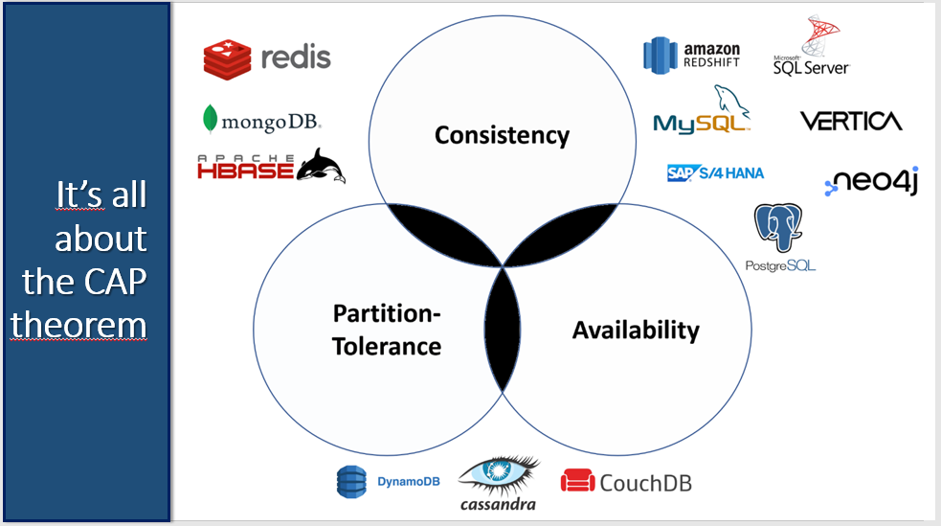
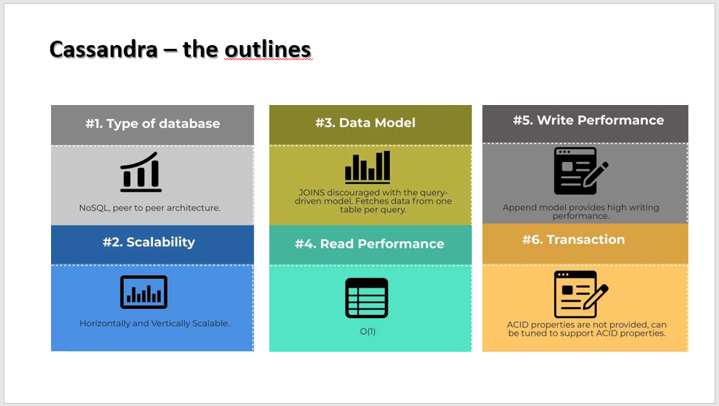
Introduction to Cassandra
Loup Meurice

Slide 85
References
https://en.wikipedia.org/wiki/CAP_theorem
https://docs.datastax.com/en/cassandra-oss/3.0/cassandra/configuration/configCassandra_yaml.html#configCassandra_yaml__partitioner https://www.baeldung.com/cassandra-keys
https://www.datastax.com/blog/basic-rules-cassandra-data-modeling https://www.educba.com/data-model-in-cassandra/
https://www.educba.com/cassandra-vs-mysql/ https://docs.datastax.com/en/cassandra-oss/2.1/cassandra/dml/dml_about_transactions_c.html
https://docs.datastax.com/en/cassandra-oss/3.0/cassandra/dml/dmlConfigConsistency.html

Slide 86
Cassandra – Commit log, MemTable and SSTables
https://stackoverflow.com/questions/34592948/what-is-the-purpose-of-cassandras-commit-log
https://www.scylladb.com/glossary/sstable/
https://docs.datastax.com/en/cassandra-oss/3.x/cassandra/dml/dmlHowDataMaintain.html Commit log = fichier optimisé sur l’append loggant tous les changements Memtable = données en cache SSTables = fichier dans lequel on flushe périodiquement les changements effectué. Chaque période de flush génère une nouvelle SSTable (seuls les données modifiées se retrouvent dans la nouvelle SSTable. Les données inchangées se trouvent uniquement dans la précédent) ➔ Compaction nécessaire (supprimer les tombstones)

