Slide 1

Introduction to MongoDB
Loup Meurice

Slide 2
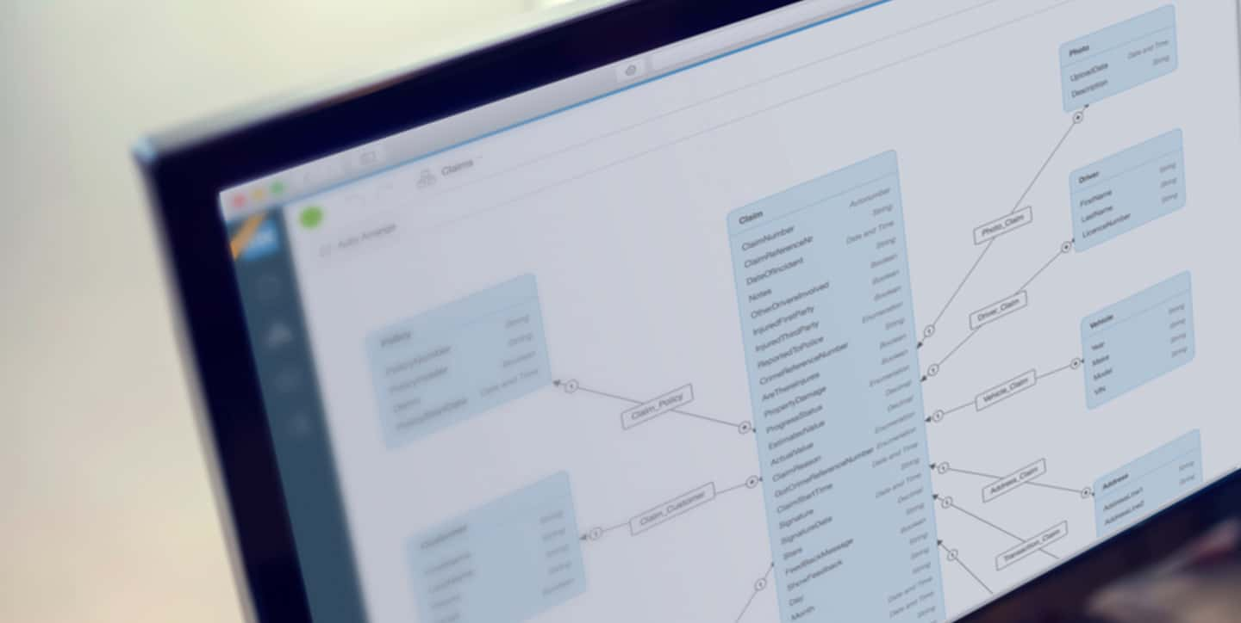
Data model

Slide 3
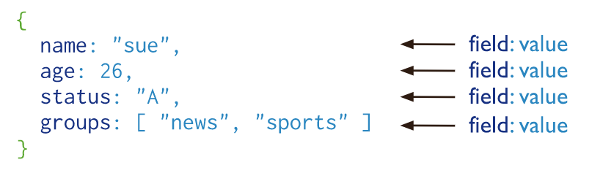
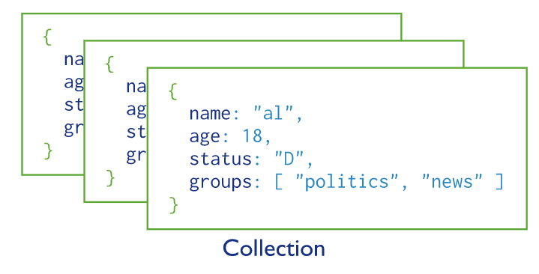
MongoDB
Collections and documents
MongoDB stores data records as documents (specifically BSON documents) which are gathered together in collections. A database stores one or more collections of documents.
MongoDB stores documents in collections. Collections are analogous to tables in relational databases.
If a collection does not exist, MongoDB creates the collection when you first store data for that collection.

Slide 4
MongoDB
Flexible schema
Unlike SQL databases, where you must determine and declare a table's schema before inserting data, MongoDB's collections, by default, do not require their documents to have the same schema.

Slide 5
MongoDB
Flexible schema
Unlike SQL databases, where you must determine and declare a table's schema before inserting data, MongoDB's collections, by default, do not require their documents to have the same schema.
That is:
The documents in a single collection do not need to have the same set of fields and the data type for a field can differ across documents within a collection.
To change the structure of the documents in a collection, such as add new fields, remove existing fields, or change the field values to a new type, update the documents to the new structure.

Slide 6
MongoDB
Flexible schema
Unlike SQL databases, where you must determine and declare a table's schema before inserting data, MongoDB's collections, by default, do not require their documents to have the same schema.
That is:
The documents in a single collection do not need to have the same set of fields and the data type for a field can differ across documents within a collection.
To change the structure of the documents in a collection, such as add new fields, remove existing fields, or change the field values to a new type, update the documents to the new structure.
In practice, however, the documents in a collection share a similar structure, and you can enforce document validation rules for a collection during update and insert operations.

Slide 7
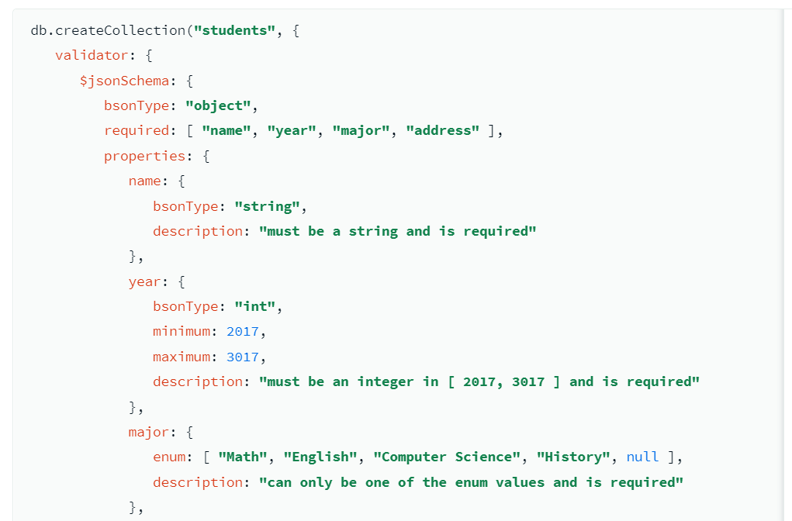
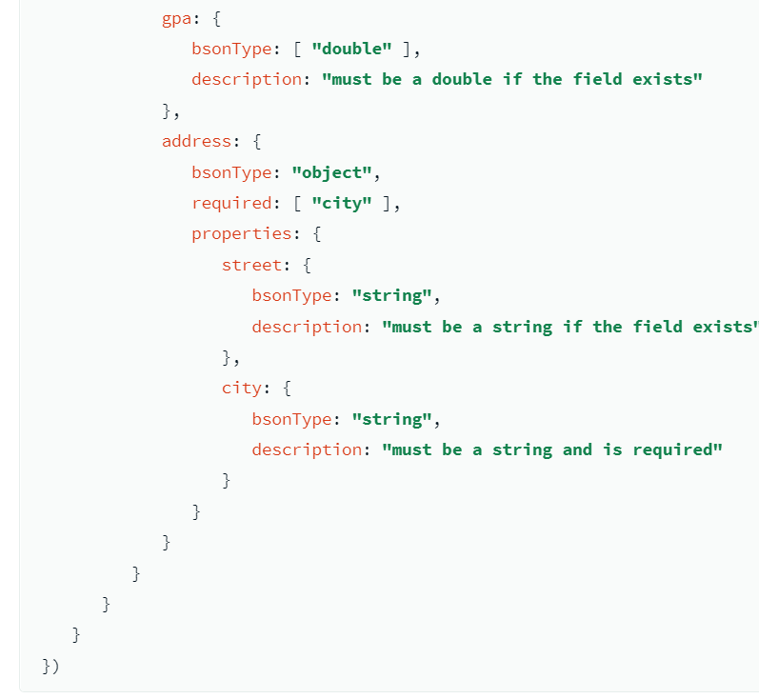
MongoDB
Flexible schema
Unlike SQL databases, where you must determine and declare a table's schema before inserting data, MongoDB's collections, by default, do not require their documents to have the same schema.
That is:
The documents in a single collection do not need to have the same set of fields and the data type for a field can differ across documents within a collection.
To change the structure of the documents in a collection, such as add new fields, remove existing fields, or change the field values to a new type, update the documents to the new structure.
In practice, however, the documents in a collection share a similar structure, and you can enforce document validation rules for a collection during update and insert operations.

Slide 8
MongoDB
Document structure
The key decision in designing data models for MongoDB applications revolves around the structure of documents and how the application represents relationships between data.
Embedded documents capture relationships between data by storing related data in a single document structure. MongoDB documents make it possible to embed document structures in a field or array within a document.
These denormalized data models allow applications to retrieve and manipulate related data in a single database operation.
References store the relationships between data by including links or references from one document to another. Applications can resolve these references to access the related data. Broadly, these are normalized data models.

Slide 9
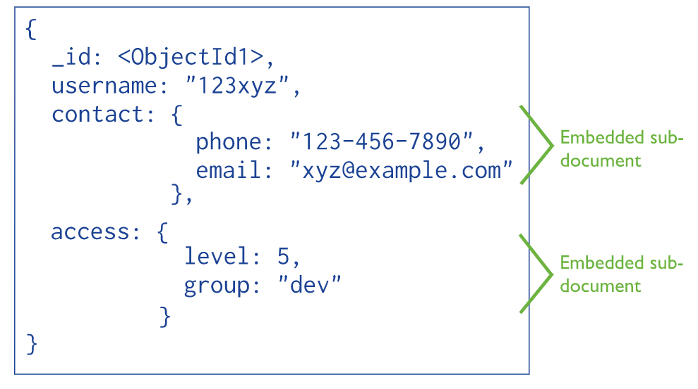
MongoDB
Document structure
The key decision in designing data models for MongoDB applications revolves around the structure of documents and how the application represents relationships between data.
Embedded documents capture relationships between data by storing related data in a single document structure. MongoDB documents make it possible to embed document structures in a field or array within a document.
These denormalized data models allow applications to retrieve and manipulate related data in a single database operation.
References store the relationships between data by including links or references from one document to another. Applications can resolve these references to access the related data. Broadly, these are normalized data models.
Embedded documents

Slide 10
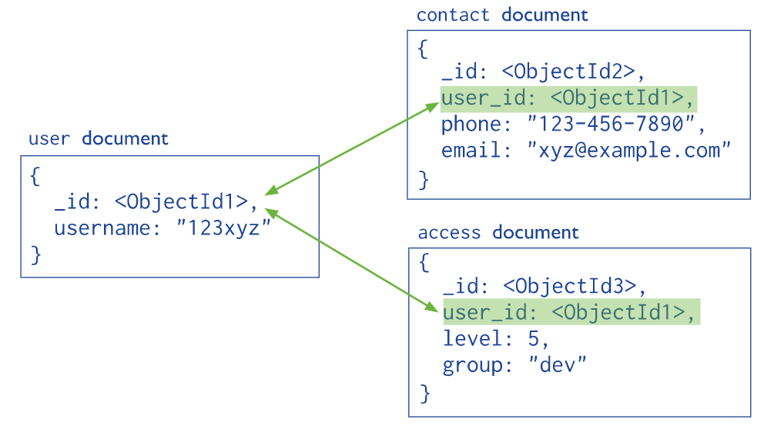
MongoDB
Document structure
The key decision in designing data models for MongoDB applications revolves around the structure of documents and how the application represents relationships between data.
Embedded documents capture relationships between data by storing related data in a single document structure. MongoDB documents make it possible to embed document structures in a field or array within a document.
These denormalized data models allow applications to retrieve and manipulate related data in a single database operation.
References store the relationships between data by including links or references from one document to another. Applications can resolve these references to access the related data. Broadly, these are normalized data models.
References

Slide 11
MongoDB
CRUD Operations

Slide 12
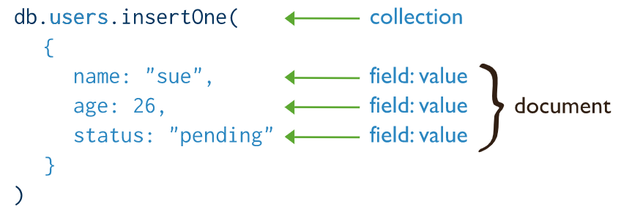
MongoDB
CRUD Operations
In MongoDB, insert operations target a single collection.
All write operations in MongoDB are atomic on the level of a single document.

Slide 13
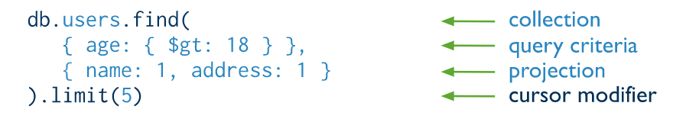
MongoDB
CRUD Operations
Read operations retrieve documents from a collection; i.e. query a collection for documents. MongoDB provides the following methods to read documents from a collection

Slide 14
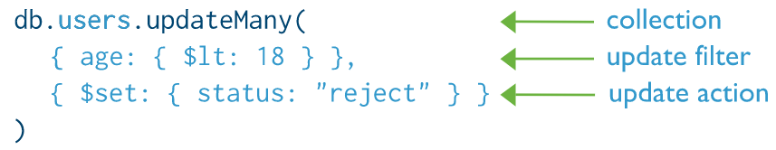
MongoDB
CRUD Operations
Update operations modify existing documents in a collection. MongoDB provides several methods to update documents of a collection

Slide 15
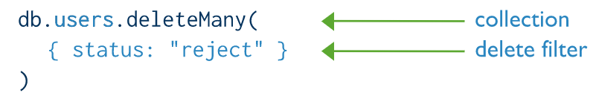
MongoDB
CRUD Operations
Delete operations remove documents from a collection. MongoDB provides several methods to delete documents of a collection

Slide 16
MongoDB
Transactions
In MongoDB, an operation on a single document is atomic. Because you can use embedded documents and arrays to capture relationships between data in a single document structure instead of normalizing across multiple documents and collections, this single-document atomicity obviates the need for multi-document transactions for many practical use cases. For situations that require atomicity of reads and writes to multiple documents (in a single or multiple collections), MongoDB supports multi-document transactions. With distributed transactions, transactions can be used across multiple operations, collections, databases, documents, and shards.
https://docs.mongodb.com/manual/core/transactions/

Slide 17
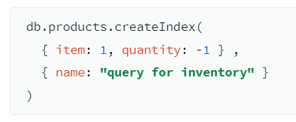
MongoDB
Indexes
Indexes support the efficient execution of queries in MongoDB. Without indexes, MongoDB must perform a collection scan, i.e. scan every document in a collection, to select those documents that match the query statement. If an appropriate index exists for a query, MongoDB can use the index to limit the number of documents it must inspect.
The following createIndex() method creates an index on item and quantity named “query for inventory”:
MongoDB creates a unique index on the _id field during the creation of a collection. The _id index prevents clients from inserting two documents with the same value for the _id field. You cannot drop this index on the _id field.

Slide 18
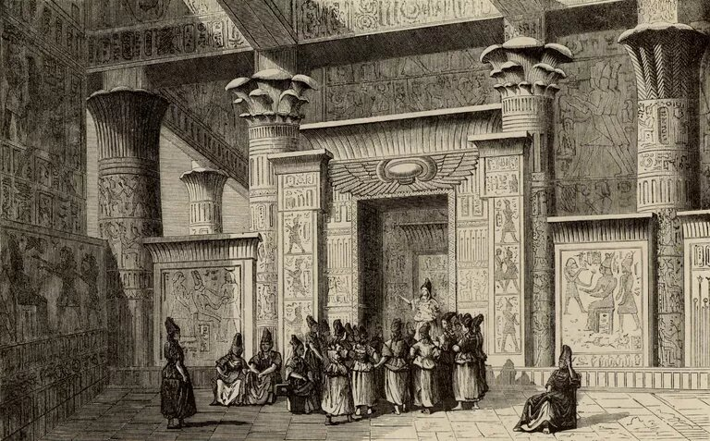
Architecture and CAP Theorem

Slide 19
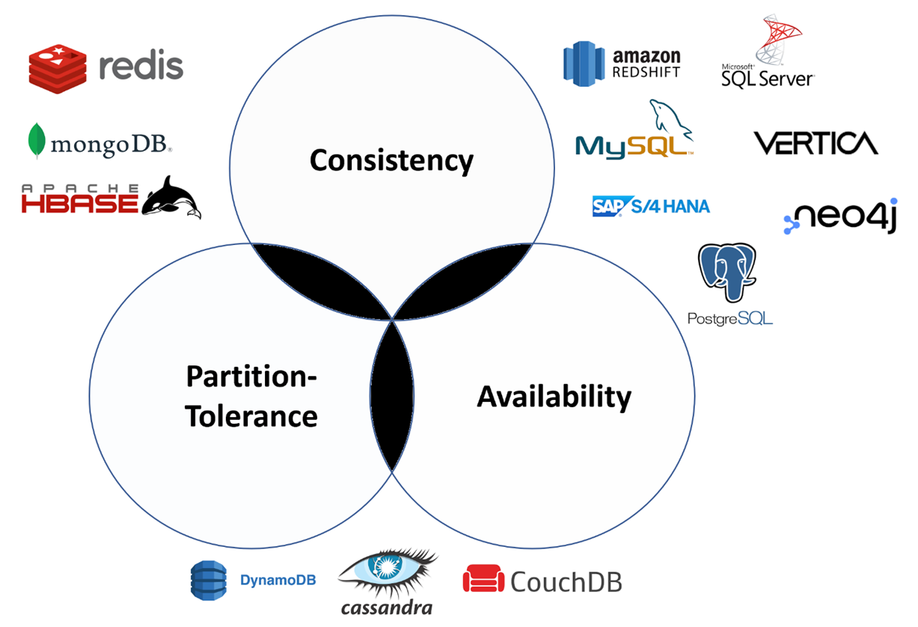
It’s all about the CAP theorem

Slide 20
It’s all about the CAP theorem

Slide 21
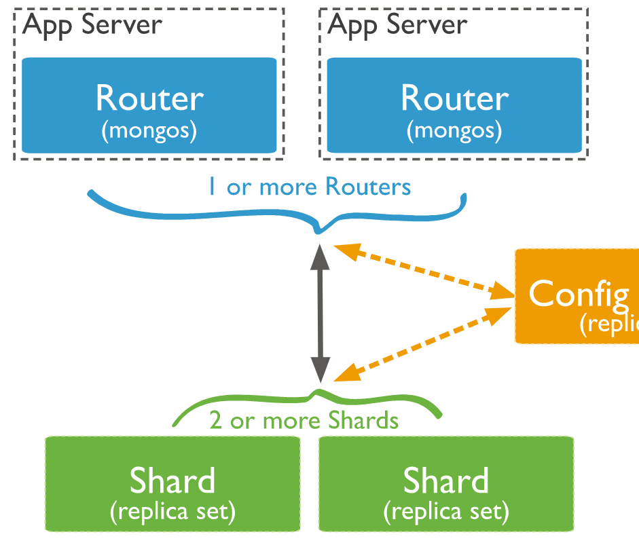
MongoDB
Sharding
Sharding is a method for distributing data across multiple machines. MongoDB uses sharding to support deployments with very large data sets and high throughput operations.
MongoDB supports horizontal scaling through sharding
A MongoDB sharded cluster consists of:
shards: Each shard contains a subset of the sharded data. Each shard can be deployed as a replica set (see Replica set).
mongos: The mongos acts as a query router, providing an interface between client applications and the sharded cluster.

Slide 22
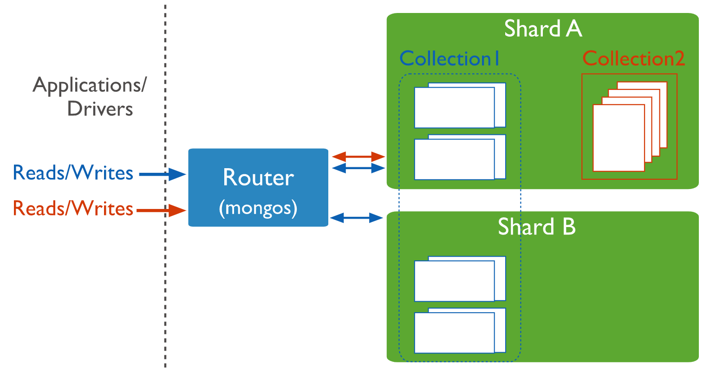
MongoDB
Sharding
A database can have a mixture of sharded and unsharded collections.
Sharded collections (Collection I) are partitioned and distributed across the shards in the cluster.
Unsharded collections (Collection 2) are stored on a primary shard.
You must connect to a mongos router to interact with any collection in the sharded cluster. This includes sharded and unsharded collections. Clients should never connect to a single shard in order to perform read or write operations.

Slide 23
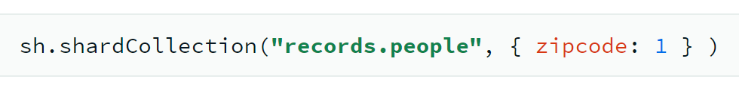
MongoDB
Sharding
The shard key determines how MongoDB distributes the collection's documents among the shards
Example:
It should be chosen in a way that the data can be evenly distributed on shards, so that it is clear for the most common queries where the shard-key resides If a query does not include the shard key, the mongos must direct the query to all shards in the cluster. These scatter gather queries can be inefficient. On larger clusters, scatter gather queries are unfeasible for routine operations.

Slide 24
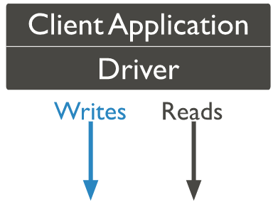
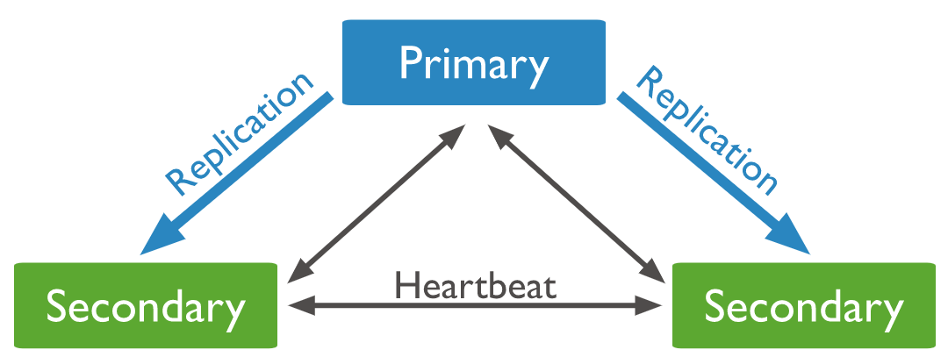
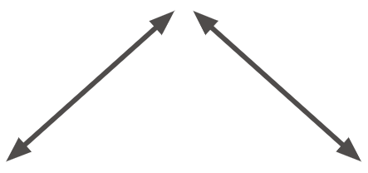

MongoDB
Replica Set
A replica set is a group of mongod instances that maintain the same data set.

Slide 25
MongoDB
Replica Set
A replica set is a group of mongod instances that maintain the same data set.
A replica set is composed of:
One primary node: receives all write operations

Slide 26
MongoDB
Replica Set
A replica set is a group of mongod instances that maintain the same data set.
A replica set is composed of:
One primary node: receives all write operations
One or more secondary nodes: asynchronously replicate the same write operations as the primary node to their data sets such that the secondaries' data sets reflect the primary's data set

Slide 27
MongoDB
Replica Set
A replica set is a group of mongod instances that maintain the same data set.
A replica set is composed of:
One primary node: receives all write operations
One or more secondary nodes: asynchronously replicate the same write operations as the primary node to their data sets such that the secondaries' data sets reflect the primary's data set
Optional arbiters: participate in elections (see Replica Set - Elections) for primary but do not have a copy of the data set and cannot become a primary

Slide 28

MongoDB
Replica Set
A replica set is a group of mongod instances that maintain the same data set.
A replica set is composed of:
One primary node: receives all write operations
One or more secondary nodes: asynchronously replicate the same write operations as the primary node to their data sets such that the secondaries' data sets reflect the primary's data set
Optional arbiters: participate in elections (see Replica Set - Elections) for primary but do not have a copy of the data set and cannot become a primary
Clients cannot write to secondaries. By default, clients read from the primary; however, clients can specify a read preference to read to secondaries, but with a certain risk to compromise data consistency.

Slide 29
MongoDB
Replica Set
A replica set is a group of mongod instances that maintain the same data set.
A replica set is composed of:
One primary node: receives all write operations
One or more secondary nodes: asynchronously replicate the same write operations as the primary node to their data sets such that the secondaries' data sets reflect the primary's data set
Optional arbiters: participate in elections (see Replica Set - Elections) for primary but do not have a copy of the data set and cannot become a primary
Clients cannot write to secondaries. By default, clients read from the primary; however, clients can specify a read preference to read to secondaries, but with a certain risk to compromise data consistency.
Data Consistency
(except if clients read to secondaries)

Slide 30
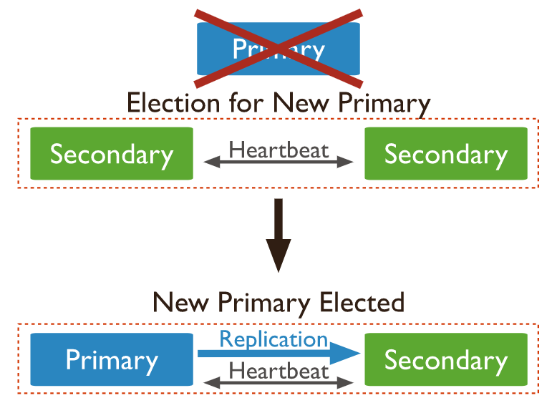
MongoDB
Replica Set - Elections
When a primary does not communicate with the other members of the set for more than the configured electionTimeoutMillis period (10 seconds by default), an eligible secondary calls for an election to nominate itself as the new primary. The cluster attempts to complete the election of a new primary and resume normal operations.
A primary can only be elected (or sustained) in a partition that has a majority of configured voting members available. If a majority cannot be reached, none primary is elected and the replica set becomes read-only

Slide 31
MongoDB
Replica Set - Elections
When a primary does not communicate with the other members of the set for more than the configured electionTimeoutMillis period (10 seconds by default), an eligible secondary calls for an election to nominate itself as the new primary. The cluster attempts to complete the election of a new primary and resume normal operations.
A primary can only be elected (or sustained) in a partition that has a majority of configured voting members available. If a majority cannot be reached, none primary is elected and the replica set becomes read-only
Partition Tolerance
Unavailability for 10s

Slide 32
MongoDB
Replica Set – Geographical distribution
To protect your data in case of a data center failure, keep at least one member in an alternate data center.
If possible, use an odd number of data centers, and choose a distribution of members that maximizes the likelihood that even with a loss of a data center, the remaining replica set members can form a majority or at minimum, provide a copy of your data.

Slide 33


MongoDB
Replica Set – Geographical distribution
To protect your data in case of a data center failure, keep at least one member in an alternate data center.
If possible, use an odd number of data centers, and choose a distribution of members that maximizes the likelihood that even with a loss of a data center, the remaining replica set members can form a majority or at minimum, provide a copy of your data.
Example of a 5-members replica set:
Data Center 1
Data Center 2

Slide 34
MongoDB
Replica Set – Geographical distribution
To protect your data in case of a data center failure, keep at least one member in an alternate data center.
If possible, use an odd number of data centers, and choose a distribution of members that maximizes the likelihood that even with a loss of a data center, the remaining replica set members can form a majority or at minimum, provide a copy of your data.
Example of a 5-members replica set:
If DC1 goes down, the replica set becomes read-only as the DC2 members cannot create a majority
Data Center 1
Data Center 2

Slide 35
MongoDB
Replica Set – Geographical distribution
To protect your data in case of a data center failure, keep at least one member in an alternate data center.
If possible, use an odd number of data centers, and choose a distribution of members that maximizes the likelihood that even with a loss of a data center, the remaining replica set members can form a majority or at minimum, provide a copy of your data.
Example of a 5-members replica set:
If DC1 goes down, the replica set becomes read-only as the DC2 members cannot create a majority
If DC2 goes down, the replica set remains writeable as the DC1 members can create a majority
Data Center 1
Data Center 2

Slide 36
MongoDB
Replica Set – Geographical distribution
To protect your data in case of a data center failure, keep at least one member in an alternate data center.
If possible, use an odd number of data centers, and choose a distribution of members that maximizes the likelihood that even with a loss of a data center, the remaining replica set members can form a majority or at minimum, provide a copy of your data.
Example of a 5-members replica set:
If any Data Center goes down, the replica set remains writeable as the remaining members can hold an election.
Data Center 1
Data Center 2
Data Center 3

Slide 37
MongoDB
High Availability possible but not 100% certain
Replica Set – Geographical distribution
To protect your data in case of a data center failure, keep at least one member in an alternate data center.
If possible, use an odd number of data centers, and choose a distribution of members that maximizes the likelihood that even with a loss of a data center, the remaining replica set members can form a majority or at minimum, provide a copy of your data.
Example of a 5-members replica set:
If any Data Center goes down, the replica set remains writeable as the remaining members can hold an election.
Data Center 1
Data Center 2
Data Center 3

Slide 38
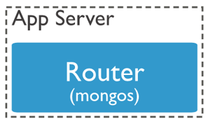
MongoDB
Sharding and Replica Set configurations combined
Shard 1
Shard 2
Shard 3

Slide 39
References
https://docs.mongodb.com/manual/introduction/
https://docs.mongodb.com/manual/core/databases-and-collections/#std-label-collections
https://docs.mongodb.com/manual/core/schema-validation/
https://docs.mongodb.com/manual/crud/
https://docs.mongodb.com/manual/sharding/
https://docs.mongodb.com/manual/core/sharding-shard-a-collection/
https://docs.mongodb.com/manual/replication/
https://docs.mongodb.com/manual/replication/#automatic-failover
https://docs.mongodb.com/manual/core/distributed-queries/
https://docs.mongodb.com/manual/core/replica-set-architecture-geographically-distributed/

