Slide 1

Introduction to Redis
Loup Meurice

Slide 2
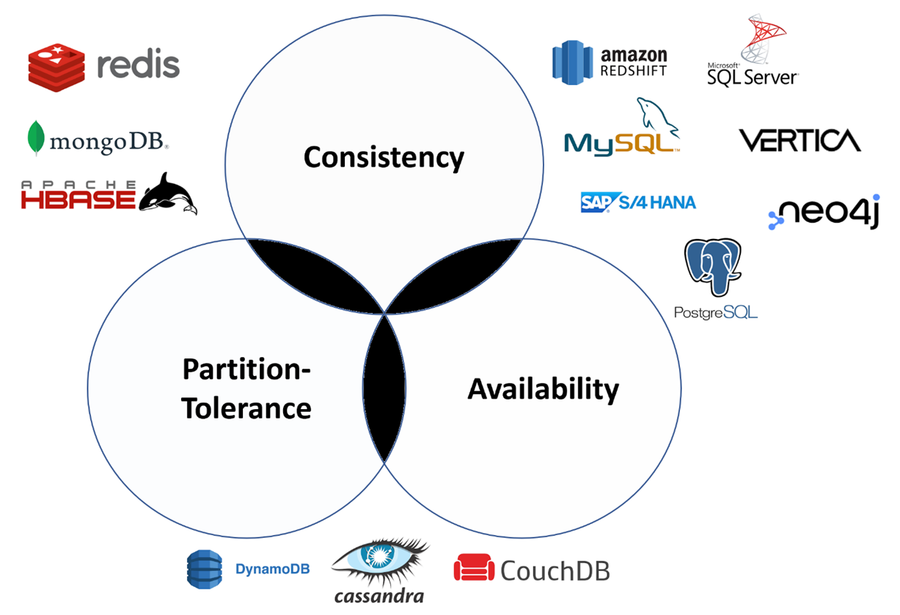
It’s all about the CAP theorem

Slide 3

Redis and the CAP theorem (in theory)

Slide 4
Redis and the CAP theorem (in practice)
“Theoretically, Redis Sentinel and Redis Cluster are neither consistent nor available under network partitions. However, there are some configurations that can minimize the consistency and availability problems.” [1]
[1] Redis Essentials p.170 by Maxwel Dayvson Da Silva and Hugo Lopes Tavares

Slide 5
Redis and the CAP theorem
Partition tolerance
Redis Cluster provides a way to run a Redis installation where data is automatically sharded across multiple Redis nodes. (horizontal scaling)
In Redis, every key (see Data Model) is conceptually part of what we call a hash slot. For each key, a hash is calculated (CRC16 of the key modulo 16384)
Every node in a Redis Cluster is responsible for a subset of the hash slots. Example of a cluster with 3 nodes, where:
Node A contains hash slots from 0 to 5500.
Node B contains hash slots from 5501 to 11000.
Node C contains hash slots from 11001 to 16383.
Any Redis node (including replica, see next slide) can receive a query and will redirect the client to the correct node, given the partitioning scheme
A [0-5500]
B [5500 - 11000]
C [11001-16383]

Slide 6
Redis and the CAP theorem
Partition tolerance
Redis Cluster uses a master-replica model where every hash slot has from 1 (the master itself) to N replicas (N-1 additional replica nodes). The replication is asynchronous.
This way, the system is able to continue if node B fails.
Node B1 replicates B, and B fails, the cluster will promote node B1 as the new master and will continue to operate correctly.
However, note that if nodes B and B1 fail at the same time, Redis Cluster is not able to continue to operate.
A [0-5500]
B [5500 - 11000]
A1
B1
C1
C [11001-16383]

Slide 7
Redis and the CAP theorem (in practice)
“Theoretically, Redis Sentinel and Redis Cluster are neither consistent nor available under network partitions. However, there are some configurations that can minimize the consistency and availability problems.” [1]
[1] Redis Essentials p.170 by Maxwel Dayvson Da Silva and Hugo Lopes Tavares

Slide 8
Redis and the CAP theorem
Consistency problem due to partition
A master A may have three replicas A1, A2, A3. Because of the very concept of asynchronous replication, each of the slaves may represent a point in time in the past history of the time line of A.
Slaves may be lagging for some reason, so it is possible that, for example, A1 is one second in the past.
A
A1
A2
A3

Slide 9
Redis and the CAP theorem
Consistency problem due to partition
A master A may have three replicas A1, A2, A3. Because of the very concept of asynchronous replication, each of the slaves may represent a point in time in the past history of the time line of A.
Slaves may be lagging for some reason, so it is possible that, for example, A1 is one second in the past.
If the master A fails, it is possible A1 to be promoted as new master containing outdated data (e.g., Node A did not have time to propagate insertion of new data before crashing)
A
A1
A2
A3

Slide 10
Redis and the CAP theorem
Availability problem due to partition

Slide 11
Redis and the CAP theorem
Client 1
Availability problem due to partition
In this system the original state was that A was the master, while A1 and A2 were replicas.
Client 1 connects and queries master A. Client 2 connects and queries slave A2 which automatically redirects to the master
A
A1
A2
Client 2

Slide 12
Redis and the CAP theorem
Client 1
Availability problem due to partition
In this system the original state was that A was the master, while A1 and A2 were replicas.
Client 1 connects and queries master A. Client 2 connects and queries slave A2 which automatically redirects to the master A partition occurred isolating the old master. Client 1 can continue to query A but A1 and A2 cannot communicate with the master.
A
A1
A2
Client 2

Slide 13
Redis and the CAP theorem
Client 1
Availability problem due to partition
In this system the original state was that A was the master, while A1 and A2 were replicas.
Client 1 connects and queries master A. Client 2 connects and queries slave A2 which automatically redirects to the master A partition occurred isolating the old master. Client 1 can continue to query A but A1 and A2 cannot communicate with the master. In this replication strategy, A2 is promoted as new master, and A1 as its slave. Client2 continues to query A2 and is no more redirected to A.
A
A1
A2
Client 2

Slide 14
Redis and the CAP theorem
Client 1
Availability problem due to partition
After a few seconds, Node A will notice its isolation and become unavailable . Client 1 cannot access the data ➔ unavailability
A
A1
A2
Client 2

Slide 15
Redis and the CAP theorem
Client 1
Availability problem due to partition
After a few seconds, Node A will notice its isolation and become unavailable . Client 1 cannot access the data ➔ unavailability
When the partition heals, Node A can recover the communication with A1 and A2
A
A1
A2
Client 2

Slide 16
Redis and the CAP theorem
Client 1
Availability problem due to partition
After a few seconds, Node A will notice its isolation and become unavailable . Client 1 cannot access the data ➔ unavailability
When the partition heals, Node A can recover the communication with A1 and A2 Node A will be notified a new configuration was setup and become the slave of A2. Client 1 will be finally able to continue
A
A1
A2
Client 2

Slide 17
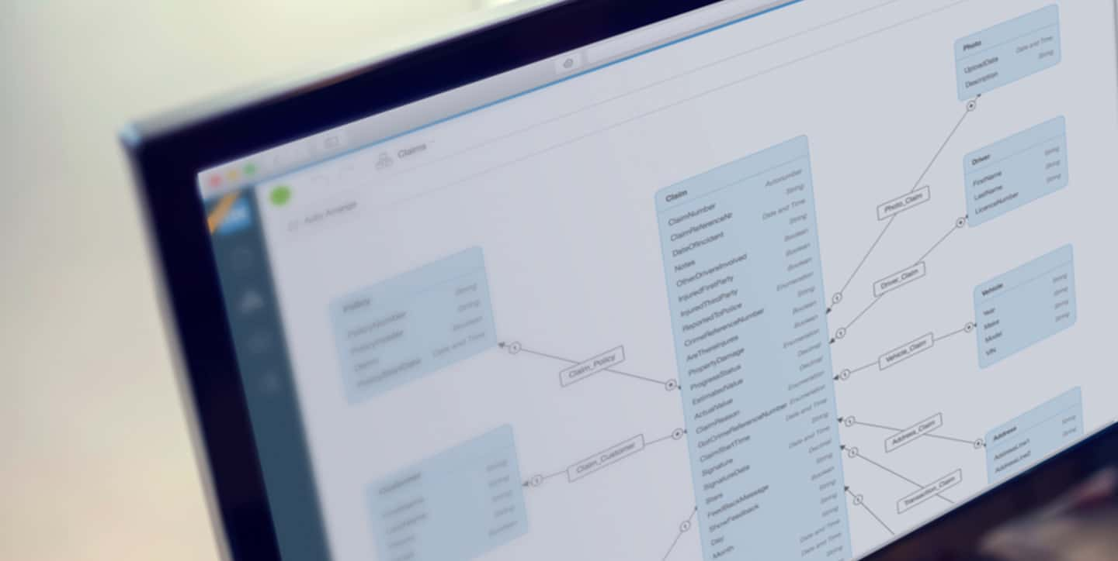
Architecture and Data model

Slide 18
Redis
Architecture
Redis is an in-memory database ➔ Storing and reading huge data are very fast

Slide 19
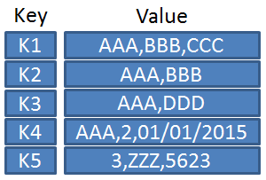
Redis
Architecture
Redis is an in-memory database ➔ Storing and reading huge data are very fast
Redis is a key-value data store
➔ data modelling directly depends on this paradigm

Slide 20
Redis
Architecture
Redis is an in-memory database ➔ Storing and reading huge data are very fast
Redis is a key-value data store
➔ data modelling directly depends on this paradigm
Redis implements several strategies to persistence (useful in case of crash) having their own advantages and disadvantages:
RDB: snapshot by specified intervals of time (easy to backup BUT cannot avoid data loss if crash)
AOF: every write operation is asynchronously logged in a file (reduces data loss BUT slower to backup)

Slide 21
Redis
Data model

Slide 22
Redis
Data model
Key
Value

Slide 23
Redis
Data model
Key
Value
String
Object

Slide 24
Redis
Data model
Redis keys are binary safe, this means that you can use any binary sequence as a key, from a string like "foo" to the content of a JPEG file.
Key
Value
String
Object

Slide 25
Redis
Data model
Redis keys are binary safe, this means that you can use any binary sequence as a key, from a string like "foo" to the content of a JPEG file.
A few rules about keys:
Very long or short keys are not a good idea.
The maximum allowed key size is 512 MB.
Try to stick with a schema and express readable keys. Ex: "object-type:id" is a good idea, as in "user:1000, "comment:1234:reply.to" or "comment:1234:reply-to"
Key
Value
String
Object

Slide 26
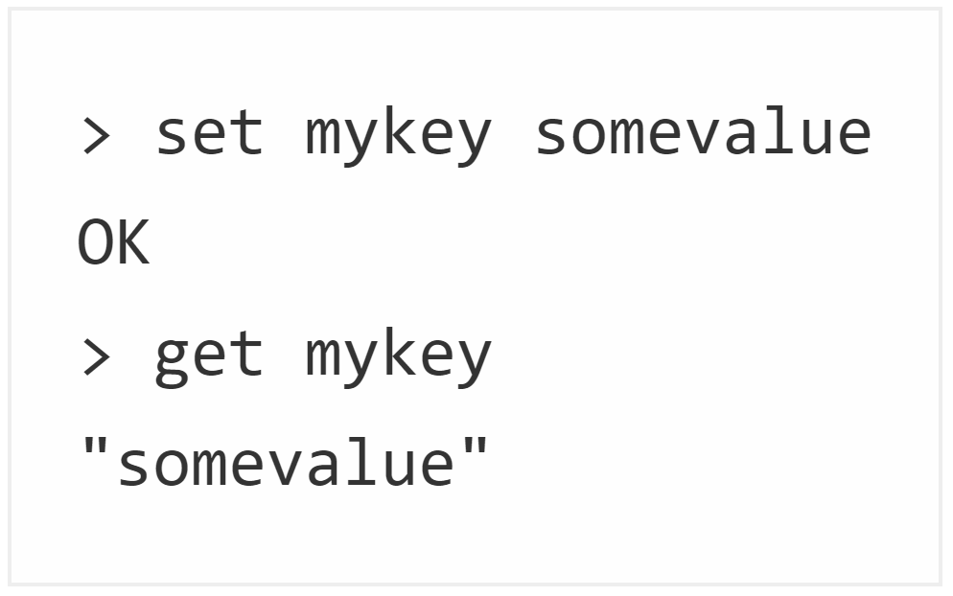
Redis
Data model
Key
Value
String
Object
String
Binary-safe strings

Slide 27
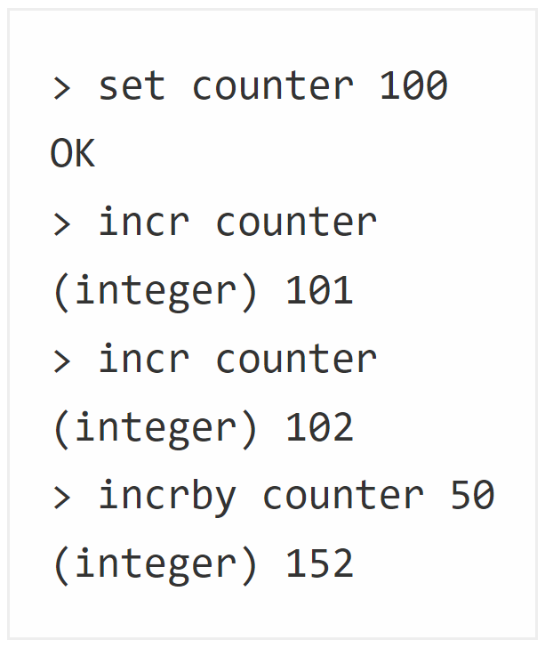
Redis
Data model
Key
Value
String
Object
String
Binary-safe strings

Slide 28
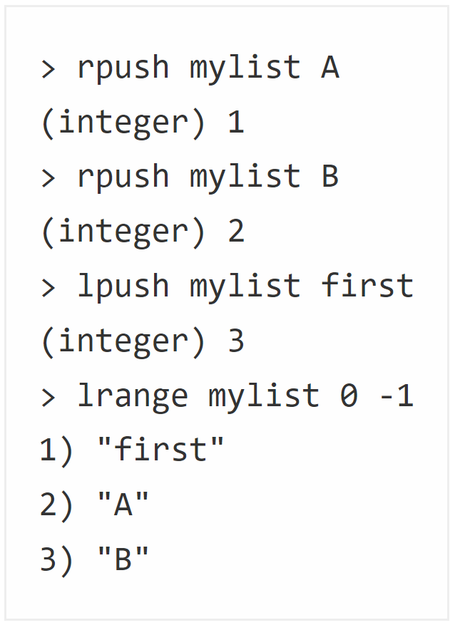
Redis
Data model
Key
Value
String
Object
String
List
collections of string elements sorted according to the order of insertion. They are basically linked lists.

Slide 29
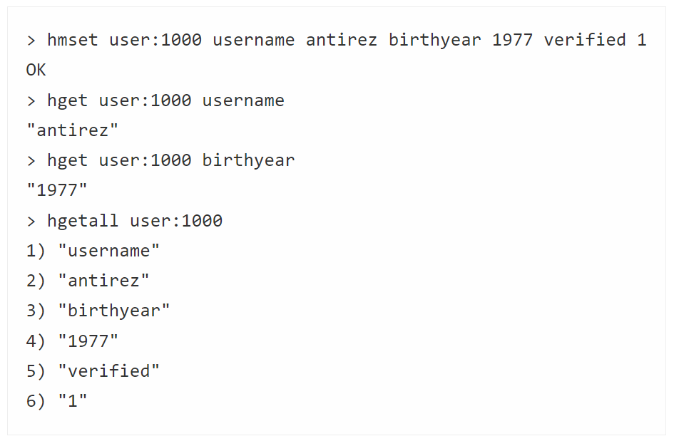
Redis
Data model
Key
Value
String
Object
Hash
String
List
which are maps composed of fields associated with values. Both the field and the value are strings

Slide 30
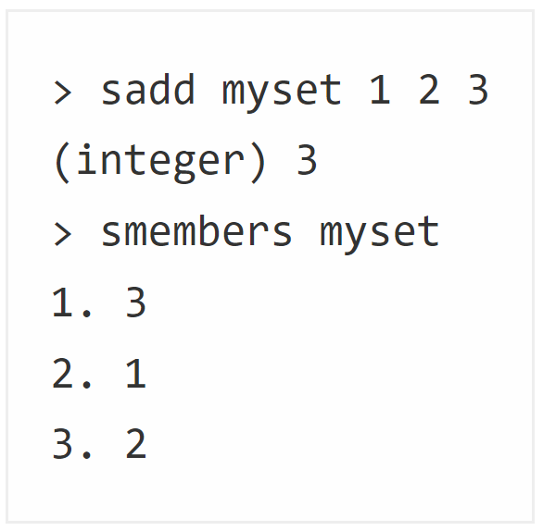
Redis
Data model
Key
Value
String
Object
Hash
String
List
Set
collections of unique, unsorted string elements

Slide 31
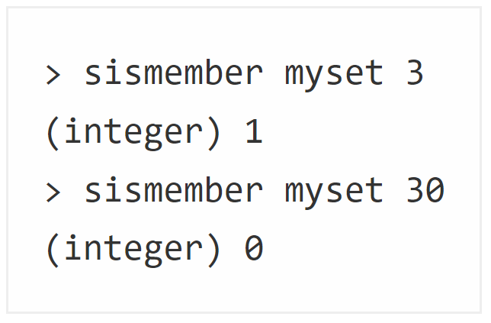
Redis
Data model
Key
Value
String
Object
Hash
String
List
Set
collections of unique, unsorted string elements

Slide 32
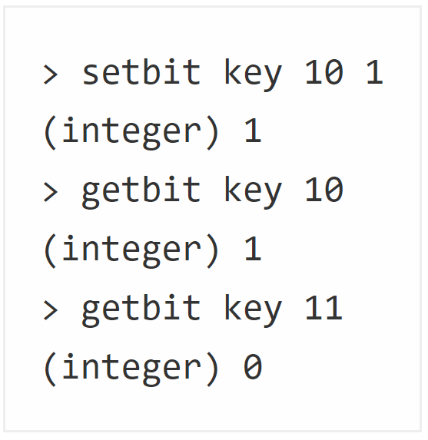
Redis
Data model
Key
Value
String
Object
Bitmaps
Hash
String
List
Set
array of bits

Slide 33
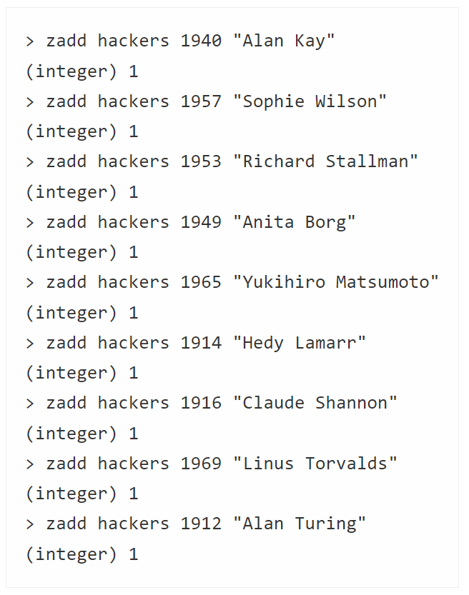
Redis
Data model
Key
Value
String
Object
Bitmaps
Hash
String
List
Set
SortedSet
similar to Sets but where every string element is associated to a floating number value, called score.

Slide 34
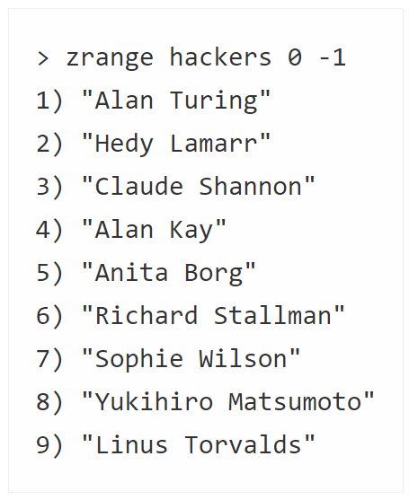
Redis
Data model
Key
Value
String
Object
Bitmaps
Hash
String
List
Set
SortedSet
similar to Sets but where every string element is associated to a floating number value, called score.

Slide 35
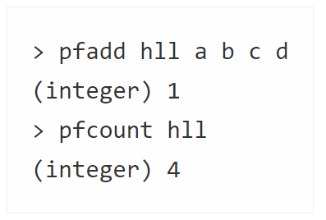
Redis
Data model
Key
Value
String
Object
HyperLogLogs
Bitmaps
Hash
String
List
Set
SortedSet
this is a probabilistic data structure which is used in order to estimate the cardinality of a set

Slide 36
Redis
Data model
Key
Value
String
Object
HyperLogLogs
Bitmaps
Hash
String
List
Set
SortedSet
Redis doesn't use structured query language, otherwise known as SQL. Redis instead comes with its own set of commands for managing and accessing data.

Slide 37
References
https://redis.io/topics/cluster-tutorial
https://redis.io/topics/sentinel
https://redis.io/topics/persistence
https://redis.io/topics/data-types-intro

