Slide 1
The BIG Green (Dashboard)
Philip Wirth
Michael Dowlin
Lourdes Milano

Slide 2
Motivation
The impacts of climate change are global in scope and unprecedented in scale. Global climate change has already resulted in a wide range of impacts across every region.
Relationships between greenhouse emission and power generation
Changes in C02 emissions across US from 1990 to 2018
Air quality vs emissions

Slide 3








Workflow
Web visualization
Flask
Static html
SQL database in
Postgres server
Data manipulation,
cleaning and mining.
Statistical analysis
Database connection
Web application framework
JSON API
csv files:
EPA website
EIA website
Json API reader, JQuery, D3,
Leaflet. plotly

Slide 4
Database
We decided to use an operational data store (ODS) model to combine data from multiple databases.
Data typically comes from multiple transaction systems (in our case, websites).
Data is presumed cleaned, including bridging common attributes across those systems/sources, allowing for easy joins.
Data is at the atomic level, giving the analyst the most flexibility possible to do different roll-ups and joins.

Slide 5
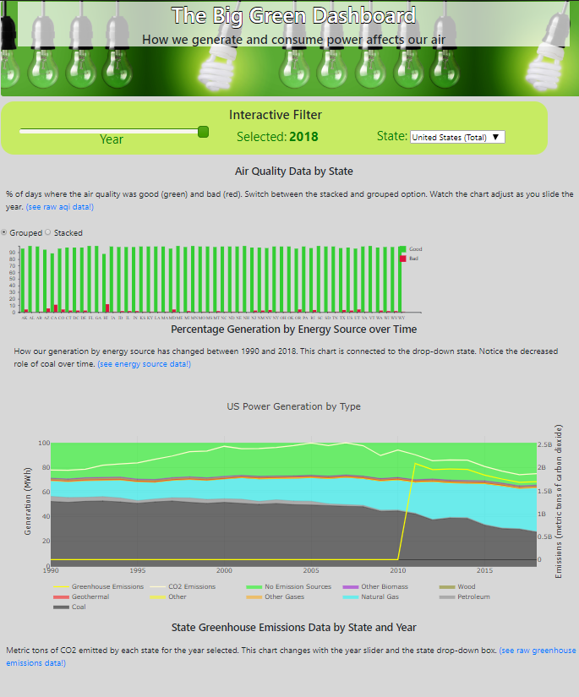
Desktop demo
Place your screenshot here
https://fpwirth.github.io/Data-Analytics-Project-2/

Slide 6
Future steps
More data!!!
We would like to continue the analysis over the next few years to see the trends, and how policies have an effect.
More dashboards!!!
Trending analysis for AQI by state over time.
facility emissions trends over time by energy source, and are they getting more efficient or are they being retired?
More stats!!!
Is the change in air quality significant?
If so, what are the significant factors?
Change in energy source?
Diminishing energy source?

Slide 7

Thanks!

