Slide 1
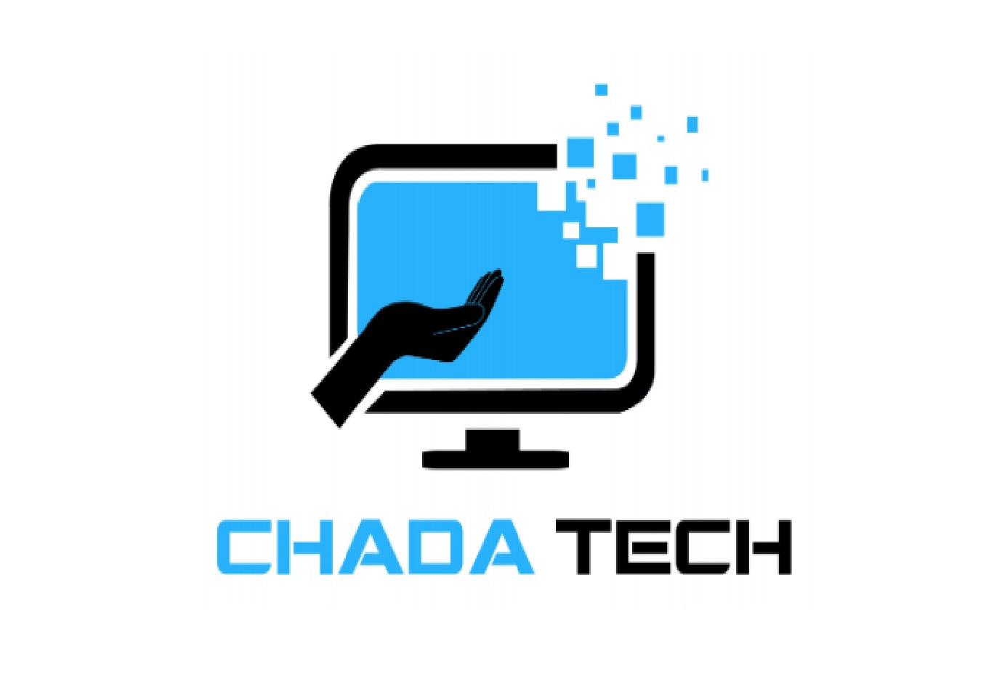
Transitioning to Scrum-Agile at ChadaTech
Louis Richards
CS 250
Feb 2026
Strategic Evaluation of Agile Adoption SNHU Travel Pilot Project

Slide 2
Why Consider Agile at ChadaTech?
Demand for Faster Value Delivery
Need for Continuous Feedback
Late Risk Detection in Waterfall
Evolving Client Requirements
Frequent requirement changes increase reword risk.
Organizations benefit from incremental product releases.
Stakeholder engagement improves alignment and reduces uncertainty.
Defects and misalignment often surface near project completion.

Slide 3
Why Consider Agile at ChadaTech?
Evolving Client Requirements
Late Risk Detection in Waterfall
Need for Continuous Feedback
Demand for Faster Value Delivery
Frequent requirement changes increase rework risk.
Defects and misalignment often surface near project completion.
Stakeholder engagement improves alignment and reduces uncertainty.
Organizations benefit from incremental product releases.

Slide 4
Why Consider Agile at ChadaTech?
Evolving Client Requirements
Late Risk Detection in Waterfall
Need for Continuous Feedback
Demand for Faster Value Delivery
Frequent requirement changes increase rework risk.
Defects and misalignment often surface near project completion.
Stakeholder engagement improves alignment and reduces uncertainty.
Organizations benefit from incremental product releases.
Traditional upfront planning limits adaptability to shifting priorities.
Agile frameworks enable iterative backlog reprioritization.
Incremental planning reduces long-term change exposure.
Sequential phase gates delay validation activities.
Testing typically occurs after development phases conclude.
Agile integrates continuous testing within each sprint cycle.
Frequent inspection supports early course correction.
Sprint Reviews provide structured validation checkpoints.
Ongoing collaboration strengthens stakeholder confidence.
Delivering usable increments accelerates time-to-value.
Agile prioritizes high-impact features early.
Iterative delivery improves return on investment visibility.
(PMI & Agile Alliance, 2021)
(PMI, 2023; Thesing et al., 2021)
(PMI, 2023)
(McKinsey & Company, 2022; Digital.ai, 2023)

Slide 5
Scrum-Agile Roles
Development Team
Product Owner
Scrum Master
Delivers functional product increments each sprint
Maximizes product value and prioritizes work
Ensures effective implementation of Scrum
Cross-functional and self-organizing
Implements prioritized backlog items
Integrates continuous testing within sprints
Produces potentially shippable increments
Owns and refines the product backlog
Aligns development with business objectives
Represents stakeholder interests/business priorities
Prioritizes features based on value and risk
Facilitates sprint planning, reviews, and retrospectives
Removes impediments that impact team progress
Protects the team from scope disruption
Promotes continuous improvement
(Kuhrmann et al., 2022; PMI, 2023)
(PMI & Agile Alliance, 2021)
(PMI & Agile Alliance, 2021)

Slide 6
Scrum-Agile Roles
Product Owner
Development Team
Scrum Master
Maximizes product value and prioritizes work
Ensures effective implementation of Scrum
Delivers functional product increments each sprint
Owns and refines the product backlog
Aligns development with business objectives
Represents stakeholder interests/business priorities
Prioritizes features based on value and risk
Facilitates sprint planning, reviews, and retrospectives
Removes impediments that impact team progress
Protects the team from scope disruption
Promotes continuous improvement
Cross-functional and self-organizing
Implements prioritized backlog items
Integrates continuous testing within sprints
Produces potentially shippable increments
(PMI & Agile Alliance, 2021)
(PMI & Agile Alliance, 2021)
(PMI & Agile Alliance, 2021; PMI, 2023)

Slide 7
How SDLC Phases Function Within an Agile Framework
Planning
Deployment
Development
Testing
LOOP
Potentially shippable increment delivered
Implementation occurs within the sprint timebox
Sprint Planning defines short-term objectives
Validation occurs throughout the sprint
Backlog items selected for the sprint
Sprint goal established
Tasks broken into manageable work units
Cross-functional collaboration
Continuous integration of features
Daily Scrums monitor progress
Working functionality demonstrated
Stakeholder feedback gathered
Feedback informs next sprint cycle
Continuous testing within development
Defects addressed immediately
Increment reviewed before sprint close
In Agile, traditional SDLC phases are executed iteratively within short sprint cycles rather than as a single linear progression (PMI, 2023).
(PMI, 2023; Kuhrmann et al., 2022)

Slide 8
Why Consider Agile at ChadaTech?
Planning
Development
Testing
Deployment
Sprint Planning defines short-term objectives
Implementation occurs within the sprint timebox
Validation occurs throughout the sprint
Potentially shippable increment delivered
Backlog items selected for the sprint
Sprint goal established
Tasks broken into manageable work units
Cross-functional collaboration
Continuous integration of features
Daily Scrums monitor progress
Continuous testing within development
Defects addressed immediately
Increment reviewed before sprint close
Working functionality demonstrated
Stakeholder feedback gathered
Feedback informs next sprint cycle
In Agile, traditional SDLC phases are executed iteratively within short sprint cycles rather than through a single linear progression (PMI, 2023).
(PMI, 2023; Baxter et al., 2023)

Slide 9
Traditional SDLC: The Waterfall Approach
Development
Deployment
Planning
Testing
Implementation follows a fixed approved design
Final product released at project completion
Requirements finalized upfront
Validation occurs after development
Scope finalized before development begins
Limited flexibility for mid-project changes
Detailed documentation drives execution
Work proceeds sequentially
Changes require formal change control
Limited stakeholder interaction during build
Full system delivered at once
Stakeholder validation occurs late
Risk of misalignment discovered near end
Defects discovered late in lifecycle
Rework impacts schedule and cost
Limited early feedback opportunities
Waterfall executes SDLC phases sequentially, often delaying validation and stakeholder feedback until later stages (PMI, 2023).
(PMI, 2023; Kuhrmann et al., 2022)

Slide 10
Why Consider Agile at ChadaTech?
WATERFALL
Planning
Development
Testing
Deployment
Requirements finalized upfront
Implementation follows a fixed approved design
Validation occurs after development
Final product released at project completion
Scope finalized before development begins
Limited flexibility for mid-project changes
Detailed documentation drives execution
Work proceeds sequentially
Changes require formal change control
Limited stakeholder interaction during build
Defects discovered late in lifecycle
Rework impacts schedule and cost
Limited early feedback opportunities
Full system delivered at once
Stakeholder validation occurs late
Risk of misalignment discovered near end
Waterfall executes SDLC phases sequentially, often delaying validation and stakeholder feedback until later stages (PMI, 2023).
(PMI, 2023; Thesing et al., 2021)

Slide 11
Selecting the Appropriate Development Approach
Stakeholder Involvement
Time-to-Value Expectations
Requirement Stability
Risk and Complexity
Level of Stakeholder Engagement
Delivery Expectations
Stability of Requirements
Project Risk and Complexity
Stable, well-defined scope favors Waterfall
Evolving or uncertain requirements favor Agile
High change frequency increases risk in linear models
Limited availability may align with Waterfall
Continuous collaboration supports Agile success
Frequent feedback reduces misalignment risk
Long, fixed release cycles align with Waterfall
Early incremental delivery favors Agile
Faster value realization improves return on investment
High technical uncertainty benefits from iterative validation
Late defect discovery increases cost exposure
Agile enables incremental risk reduction
Selecting an approach should align with project uncertainty, stakeholder engagement, and delivery expectations (PMI, 2023).
(PMI, 2023; McKinsey & Company, 2022)

Slide 12
Why Consider Agile at ChadaTech?
Requirement Stability
Stakeholder Involvement
Risk and Complexity
Time-to-Value Expectations
Stable, well-defined scope favors Waterfall
Evolving or uncertain requirements favor Agile
High change frequency increases risk in linear models
Limited stakeholder availability may align with Waterfall
Continuous collaboration supports iterative development
Frequent feedback reduces misalignment risk
High technical uncertainty benefits from iterative validation
Late defect discovery increases cost exposure
Agile enables incremental risk reduction
Long, fixed release cycles align with Waterfall
Early incremental delivery favors Agile
Incremental delivery accelerates return on investment
Selecting an approach should align with project uncertainty, stakeholder engagement, and delivery expectations (PMI, 2023).
(PMI, 2023; Thesing et al., 2021,Baxter et al., 2023)

Slide 13
References
Thesing, T., Feldmann, C., & Burchardt, M. (2021). Agile versus waterfall project
management: Decision model for selecting the appropriate approach to a project.
Project Leadership and Society, 2, 100012. https://doi.org/10.1016/j.plas.2021.100012
Baxter, D., Dacre, N., Dong, H., & Ceylan, S. (2023). Institutional challenges in agile adoption: Evidence from a public sector IT project. Government Information
Quarterly, 40(2), 101858. https://doi.org/10.1016/j.giq.2023.101858
Digital.ai. (2023). 17th annual state of agile report.
Project Management Institute & Agile Alliance. (2021). Agile practice guide. Project
Management Institute.
Project Management Institute. (2023). A guide to the project management body of
knowledge (PMBOK® Guide) (7th ed.). Project Management Institute.
Louis Richards
CS 250
Feb 2026
Strategic Evaluation of Agile Adoption SNHU Travel Pilot Project

