Slide 1
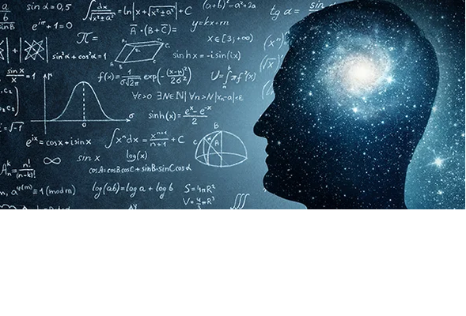
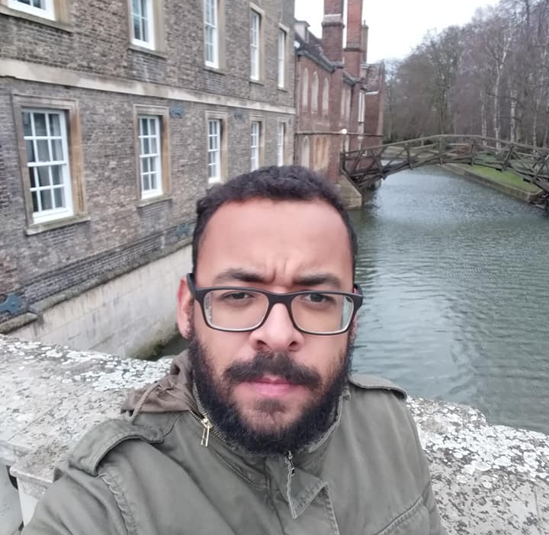
Lourival Lima
Associate Professor
Department of Mathematical and Computational Sciences,
Yachay Tech University - UITEY

