Slide 1


Rails Girls 2020
Ruby And Ruby on Rails

Slide 2


Presented by Steve Lourenço
Co-founder & Lead Developer
Facture.lu
Shoebox.lu

Slide 3
Table of contents
Ruby
Ruby On Rails

Slide 4
Difference between Ruby and Ruby On Rails
Ruby is the language
Ruby On Rails is a framework (library) based of Ruby

Slide 5


Difference between Ruby and Ruby On Rails
Ruby is the language
Ruby On Rails is a framework (library) based of Ruby
Real Life example: Luxembourgish is the language
and the luxembourgish library is your framework

Slide 6
Goal of RailsGirls event
Ruby
Other languages, technologies
Ruby On Rails
To create your (first) application

Slide 7
Ruby
https://try.ruby-lang.org/
Basic Guide: https://www.learnrubyonline.org/en/Welcome

Slide 8
Important basics
Variables are used to save a specific information in a specific type
Main types of variables:
String → ‘Hello’
Integer (entire numbers) → 27
Float (decimal numbers) → 27,44
Boolean (true of false) → true
Example:
event = ’Rails Girls 2020 Luxembourg’
coach = ‘Steve’
puts ”Welcome to #{event}! My name is #{name}! : )”
Or
puts “Welcome to “ + event + “! My name is ” + name + “! : )”

Slide 9
Important basics
Depending from the variable type the Operators (*, /, +, - ) will have different meaning:
var1 = 1
var2 = 2
puts var1 + var2
Result: 3
var1 = ’Hello ’
var2 = “people”
puts var1 + var2
Result: ”Hello people”
String variables need to be open and closed with the same quote.
‘Hello’ (Single quote)
“Hello” (Double quote)
‘Hello” (Single quote opening and closing with double quote does not work)

Slide 10
Important basics
Conditions
Operators for comparison
== (equal?)
> (greater than)
>= (greather or equal than)
Careful:
= (is not a comparison operator)
= is used to assign values
Example:
car = ‘Tesla’
puts car
returns → Tesla

Slide 11
Ruby On Rails
Guide for beginners and professionals: https://guides.rubyonrails.org/getting_started.html

Slide 12
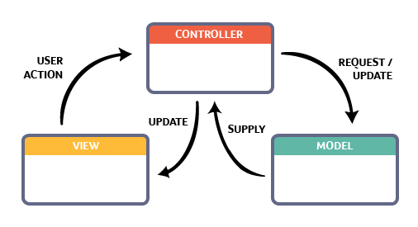
MVC Principle
app/views folder is where you put your content
app/controllers folder is where the decisions are made
app/models manipulate the data of a specific table

Slide 13

Let’s try together

Slide 14
Keep calm and enjoy! ☺

