Slide 1
Ruby on Rails
Lugano, 29.03.2014
railsgirlsticino@gmail.com | @RailsGirls_TI | WWW.RAILSGIRLS.COM/TICINO

Slide 2

INTRODUCTION
THE BASICS
THE BASICS – ROR
DEVELOPING THE APPLICATION
CONCLUSIONS

Slide 3
01. Introduction

Slide 4

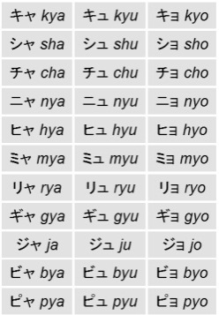

Introduction – The Background
The programming language Ruby was creted by Yukihiro Matsumoto in 1993
But initially it wasn’t a great success!
Unpopular for over a decade
Originally the documentation only existed in Japanese!!!
The turning point was in 2006
The year when the framework Ruby on Rails started gaining recognition

Slide 5
Introduction – Some Features
The programming language Ruby is:
open source
general purpose
interpreted
object oriented
Ruby has borrowed a lot from other programming languages, such as:
Smalltalk, Perl, Python, C, C++, PHP, Phyton...
http://www.ruby-lang.org/en/documentation/ruby-from-other-languages/
In fact, one of their first slogans was:
( Smalltalk + Perl ) / 2

Slide 6
Introduction – What is Ruby On Rails (ROR) ?
RUBY ON RAILS IS
“... an Open-source web framework that’s optimized for programmer happiness and sustainable productivity. It lets you write beautiful code by favoring convention over conﬁguration.”
“... a breakthrough in lowering the barriers of entry to programming. Powerful web applications that formerly might have taken weeks or months to develop can be produced in a matter of days.”
( source: http://www.rubyonrails.org )
Ruby on Rails, or RoR , is an open source MVC (Model View Controller) framework based on Ruby.
With Ruby on Rails , you can develop applications in a simple way minimising the part of coding that is usually repeated in every application.
The pattern Model View Controller is a programming convention that makes the distinction between the data representation, the logic of the application and the content more clear.
The applications developed in Ruby on Rails are especially suited for dynamic, flexible use with a continuous need for updating or future additions.

Slide 7
Introduction - Why Ruby On Rails
The strengths of RoR
WHY CHOOSE RUBY ON RAILS FOR DEVELOPING?
Simple
Intuitive
Scalable
Fast
Minimises code complexity
The code is self explanatory
Since it eliminates the dull parts of coding, there’s more time to concentrate on the essentials: the user’s idea of how the app should be.

Slide 8









Introduction – Websites On Rails
Twitter, SlideShare, GitHub, Basecamp, Shopify, Scribd, OneHub, Yellow Page, Ask.fm, Cookpad, Hulu, CrunchBase, Zendesk, MedHelp, Freckle, CrazyEgg, 43Things……………..

Slide 9










Introduction – Who uses Rails

Slide 10
02. The basics

Slide 11
Object Oriented Programming (OOP)
The definition
Allows grouping definitions of data structures and procedures operating on them into restricted bits (classes) of the source code.
In object oriented programming (OOP, Object Oriented Programming) an object may be sen as a container of data with attributes (data) and a group of methods (procedures) defined in its class.
An object is an instance of a class
It is assigned all the attributes and methods defined in its class.
Features :
Heritability
Polymorphism
Encapsuling

Slide 12
Object Oriented Programming (OOP)
Heritability
Person
This diagram shows how Teacher and Student derive from the class Person from which they inherit attributes and methods; they “extend” the class Person
- name
- surname
- address
Superclass
+getName()
+getAddress()
+setData()
Teacher
Student
- nrAvs
- faculty
Subclasses

Slide 13

Object Oriented Programming (OOP)
Example
class Person
attr_accessor : name, :surname, :address
def initialize (name, surname, address)
@name = name
@surname = surname
@address = address
end
end
Object
Class
Notes:
Questa o la prossima ? La prossima è più completa
O la prossima ma con lo stile di questa ? ☺

Slide 14
03. The basics - ROR

Slide 15
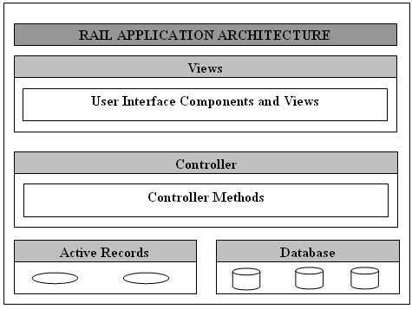
MVC
The Model View Controller pattern
The data (model) is separated from the interface (view)
Model - Maintains the connection between the objects and the database, and is in charge of confirming, connecting, transactions and other processes.
- Access to the data and the logic of the application - Indipendent of the view and the controller.
View - Presentation of the data and interaction with the user
- Only displays what is in the model
Controller The logic of the application.
- Coordinates the interaction between the user, the view and the model.
- In charge of what is happening

Slide 16
MVC
How It Works
1. The browser sends a request
2. The controller interacts with the model
3. The controller calls the view
4. The view displays the information in the browser

Slide 17
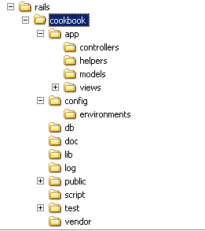
The Structure Of A Ruby on Rails Application
The applications developed using Rails share a common feature; they are all organised according to the same structure.
This is because the command rails generates a group of directories and files that follow a guideline that permits Rails to implement various things automatically (for instance loading and generating files as well as recognising them during runtime).
This common structure also aids in understanding other developers’ code easily, as the projects are organised according to the same principles.
The structure of the applications

Slide 18
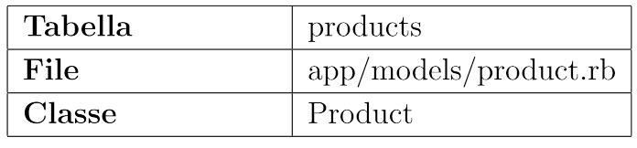
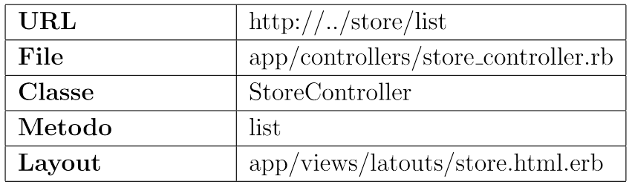
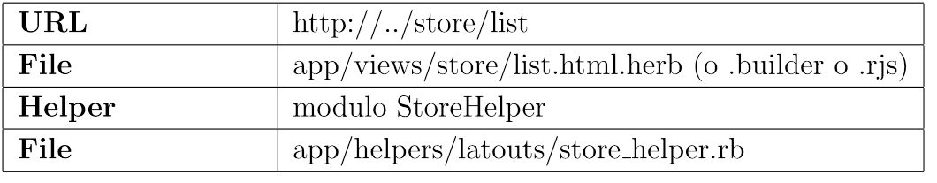
Naming conventions – Ruby on Rails
Rails has configuration conventions to save the developer the trouble of having to specify e.g. the association between tables and classes.
For the association between tables and classes to work, it’s enough that the tables are given the pluralised lowercase names of the classes.
EXAMPLE : The table messages thus mapped to the class Message, authors to Author and topics to Topic. The mechanism of the ActiveRecord that takes care of the conversion is more intelligent than you’d think; for instance, it understands that the plural of \person” is \people" and the plural of \status” is \statuses".
Models
The Contoller
Views

Slide 19
04. Developing the application
http://guides.railsgirls.com/app/
Notes:
Per questa parte ditemi voi cosa preferite fare ? Io stavo seguendo le basi che definiscono sul sito rails…

Slide 20
05. Conclusions

Slide 21
Tutorial
http://railsforzombies.org/
http://ruby.railstutorial.org/
http://railscasts.com/
http://guides.rubyonrails.org/
Notes:
Altri interessanti ?

Slide 22

Conclusions
QUESTIONS

