Slide 1

HTML
Basics of html
Presented BY Steve Lourenco

Slide 2
What is HTML?
abbreviation for Hyper Text Markup Language
standard markup language for documents which are displayed in a web browser
officially born in 1993
describes the structure of a web page
Example: http://info.cern.ch/hypertext/WWW/TheProject.html (first web page using HTML)

Slide 3
Who IS DEFINING HTML?
W3C (World Wide Web Consortium) was in charge of creating the HTML Standard
The control informally moved to the group WHATWG (Web Hypertext Application Technology Working Group)
The control changed because of XHTML

Slide 4
HTML VERSIONs
28 May 2019: W3C declared that the “true” HTML version was from WHATWG.
HTML version 1 (1993)
HTML version 2 (1995)
HTML version 3 and 4 (1997)
XML (eXtensible Markup Language) version 1 (1998)
XHTML(eXtensible HyperText Markup Language) version 1 (2000)
HTML5 (2014)

Slide 5
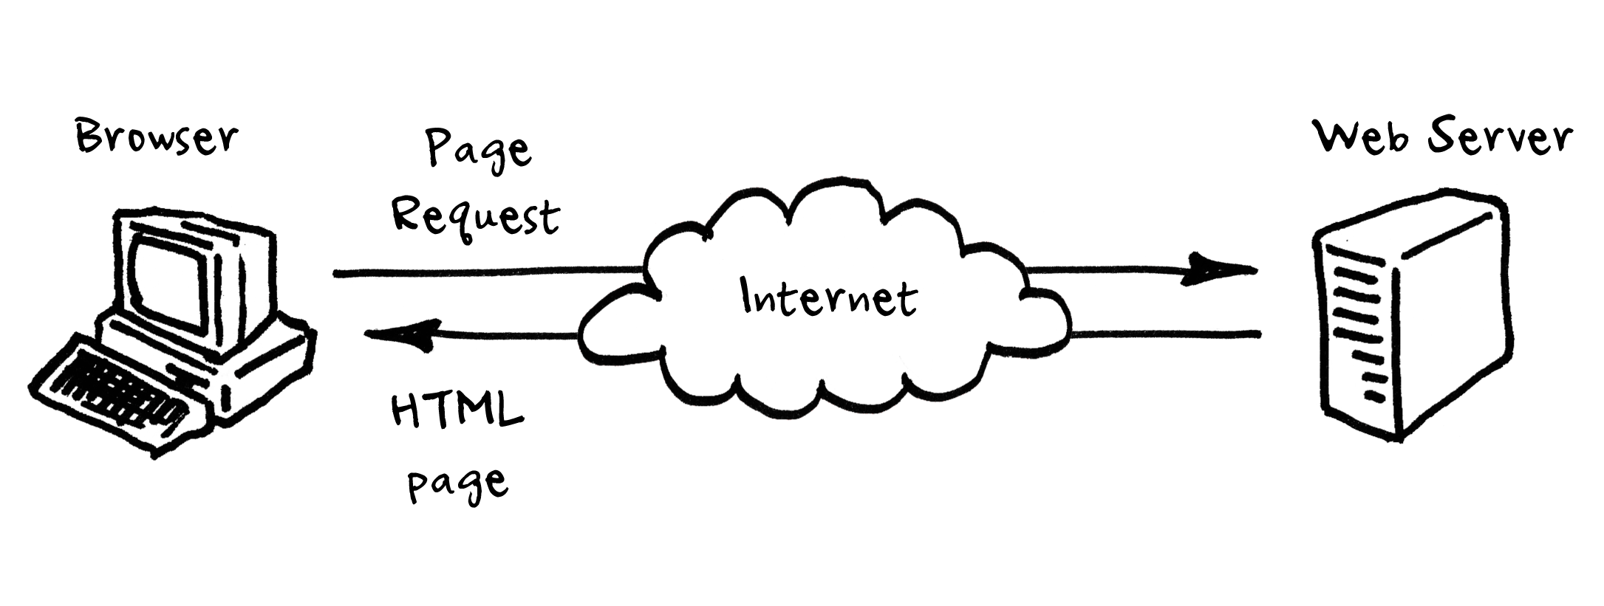
How is html served to the browsers?
Generated by a server-side application
Generated with Javascript (client-side application)
Save HTML in a file and serve it with help of a Web server

Slide 6

How is html served to the browsers?
Today, we are going to store HTML in a file and ask the browser to load it.

Slide 7
HOW TO START CODING?
We need an application:
to code
to help us find the problems with the different syntaxes
to simplify our life.
https://code.visualstudio.com/ (Compatible with Windows, Mac and Linux)

Slide 8
HOW TO SEE THE RESULT ?
We need to visualize the result of our coding.
If we want to code and have fun, we only need one browser
If we want to code, have FUN and make it visible to the world, we need all browsers available online and all versions
Problem: The users visit a web site and they don't use the same browser with the same version.
https://en.wikipedia.org/wiki/List_of_web_browsers
Is it worth it to adapt web site to each web browser?
You lose too much time money, it starts to be unproductive!
NO

Slide 9
HOW TO SEE THE RESULT ?
We normally try to make it compatible with the Firefox, Chrome and Safari browsers.
Minimal requirements (one of this browsers):
Mozilla Firefox (verify if it is updated to the most recent version)
Google Chrome (verify if it is updated to the most recent version)
We have now an editor application and a browser application installed.

Slide 10
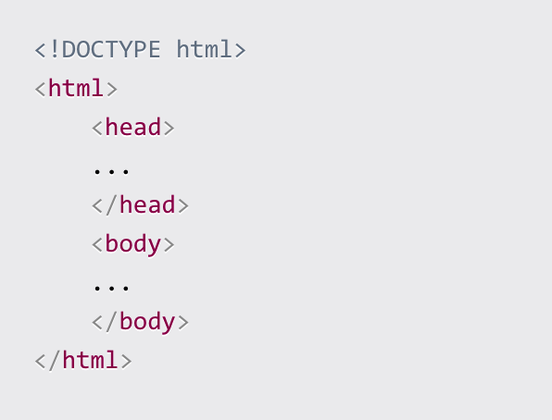
HTML standard page structure
Main page of a project, we will call: index.html
HTML5
<!DOCTYPE html>
Indicates the browser that this file is an HTML file version 5
<html></html>
Is the root tag of an HTML page
<head></head>
contains meta information about the document
<body></body>
contains the visible page content
index.html

Slide 11
HTML standard page structure
HTML5
Head Tag
Here we will insert essential tags to creating a web page
Title
Metadata
Internal, external Css (Next weekend)
Javascript
Mostly things that do not directly appear on the page, but only help the browser
index.html

Slide 12
HTML standard page structure
HTML5
Body Tag
Here, we will have the content of the page
The visible content
index.html

Slide 13
TAGS, ELEMENTS AND ATTRIBUTES
<br> → Tag
<p>A paragraph of text</p> → Element has a starting tag, ending tag and it contains text
<p class="a-class">A paragraph of text</p> → Starting tag of an element can have multiple attributes
Syntax
key="value” (if the attribute has multiple value options)
OR
key (if the attribute is boolean [true or false])

Slide 14
ID and Class attribute
id and class attributes are the two most common used in HTML
We are going to talk about it in more details, next week (Forbidden to use this session)

Slide 15
HTML NORMS
HTML is case insensitive
<P>A paragraph of text</P> →Before HTML5, it was recommended to write tags uppercase
<p>A paragraph of text</p> → Today, it is recommended to write lowercase
Multiple white spaces are ignored
<p>A paragraph of text</p> you get the same result with <p> A paragraph of text </p>

Slide 16
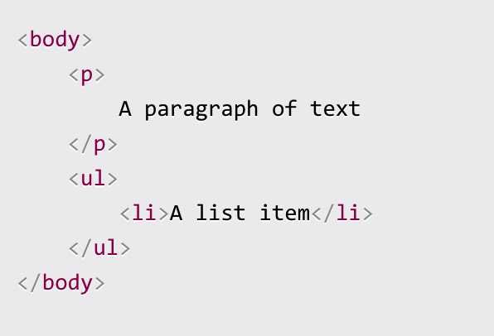
HTML NORMS
Nested tags should be indented with 2 or 4 characters
<body> <p> A paragraph of text </p> <ul> <li>A list item</li> </ul> </body>

Slide 17
HEAD TAGS
title
script → Javascript
noscript
link → CSS
style → CSS
meta
We will not talk about them today

Slide 18
HEAD TAGS: Title
determines the page title
It is displayed in the browser
one of the key factors for Search Engine Optimization (SEO)

Slide 19
HEAD TAGS: Meta
<meta charset="utf-8"> → It allows to indicate the page character encoding
Most of the cases, we use UTF-8
Example:
http://www.fileformat.info/info/charset/UTF-8/index.htm (Unicode Standard)
http://www.fileformat.info/info/charset/US-ASCII/list.htm (American Standard Code)

Slide 20
BODY TAGS: BLOCK vs INLINE element
We can classify visual elements In two categories:
block elements (p, div, heading elements, lists and list items, ...)
inline elements (a, span, img, ...)
What is the difference?
Block elements, when positioned in the page, do not allow other elements next to them. To the left, or to the right.
Inline elements instead can sit next to other inline elements.
Example: https://www.w3schools.com/html/html_blocks.asp

Slide 21
BODY TAGS: Interaction with text
Examples:
p
span
br
h1, h2, h3, h4, h5, h6
strong
em
blockquote
hr
Code
ul, ol, li
https://www.w3schools.com/html/html_paragraphs.asp
https://www.w3schools.com/html/html_formatting.asp
https://www.w3schools.com/html/html_headings.asp
https://www.w3schools.com/html/html_lists.asp

Slide 22
BODY TAGS: Links
<a href="https://flaviocopes.com">click here</a> External links
<a href="/test">click here</a> Local links
Examples: https://www.w3schools.com/html/html_links.asp

Slide 23
BODY TAGS: CONTAINER TAGS AND PAGE STRUCTURE
Containers
div is the generic container element
article https://www.w3schools.com/tags/tag_article.asp
section https://www.w3schools.com/tags/tag_section.asp
Page structure
nav
aside
header
main
footer

Slide 24
BODY TAGS: FORMS
https://www.w3schools.com/html/html_forms.asp

Slide 25
BODY TAGS: Tables
table
tr
td
th
thead
tbody
tfoot
caption
https://www.w3schools.com/html/html_tables.asp

Slide 26
BODY TAGS: Images
<img src="image.png">
<figure>
<img src="dog.png" alt="A nice dog">
<figcaption>A nice dog</figcaption>
</figure>
<picture>
<source type="image/webp" srcset="image.webp">
<img src="image.jpg" alt="An image">
</picture>
https://www.w3schools.com/html/html_images.asp

Slide 27
PROJECT
Create your portfolio
OR
Create a tribute page
WITH ONLY HTML

Slide 28
Sources
https://www.w3schools.com/html/default.asp
https://www.freecodecamp.org/news/the-html-handbook/

Slide 29

Thank You!
Lourenco.steve@outlook.com

