Slide 1
Machine Learning & Deep Learning Projects
For SEQUENTIAL DATA CLASSIFICATION

Slide 2

Introduction
1
Project 1

Slide 3
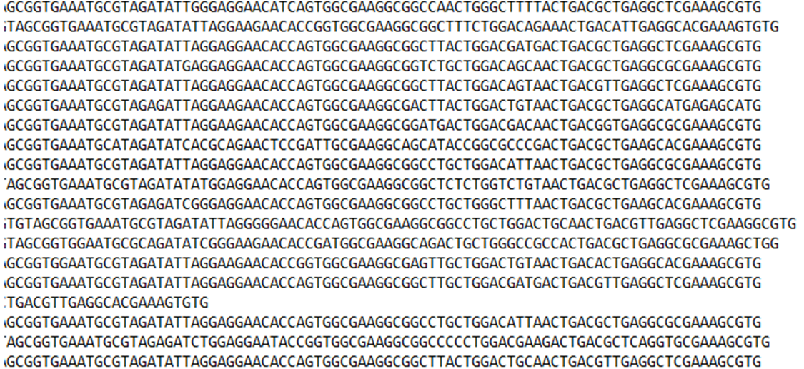
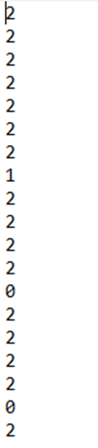
Introduction
2
Original Data

Slide 4
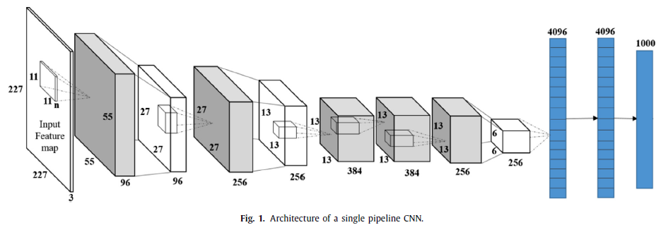
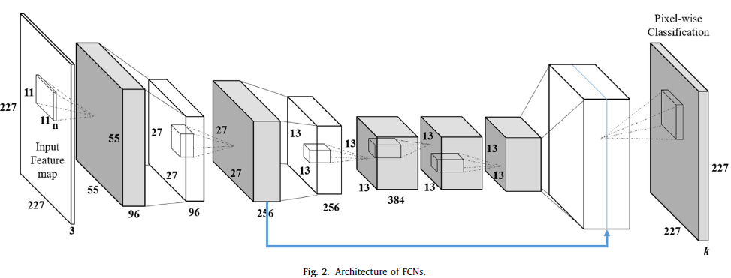
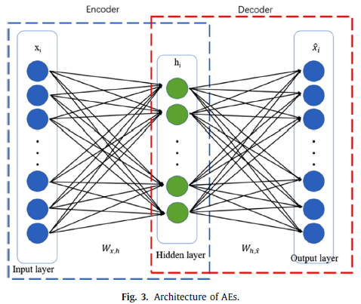
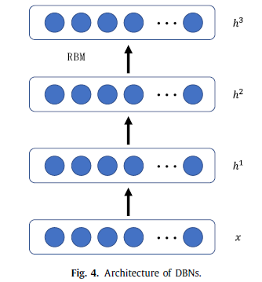
Methodologies
3
Figure copied from Z. He, et al.(2018)

Slide 5
Methodologies
4
Built the models in Python with the TensorFlow backend to classify multi-classes and multi- label data. The models include NN, CNN, RNN, LSTM, RF(binary relevance, classifier chain, power set, MLKNN).
Improved performance for each kind of model based on the same data by measuring the classification accuracy, confusion matrix, f1 scores, recalls, precision, etc.

Slide 6
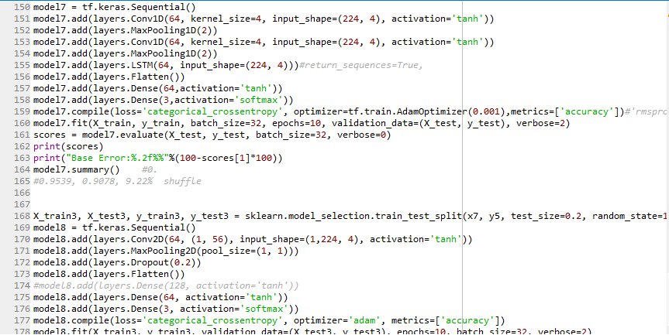
Code Screenshot
5

Slide 7
Summary
6
Model (multi-class sequential data) | Accuracy | Error Rate
LSTM | 0.7463 | 23.50%
NN & LSTM & Masking & Shuffle | 0.8616 | 11.99%
NN & LSTM & Masking & Shuffle & Normalization | 0.9273 | 8.30%
CNN(1) & LSTM & Shuffle & Normalization | 0.9539 | 9.22%
CNN(2) & LSTM & Shuffle & Normalization | 0.9885 | 1.38%

Slide 8
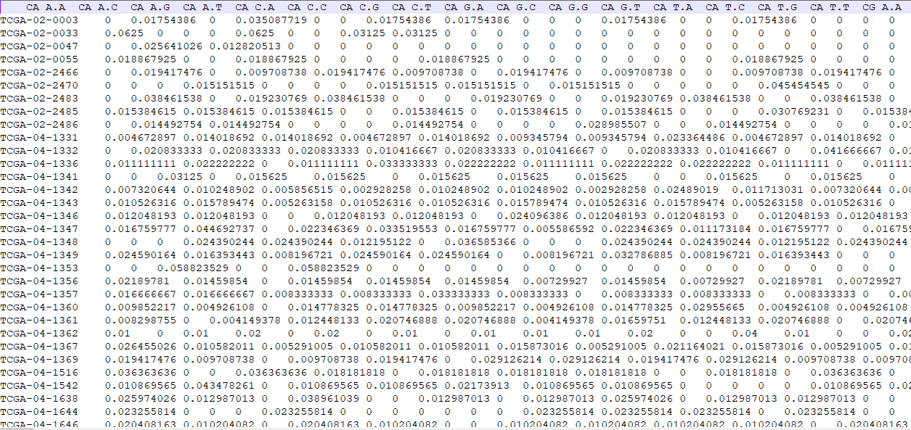
Introduction
7
Project 2

Slide 9
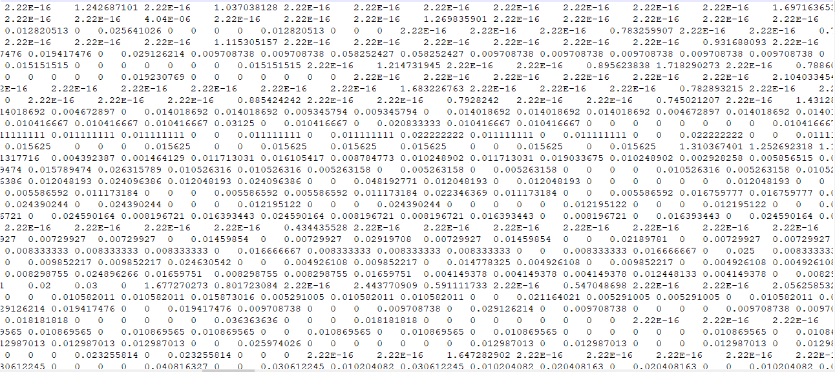
Introduction
8
Multi-labels

Slide 10
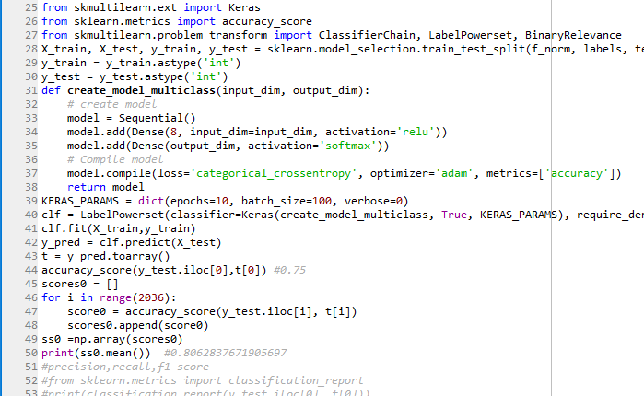
Code Screenshot
9

Slide 11
Summary
10
Model / Classifier (multi-label data) | Accuracy
OneVsRestClassifier & PCA | 0.3117
MLKNN | 0.3188
BinaryRelevance | 0.5170
ClassifierChain | 0.6317
LabelPowerset | 0.7816
LabelPowerset & Deep Learning | 0.8063
KNN (KNeighbors) | 0.8491

Slide 12
Conclusion
11
For different original data, it applies different strategies for certain specific goals based on the feature of the input.
The models that mix several different kind of processing techniques can usually improve the performance of the target.

Slide 13
References
12
[1] Internet Resources, https://scikit-learn.org/stable/tutorial/index.html, https://www.tensorflow.org/tutorials/sequences/text_generation, etc.
[2] A. Krizhevsky, I. Sutskever, Geoffrey E. Hinton, ImageNet Classification with Deep Convolutional Neural Networks, Neural Information Processing Systems (NIPS), 2012.
…….

Slide 14
Thank You

