Slide 1
Data Models : Team Alpaga R Pollution
Durand sabri 61540460050
Merotto enzo 61540460051
Tavernier leo 61540460052

Slide 2
Introduction to the problem
The evolution and the consequences of the air pollution in the world

Slide 3
Analytic objective
See the evolution and the repartion of the air pollution in the world
See the effects and the consequences of this pollution
Understand some of the reasons that cause this pollution

Slide 4
Data description and preparation
1) « Exposure to PM2.5 fine particles countries »
2) « Death rate from ambient particles air pollution »
3) « GDP per country($) »
4) « Emissions of particles matter »
5) « Air pollutant emission »

Slide 5



Data exploration and visualization

Slide 6
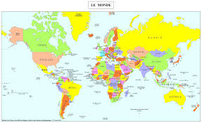
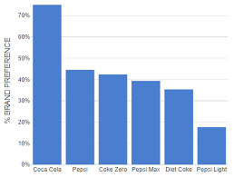
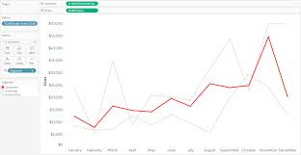

Model explanation
2 Map
1 Bar Chart
3 graph
1 Number

Slide 7
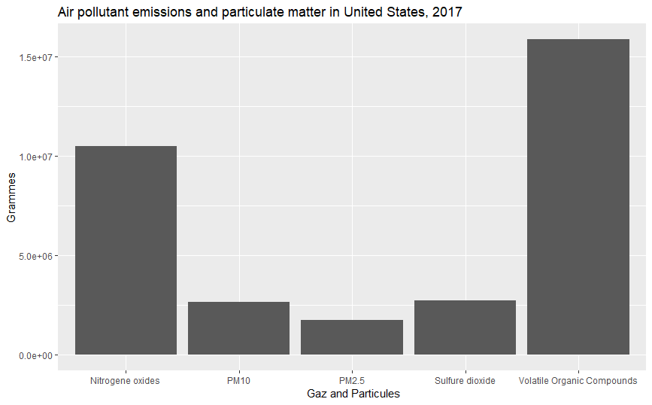

Slide 8
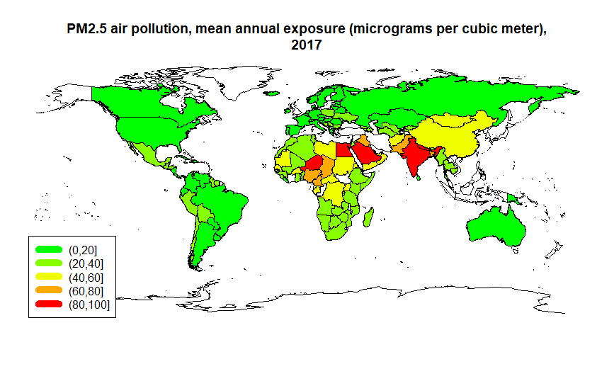

Slide 9
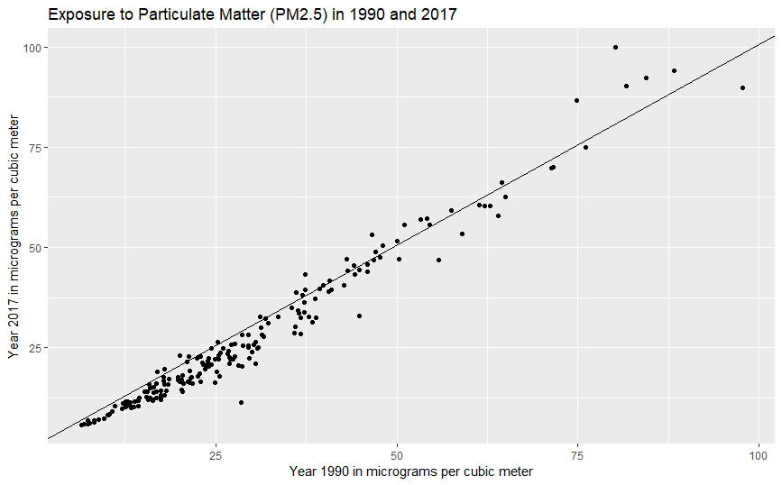

Slide 10
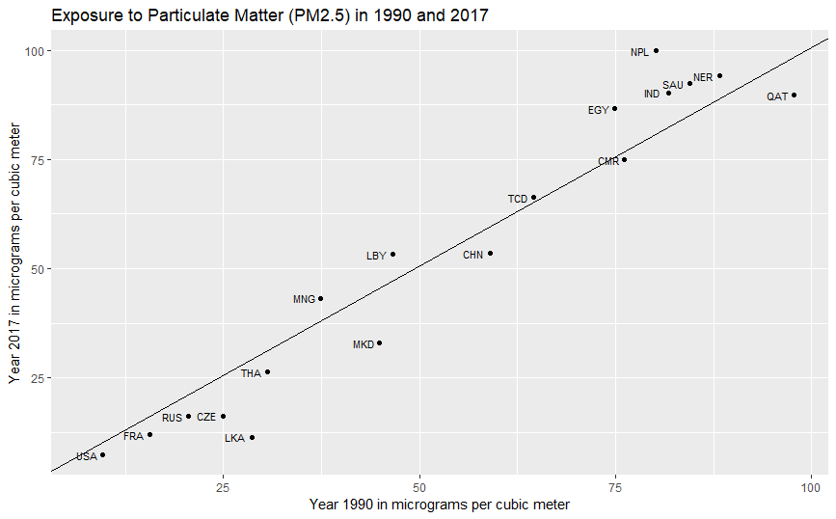

Slide 11
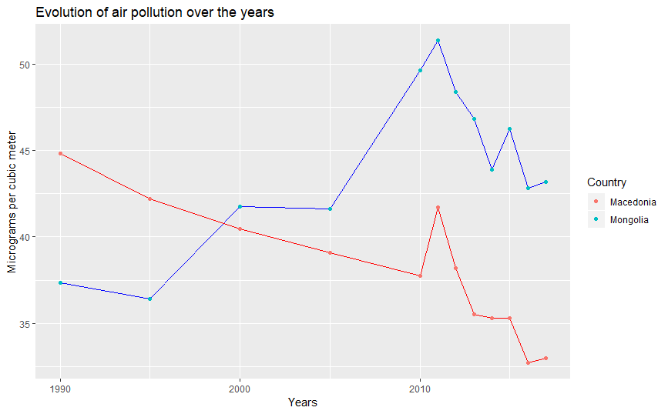

Slide 12
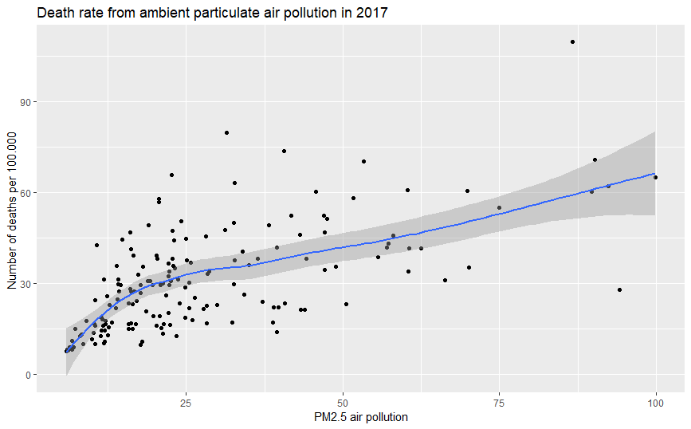

Slide 13
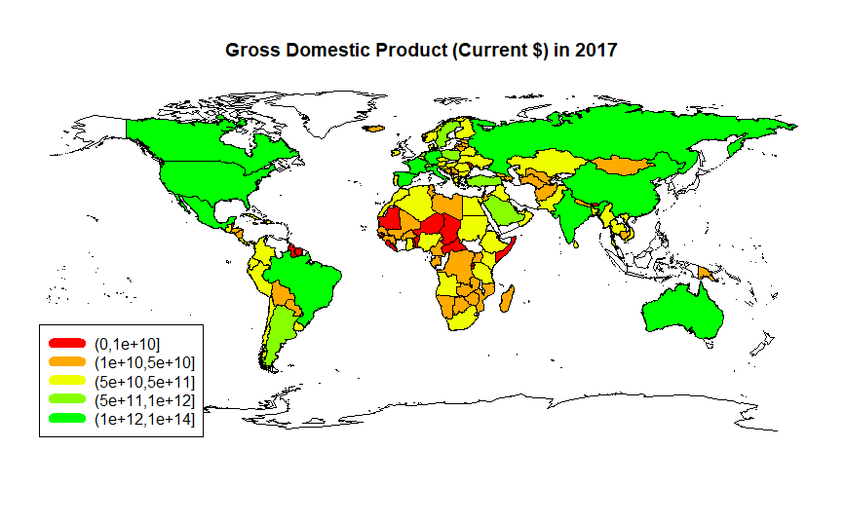


Slide 14
Conclusion

