Slide 1





MULTIMODAL RETRIEVAL-AUGMENTED GENERATION
Beyond Text RAG
Teaching AI to Retrieve Information from Text, Tables, Images & Video
Document Intelligence • Vision-Language Models • Local & Free
College AI Systems Series
01 / 22
Notes:
EXPLAIN: Welcome students. Today we move beyond text-only RAG into multimodal RAG — systems that retrieve from text, tables, charts, images, and video, not just paragraphs.
EXAMPLE: Ask: 'When you research a company, do you only read paragraphs, or do you also look at tables and charts?' Real documents are multimodal — our retrieval systems need to be too.
ASK STUDENTS: What kinds of content — besides plain text — do documents you work with usually contain?
TIME: ~2 min

Slide 2
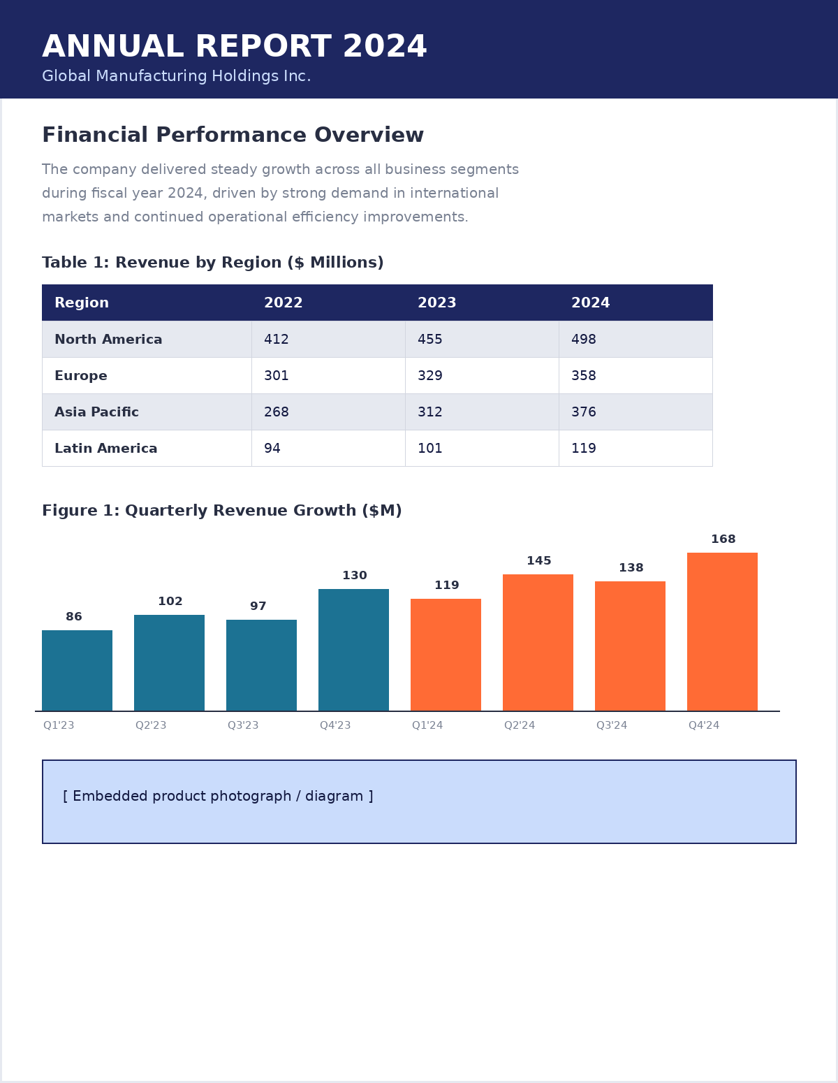

LET'S START WITH A QUESTION
Can Normal RAG Understand Everything Here?
A typical annual report contains paragraphs, tables, charts, and images — all on the same page.
"What does this chart tell us?"
A student asks this question about the report on the right.
Traditional text-based RAG can answer questions about the paragraphs easily.
But can it actually understand the chart showing quarterly growth?
Beyond Text RAG
02 / 22
Notes:
EXPLAIN: Show the annual report mockup. Point out it has narrative text, a data table, and a bar chart — all in one page, which is completely normal for real business, medical, legal, or research documents.
EXAMPLE: If we ask a text-only RAG system 'what does the chart tell us', it will likely fail — because it never converted the chart into anything retrievable in the first place.
ASK STUDENTS: Before we go further — what do you think happens to that chart when a normal PDF-to-text RAG pipeline processes this page?
TIME: ~2 min

Slide 3


SECTION 2 — THE PROBLEM
Where Traditional RAG Struggles
Text
Works well
Clean chunking & embeddings
Table
Loses structure
Rows/columns flatten into noisy text
Chart
Hard to interpret
Trends & values aren't 'readable' text
Image
Text embedding insufficient
No pixels are represented at all
Video
Multiple info types at once
Frames + audio + speech + on-screen text
Beyond Text RAG
03 / 22
Notes:
EXPLAIN: Walk down the list. Text-only RAG genuinely works for prose. But the moment structure (tables), visual trends (charts), pixel content (images), or temporal/audio content (video) enter the picture, plain text embeddings break down.
EXAMPLE: A table flattened into text loses the row/column relationship — '412 455 498' means nothing without knowing which region and which year each number belongs to.
ASK STUDENTS: Which of these five have you personally seen an AI tool get wrong before?
TIME: ~3 min

Slide 4






SECTION 2 — THE PROBLEM
The Familiar PDF-RAG Pipeline
PDF
Text Extraction
Chunking
Embeddings
Vector DB
Retriever
LLM
Only the text is being represented — tables, charts, images and video never enter the pipeline.
This is the pipeline you already know from PDF-based RAG. It's the baseline we'll extend today.
Beyond Text RAG
04 / 22
Notes:
EXPLAIN: This is the standard pipeline students already know. The key teaching moment: every box only ever carries text forward. Even if a PDF page had a chart, only the surrounding caption text (if any) survives extraction.
EXAMPLE: If a PDF page has a bar chart with no caption, this pipeline captures nothing about it — the chart is invisible to the retriever.
TIME: ~3 min

Slide 5
SECTION 3 — WHAT IS MULTIMODAL RAG?
Defining Multimodal RAG
Multimodal RAG retrieves information from multiple types of data and provides the relevant information to a model capable of understanding those modalities.
Text
Tables
Charts
Images
Video
Beyond Text RAG
05 / 22
Notes:
EXPLAIN: Give students this one-line definition and let it sit. The key shift: retrieval is no longer only over text chunks — it's over whatever representation best captures each modality — and the generation model must be capable of understanding that modality (e.g., a vision-language model for images).
EXAMPLE: Think of a research assistant who can read the paragraph, read the table, look at the chart, and watch the video clip — not just skim the words.
TIME: ~2 min

Slide 6
SECTION 3 — WHAT IS MULTIMODAL RAG?
Traditional RAG vs. Multimodal RAG
TRADITIONAL RAG
MULTIMODAL RAG
Text
Retrieve
Generate
Text
Tables
Images
Video
Retrieve
Understand
Generate
Beyond Text RAG
06 / 22
Notes:
EXPLAIN: Contrast the two flows side by side. Traditional RAG is a straight line: text in, text out. Multimodal RAG fans in from several modalities, adds an 'understand' step (often a vision-language model), then generates.
EXAMPLE: Ask: in the multimodal flow, which step is new compared to the traditional pipeline? (Answer: 'Understand' — reasoning over non-text representations.)
ASK STUDENTS: Why might 'Understand' need a different kind of model than plain text generation?
TIME: ~3 min

Slide 7



SECTION 4 — ARCHITECTURE
The Multimodal RAG Architecture
PDF / Images / Video
Content Extraction
Text / Tables / Images / Frames
Embeddings
Vector Store
Retriever
Multimodal Context
LLM / VLM
Answer
Beyond Text RAG
07 / 22
Notes:
EXPLAIN: This is the full-picture architecture. Emphasize that this is the SAME skeleton as PDF-RAG students already know — the difference is what flows through it: multiple content types, multiple embedding strategies, and a model that can 'see' as well as 'read'.
EXAMPLE: Trace one modality through: an image goes Extraction → Image representation → Vector Store → Retriever → passed to a Vision-Language Model → Answer.
ASK STUDENTS: Which single box in this diagram do you think is hardest to build well?
TIME: ~3 min

Slide 8
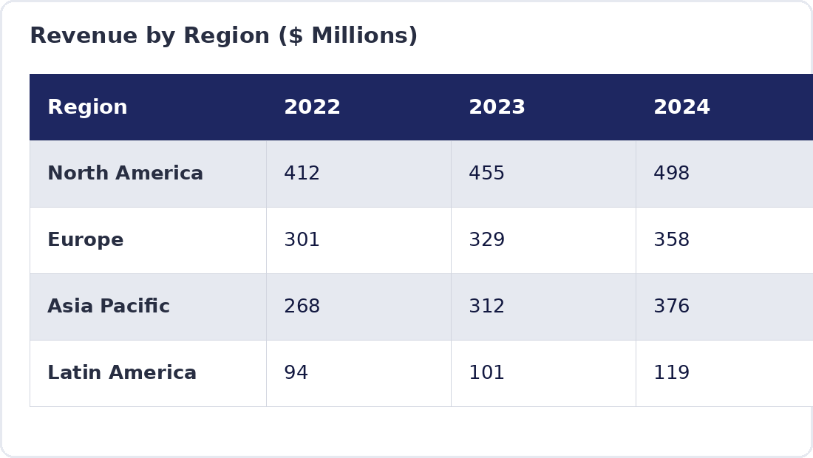
SECTION 4 — ARCHITECTURE
What Happens to a Table?
PDF Table
Table Extraction
Structured Representation
Embedding / Indexing
Retrieval
A markdown/structured table preserves rows, columns & headers — so "North America, 2024 → 498" stays a single, retrievable fact.
Answer
Beyond Text RAG
08 / 22
Notes:
EXPLAIN: Tables need structure-preserving extraction (e.g., detecting rows/columns, converting to markdown or JSON) before embedding — otherwise numbers lose their row/column meaning.
EXAMPLE: Show the table on the right: 'Asia Pacific, 2024 → 376' is meaningful only because row and column are kept together during extraction.
ASK STUDENTS: What could go wrong if we just concatenated every cell into a plain sentence?
TIME: ~3 min

Slide 9
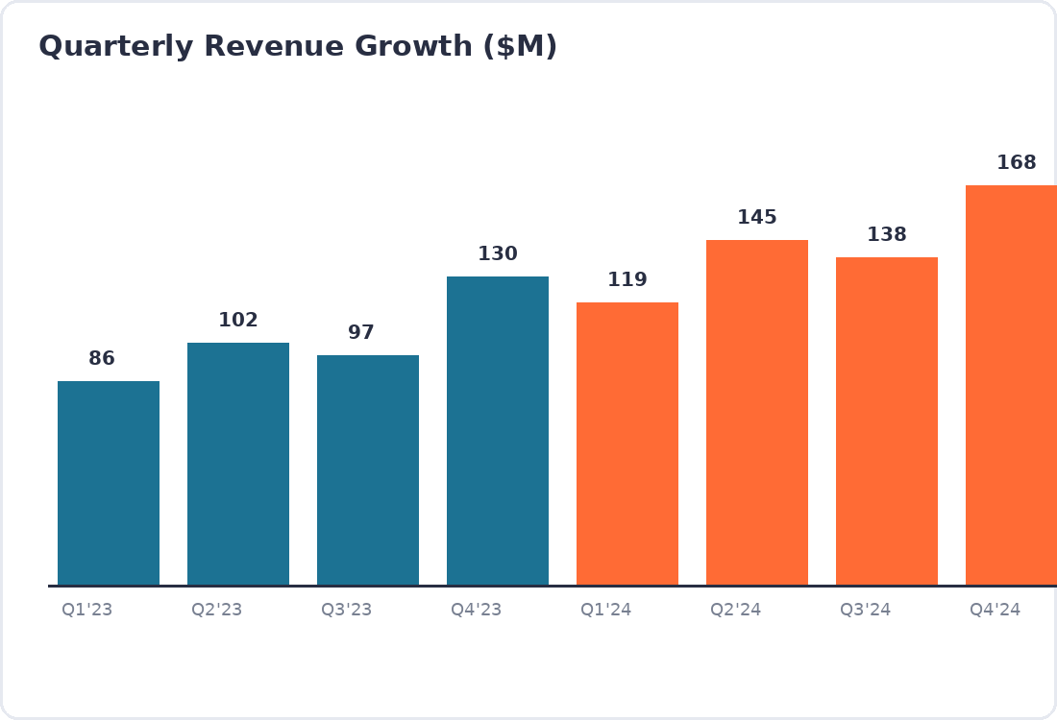
SECTION 4 — ARCHITECTURE
What Happens to an Image?
Image
Image Representation
Index
Retrieve
Vision-Language Model
Answer
Beyond Text RAG
09 / 22
Notes:
EXPLAIN: Images (including charts and diagrams) are represented with an image embedding model (e.g., CLIP-style) or described via a vision-language model, then indexed the same way as text embeddings — so text queries can retrieve relevant images.
EXAMPLE: The chart on the right gets embedded as an image; a query like 'show quarterly growth trend' retrieves it directly, and a VLM then reads the bars to answer 'which quarter grew the most?'
ASK STUDENTS: How is retrieving an image different from retrieving a text chunk?
TIME: ~3 min

Slide 10
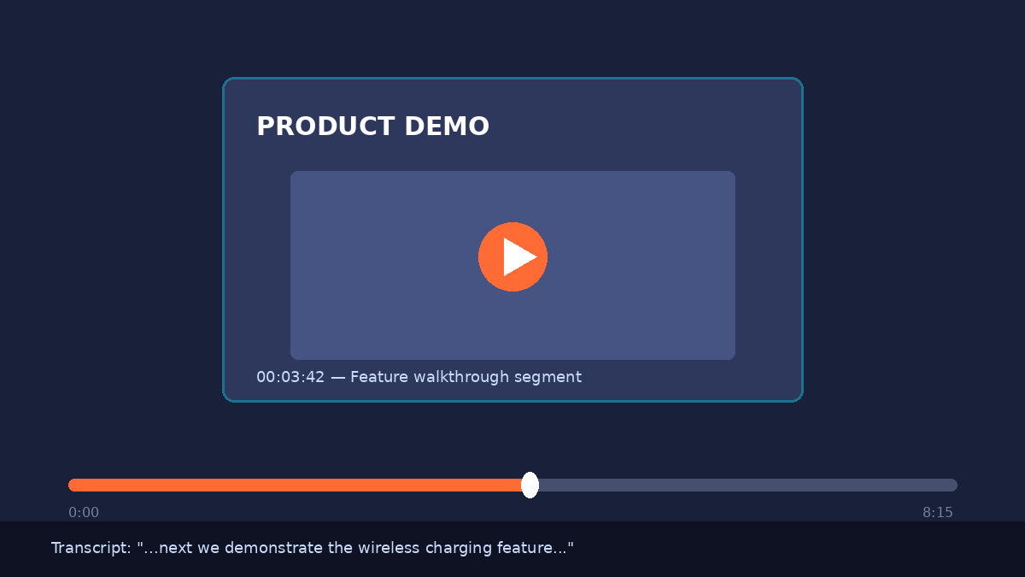
SECTION 4 — ARCHITECTURE
What Happens to a Video?
Video
Frames
Audio
Transcript
Representations
Retrieval
Relevant Frame / Context
Answer
Beyond Text RAG
10 / 22
Notes:
EXPLAIN: Video is the most complex modality: it's sampled into frames (for visual content), its audio is transcribed via speech-to-text, and both are embedded and indexed alongside timestamps — so retrieval can point to the exact moment relevant to a query.
EXAMPLE: The mockup on the right shows a product-demo video with a transcript caption — that transcript line becomes retrievable text, while the frame itself becomes a retrievable image, both linked to the same timestamp.
ASK STUDENTS: If a student asks about something only spoken (not shown) in a video, which representation answers it — frame or transcript?
TIME: ~3 min

Slide 11




SECTION 5 — TECHNOLOGY
Can We Build This Without API Keys?
YES.
A fully local, free, open-source stack — no OpenAI / Gemini / Claude / Groq API key required for the core demo.
Python
Ollama
Local LLM / VLM
Sentence Transformers
FAISS
PyMuPDF
Pillow
OpenCV
Whisper
Beyond Text RAG
11 / 22
Notes:
EXPLAIN: This is the exact stack we'll use in the live demo. All of these run locally on your own machine — Ollama serves local LLMs/VLMs, Sentence Transformers + FAISS handle embeddings & similarity search, PyMuPDF/Pillow/OpenCV handle extraction, and Whisper handles speech-to-text for video.
EXAMPLE: No signup, no billing, no rate limits — everything after the initial model download runs offline.
TIME: ~3 min

Slide 12
SECTION 5 — TECHNOLOGY
Ollama & Local Models, Simply
Ollama runs open-weight models directly on your machine — your application talks to it like a local API.
Your Application
Ollama
Local Model
Lightweight vision-language models
A note on hardware
Models such as Qwen2.5-VL are suitable where image/chart understanding is needed, run locally through Ollama.
Requirements depend on model size — larger models need more RAM/VRAM. Start small, scale up as needed.
Beyond Text RAG
12 / 22
Notes:
EXPLAIN: Ollama abstracts away the complexity of running local models — your code sends a prompt (and optionally an image) and gets a response, similar to calling a hosted API, except everything runs on your own hardware.
EXAMPLE: For image/chart understanding we need a vision-language model, not a text-only LLM — Qwen2.5-VL is one practical, lightweight option compatible with Ollama.
ASK STUDENTS: Why might a smaller local model still be a good choice for a classroom demo, even if it's less capable than a large hosted model?
TIME: ~3 min

Slide 13
SECTION 6 — LIVE DEMO
Let's Build It
Our input: a single PDF that mixes narrative text, a data table, and a chart.
Text content present in the PDF
Table content present in the PDF
Chart / Image content present in the PDF
Beyond Text RAG
13 / 22
Notes:
EXPLAIN: Introduce the live coding portion. We'll process this single PDF end-to-end: extract, index, then query it with both a text question and a chart/image question.
EXAMPLE: This mirrors a real annual report page — nothing artificial about the structure.
TIME: ~1 min

Slide 14
SECTION 6 — LIVE DEMO
Stage 1 — Extraction
PDF
Text
Tables
Images
PyMuPDF pulls out each modality separately — plain paragraphs, detected table regions, and embedded images/charts — instead of flattening the page into one text blob.
Beyond Text RAG
14 / 22
Notes:
EXPLAIN: Show the code that opens the PDF and loops through pages, separately pulling text blocks, detected tables, and embedded images. Each modality is kept as its own object rather than merged into one string.
EXAMPLE: For this page: one text block, one table (4x4), and one chart image come out as three distinct extracted items.
TIME: ~3 min

Slide 15
SECTION 6 — LIVE DEMO
Stage 2 — Indexing
Content
(Text/Table/Image)
Embeddings
FAISS
Searchable
Knowledge Base
Sentence Transformers embed the text & table content; an image embedding step handles the chart. All vectors are stored together in a single FAISS index.
Beyond Text RAG
15 / 22
Notes:
EXPLAIN: Each extracted item (text chunk, table representation, image) is converted into a vector. All vectors land in one FAISS index so retrieval can pull back a mix of modalities for a single query.
EXAMPLE: A query about revenue could retrieve the paragraph AND the table AND the chart, all from one search.
TIME: ~3 min

Slide 16
SECTION 6 — LIVE DEMO
A Student Question — Text
"What was the revenue in 2024?"
Question
Retriever
Relevant Text Chunk
LLM
Answer
Answer: North America generated $498M in revenue in 2024.
Beyond Text RAG
16 / 22
Notes:
EXPLAIN: This question is answerable from the extracted table content — show the retriever pulling back the table row and the LLM composing a natural-language answer.
EXAMPLE: Note this doesn't require any image/vision capability — it's really still 'text/structured-data RAG' under the hood, just working correctly this time because the table was extracted properly.
ASK STUDENTS: Is this a genuinely 'multimodal' retrieval, or just good text/table extraction?
TIME: ~3 min

Slide 17
SECTION 6 — LIVE DEMO
A Multimodal Question
"What does the chart on page 5 indicate?"
Question
Retriever
Relevant Image
Vision-Language Model
Answer
Answer: Revenue grew every quarter, accelerating sharply from Q1 to Q4 2024.
Beyond Text RAG
17 / 22
Notes:
EXPLAIN: This question CANNOT be answered from text alone — the retriever must fetch the chart image itself, and a vision-language model must visually interpret the bars/trend to produce an answer.
EXAMPLE: Contrast directly with slide 16 — same pipeline shape, but the model actually 'looks' at pixels this time.
ASK STUDENTS: What would happen here if we only had a text-only LLM at the end instead of a VLM?
TIME: ~3 min

Slide 18
SECTION 6 — LIVE DEMO
Two Kinds of Questions, Side by Side
ANSWERED USING TEXT
NEEDS IMAGE / TABLE UNDERSTANDING
"What was the revenue in 2024?"
"What does the chart on page 5 indicate?"
• Needs:
text / table extraction only
• Model:
standard LLM
• Retrieval target:
a text/table chunk
• Needs:
image/chart retrieval + visual reasoning
• Model:
vision-language model
• Retrieval target:
an image embedding
Beyond Text RAG
18 / 22
Notes:
EXPLAIN: Summarize the demo with a direct side-by-side. This is the key mental model to leave students with: the question determines what needs to be retrieved and which kind of model needs to process it.
EXAMPLE: Same pipeline shape both times — different modality flowing through it.
ASK STUDENTS: Can you think of a question about this PDF that would need BOTH the table and the chart to answer correctly?
TIME: ~2 min

Slide 19

SECTION 7 — VIDEO RAG
Multimodal RAG + Video
Video
Frames + Transcript
Index
Retrieval
Relevant Frame / Context
Answer
"Which product feature was demonstrated around the middle of the video?"
Video RAG is not a new architecture — it's the same retrieval architecture, extended: sample frames, transcribe audio, embed both, and retrieve the moment that matches the query.
Beyond Text RAG
19 / 22
Notes:
EXPLAIN: Frame this as an extension, not a new system: the same 'extract → represent → index → retrieve → generate' shape from slide 7 applies directly to video, just with frames and transcripts as the extracted content.
EXAMPLE: For the sample question, the system would retrieve the transcript segment and the nearby frame from the middle of the video, then let the model describe the feature shown.
ASK STUDENTS: What timestamp precision would you want the retriever to return for this to feel useful?
TIME: ~3 min

Slide 20








SECTION 8 — REAL-WORLD APPLICATIONS
Where This Shows Up in the Real World
Financial reports
Medical documents
Education
Manufacturing manuals
Legal documents
Product documentation
Security footage analysis
Training videos
Customer support
Research papers
Beyond Text RAG
20 / 22
Notes:
EXPLAIN: Pause here and let students connect the architecture to industries they recognize. Every one of these domains mixes text with tables, images, or video, which is exactly the pattern we've been building toward all class.
EXAMPLE: Security footage analysis and training videos both rely on the video-RAG flow from the previous slide; financial reports and research papers rely on the table/chart flow from earlier.
ASK STUDENTS: Which one of these applications would YOU want to build first, and why?
TIME: ~3 min

Slide 21
SECTION 9 — FINAL CONCEPT
Traditional RAG vs. Multimodal RAG
Traditional RAG
Multimodal RAG
Data types
Text only
Text, tables, images, video
Representation
Text embeddings
Text + image + structured embeddings
Retrieval
Single-modality search
Cross-modal search
Model
Standard LLM
Vision-Language Model / multimodal LLM
Use cases
Simple Q&A over prose
Reports, manuals, research, video analysis
Beyond Text RAG
21 / 22
Notes:
EXPLAIN: Use this table as a recap. Go row by row quickly — data types, representation, retrieval, model, use cases — reinforcing vocabulary from the whole session.
EXAMPLE: Point back to specific earlier slides for each row: 'representation' ties back to slides 8–9, 'model' ties back to slide 17.
TIME: ~3 min

Slide 22

SECTION 9 — FINAL CONCEPT
RAG Doesn't Have to Retrieve Only Text
TEXT + TABLES + IMAGES + VIDEO
MULTIMODAL RETRIEVAL
BETTER CONTEXT
BETTER ANSWERS
If you could build a Multimodal RAG system for one real-world problem, what would it be?
Beyond Text RAG
22 / 22
Notes:
EXPLAIN: Close by walking the vertical stack: mixing modalities leads to multimodal retrieval, which leads to richer context, which leads to better answers. Then open the floor with the closing question.
EXAMPLE: Let 2-3 students share their idea out loud before wrapping up; connect their answers back to the applications from slide 20 where relevant.
ASK STUDENTS: If you could build a Multimodal RAG system for one real-world problem, what would it be?
TIME: ~3 min

