Slide 1
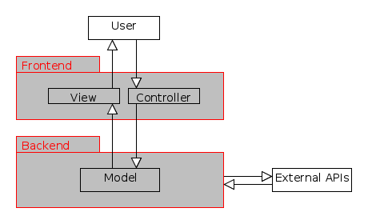
Hierarchy
Here we use a common two level hierarchy design with the model-view-controller pattern, where the controller and view lays in the frontend and the model in the backend.

Slide 2
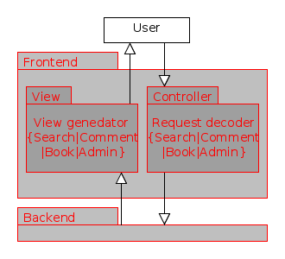
Hierarchy – Frontend
The frontend handles user input and generates final results to users.

Slide 3
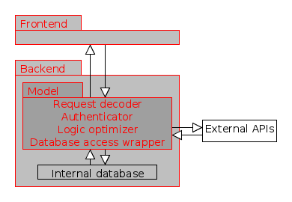
Hierarchy – Backend
The backend request from frontend and manipulates with internal databases and external APIs.

