Slide 1
Asteroids Game
Drew Martin
Nick Porter

Slide 2
Overview
Set in space, in the vicinity of the Earth
3D movement
1st and 3rd person point of view
Shoot asteroids to break them into smaller chunks

Slide 3
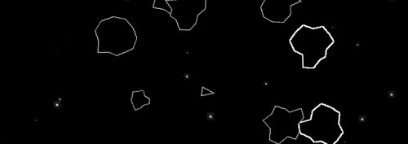
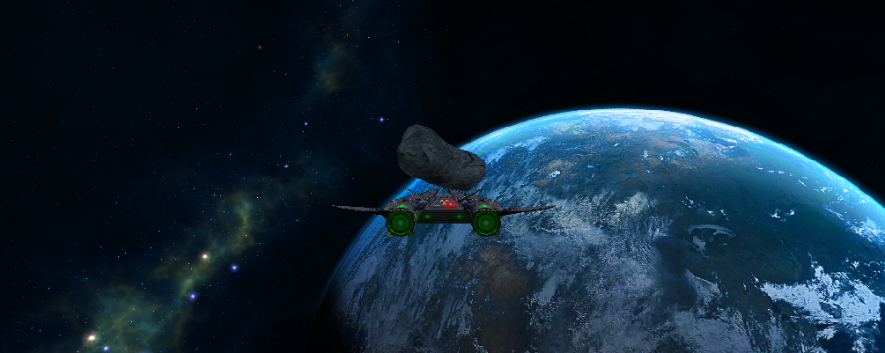

Slide 4
Special Features
Accomplished:
Flexible component system
Camera that follows a specific game object
Simple physics (laser and asteroid collisions)
Skybox
Not accomplished:
Asteroid-asteroid and asteroid-ship collisions
Particle effects
Glowing lasers
Crosshair

Slide 5
Follow Camera
Follows one particular object in the game
Can be used to display first-person or third-person views
Bases its position/orientation on that of the object (with an offset in third-person)
Changes the field of view based on the speed of the followed object to help display the speed
Keeps a stack of the previous rotations of the followed object and uses older rotation values to show the followed object’s movement (only in third-person view)
Can easily swap the object being followed

Slide 6
Time Estimate
Task | Estimate | Actual | Reasons
Overall effort | 47 | 70
Design of project | 2 | 2 | We intentionally kept the design simple.
Design of code | 5 | 5 | Mostly designing the component system. Other features were basically made ad-hoc within the confines of the component system.
Implementation | 40 | 63 | Went overboard with the component system. We added more features than originally planned (more complex camera, skybox)
Integration and testing | 0 | 0 | We tested as we added, no unit/integration testing

