Slide 1


SANSKAR
Educational Group
PROJECT : TYPING NINJA

Slide 2
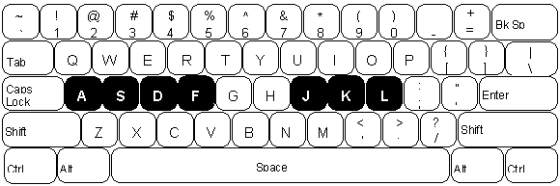
TYPING NINJA
BY:
Love Tomer
2002150100021
B.Tech CS 3rd sem
TO:
Prof. Pradeep Tripathi

Slide 3

INTRODUCTION
Typing Ninja is a kind of game by which you can test or increase or improve your Typing skills.
C++ is used in the development of this game.

Slide 4
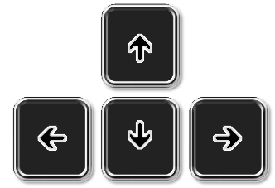
OBJECTIVE
Develop typing skills
Recognize position of the key’s to use all fingers
Identify the location of different keys and different letters
To practice Typing with all fingers

Slide 5

HOW TO PLAY
Press key which is on the screen to score a point
Try to keep up, Because if any alphabet touch the bottom line the game will be over

Slide 6
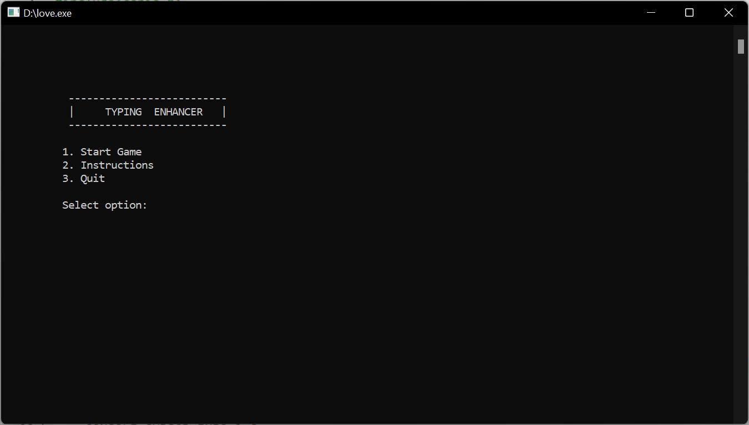
SNAPSHOT

Slide 7
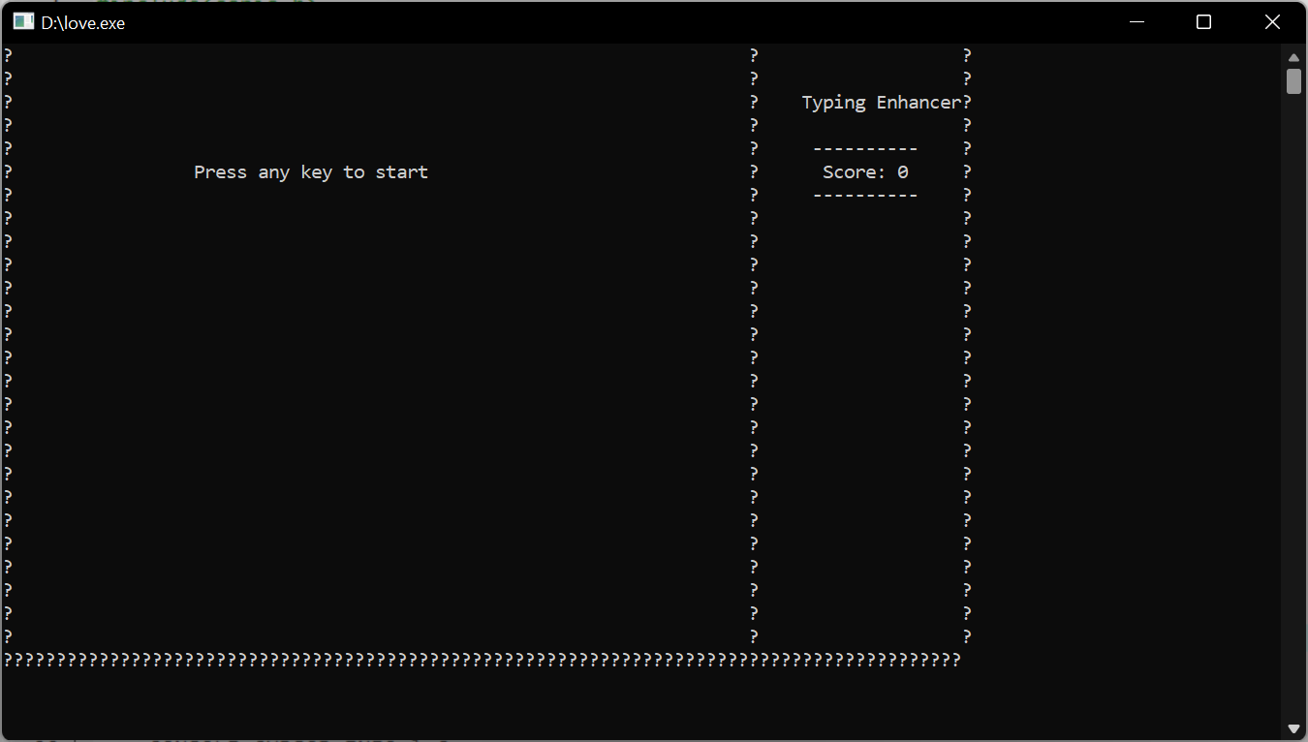
SNAPSHOT

Slide 8
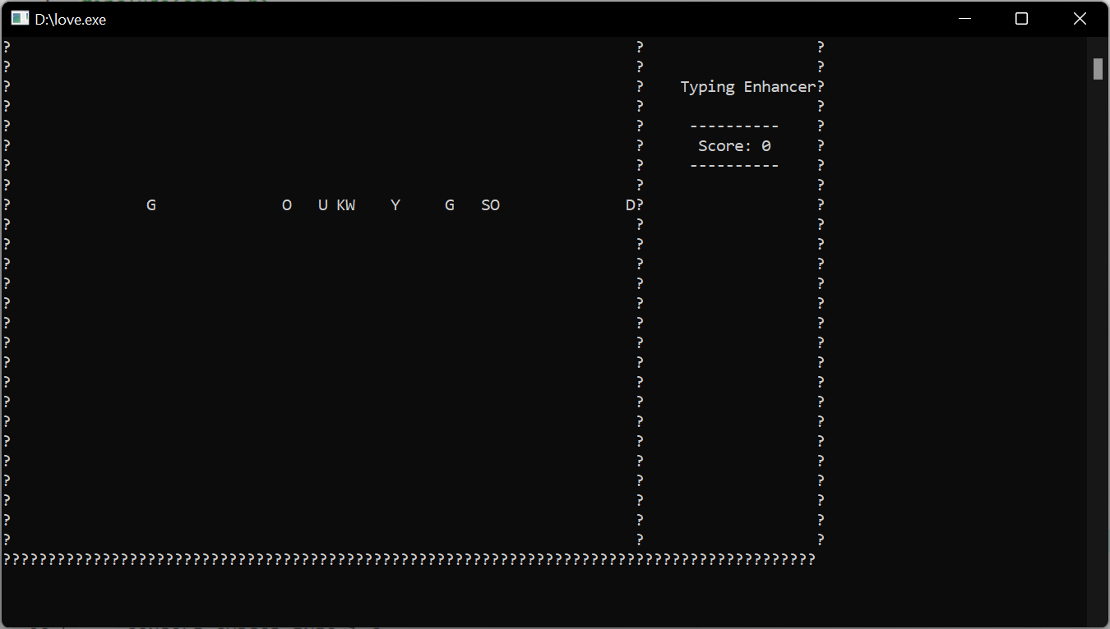
SNAPSHOT

Slide 9
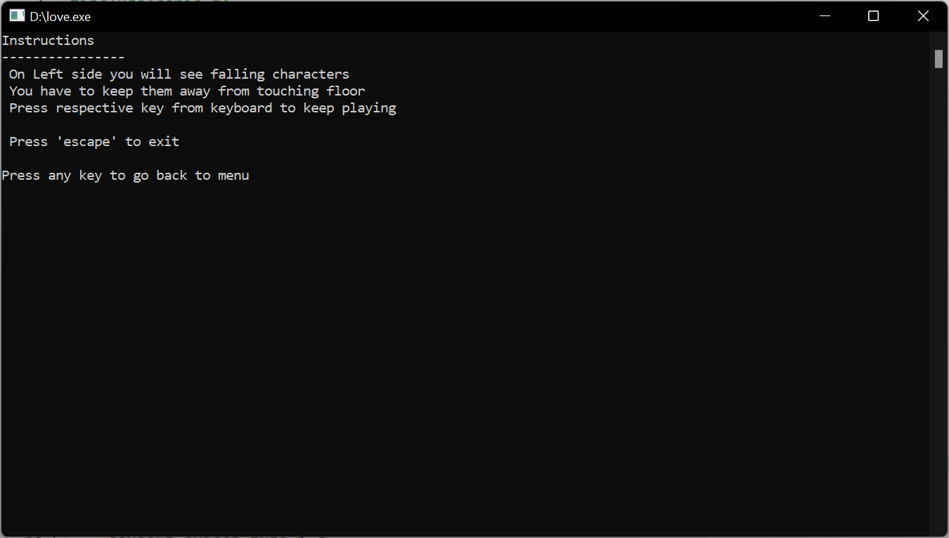
SNAPSHOT

Slide 10

QUERY SESSION

Slide 11
THANK YOU

