Slide 1
Blind Separation of Two Speeches Using ICA
Yigit Bilgen
Elliot Rosen

Slide 2
Independent Component Analysis
“Cocktail Party Problem”
Separate up to n sources from n signals
Assume signals are independent
Model signals as a linear combination of source signals
(Blindly) Guess the weighting of the signals to recover the original source signals
Notes:
Self explanatory?
x = A * s, for any time sample.

Slide 3
FastICA
Preprocess
Center the mixture
Whiten the mixture
Iterate until weight vectors stabilize:
Increase (approximated) negentropy
Normalize weight vectors
Decorrelate weight vectors

Slide 4
Preprocessing
Center the data
Whitening: decorrelate the signals to make computation easier
Covariance matrix = I
These are necessary for the negentropy approximation used later (zero mean, unit variance)

Slide 5
Preprocess.m
function [xwhitened, mu, whitener] = Preprocess(x)
% x: nxk vector, n is the number of mixtures, k is the number of samples
% Returns: xwhitened = preprocessed data;
% mu = data means
% whitener = matrix used for whitening. Used later for comparison.
% Center
mu = mean(x, 2);
xcenter = x - repmat(mu, 1, length(x));
% Covariance
sigma = cov(xcenter');
[V, D] = eig(sigma);
% Whiten
whitener = V * diag(diag(D).^(-0.5)) * V';
xwhitened = whitener * xcenter;
end

Slide 6
Negentropy
Definition
Maximize this to maximize independence
Minimize mutual information
Approximation of J for faster calculation

Slide 7
Iteration
Increase negentropy:
Normalize (because we still want variance of 1, keeps things scaled)
Decorrelate W, to prevent weights from biasing to the same source.
Notes:
Symmetric decorrelation!

Slide 8
IterateICASingle.m
function [out] = IterateICASingle(w, x)
% Performs one iteration of ICA
% W: Weighting vector (nx1); x: data (nxk)
[n, k] = size(x);
p = w'*x;
gp = g(p);
% E{x * g(p)}
out = x * gp' / k;
% E{g’(p)} * w
g2 = mean(gdot(p), 2) * w;
out = out - g2;
% Normalize
out = out / norm(out);
end

Slide 9
ICA.m
[x, mu, whitener] = Preprocess(x);
w1 = [2; -1];
w2 = [-1; 2];
w1 = w1 / norm(w1);
w2 = w2 / norm(w2);
W0 = zeros(2, 2); % old value of W
W = [w1, w2]';
while norm(eye(2, 2) - abs(W' * W0)) > 0.001
w1 = IterateICASingle(w1, x);
w2 = IterateICASingle(w2, x);
W0 = W;
W = [w1, w2]';
[V, D] = eig(W*W');
W = (V / sqrt(D)) * V' * W;
Wt = W';
w1 = Wt(:,1);
w2 = Wt(:,2);
end
near_i = abs(W * whitener * A);
near_i = near_i / norm(near_i);
% distance from identity matrix. Flip rows if necessary.
score = min(norm(eye(2, 2) – near_i), norm(eye(2, 2) – flipud(near_i)));

Slide 10
Testing
Confirm accuracy for different mixing matrices.
Do a Monte Carlo simulation for a mixing matrix generated by a random parameter
Normalize and compare to I
Should be close and consistent for a good result
Use the same speech

Slide 11
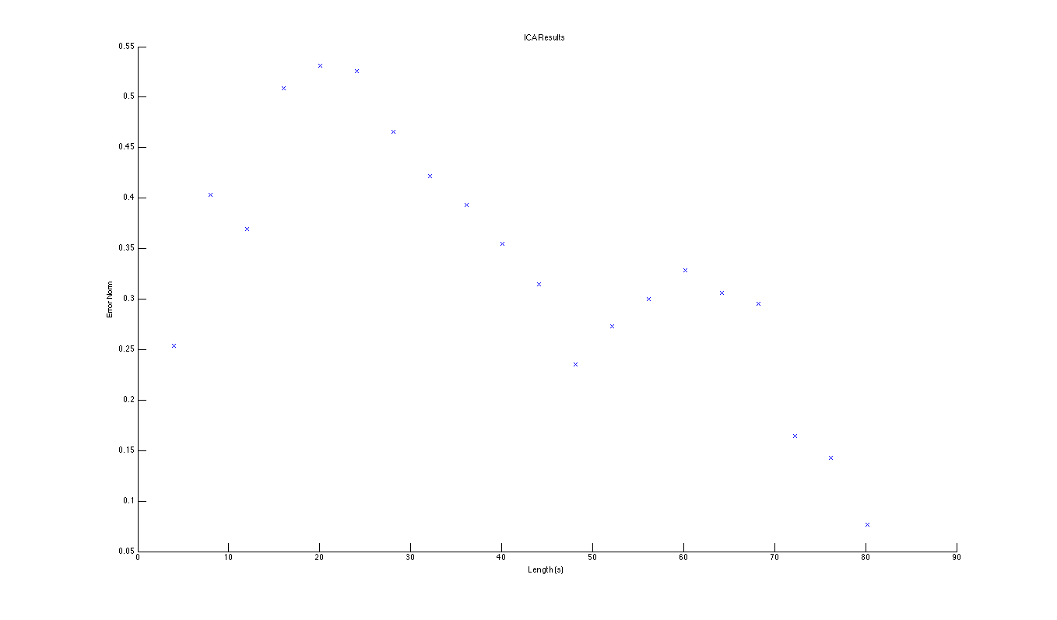
Results (10 trials per clip length)

Slide 12
Conclusions
FastICA converged very consistently, regardless of the mixing parameters
Learning generally increased with time
FastICA in this form is only applicable to artificially mixed sources

Slide 13
Other ideas
Live mixtures
More preprocessing specific to time-variant signals (like sound)
Alternate approximation and decorrelation methods
Establish when overlearning occurs

Slide 14
Sources
Pulp Fiction (1994)
Doctor Who: “Blink” (2007)
Hyvärinen, Aapo, and Erkki Oja. "Independent component analysis: algorithms and applications." Neural networks 13.4 (2000): 411-430.

