Slide 1
INTRODUCTION TO ARTIFICIAL INTELLIGENCE
MIDTERM PRESENTATION
502043 - Introduction to Artificial Intelligence
1

Slide 2
I. INTRODUCTION
Student ID | Fullname | Assign tasks | Complete Percentage
523H0115 | Nguyễn Trần Nhật An 523H0115@student.tdtu.edu.vn | Task 1 | 100%
523H0185 | Nguyễn Phúc Toàn 523H0185@student.tdtu.edu.vn | Task 2 | 100%
523H0140 | Nguyễn Quang Huy 523H0140@student.tdtu.edu.vn | Task 3 | 100%
523H0196 | Chung Quang Vũ 523H0196@student.tdtu.edu.vn | Task 4 | 100%
523H0187 | Nguyễn Minh Trí 523H0187@student.tdtu.edu.vn | Task 4 | 100%
502043 - Introduction to Artificial Intelligence
2

Slide 3
II. IMPLEMENTATION:
Task 1
Solving 8-Puzzle using A*
502043 - Introduction to Artificial Intelligence
3

Slide 4

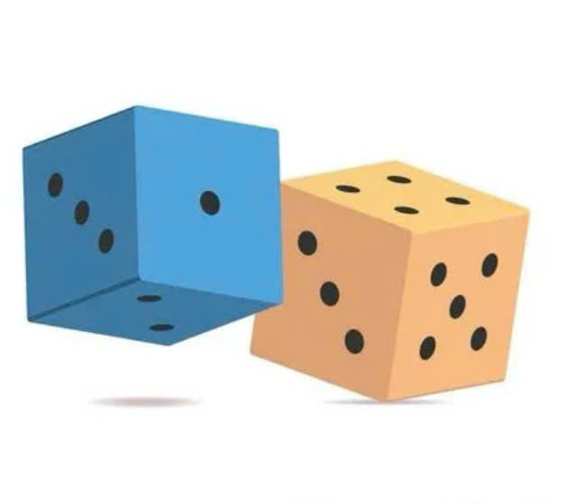
Essential libraries and modules
Generates visualizations of the search tree and solution path
GRAPHVIZ
Shuffles tiles to generate random initial states
RANDOM
502043 - Introduction to Artificial Intelligence
4

Slide 5


Essential libraries and modules
Implements a priority queue (min-heap) for efficient state expansion in the A* search.
HEAPQ
Creates independent copies of puzzle states during transitions to avoid reference conflicts.
COPY
502043 - Introduction to Artificial Intelligence
5

Slide 6
Class Puzzle
- Represents a single state of the 8-puzzle board and manages the state transitions within the search algorithm
- Attributes:
state: 3x3 grid
id: unique string representation of state
action: move taken to reach this state
parent: previous state
502043 - Introduction to Artificial Intelligence
6

Slide 7
Class Puzzle
- Represents a single state of the 8-puzzle board and manages the state transitions within the search algorithm
- Attributes:
g = cost since intitial state
h = estimated cost to goal state
f = g + h
502043 - Introduction to Artificial Intelligence
7

Slide 8
Class Puzzle
- Essential methods:
get_pos(state, value):
for each row and column in state:
if value found: return (row,col)
swap(a, b):
get positions of a and b
swap their values
502043 - Introduction to Artificial Intelligence
8

Slide 9
Class Puzzle
- Essential methods:
check_neighbor(state, a, b):
get positions of a and b
return true if adjacent
502043 - Introduction to Artificial Intelligence
9

Slide 10
Class Puzzle
- Essential methods:
get_dest_pos(action, pi, pj):
if action is 'L': return (pi, pj + 1)
if action is 'R': return (pi, pj - 1)
if action is 'U': return (pi + 1, pj)
if action is 'D': return (pi - 1, pj)
502043 - Introduction to Artificial Intelligence
10

Slide 11
Class Puzzle
- Essential methods:
get_successor(action, state):
find position of empty tile (0)
get new position based on action
if new position is valid:
swap values
return new state
else return None
502043 - Introduction to Artificial Intelligence
11

Slide 12
Class Puzzle
- Essential methods:
get_successors():
check if 1-3 and 2-4 are neighbors initially
successors = []
for each possible move ('L', 'R', 'U', 'D'):
generate new state
502043 - Introduction to Artificial Intelligence
12

Slide 13
Class Puzzle
- Essential methods:
get_successors():
if new_state is valid:
if 1-3 are now neighbors but weren't before:
swap 1 and 3
if 2-4 are now neighbors but weren't before:
swap 2 and 4
add new Puzzle state to successors
502043 - Introduction to Artificial Intelligence
13

Slide 14
Class Puzzle
- Essential methods:
get_solution_path():
path = []
node = current node
while node has parent:
add node's action to path
node = node.parent
return reversed path
502043 - Introduction to Artificial Intelligence
14

Slide 15
Class Puzzle
- Essential methods:
draw(dot):
generate a table representation
add node to dot
if parent exists:
create edge between parent and current node
502043 - Introduction to Artificial Intelligence
15

Slide 16
Class PuzzleAgent
- Implements an A* search algorithm to solve the 8-puzzle, that supports multiple goal states, heuristics functions, and visualization.
- Attributes:
dot graph for visualization
explored = set()
drawn = set()
open_set = []
state_map(maps state string to Puzzle object)
502043 - Introduction to Artificial Intelligence
16

Slide 17
Class PuzzleAgent
- Essential methods:
solve():
+ Compute initial heuristic (h0) to any goal state
+ Create start Puzzle node with g=0, h=h0
+ Add start node to open_set and state_map
502043 - Introduction to Artificial Intelligence
17

Slide 18
Class PuzzleAgent
- Essential methods:
solve():
while open_set is not empty:
extract node with lowest f from open_set
if node's state matches any goal state:
if node not drawn:
draw node and add to drawn
node = node.parent
502043 - Introduction to Artificial Intelligence
18

Slide 19
Class PuzzleAgent
- Essential methods:
solve():
for each successor of current node:
if successor already explored, continue
compute g, h, and f values for successor
if successor not in state_map or has better f value:
add to open_set
update state_map
502043 - Introduction to Artificial Intelligence
19

Slide 20
Heuristic functions
h_manhattan(state, goal):
distance = 0
for each tile 1-8:
get positions in state and goal
compute Manhattan distance
return distance
502043 - Introduction to Artificial Intelligence
20

Slide 21
Heuristic functions
h_near_goal(state, goal, n=2):
count = 0
for each tile 1-8:
get positions in state and goal
if Manhattan distance ≤ n:
count +=1
return count
502043 - Introduction to Artificial Intelligence
21

Slide 22
Heuristic functions
Heuristic function | Admissibility | Consistency
h_manhattan (Sum of Manhattan distances for all tiles) | - Never overestimates the true cost to the goal. - Each tile must move at least its Manhattan distance to reach its goal position. - Summing these distances gives a lower bound on the total moves needed. | - For any move, the heuristic function satisfies: h(n) ≤ cost(n→n′)+h(n′) - Ensures A* finds the optimal path without reopening nodes.
502043 - Introduction to Artificial Intelligence
22

Slide 23
Heuristic functions
Heuristic function | Admissibility | Consistency
h_near_goal (Counts tiles within n=2 moves of their goal) | - Counts how many tiles are "close enough" to their goal positions. - Since it only considers tiles within a small distance (n=2), it never overestimates the true cost. | - Similar logic applies: moving a tile can change its status at most 1, so it satisfies: h(n)≤1+h(n′)
502043 - Introduction to Artificial Intelligence
23

Slide 24
Main execution
goal_states = list of goals
generate random initial_state
result, graph = PuzzleAgent.solve(initial_state, goal_states, h_manhattan)
if result:
print solution information
display graph
else:
no solution found
502043 - Introduction to Artificial Intelligence
24

Slide 25
Evaluation table
Aspect | Advantages | Disadvantages | Completion Status
Algorithm (A)* | Guarantees optimal solution with admissible and consistent heuristics. | Memory-intensive (stores all explored states). | 100%
Special Rules | Correctly handles unique constraints | Increases complexity of successor generation. | 100%
Visualization | Helpful visual debugging tools | Limited by graph_depth | 100%
Heuristics | Supports customizable heuristics | Requires careful heuristic design for best results | 100%
Multiple Goals | Solves for multiple goal states in one run. | Computes heuristics for all goals, adding overhead. | 100%
502043 - Introduction to Artificial Intelligence
25

Slide 26
II. IMPLEMENTATION:
Task 2
Pathfinding Algorithm
for Pac-Man Navigation
using A*
502043 - Introduction to Artificial Intelligence
26

Slide 27

Essential libraries and modules
Implements a priority queue (min-heap) for efficient state expansion in the A* search.
HEAPQ
Creates a graphical user interface for rendering, displaying sprites, and updating the game state on screen...
PYGAME
502043 - Introduction to Artificial Intelligence
27

Slide 28

Essential libraries and modules
Compresses a sequence of moves by grouping consecutive identical directions.
ITERTOOLS
502043 - Introduction to Artificial Intelligence
28

Slide 29
Essential constants and parameters
Pos = tuple[int, int]
A type alias for position coordinates.
Directions{}
Map direction names to coordinate offsets.
502043 - Introduction to Artificial Intelligence
29

Slide 30
Game Background
- You are Wilbur the goldfish and your job is to collect all pearls scattered across the map.
- On each corner, there is a portal. When landing on it Wilbur will get teleported to the opposite corner (e.g. Top left 🡒 Bottom right).
- There are also gems – magical collectibles that allow Wilbur to “ghost” through walls for 5 turns.
502043 - Introduction to Artificial Intelligence
30

Slide 31
Class Game
- Responsible for storing a state of the game and handling the rules.
- Attributes:
player: The current position of Wilbur.
pearls: A set of uncollected pearls.
gems: A set of uncollected gems.
ghost_turns: Number of turns left for ghost mode.
walls: A set of wall coordinates.
portals: Teleporting locations.
502043 - Introduction to Artificial Intelligence
31

Slide 32
Class Game
- Essential methods:
load_map(map_str): Creates a game state from a map string.
width, height = length rows and columns
FOR each character in map_str:
IF “P”: SET player_pos
IF “.”: ADD to pearls
IF “O”: ADD to gems
IF “%”: ADD to walls
502043 - Introduction to Artificial Intelligence
32

Slide 33
Class Game
- Essential methods:
get_moves(): Determines all valid moves at the current state.
x, y = player
moves = {}
FOR each direction(dx, dy) in directions:
new_pos = (x+dx, y + dy)
IF new_pos is OUTSIDE map boundaries: CONTINUE
IF new_pos is a wall AND ghost_turns == 0: CONTINUE
IF new_pos is a portal: new_pos = TELEPORTING_POSITION
ADD {direction: new_pos} to moves
502043 - Introduction to Artificial Intelligence
33

Slide 34
Class Game
- Essential methods:
move_to(new_pos): Creates a new state after moving to a new position.
IF new_pos == current position: # No need to move
RETURN self
new_pearls = COPY(self.pearls)
new_gems = COPY(self.gems)
new_ghost_turns = self.ghost_turns - 1
502043 - Introduction to Artificial Intelligence
34

Slide 35
Class Game
- Essential methods:
move_to(new_pos): (cont.)
IF new_pos is in new_pearls:
REMOVE new_pearls(new_pos)
IF new_pos is in new_gems:
REMOVE new_gems(new_pos)
new_ghost_turns = 5
RETURN Game(new_pos, new_pearls, new_gems, new_ghost_turns)
502043 - Introduction to Artificial Intelligence
35

Slide 36
Class Game
- Essential methods:
__hash__(): Generates a unique hash for the game. Reduce the overhead when comparing visited game states 🡒 performance improvement!
RETURN hash((player position, frozen_set(pearls), frozen_set(gems), ghost_turns))
502043 - Introduction to Artificial Intelligence
36

Slide 37
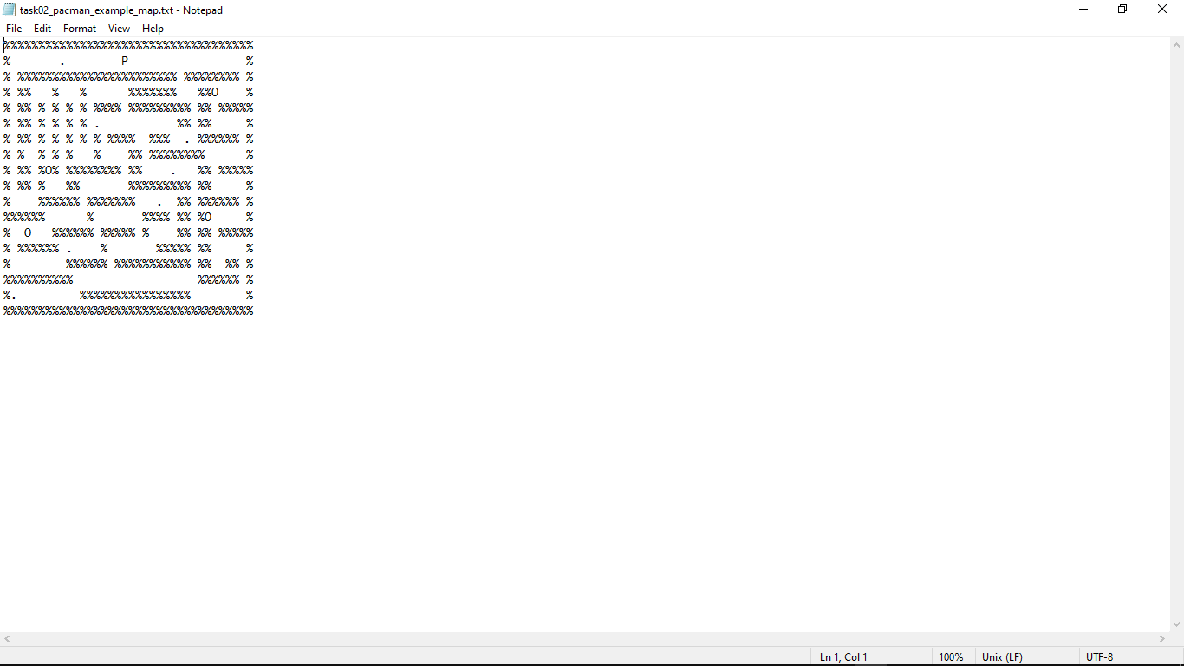
Class Game
- Essential methods:
__str__(): Returns the game state as a string for console output.
Figure 1. __str__()’s output
502043 - Introduction to Artificial Intelligence
37

Slide 38
Class Pathfinder
- Defines an agent for finding the optimal path to collect all pearls in a game state. The agent uses A* search algorithm with a Minimum Spanning Tree (MST) heuristic.
- A MST is the most efficient way to connect all target nodes in a graph without forming any loops using the least total path cost.
502043 - Introduction to Artificial Intelligence
38

Slide 39
Class Pathfinder
- The heuristic uses Prim algorithm to find the MST of a given game state:
Start at the player position (initial node).
Calculates a path cost of all reachable pearls and gems; then pick the shortest node.
Repeat step 2 at that node until all nodes are connected, forming the MST.
502043 - Introduction to Artificial Intelligence
39

Slide 40
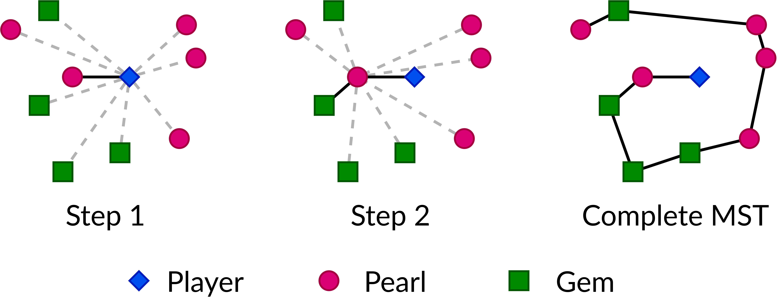
Class Pathfinder
Figure 2. Prim Algorithm visualization
502043 - Introduction to Artificial Intelligence
40

Slide 41
Class Pathfinder
- A* search with Prim MST Heuristic:
Complete? YES
Optimal? YES
Time complexity? O(E*log(V))
Space complexity? O(V + E)
(E is the number of edges, V is the number of vertices)
502043 - Introduction to Artificial Intelligence
41

Slide 42
Class Pathfinder
- Essential methods:
estimate(): Computes the MST cost to connect all remaining pearls, gems, and the player.
nodes = pearls + gems + [player]
IF node is empty:
return 0
visited = set()
min_heap = MIN_HEAP([(0, nodes[0])])
502043 - Introduction to Artificial Intelligence
42

Slide 43
Class Pathfinder
- Essential methods:
estimate(): (cont.)
WHILE heap has items AND NOT all nodes visited:
cost, (x, y) = POP smallest item from heap
IF (x, y) already IN visited:
CONTINUE
MARK (x, y) as visited
ADD cost to total_cost
502043 - Introduction to Artificial Intelligence
43

Slide 44
Class Pathfinder
- Essential methods:
estimate(): (cont.)
FOR each (nx, ny) in nodes:
IF (nx, ny) not in visited:
distance = |nx - x| + |ny - y|
PUSH (distance, (nx, ny)) to heap
RETURN total_cost
502043 - Introduction to Artificial Intelligence
44

Slide 45
Class Pathfinder
- Essential methods:
find(): Finds the shortest sequence of moves to collect all pearls.
frontier = [(self.estimate(self.src), 0, player, pearls, gems, ghost_turns, [])]
visited = SET()
WHILE frontier NOT EMPTY:
f_cost, g_cost, player_pos, pearls_left, gems_left, path, ghost_turns = POP(frontier)
game = Game(player_pos,….)
502043 - Introduction to Artificial Intelligence
45

Slide 46
Class Pathfinder
- Essential methods:
find(): (cont.)
IF hash(game) is NOT IN visited:
visited.add()
IF pearls_left is EMPTY:
RETURN path
502043 - Introduction to Artificial Intelligence
46

Slide 47
Class Pathfinder
- Essential methods:
find(): (cont.)
FOR direction, new_pos IN get_moves()
new_game = game.move_to(new_pos)
new_g_cost = g_cost + 1
new_f_cost = new_g_cost + self.estimate(new_game)
IF hash(new_game) not IN visited:
heappush(frontier, (new_f_cost, new_g_cost, new_game.player, new_game.pearls, new_game.gems, new_game.ghost_turns, path + [direction]))
502043 - Introduction to Artificial Intelligence
47

Slide 48
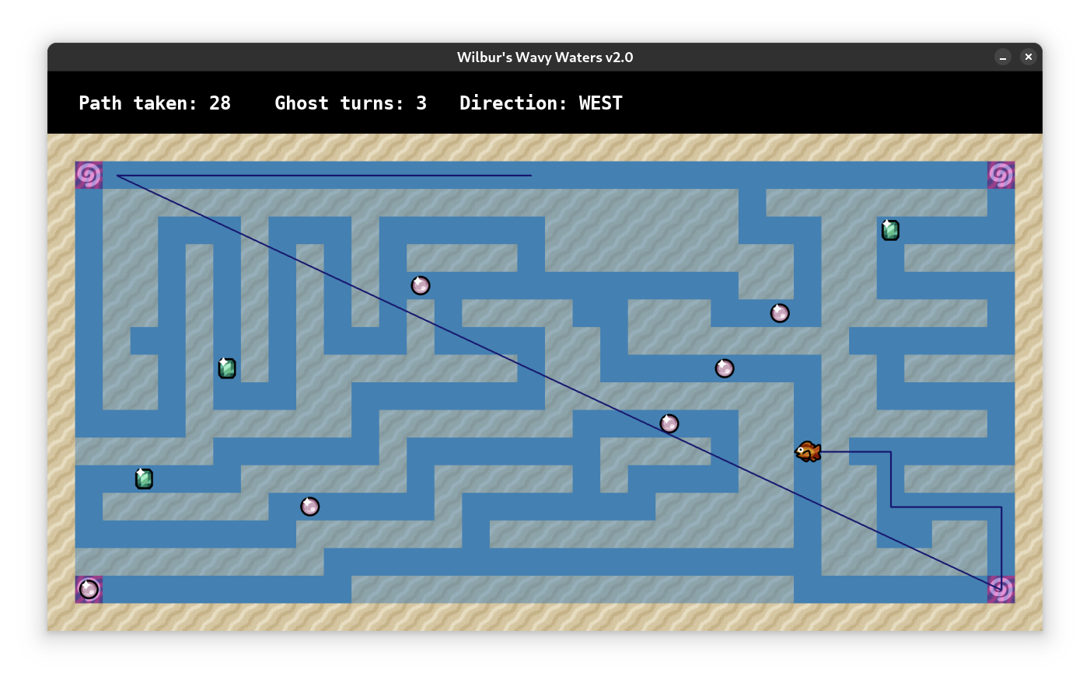
Class Rendering
Uses pygame to visualise the game and the path Wilbur took!
Figure 3. pygame UI
502043 - Introduction to Artificial Intelligence
48

Slide 49
II. IMPLEMENTATION:
Task 3
Solution to 16-Queens
with Genetic Algorithm
502043 - Introduction to Artificial Intelligence
49

Slide 50

Essential libraries and modules
Numpy is used to create
and manipulate the chessboard as a 2D array.
NUMPY
Random is used to
generate random integers for the initial placement of queens on the chessboard.
RANDOM
502043 - Introduction to Artificial Intelligence
50

Slide 51
Essential constants and parameters
BOARD_SIZE
POPULATION_SIZE
MUTATION_RATE
MAX_GENERATION
Size of the chessboard and
the number of queens to be placed on.
The number of individuals (states)
in the population for each generation.
The probability of mutation occurring
in the population during each generation.
The maximum number of generations
that the algorithm will run before stopping.
502043 - Introduction to Artificial Intelligence
51

Slide 52
Class Chessboard
- This is a class to represent a chessboard in 2D array
- Attributes:
board_size (int): The size of the chessboard.
board (numpy.ndarray): A 2D array representing the chessboard.
- Every cell of the initial chessboard will be filled by a dot "."
- And the Queen will be visualize by a "Q".
- Index of column and row both start from 0.
502043 - Introduction to Artificial Intelligence
52

Slide 53
Class Chessboard (cont.)
- Essential methods:
place_queen(self, state): This method is used to fills the board
with dots and places queens ("Q") based on the provided state,
which is a list of row indices for each column.
Pseudocode (next slide)
502043 - Introduction to Artificial Intelligence
53

Slide 54
Class Chessboard (cont.)
- Essential methods:
place_queen(self, state) - Pseudocode
function place_queen(state) returns an 2D array
fill every cell of the self.board with a dot “.”
iterate the state to get both index of col and row
set the self.board[row, col] = “Q”
end
502043 - Introduction to Artificial Intelligence
54

Slide 55
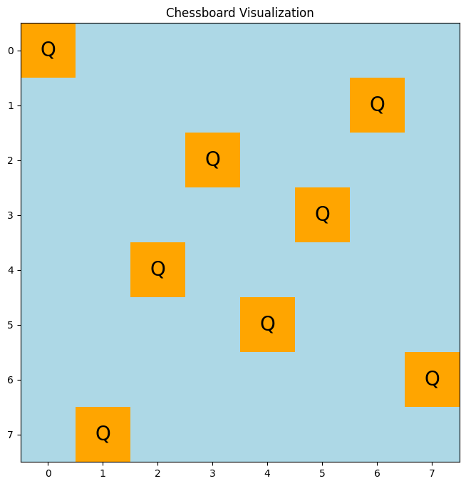
Class Chessboard
0
1
2
3
4
5
6
7
0
Q
1
Q
2
Q
3
Q
4
Q
5
Q
6
Q
7
Q
Figure 4. 2D chessboard by numpy
Figure 5. 2D chessboard by matplotlib
502043 - Introduction to Artificial Intelligence
55

Slide 56
Class State
- This is a class to represent a state of chessboard in 1D array.
- Attributes:
board_size (int): The size of the chessboard.
state (list): A list of integers representing
the row positions of queens.
maximum_non_attacking_pairs (int): The maximum
number of non-attacking pairs of queens.
502043 - Introduction to Artificial Intelligence
56

Slide 57
Class State (cont.)
- Attributes:
fitness_score (int): The fitness score of the state.
selection_prob (float): The selection probability of the state.
length (int): The length of the state
502043 - Introduction to Artificial Intelligence
57

Slide 58
Class State (cont.)
- Essential methods:
calculate_fitness(self): This method is used to calculate
the fitness or number of non-attacking pair of each state.
Pseudocode (next slide)
502043 - Introduction to Artificial Intelligence
58

Slide 59
Class State (cont.)
- Essential methods:
calculate_fitness(self) - Pseudocode
function calculate_fitness() returns an integer (numbers of non-attacking pair
in each state)
initialize an array to store numbers of queen in each col
initialize an array to store numbers of queen
in main diagonal (from top-left to bottom-right)
and anti diagonal (from bottom-left to top-right)
initialize a variable to count numbers of attacking pair
(attacking_pair, main_diagonal, anti_diagonal)
502043 - Introduction to Artificial Intelligence
59

Slide 60
Class State (cont.)
- Essential methods:
calculate_fitness(self) - Pseudocode
function calculate_fitness() returns an integer
(initialize step)
loop row <- in range of board_size
col <- self.state[row]
number_of_queens_col[col] ++
main_diagonal[row - col + (board_size - 1) ] ++
anti_diagonal[row - col + (board_size - 1) ] ++
502043 - Introduction to Artificial Intelligence
60

Slide 61
Class State (cont.)
- Essential methods:
calculate_fitness(self) - Pseudocode
function calculate_fitness() returns an integer
( initialize and counting step)
iterate count in number_of_queens_col
if count > 1: attacking_pair += count * (count -1) // 2
iterate count in main_diangonal if count > 1: attacking_pair += count * (count -1) // 2
iterate number_of_queens in anti_diangonal
if count > 1: attacking_pair += count * (count -1) // 2
502043 - Introduction to Artificial Intelligence
61

Slide 62
Class State (cont.)
- Essential methods:
calculate_fitness(self) - Explaination
Take the 4 * 4 chessboard as an example. The number of diagonal from top- left to bottom-right is (2*board_size - 1) and the same to the diagoanl from bottom-left to top-right (Visualize in figure 3 and figure 4 in the next slide).
After counting the appearance of queens in column, main diagonal and anti diagonal, apply the equation below to calculate the number of attacking pair:
number_of_attacking_pair = number_of queen * (number_of_queen - 1) // 2
502043 - Introduction to Artificial Intelligence
62

Slide 63
Class State (cont.)
3
4
5
6
0
1
2
3
2
Q
Q
4
1
Q
Q
5
0
Q
Q
6
Q
Q
Figure 6. Main diagonal
Figure 7. Anti diagonal
-> [0, 0, 1, 2, 1, 0, 0]
-> [1, 0, 0, 2, 0, 0, 1]
502043 - Introduction to Artificial Intelligence
63

Slide 64
Class Population
- This is a class to represent the collection of state (generation).
- Attributes:
board_size (int): The size of the chessboard.
population_size (int): The size of the population (generation)
mutation_rate (float): Definition at the 3rd slide.
max_fitness (int): The max fitness score of each population.
selection_prop (float): The selection probability of each state.
502043 - Introduction to Artificial Intelligence
64

Slide 65
Class Population (cont.)
- Essential methods:
cross_over (self, parent1, parent2): This method is used to
calculate the fitness or number of non-attacking pair of
each state.
Pseudocode (next slide)
502043 - Introduction to Artificial Intelligence
65

Slide 66
Class Population (cont.)
- Essential methods:
cross_over(self, parent1, parent2) - Pseudocode
function cross_over(parent1, parent2) returns an two child state
initialize start_point, end_point by random in range
initialize allele1 <- parent1[start_point:end_point]
allele2 <- parent2.copy()
allele3 <- parent2[start_point:end_point]
allele4 <- parent1.copy()
502043 - Introduction to Artificial Intelligence
66

Slide 67
Class Population (cont.)
- Essential methods:
cross_over(self, parent1, parent2) - Pseudocode
function cross_over(parent1, parent2) returns an two child state
(initialize step)
iterate number <- allele1
iterate i in allele2
if number == i -> allele2.remove(i)
iterate number <- allele3
iterate i in allele4
if number == i -> allele4.remove(i)
502043 - Introduction to Artificial Intelligence
67

Slide 68
Class Population (cont.)
- Essential methods:
cross_over(self, parent1, parent2) - Pseudocode
function cross_over(parent1, parent2) returns an two child state
(initialize and remove duplicate number in parent step)
if len(allele1) + len(allele2) == 16
child1 = allele2[:start_point] + allele1 + allele2[start_point]
else
child` = allele2[:start_point] + allele1 + allele2[start_point:end_point]
same with child2
502043 - Introduction to Artificial Intelligence
68

Slide 69
Class Population (cont.)
- Essential methods:
cross_over(self, parent1, parent2) - Explaination
allele 1: [3, 2, 4]
Parent 1
7, 1, 3, 2, 4, 5, 6, 0
Allele 1
3, 2, 4
length = 3
1
2
5
2
Parent 2
2, 6, 1, 0, 5, 2, 7, 3
Allele 2
6, 1, 0, 5, 2, 7
length = 6
insert allele 1 from here
3
Child 1
6, 1, 3, 2, 4, 0, 5, 2, 7
7 is out of bound, so remove it
length = 8
502043 - Introduction to Artificial Intelligence
69

Slide 70
Overral
random_start_point
Fitness score
Selection probability
random_end_point
31%
24
2, 4, 7, 4, 8, 5, 5, 2
2, 4, 7, 4, 8, 5, 5, 2
29%
23
3, 2, 7, 5, 2, 4, 1, 1
3, 2, 7, 5, 2, 4, 1, 1
26%
20
2, 4, 4, 1, 5, 1, 2, 4
2, 4, 4, 1, 5, 1, 2, 4
14%
11
3, 2, 5, 4, 3, 2, 1, 3
3, 2, 5, 4, 3, 2, 1, 3
Initial population
Selection
The state has the lowest selection probability will be eliminated
The state has the higest selection proabiltiy will replace the blank space
502043 - Introduction to Artificial Intelligence
70

Slide 71
Overral (cont.)
2, 4, 7, 4, 8, 5, 5, 2
3, 2, 7, 4, 5, 2, 1, 1
3, 2, 7, 4, 5, 0, 1, 1
3, 2, 7, 5, 2, 4, 1, 1
2, 4, 7, 5, 4, 8, 5, 2
2, 4, 7, 3, 4, 8, 5, 2
2, 4, 4, 1, 5, 1, 2, 4
3, 2, 4, 1, 5, 1, 3, 2
3, 2, 0, 1, 5, 1, 3, 2
3, 2, 5, 4, 3, 2, 1, 3
4, 1, 5, 4, 3, 2, 1, 2
4, 1, 5, 4, 7, 2, 1, 2
Selection
Crossover
Mutation
NEW GENERTATION
If this generation does not contain the solution,
return to Selection step
502043 - Introduction to Artificial Intelligence
71

