Slide 1
JMH - a tool to measure performance in method level
Zhang, Tim

Slide 2
WHAT
JMH is a Java harness for building, running, and analysing nano/micro/milli/macro benchmarks written in Java and other languages targeting the JVM
From GitHub
Want to know exactly how long a method needs to be executed
Compare the throughput of different interfaces under given conditions
See what percentage of requests are completed in how long
junit test: method level, issue
integration testing -> API level, business flow
stress test -> API/application level, maximum throughput
benchmarks -> method level, method performance

Slide 3


WHY
Author: people who implement JIT in Oracle
Metrics: average time, minmum time, maximun time, throughput, CI
Users:

Slide 4
HOW
Add dependency
Write benchmark
Run benchmark
Analyze report

Slide 5
Add dependency
<dependencies>
<dependency>
<groupId>org.openjdk.jmh</groupId>
<artifactId>jmh-core</artifactId>
<version>1.23</version>
</dependency>
<dependency>
<groupId>org.openjdk.jmh</groupId>
<artifactId>jmh-generator-annprocess</artifactId>
<version>1.23</version>
</dependency>
</dependencies>

Slide 6
Write benchmark
@BenchmarkMode
@State
@Warmup
@Measurement
@Fork
@Threads
@OutputTimeUnit
@Param
@Setup
@TearDown
@Benchmark

Slide 7


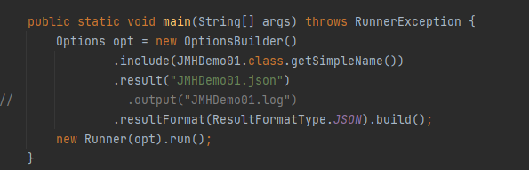

Slide 8
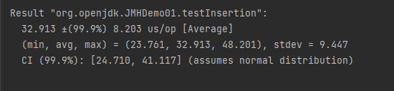
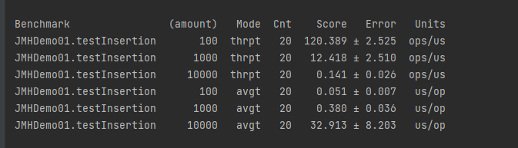
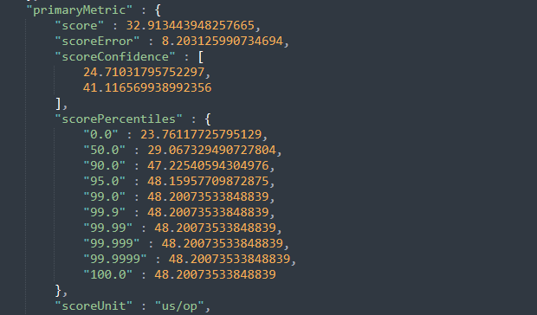

Slide 9
{ code }

Slide 10
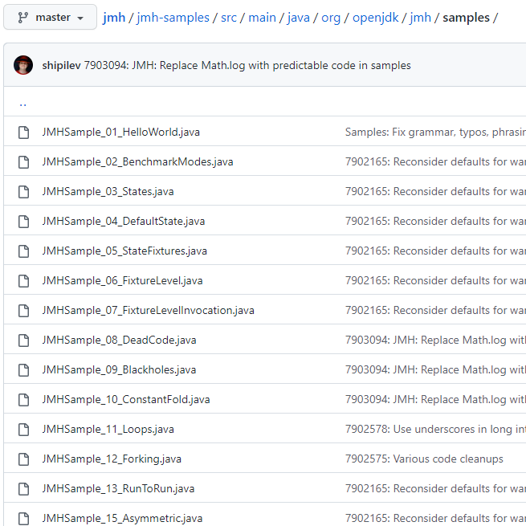
Benchmark trap
Dead code elimination
Black holes
Safe looping
...

Slide 11
https://www.cnkirito.moe/java-jmh/
https://segmentfault.com/a/1190000020328653
https://github.com/openjdk/jmh

Slide 12
Thanks

